Slide 1
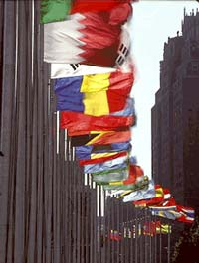
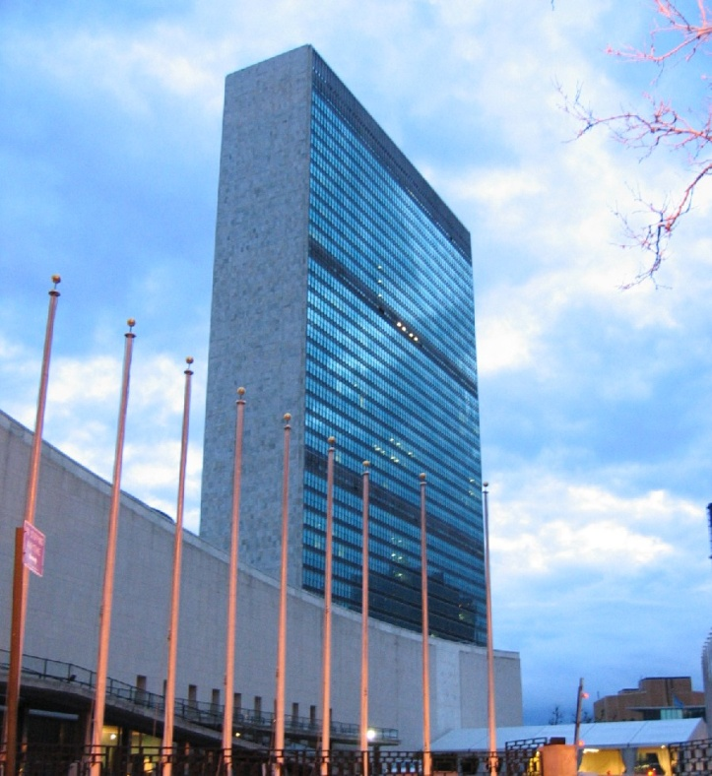
The United Nations

Slide 2
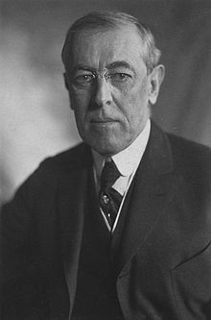
Lead-Up to the UN
Following the end of World War I, Woodrow Wilson in his famous “Fourteen Points” called for the creation of an international body that would help provide security and peace throughout the world.
It was an idea that he believed would help to stop all future wars and lead to a more peaceful civilization.
However, because of the other events that followed after World War I, namely the Versailles Peace Treaty and the Great Depression, aggression once again grew throughout the world, and the League of Nations would be exposed as a body that had no legitimacy or power to deal with international problems.
With the end of World War II, however, many world powers were determined that this would never happen again.

Slide 3
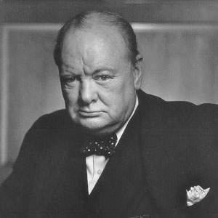
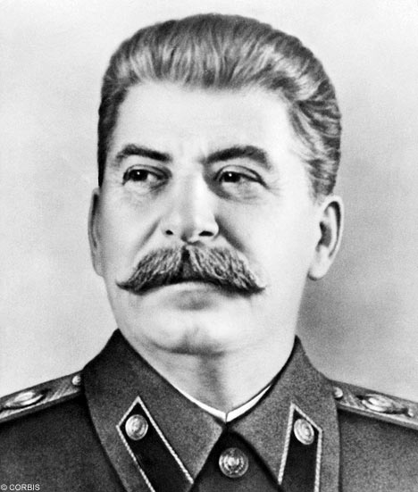
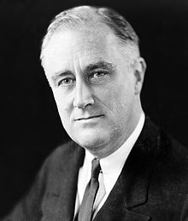
The roots of the United Nations were born during WW2
The roots of the United Nations were born during the Second World War itself. Throughout the war, the leaders of the Soviet Union (Josef Stalin), the United States (Franklin Roosevelt) and the United Kingdom (Winston Churchill) met frequently throughout the world.
They discussed joint war plans and how to attack the Axis powers; they also discussed how plans for the post-War world.

Slide 4
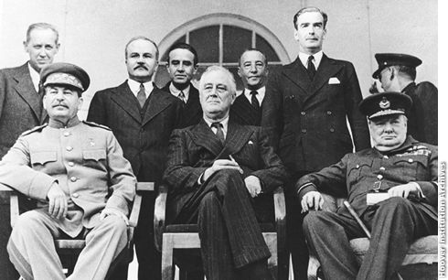
Tehran Conference
They felt that it was necessary to have an international body in which nations could settle their disputes.
The first plans were laid in 1943, at the Moscow, and later Tehran, conferences. These were only the most basic of discussions, and the leaders agreed to meet with one another later to develop more in-depth plans.

Slide 5
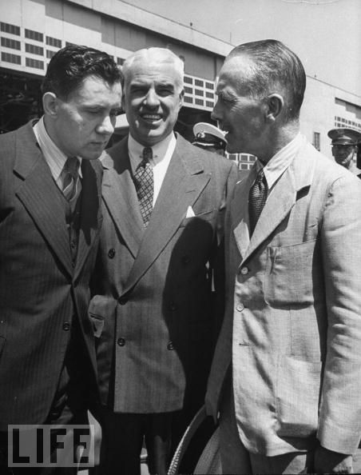
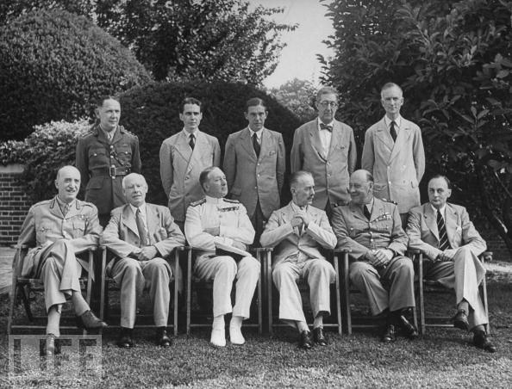
Dumbarton Oaks Conference
Finally, in 1944, the leaders of China, the United States, the Soviet Union, and Great Britain met at the Dumbarton Oaks Conference, held just outside of Washington, DC.
Here the outline for the United Nations was developed, including its membership and organs, as well as arrangements to maintain international peace and security and international economic and social cooperation.

Slide 6
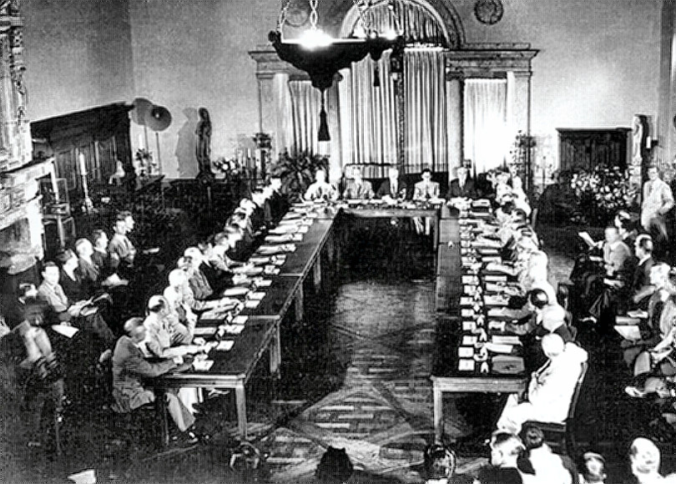

Slide 7
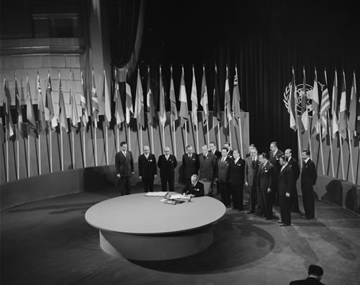
Establishment of the UN
In 1945, with the end of WWII nearing, the United Nations was created to replace the failed League of Nations
On April 25, 1945, the United Nations Conference on International Organization began in San Francisco.
In addition to governments, a number of non-government organizations, including Rotary International and Lions Clubs International received invitations to assist in the drafting of a charter.

Slide 8
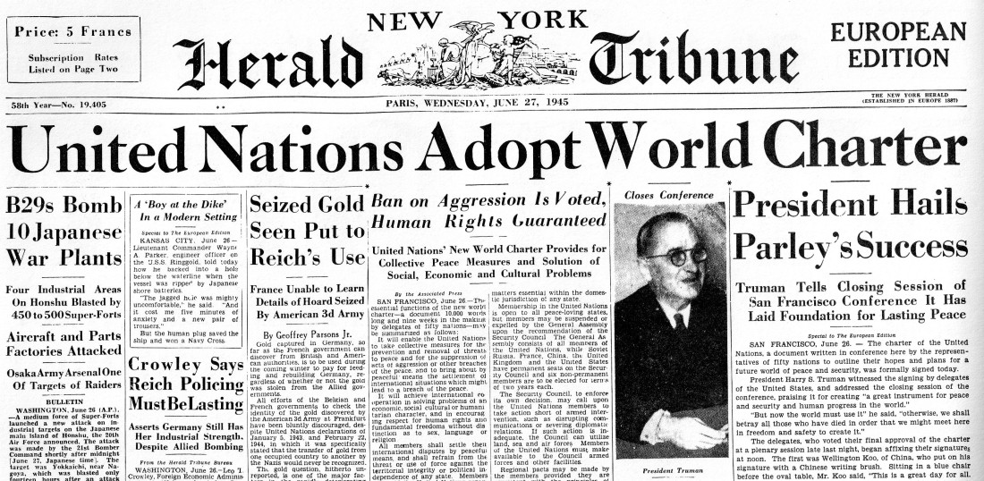
Birth of the UN
After working for two months, the fifty nations represented at the conference signed the Charter of the United Nations on June 26.
The charter stated that before it would come into effect, it must be ratified by the Governments of the China, France, the Soviet Union, Great Britain, and the United States, and by a majority of the other 46 signatories.
This occurred on October 24, 1945, and the United Nations was officially formed.
Canada would be one of the first 60 nations to sign onto the agreement, and would soon play a very important role in the development of the UN.

Slide 9
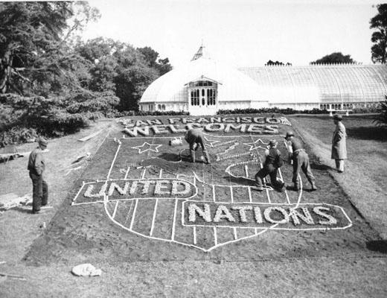

Slide 10
The League of Nations formally dissolved itself on 18 April 1946 and transferred its mission to the United Nations.

Slide 11
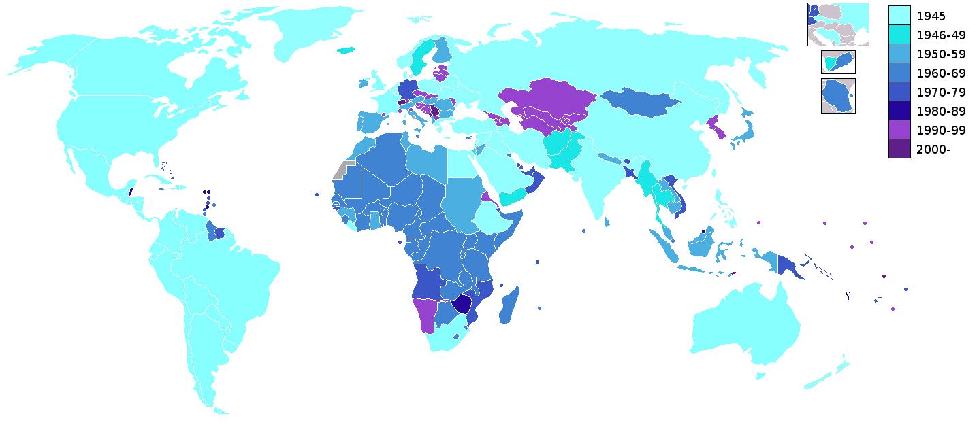
Almost immediately, the number of countries joining the UN began to grow.
From the 50 nations that signed the declaration on October 24, 1945, over 100 more nations joined within the first decade of its existence.
Below you will see a map that shows the growth of the UN through the decades.

Slide 12
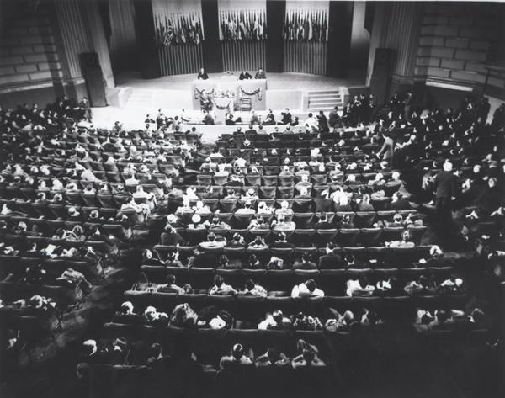
United Nations Charter
The Charter consists of a preamble and a series of articles grouped into chapters.
The preamble consists of two principal parts.
The first part containing a general call for the maintenance of peace and international security and respect for human rights.
The second part of the preamble is a declaration in a contractual style that the governments of the peoples of the United Nations have agreed to the Charter.

Slide 13
What does the United Nations Do?
The UN was created to maintain international peace and security.
It also works to maintain friendly relationships between countries.
Lastly, it works to promote economic development of member nations.
***Not a world government, and it does not make laws.
•Provide the means to help resolve international conflict and formulate policies on matters affecting all of us.

Slide 14
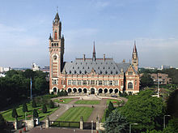
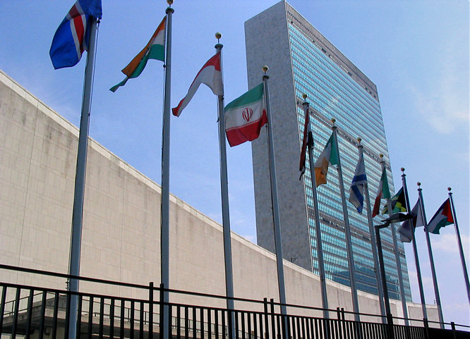
Who and Where?
Almost all countries in the world are members of the UN.
There are currently 191 countries in the UN.
The headquarters is in New York City.
The International Court of Justice (ICJ) is located in The Hague in the Netherlands.

Slide 15
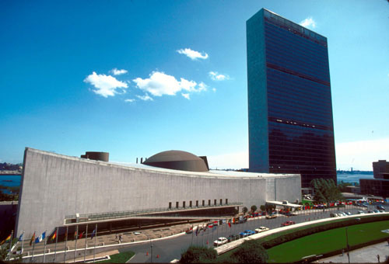
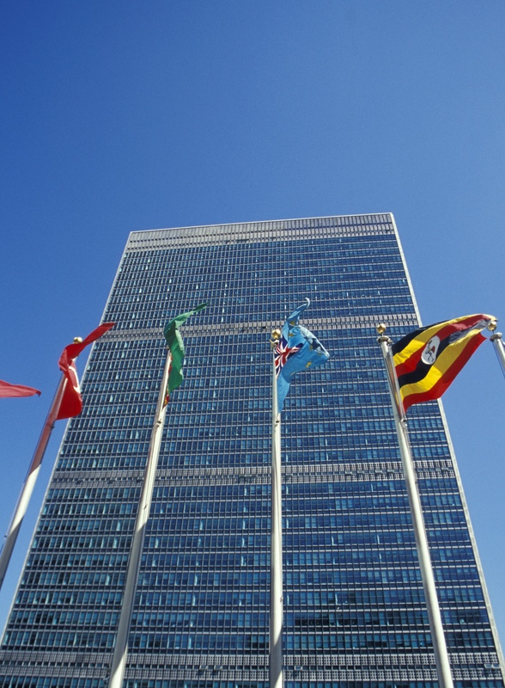
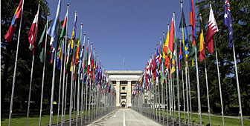
UN World Headquarters New York

Slide 16
Parts of the United Nations
1. The General Assembly – the ‘town meeting’ of the world.
2. UN Security Council – maintains world peace (most powerful branch)
3. Economic and Social Council - works with the UN’s economic, cultural, health and educational activities.
4. Trusteeship Council - territories
5. ICJ – International Court of Justice
6. The Secretariat – administrative duties and can bring any topic before the SC.

Slide 17
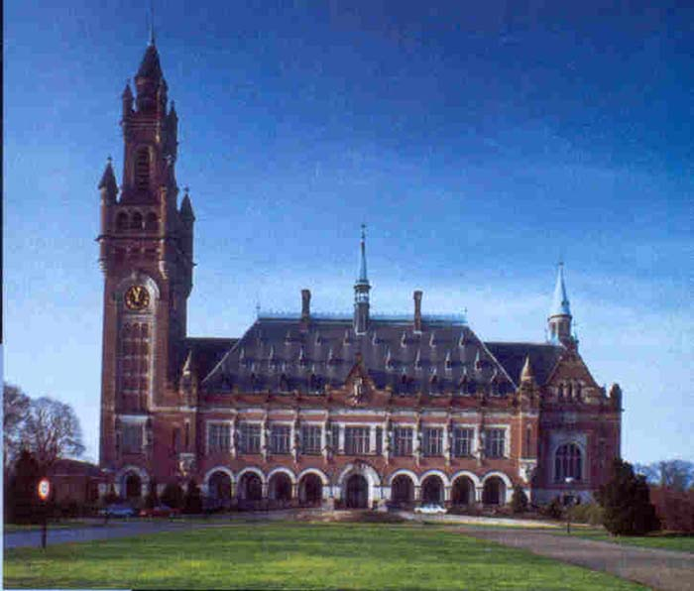
International Court of Justice The Hague, Netherlands

Slide 18
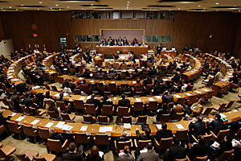
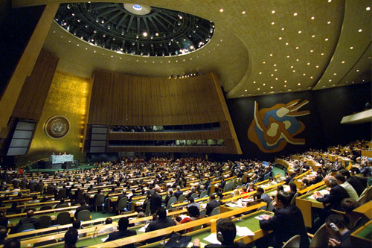
The General Assembly
The General Assembly is made up of all 190 member countries, each country holding one vote.
•The General Assembly acts as a sort of town hall, a powerful way for a country to make its opinion heard.
•Routine matters require simply a majority vote, whereas more important issues require a two-thirds majority.
•Annual meetings run from mid-September to mid-December.
•At the beginning of each regular session, a president is elected to preside over the Assembly

Slide 19
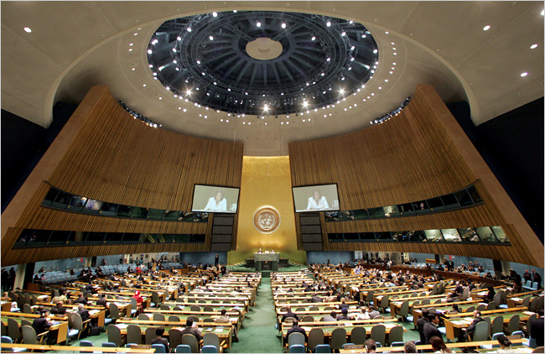
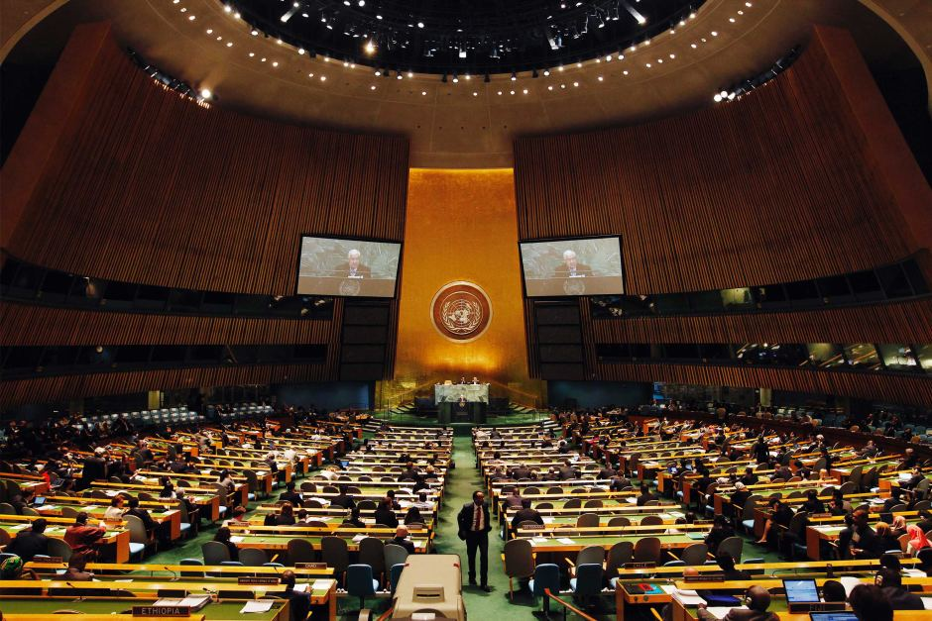
The General Assembly
Every member nation has a seat at the General Assembly.
Brings up international issues that they want the Security Council to deal with
Holds elections for Security Council members and other leaders

Slide 20
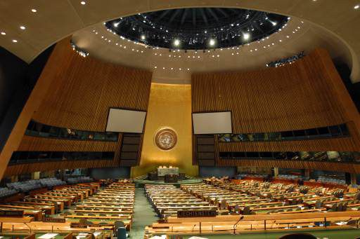
The General Assembly Inside UN Headquarters

Slide 21
Secretariat -Secretary General
The Secretary General is public figure head of the UN.
He or she plays a major role in setting the organizations agenda in international security.
The secretary general acts as a neutral mediator in international conflicts and brings hostile parties to the negotiating table

Slide 22
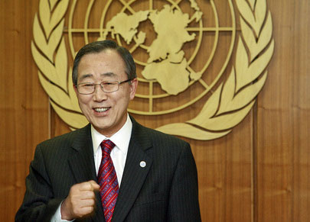
United Nations Secretary General Ban Ki Moon
Took over from Koffi Anan in 2007
Former Foriegn Affairs for South Korea
He is considered to be a "quiet diplomat"
Fluent in several langauges

Slide 23
Security Council
The strong-arm of the UN
Maintains international peace
The Security Council is mainly responsible for maintaining international peace and security.
How does it do this:
Recommends peaceful negotiations (peace talks)
Can use Economic Sanctions
Can use Military Sanctions
THE RULES:
•There are 15 council members, 5 of whom are permanent members.
10 non-permanent countries (elected every two years)
•Any decision to be made requires at least 9 yes votes.
THE VETO POWER:
The five permanent members of the UN Security Council are: Great Britain, France, the U.S.A., Russia, and China (they all have the power of “veto”).

Slide 24
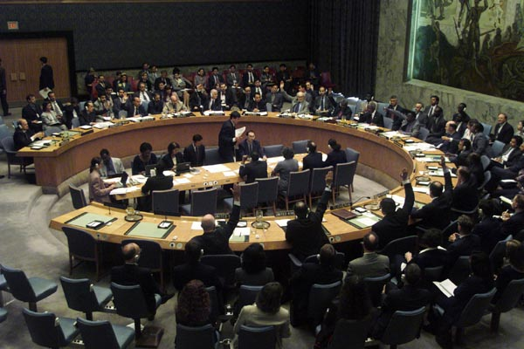
The UN Security Council Inside World Headquarters

Slide 25
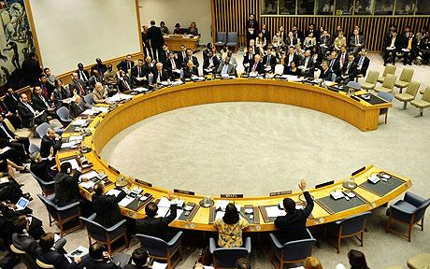
Sanctions
Sanctions are used to punish a country for violating international law. They can be used to force a country to follow a law.
In order for sanctions to be used by the UN Security Council, ALL FIVE permanent members must have a unanimous vote.

Slide 26
Types of Sanctions
Diplomatic Sanctions – removal of all political ties (like embassies)
Economic Sanctions – ban on all trade with a country (except food)
Military Sanctions – using a military to force compliance.

Slide 27
Military Sanctions
UN Peacekeepers – a group of armed soldiers sent to a hostile area to promote peace. They ARE NOT COMBAT TROOPS.
These soldiers maintain peace.
They don’t go on combat missions.
They are not an ‘army’
UN Military Force – an army made up of soldiers from more than one UN country that can serve as combat troops.
They are not very effective and are not used very often.

Slide 28
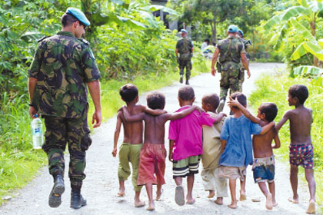
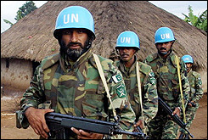
UN Peacekeepers
They always wear blue berets or blue helmets to identify themselves

Slide 29
Major UN Missions
East Timor (Asia) – the UN supervised the independence of this country
Iraq (Middle East) – UN tried to cut all trade with Iraq after it failed to comply with international law, but some nations continued to trade with them.
Somalia (Africa) – UN humanitarian mission to get food and supplies to people in need
Haiti (Caribbean) – UN helped strengthen government, army, and hold elections

Slide 30
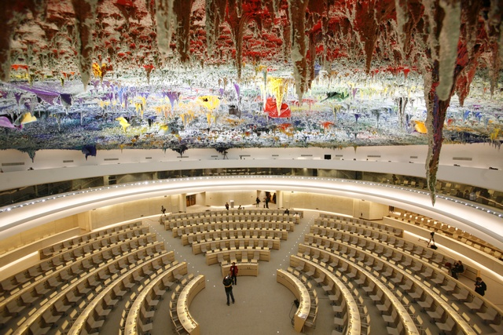
Other UN Mechanisms
The Human Rights Council is a body of political representatives which can establish Working Groups and Special Rapporteurs to investigate human rights and can also issue statements.
Special Rapporteurs are independent experts appointed by the Council to investigate and report on particular countries or human rights issues.
The Special Rapporteur on the Right to Education visited the U.S. in 2001 and NGOs organized some briefings and publicity.

Slide 31
Other UN Mechanisms
The Office of the UN High Commissioner for Human Rights provides support to the treaty bodies and special rapporteurs, and can also bring attention to human rights issues.
The General Assembly and Security Council can pass resolutions about human rights issues and could even impose sanctions or take other actions, but they rarely do so.

Slide 32
International Atomic Energy Agency (IPEA)
The International Atomic Energy Agency isolated in northeastern Austria in the city of Vienna.
•Established in 1957, this intergovernmental organization sought to accelerate and enlarge the contributions of atomic energy to peace, health, and prosperity throughout the world.
•Activities within the agency range from water desalination to the transport of nuclear materials.
•When it comes to disarmament, the IAEA plays an important policing role in relation with the non-proliferation treaty of 1970

Slide 33
International Court of Justice
The International Court of Justice or the World Court, is the judicial organ in the UN
•This court consists of a panel of 15 judges, all of whom are elected by the General Assembly and the Security Council
•Participation in this court is entirely voluntary, but once a state has decided to participate, it must comply with the courts decision

Slide 34
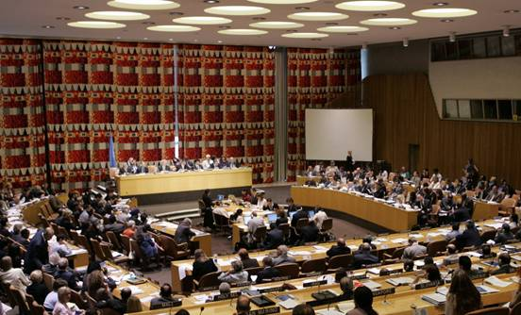
Economic and Social Council, or ECOSOC
The Economic and Social Council, or ECOSOC, is under the authority of the General Assembly and it works to coordinate the economic and social work of the UN and her family.
•Provides a forum for discussing economic and social issues abroad.
•The ECOSOC is a vital link between the United Nations and civil society.
•The council has 54 members, all of whom are elected by the General Assembly, each for a three-year term

Slide 35
United Nations Children’s Fund UNICEF
The United Nations Children’s Fund was founded by the UN in 1946 to provide children with food, clothing, and rehabilitative programs
•The organization’s mission is as follows:
–(1) to ensure that basic nutrition, health, and education needs of children are met,
–(2) to give children the opportunity to expand their potential, and
–(3) to create an international ethical standard of behavior toward children
•UNICEF also provides relief for children and their parents in the wake of disasters
•A world Summit was held in 1990. Their action plan included the establishment of goals for the health and well-being of children

Slide 36
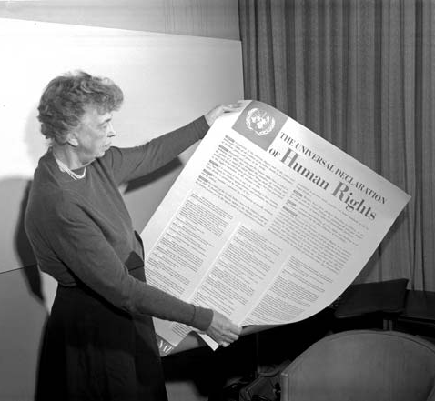
Human Rights
December 10, 1948, the UN adopted and proclaimed the Universal Declaration of Human Rights.
•The UN then called upon its members to embrace these rights and "to cause it to be disseminated, displayed, read and expounded principally in schools and other educational institutions, without distinction based on the political status of countries or territories."
•The Commission on Human Rights monitors the human rights abuses in countries.

Slide 37
World Health Organization WHO
The World Health Organization is a specialized UN agency, founded in 1948
• According to its constitution, the WHO is “the directing and coordinating authority on international health work.”
•The WHO helps people on two levels, advisory and technical
•WHO includes a policy making body called the World Health Assembly

Slide 38
Associated UN Agencies
UNICEF
World Bank
International Monetary Fund
World Health Organization

Slide 39
Strengths of the UN
Provides a forum for almost all of the world’s nations to discuss international issues
Humanitarian efforts
AIDS
Landmine removal
Food and supply organization
Peacekeeping forces
Will get involved with messes that no one else will

Slide 40
Weaknesses of the UN
Sanctions are only effective if ALL countries follow them (Iraq example)
Military force is rarely used and is usually ineffective
ALL permanent members of the security council have to vote unanimously (one country can stop a sanction)
Inadequate funding by member nations
14 Countries Pay 85% of the subscriptions (membership fee)
Big gap between developing and industrialized nations

Slide 41
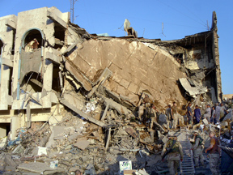
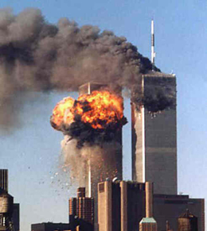
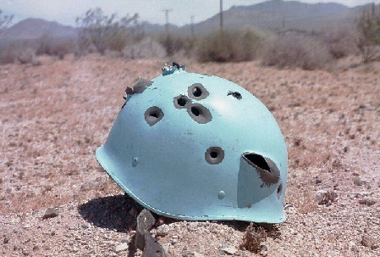
Current Threats to the UN
Terrorists

Slide 42
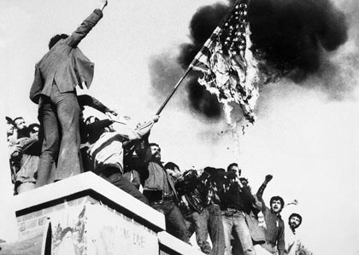
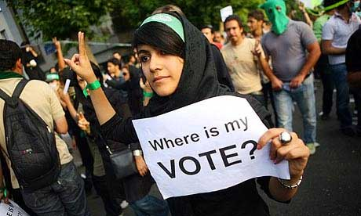
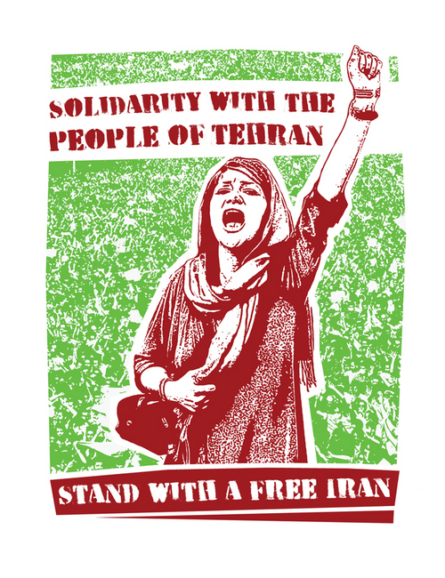
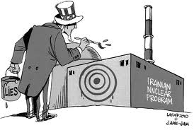
Rogue Countries: Iran

Slide 43
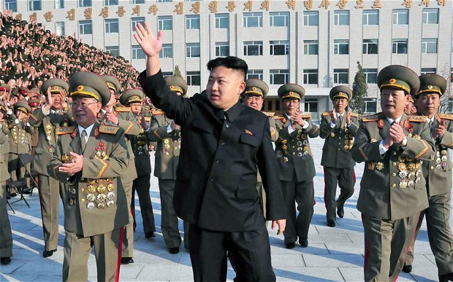
Rogue Countries: North Korea
The "beloved" Leader: Kim Jong Un

Slide 44
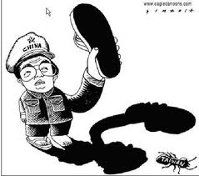
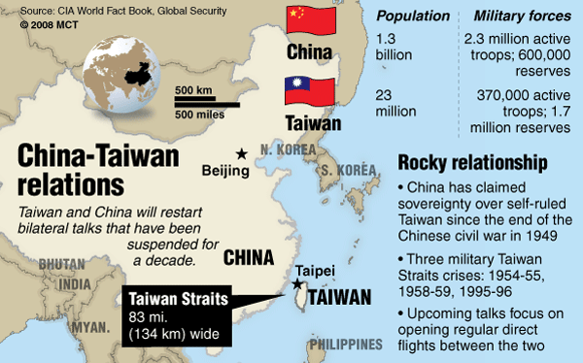
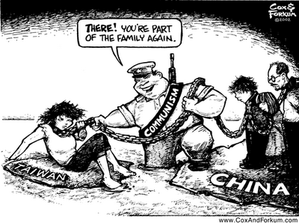
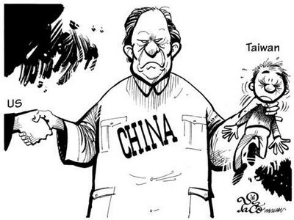
China/Taiwan

Slide 45
UN Analysis Questions
Some of the weaknesses of the UN are caused by flaws in the structure of the organization. Would it be better to start from scratch, or spend time and money solving the problems from within?
What do you think the world would be like without the United Nations?

Slide 46
UN Analysis Questions (cont)
Which part of the Untied Nations would you put the most money towards? Why?
What are some alternatives to economic and military sanctions if they don’t work?

Slide 47
Canada and the United Nations

Slide 48
Canada &The United Nations
Canada was a very involved member of the United Nations Organization.
We were members of all thirteen of the Specialized Agencies.
Between 1947 and 1967 we were three times a non-permanent member of the Security Council.

Slide 49
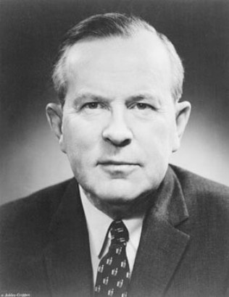
Planning for Peace: The United Nations
Canada would be an active member of the U.N. participating in many aspects of the organizations structure.
Canada would be a member of the prestigious Security Council in every decade of the U.N.’s existence.
It would be Lester B. Pearson, who would become Prime Minister of Canada in 1963, who suggested a solution to the Suez Crisis with the deployment of an international peace keeping force to maintain the peace.

Slide 50
Significant Canadian International Recognition
Lester B. Pearson – Nobel Peace Prize, Suez 1956
Maj. Gen. (ret’d) Lewis MacKenzie – Chief of Staff for the United Nations Protection Force in Yugoslavia (UNPROFOR) in 1992.
General Maurice Baril – Senior military advisor to UNSG Boutros-Boutros Gali and head of the Military Division of the UN DPKO from 1992 to 1997.
Lt. Gen. Roméo Dallaire – Commander of the UN Observer Mission Uganda-Rwanda (UNOMUR) and the UN Assistance Mission for Rwanda (UNAMIR) between 1993 and 1994.
Justice Louise Arbour – Chief Prosecutor of War Crimes before the International Criminal Tribunal for the former Yugoslavia and Rwanda from 1996 to 1999, now UN High Commissioner for Human Rights.
Louise Fréchette – Former Canadian Permanent Representative to the UN, first Deputy SG of the UN from 1997 to 2005.
Carolyn McAskie – Head of Peacebuilding Commission since May 2006.
Brig. Gen. (ret’d) Gregory Mitchell – Former Commander of the multinational Stand-by High-Readiness Brigade (SHIRBRIG) in Sudan and Deputy Force Commander for the United Nations Mission in Sudan (UNMIS) between 2004 and 2006.

Slide 51
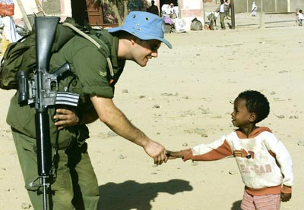
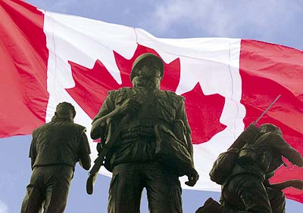
Peacekeeping
Canada’s peacekeeping role has evolved over the 50 years of their involvement.
We support and participate in peace operations led by the North Atlantic Treaty Organization (NATO), the European Union (EU) and the African Union (AU).
'Peace operations' is a simple label for a huge range of connected military, diplomatic and humanitarian tasks, such as:
reforming justice and security systems,
disarming and demobilizing troops,
reintegrating them into peaceful pursuits,
supporting humanitarian assistance.

Slide 52
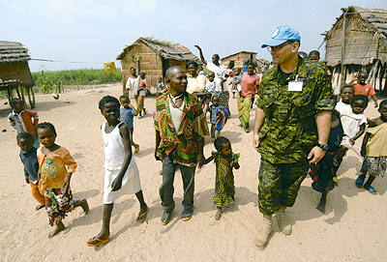
Tens of thousands of Canadians have served in more than 40 separate peacekeeping missions.
More than 100 Canadians have died in peacekeeping operations and hundreds more have been wounded.
Canada has always been a strong supporter of the United Nations (UN) and of peacekeeping, and has participated in almost every mission since its inception.
As of early 2006, women constituted approximately 1% of military personnel and 4% of police personnel in UN peacekeeping; 30% of international civilian staff and 28% of nationally recruited civilian staff are women.

Slide 53
Canadian Peacekeeping Missions
1940-present ~ Arab-Israeli and India-Pakistan conflicts.
1950 to 1953 ~ the Korean War
1956 ~ Suez Crisis (Egypt)
1958 ~Lebanon
1960-64 ~ Congo
1964-Present ~Cyprus
1973-79 ~ Egypt (Israeli vs Egypt tension)
1974-present ~ Syria:
More than 12,000 Canadians have served there
1978 – present ~ Lebanon
1988-90 ~ Afghanistan

Slide 54
1988-91 ~ Persian Gulf (The Gulf War)
More than 4,000 Canadian Forces personnel served in the tense Persian Gulf region as part of the international coalition of countries
1990-91 ~ Haiti
1991-95 ~ El Salvador
Canada sends contingent to observer mission to monitor ceasefire following El Salvador’s 12 year civil war.
1992-95 ~ Somalia
The mission gains attention and becomes a national scandal referred to as “the Somalia Affair” after Canadian soldiers are convicted of torture, assault and murder of Somali civilians.
1993-94 ~ Rwanda
This mission met significant hurdles as UN troops witnessed the slaughter of nearly 800,000 Rwandans

Slide 55
UN Agencies
Canada is among the top ten donors, providing over US$600 million dollars a year in core and program funding to the UN System of funds, programs and agencies, such as:
UN Development Program
UNICEF
World Health Organization

Slide 56
The United Nations Building, NYC

