Slide 1
Define the term: Power
Power is a goal of states or leaders
Power is a measure of influence or control over outcomes, events, actors and issues.
Power is reflecting victory in conflict and the attainment of security
Power is control over resources and capabilities

Slide 2
International Power
Satellite power (small power):
A small powers is characterized by dependence on others.
A small power recognizes that it cannot obtain security by relying solely on its own capabilities.
They cannot affect the international system
Need to concerted effort they can have an impact on the way the system works.
In an alliance, small powers tend to follow the alliance leader closely, lend it what support they can and avoid antagonizing it. Under regional hegemony with a low probability of punishment, small powers tend to adopt neutrality.
Small powers display variable geometry. In terms of military capabilities there is no ability to project power on a global scale.
Small powers are the primary beneficiaries of international institutions and are, by necessity, lovers of the law.
Middle power:
middle powers can be partially defined as those that lie between small and big powers.
On most counts this means they have an average (as opposed to low or high) material capacity in terms of armed forces or foreign aid budget but an above average diplomatic capacity to engage in international activities.
Principal Power:
A great power is a state that is recognized as having the ability to exert its influence on a global scale.
Great powers characteristically possess military and economic strength and diplomatic power and influence which may cause small powers to consider the opinions of great powers before taking actions of their own.
recognized in conferences such as the international structure such as the United Nations Security Council. Respected as a ‘superpower’

Slide 3
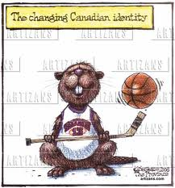

Assess Canada’s Principal
Are we a small, middle or principal power???

Slide 4
Canada as a Small Power
We are a mere satellite of the United States
Very small military
Caught in-between USA and USSR
No Nuclear Weapon Program
Small Global Peacekeeping Presence
Unable to Fight a war by Ourselves
At mercy of superpowers

Slide 5
Canada as a Middle Power
(a) partisanship (b) economic situation; (c) the prime ministerial need to differentiate their tenure (d) approach to global affairs
‘middle power’ by Canadian politicians was most prominent during the ‘golden decade’ of international activity under the Liberal tenures of Louis St. Laurent and Lester Pearson. American influence.

Slide 6
Canada as a Principal Power
One of world’s top economies (G8)
Canada has a steady trade surplus with the United States
Compared to the U.S. ‘Everyone appears to be a smaller power’
Respected around the world
Landmine Convention and devotion to Human Rights

Slide 7
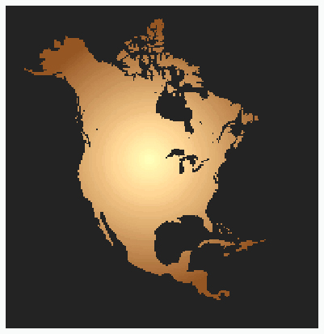
A Middle Power
Canada emerged from the war with a new sense of confidence about her place in the world.
During the war we were increasingly pulled into the American sphere of influence and away from Britain.
American Sphere of Influence

Slide 8
International Leadership
Mackenzie King was determined that Canada should go its own way in the post-war world.
He believed that Canada had an important contribution to make in many international areas.
We were a prosperous nation undamaged by the war but not a great military power.

Slide 9
Global Influence
The term “middle power” reflected the strength of Canada’s economy and our ability to positively influence world affairs.
We became members of the newly formed United Nations and served on most of this organization’s important committees.
This included the Atomic Energy Commission where we were the only nation not identified as a great power.

Slide 10
Canadian Autonomy
In 1949 the Supreme Court of Canada became the final court of appeal for all Canadians.
In 1952 Vincent Massey was appointed the first Canadian born Governor General.
The Canada Council was established in 1957 to protect Canadian culture from domination by the United States.
Vincent Massey

Slide 11
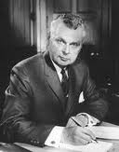
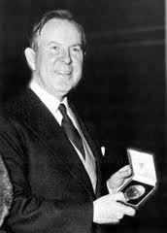
Building a Nation
Diefenbaker
Pearson
Canadian Bill of Rights 1960
Vote extended to native peoples in Canada 1960
Royal Commission on Health Services 1961
Agriculture Rehabilitation and Development Act 1961
Found market in China for prairie wheat
Created National Productivity Council 1963
Expanded old age pensions
Canada Pension Plan 1965
Auto Pact 1965
National Flag of Canada 1965
Bilingualism and Bicultural Commission was established in 1963 to study the relations between French and English Canadians.
In 1964 the Liberals adopted the new Canadian flag
1964 said ‘one song would have to be chosen as the country's national anthem’.

Slide 12
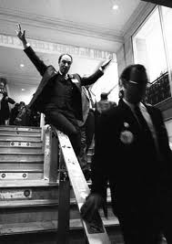
The End of the Pearson Era
The celebration of Canada’s centennial in 1867 was the highlight of Pearson’s term as prime minister.
Pearson was succeeded as leader of the Liberal party in 1968 by Pierre Elliot Trudeau.
Trudeau was from Quebec but he was not a “narrow nationalist.”

Slide 13
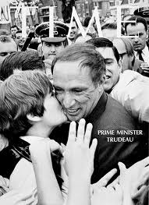
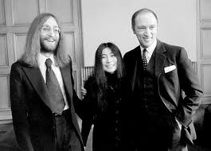
Pierre Elliott Trudeau
Trudeau brought a breath of fresh air to Canadian politics and a new term entered the language - Trudeaumania.
His message, that bilingualism was to be the future for Canada, was very clear.
He won a sound majority on the 25th of June 1968 by defeating Bob Stanfield, the new Conservative leader.
Notes:
Trudeau National Archives of Canada C 46600
Bob Stanfield C 27659

Slide 14
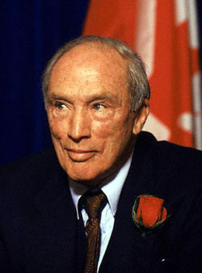
Trudeau’s Foreign Policy
Trudeau He wanted to become less dependent on the U.S.A.
He officially recognized the communist government of China contrary to American opinion and ordered nuclear missiles removed from Canadian NATO forces in Europe.
He dismantled BOMARC missile bases in Canada and ordered the defence budget cut.
He reduced Canada’s NATO contingent in Europe by half.

Slide 15
CIDA
Trudeau also recognized the split between development in poorer countries and richer countries and part of his mission was to improve their economic status.
C.I.D.A., the Canadian International Development Agency, was formed to assist developing countries.
Canada used “tied-aid”, whereby countries receiving aid agreed to buy Canadian goods, as an improvement strategy.
Canadian Aid

Slide 16
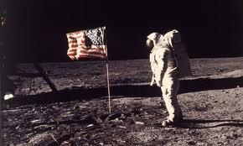
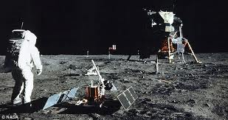
Advances in Science and Technology
On July 21, 1969, the first manned moon landing by the U.S.A. occurred.
The ozone layer was discovered in 1976.
In 1969 ARPANET was created, it provided the foundation for the development of the Internet.
Spar Arrowspace, a Canadian company, would develop the Canadarm for the U.S, space missions.

Slide 17
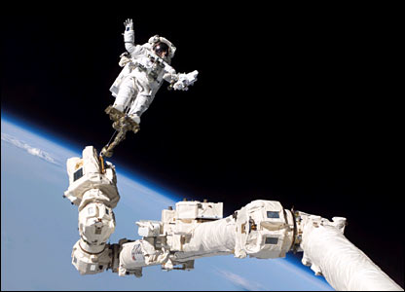
SPAR Aerospace Canadarm

Slide 18
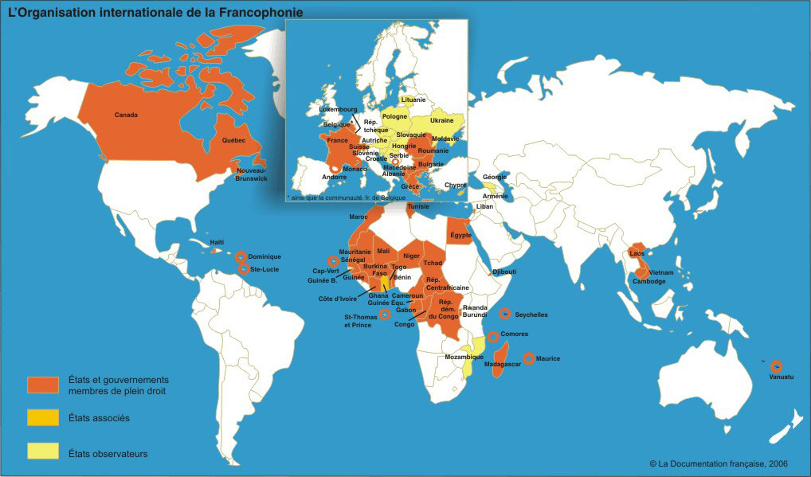
La Francophonie
Canada joined La Francophonie, an organization of French speaking countries, many former colonies of France.
Canada also participated in the Colombo Plan, a plan to assist developing countries.
Canada invited overseas students to study in Canada and sent experts overseas to give technical assistance.

Slide 19
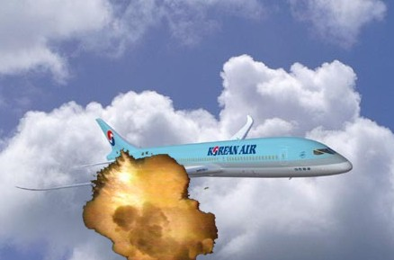
USA Arms while Canada de-arms
The U.S.A. increased its defence spending and a Korean passenger jet was shot down over the U.S.S.R. after it wandered into Russian air space.
U.S. forces invaded Grenada and deposed a pro-Soviet government.

Slide 20
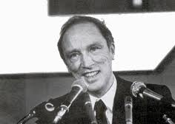
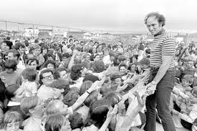
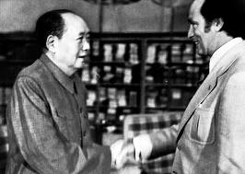
International Mediator
Prime Minister Trudeau went on a world tour endeavouring to engage world leaders in a campaign to mediate between the superpowers.

Slide 21
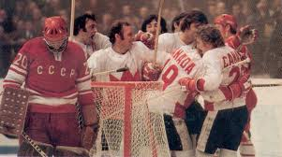
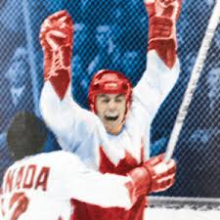
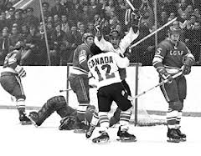
1972 Summit Series
The Canada–USSR Series, was an eight-game series of ice hockey between the Soviet Union and Canada, held in September 1972. It was the first competition between the Soviet national team and a Canadian team represented by professional players of the National Hockey League (NHL),

Slide 22
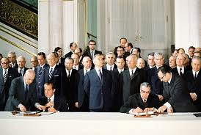

SALT (1)
In 1972 SALT 1 (Strategic Arms Limitation Talks) was signed which reduce the number of nuclear weapons between the U.S.A. and the U.S.S.R.
In 1979, the U.S.S.R. sent troops into Afghanistan and NATO did the same.
SALT talks were suspended and many western nations boycotted the 1980 Olympic Summer Games in Moscow in protest.

Slide 23
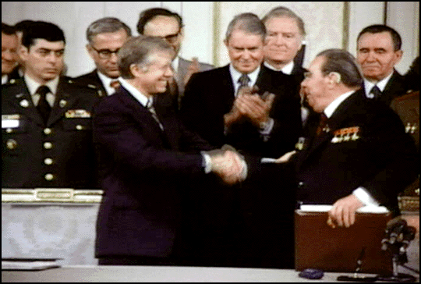
SALT II Talks: President Carter and Leonid Brezhnev Sign Treaty

Slide 24
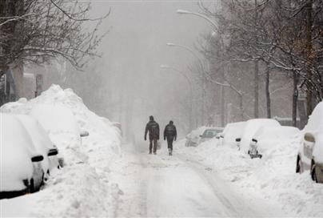
Conclusion
In February of 1984, after his famous walk in the snow, Trudeau decided to leave politics.
By the end of the Trudeau era in 1984 Canada faced many unresolved problems.
National unity, the Constitution, the economy, our identity, our relationship with the United States as well as with the world, were all troubling issues that were to occupy successive Canadian governments.

Slide 25
Keeping You Sharp
Why was Canada viewed as a “middle power” after World War Two?
A. It was a member of the Commonwealth.
B. Its nuclear weapon program was developing.
C. Its economy was based on primary resources.
D. It was becoming influential in international
affairs.

