Slide 1
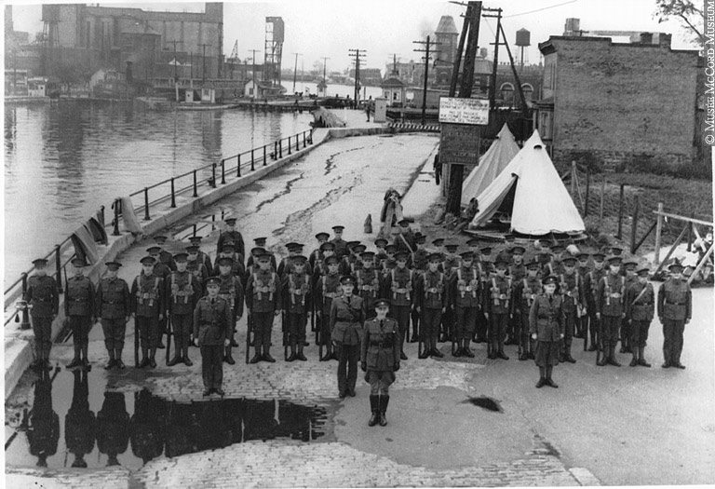
Canada Reacts to War

Slide 2
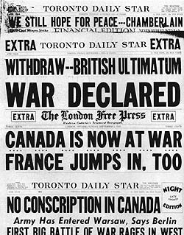

Slide 3
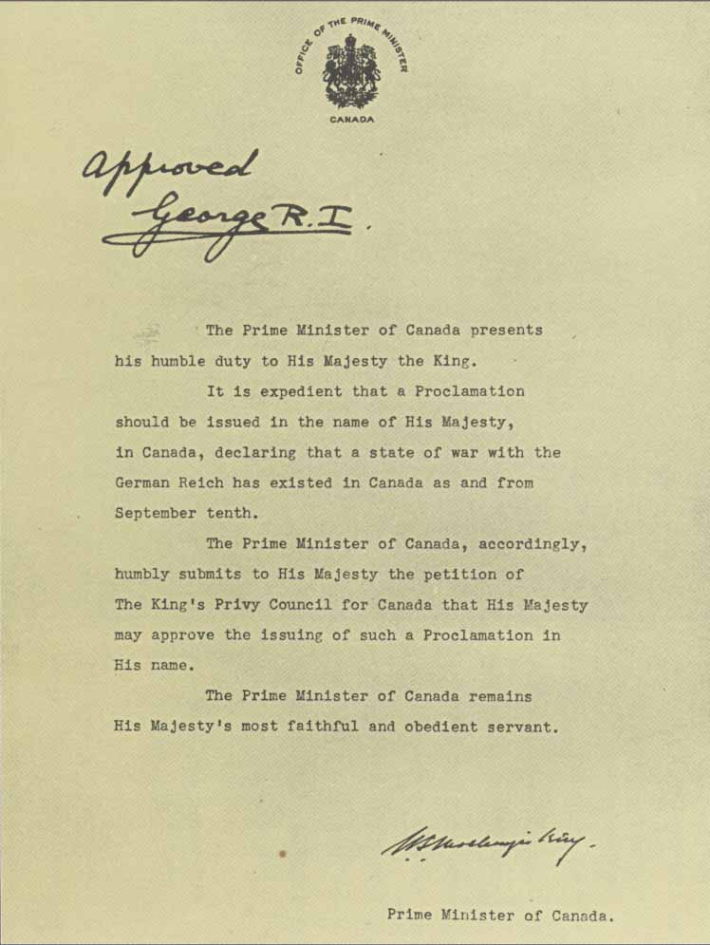
The announcement

Slide 4
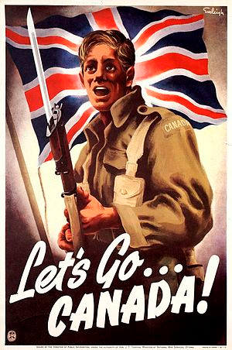
Was Canada Ready for War?
4500 Regular soldiers
51,000 reservists (partially trained)
20 modern combat planes
6 Destroyers (smallest ocean-going ship)
King promised only volunteers would be sent to fight

Slide 5

Canada in 1939
Population: 11 million
750,000 unemployed
Largest city is Montreal
9 provinces and 2 territories

Slide 6

Why go to war?
Canada is now an autonomous nation
No direct threat from Hitler
Very small armed forces
Many opposed the war
  JS Woodsworth
  Pacifists
  Isolationists

Slide 7
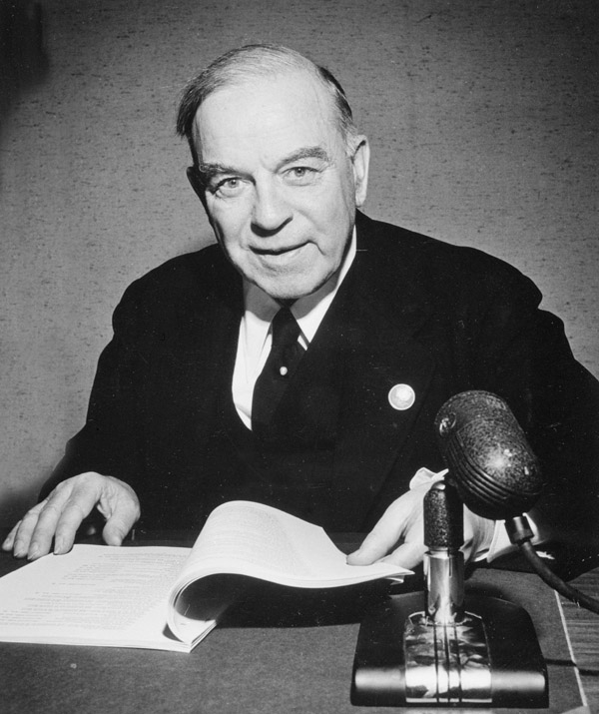
The Decision
Parliament will decide…
A special session of Parliament was called on Sept. 7. Canada remained neutral until Sept. 10
PM Mackenzie King believed entrance into the war was "a self-evident national duty."
Parliament approved the Prime Minister's request to go to war.
King George VI announced declared war on Germany in the name of Canada the same day.

Slide 8
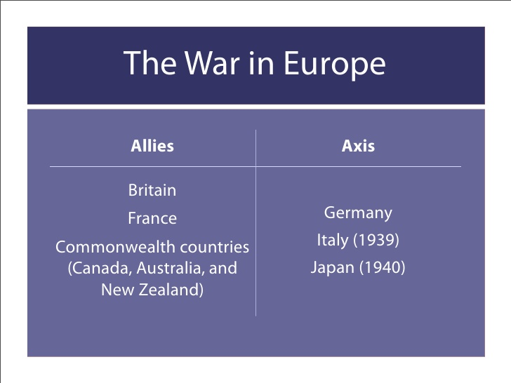

Slide 9
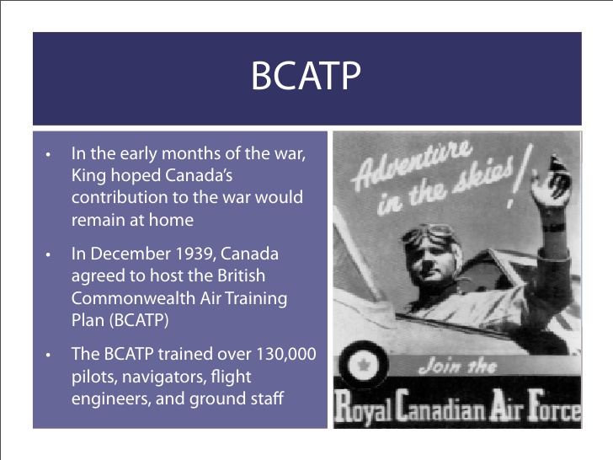

Slide 10
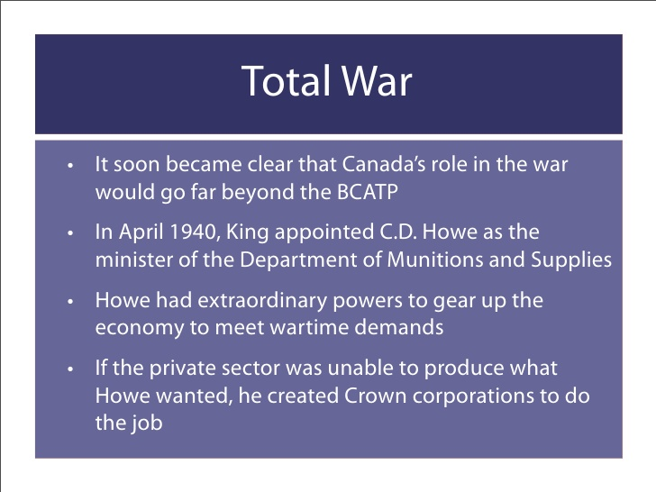

Slide 11
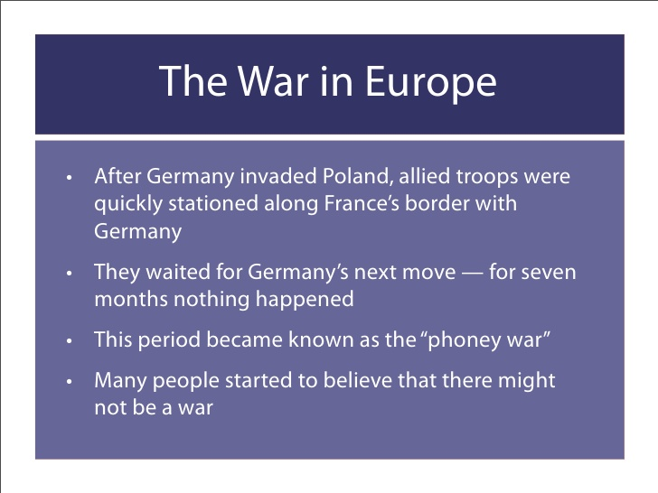

Slide 12
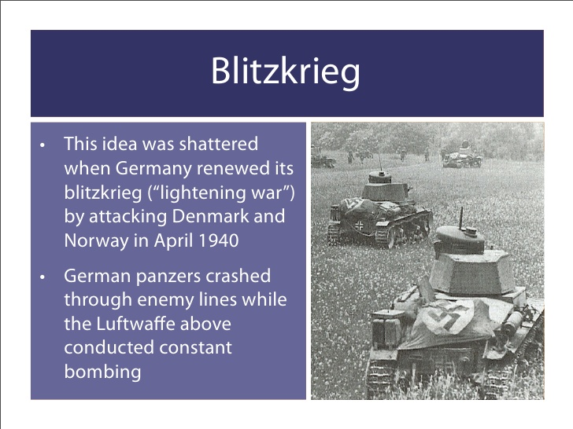

Slide 13
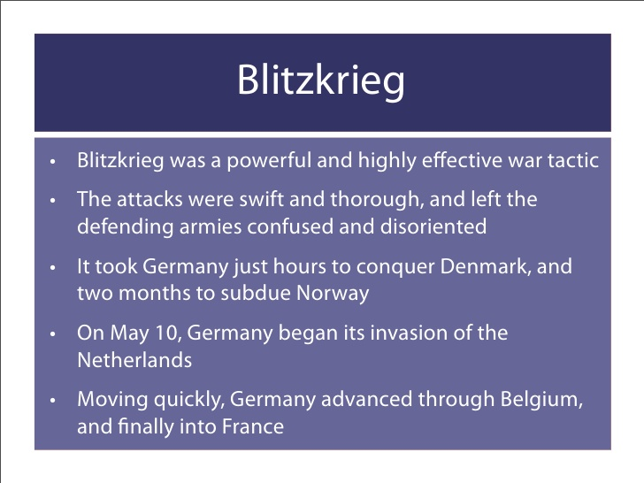

Slide 14
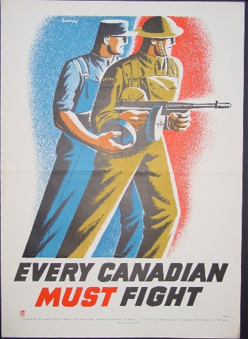
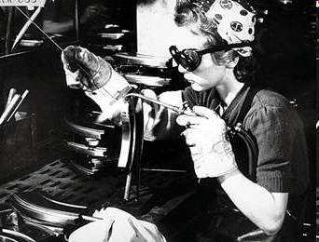

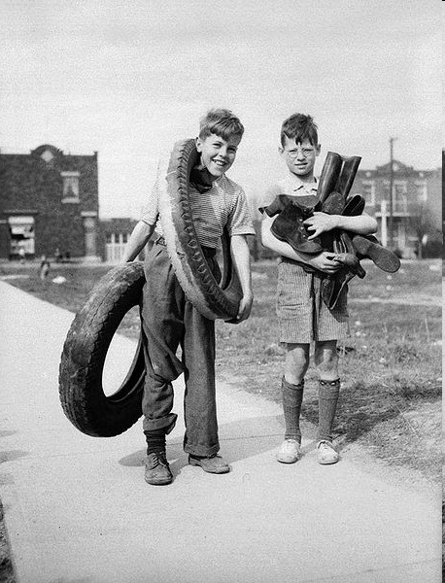
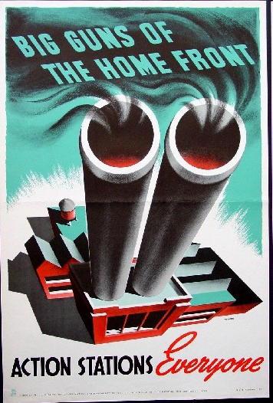
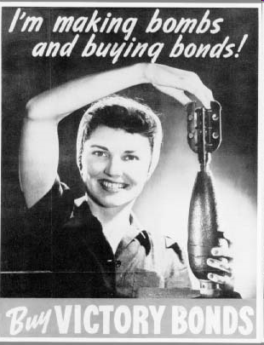
WWII: The War at Home

Slide 15
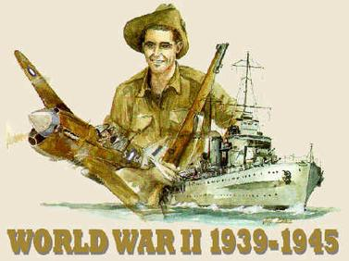
The Mood in Canada
There was little enthusiasm for war in Canada.
Mackenzie King tried to ensure that Canadian participation was as limited as possible.
He particularly wished to avoid splitting the nation over issues such as conscription.

Slide 16
Regulating the
Economy
There was fear that war might bring a return to the economic problems experienced between 1914 and 1918.
These included inflation and war profiteering.
The War Measures Act gave the government special powers.
The Wartime Prices and Trade Board was set up to control prices and profits.

Slide 17
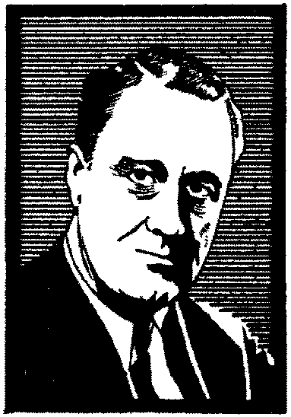
“ A Fireproof House?”
It became increasingly clear to both the Canadian and American governments that if Britain fell to the Germans Canada could be threatened by the conflagration of European war.
In 1940 President Roosevelt and Prime Minister King signed the Ogdensburg Agreement which ensured American support in the defense of the continent.
F.D.R.

Slide 18
Political Problems
Mackenzie King’s cautious approach to participation in the war was openly criticized by the Conservative Opposition led by Robert Manion.
When Manion demanded a “National Government” prepared to “wage real war” King called an election for March 26, 1940.

Slide 19
The Election of 1940
Mackenzie King’s government won the largest majority in Canadian history making it clear that most Canadians were solidly behind him.
Liberals
178 seats
Conservatives
39 seats
Social Credit
10 seats
CCF
8 seats
Others
10 seats

Slide 20
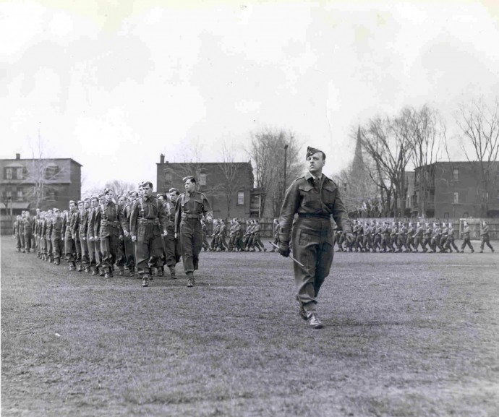
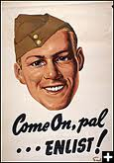
“Total War”
Mackenzie King soon realized that Canada’s contribution to the war had to involve all sectors of the economy as well as the Canadian workforce.
Both resource and manufacturing industries were quickly directed to the war effort.
Britain desperately needed Canada’s productive capacity if she was to survive the German onslaught.

Slide 21
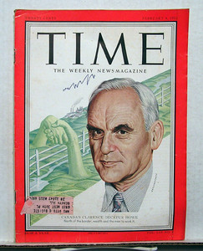
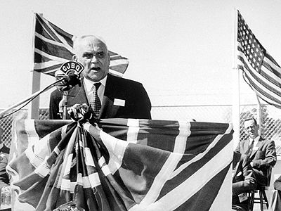
Clarence Howe
American–born engineer who was King’s Minister of Munitions & Supply
On his way to Britain, Howe’s ship was torpedoed, he became a hero
Convinced Britain to buy Canadian goods
– guns, radios, radars, aircrafts

Slide 22
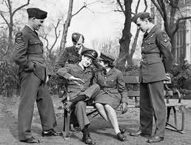
Clarence Decatur Howe
Canadian factories underwent enormous expansion and produced a wide range of products from aircraft to weapons of all types.
Howe created 28 Crown corporations
Howe has a lot of authority, and shows it by telling industries to produce goods they had never made before.
Vancouver built ships, and Montreal built planes and bombers (Lancaster)

Slide 23
J. L. Isley
CONTROL
Isley was the Canadian Minister of Finance and responsible for financing the war effort.
He revived the sale of Victory Bonds and expanded the taxation powers of the central government.
The debt level of the Canadian government rose rapidly but inflation was largely controlled because prices were frozen by the Wartime Prices and Trade Board.

Slide 24
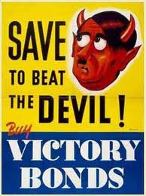
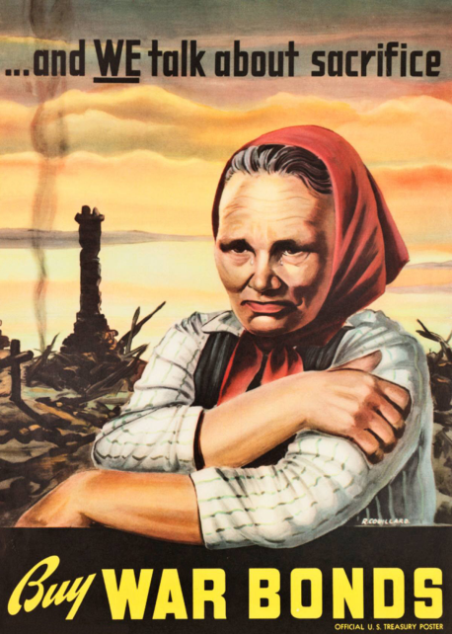
Finance
Canada’s Finance Minister, J.L. lsley, recycled ideas of WW1 (war bonds, war saving stamps & higher income tax)
Full employment, regular pay cheques – rising profits eased financial burden
Canada’s debt went from $ 3 billion to $11 billion by end of war
Both Canada & Britain running out of money
Britain borrowed money form US, with promise to pay it back after the war
In April 1941, King & Roosevelt negotiate an agreement under which each country would produce the armament it was best at producing
By 1943, the million & a quarter men & women in Canada’s factories had become a skilled, efficient work force.

Slide 25

Paying for the War
The Canadian Government did raise taxes during the WWII to help pay for the cost of the war.
The Canadian government turned to an old idea: Victory Bond drives.
The government conducted nine Victory Bond drives between June 1941 and October 1945. These campaigns raised nearly $12 billion by the end of the war.

Slide 26
The Hyde Park Declaration
After Pearl Harbour the American military underwent rapid expansion.
Canada assisted in this process and was able to earn valuable American dollars by expanding her trade with United States.
This trade was made possible by the Hyde Park Declaration which allowed Canadian goods of all kinds to move freely into the United Sates.

Slide 27
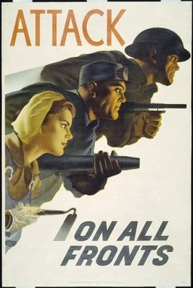
Total War
By 1942, Canada was committed to a policy of “Total War” which meant that all industries, materials and people were put to work for the war effort.

Slide 28
“Total War”
British described their desperate struggle against Hitler as “Total War”
P.M King hoped Can. role would be as an “arsenal for democracy” – did not want to send troops to Europe

Slide 29
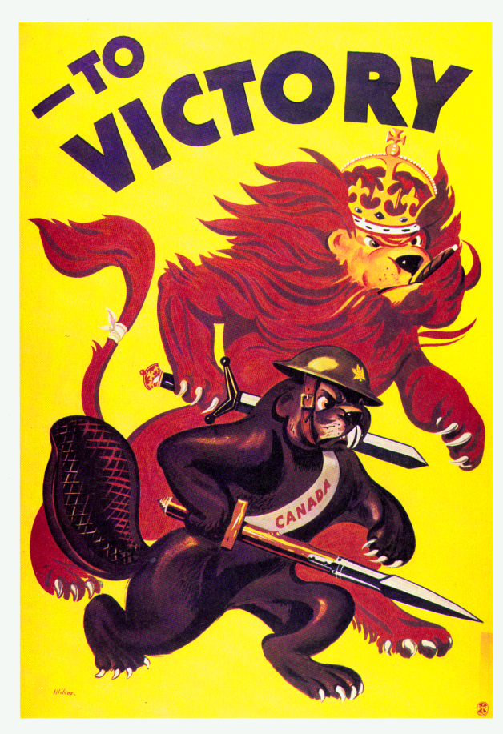
“Total War” - Manpower
The National Resources Mobilization Act gave the government the power to conscript manpower but only for the defense of Canada.
The National Selective Service directed Canadian workers to the requirements of industry.
Experienced businessmen volunteered their services to the government for a “dollar-a-year.”
In 1942, single women aged 20 to 24 were ordered to register
No able bodied man aged 17 to 45 was permitted to drive a taxi, sell real estate, or help make such products as beer, toys and sporting goods

Slide 30
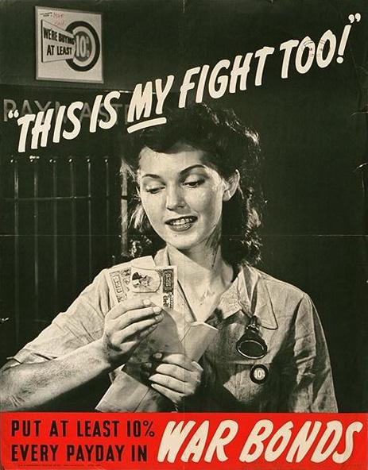
“Total War” and Canadian Women
Men enlisting in the Canadian forces left important jobs in many industries.
These jobs were filled by women from all across Canada.
Women worked in every sector of the economy including shipbuilding, construction and agriculture.
Women in large numbers also joined all of the services filling a variety of roles.

Slide 31
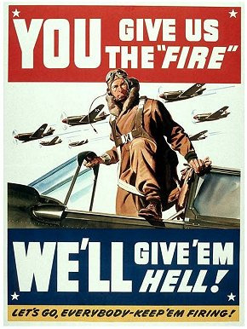
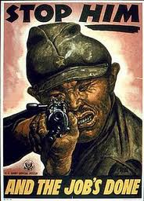
Recruitment
All 3 branches of the armed forces scrambled for the highly trained men vital to modern war
Navy no problem recruiting – men from Prairies flocked to it.
Air force no problems – excitement & glamour of aerial combat
Army hard time – people remembered WWI – grand battles

Slide 32
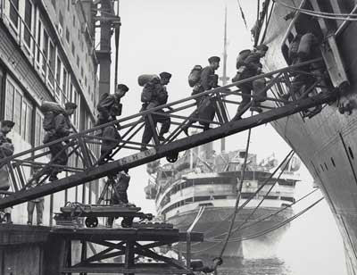

Slide 33
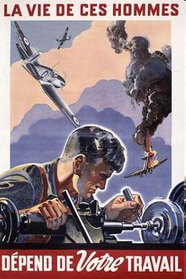
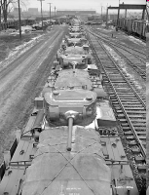
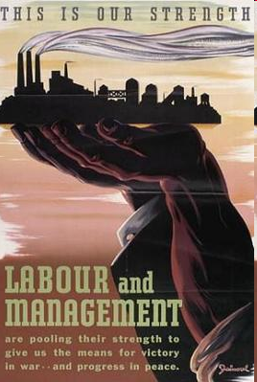
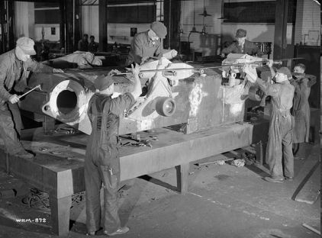
Government and the Economy
The war launched Canada out of the depression and into an economic boom.
Canada became an industrial power: new factories were built and old ones adapted for war purposes. Factories produced thousands of guns, ships, fighter planes and military vehicles.

Slide 34
Not Another Bloody Saturday-Avoiding Social Unrest
Wage freezes made striking difficult for unions
The labour (worker) shortage was a benefit
Howe was strongly opposed to labour unions but steel workers in BC and Nova Scotia went on strike in 1943 anyways
This forced the government to ensure that employers recognized unions chosen by employees
In response to the growth of the CCF, King created the Family Allowance program ($ paid to families with children)
This started Canada’s “cradle to grave” social security policy

Slide 35
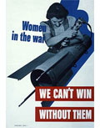
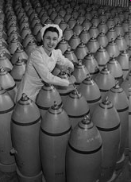
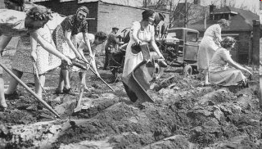
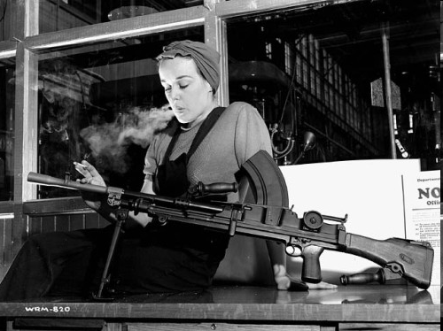
At first only single women were recruited, but upon severe labour shortages, both married women and mothers were sought out; the government even funded daycare centres so that women would be free to work.
In 1943, there were approximately 225,000 Canadian women working in munitions factories.

Slide 36
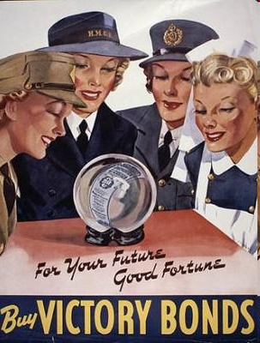
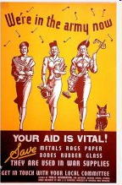
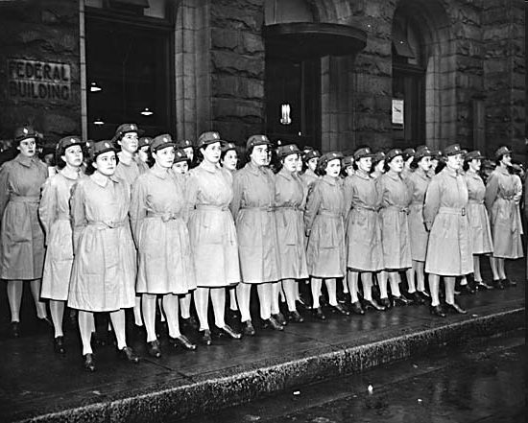
In The Army Now…
In 1941, for the first time in Canadian history, women were able to enlist in their own divisions of the Army, Navy and Air Force.
Although Canadian women were not allowed into combat during the Second World War, they did just about everything else.
Women served as nurses, stretcher bearers, drivers, machine operators, cooks and secretaries. They also flew Canadian built planes to bases in Britain
They were paid roughly 60% of what males in the military were paid

Slide 37
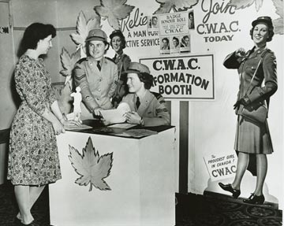
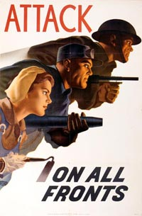
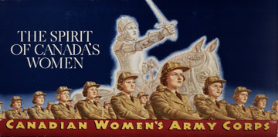

Slide 38
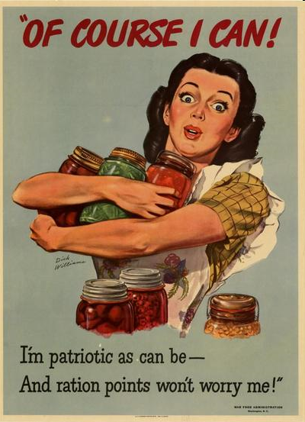
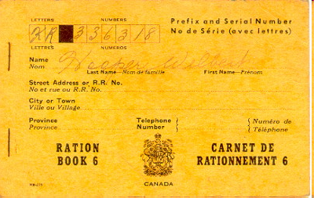
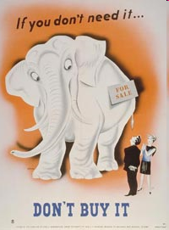
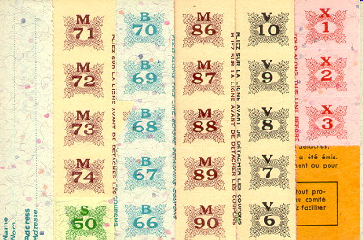
Rationing: A Little Goes a Long Way!
To ensure there was a large enough supply to meet both military and civilian needs, certain staple goods were rationed.
Rationed Items Included:
Meat, Butter, Tea, Coffee, Gasoline, Tires (rubber), Alcohol, Clothing Fabric and Silk

Slide 39
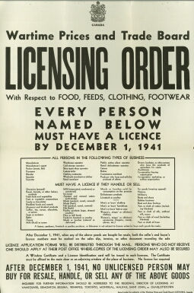


Slide 40


Slide 41


Social Support
In 1940, the government passed the Unemployment Insurance Act. In the face of unemployment, workers could now collect insurance.
In 1944, the government introduced Family Allowance and in 1945 the first “baby bonus” cheques were mailed out.

Slide 42


Arsenal of Democracy
Beds at a factory so workers could world longer hours making stuff for the war effort.

