Slide 1
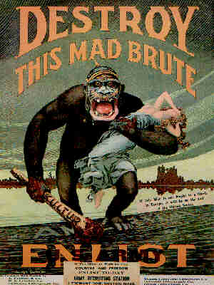
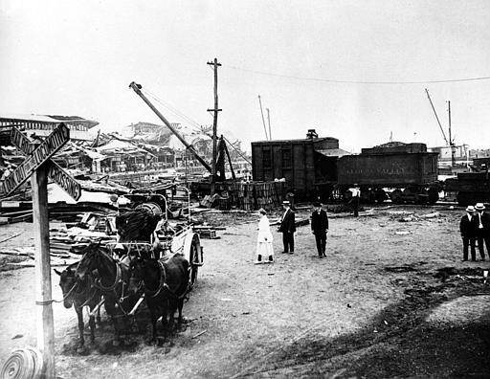
Reasons for American Entrance Into WWI
German USW
(unrestricted Submarine Warfare)
Allied Propaganda
Hostility Toward Germany
American economic Interests
American Idealism

Slide 2
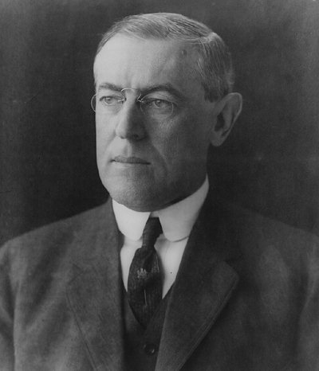
American Neutrality
In 1914 the United States issues a Proclamation of Neutrality.
Woodrow Wilson won the Presidency in 1916 under the slogan; “He Kept Us Out Of War.”

Slide 3
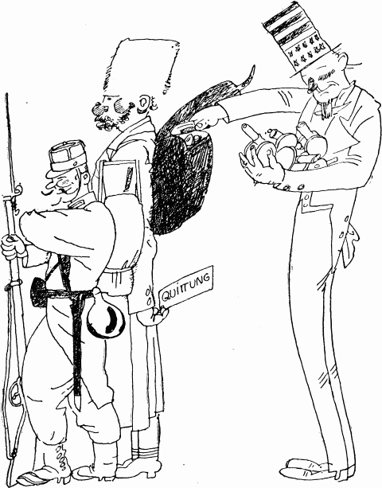
A Prosperous War for the United States
America’s economy was greatly aided by trading supplies to European countries when the Great War broke out.
America traded mostly with Britain and France.
In June of 1915 Austria-Hungary suggested that American neutrality was threatened by its munitions trade with the Allies.
As the war went on, it was in the best interest for the U.S. that the Allies won the war. $$$

Slide 4
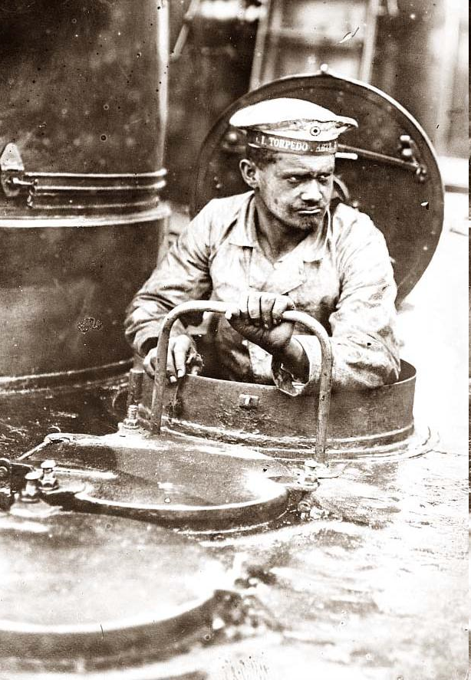
Unrestricted Submarine Warfare
German plan to blockade Britain and France.
U-Boats attack without warning and without attempting to save crews and passengers.
Torpedoed neutral and belligerent ships.

Slide 5
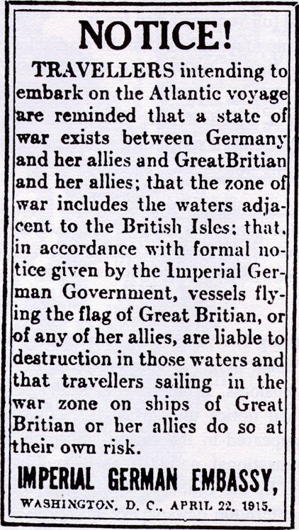
Germany Warns the U.S.
Because many Americans traveled to Britain, Germany tried to urge Americans not to travel to Europe.
The Germans went as far as taking out an add in the New York Time to discourage Americans from traveling to Europe.

Slide 6
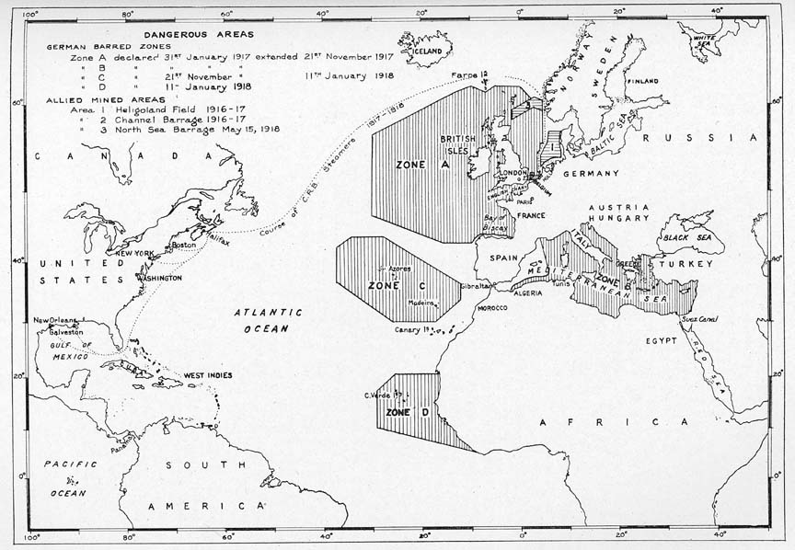

Slide 7
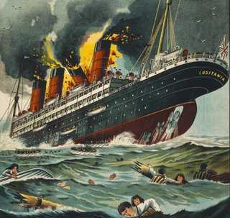
The Sinking of the Lusitania
On May 7, 1915 a German U-Boat sank the British passenger ship the Lusitania, 1198 die including 128 Americans.
The Germans argued that the Lusitania was carrying munitions in the hull.
The U.S. pressures Germany to end Unrestricted Submarine Warfare.
Germany agrees to end USW after signing the Sussex Pledge in 1916.

Slide 8
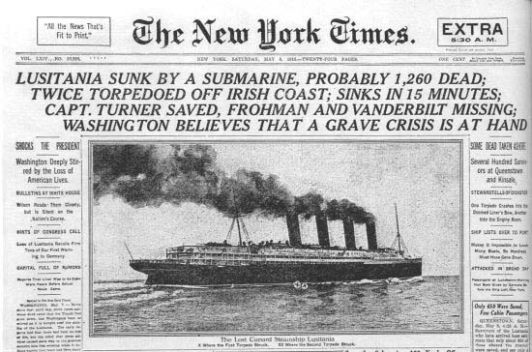

Slide 9
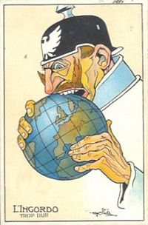
Germany Sees No Other Alternative
Unable to make any headway after ending Unrestricted Submarine Warfare, Germany decides to take action.
On January 1917 Germany resumed Unrestricted Submarine Warfare believing they could defeat England in 5 months.
“We will frighten the British flag off the face of the waters and starve the British people until they, who have refused peace, will kneel and plead for it.” Kaiser Wilhelm

Slide 10
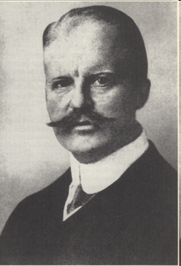
The Zimmermann Telegram
On January 19, 1917, British naval intelligence intercepted and decrypted a telegram sent by German Foreign Minister Arthur Zimmerman to the German Ambassador in Mexico City.
In return for Mexico’s help in the war, Germany promised to assist Mexico in recovering the territories ceded to the U.S. after the Mexican-American war.
Texas, New Mexico, and Arizona
Arthur Zimmermann

Slide 11
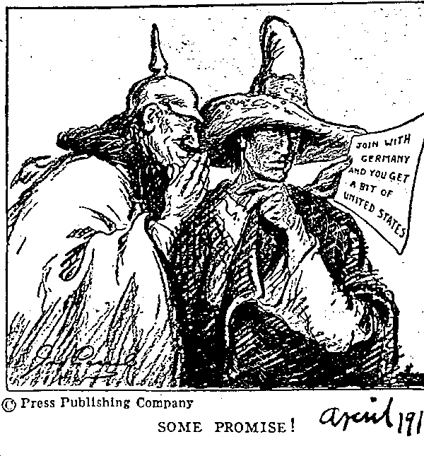

Slide 12
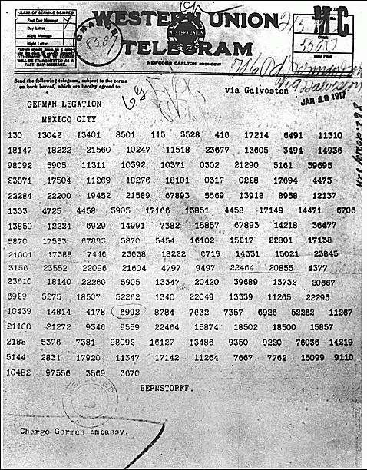
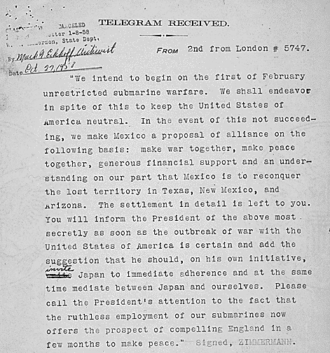
The Actual Zimmermann Telegram

Slide 13
Germany's submarine warfare is no longer directed against belligerents, but against the whole world. All nations are involved in Germany's action. The challenge is to all mankind. Wanton, wholesale destruction has been effected against women and children while they have been engaged in pursuits which even in the darkest periods of modern history have been regarded as innocent and legitimate.
There is one choice I cannot make. I will not choose the path of submission, and suffer the most sacred rights of the nation and of the people to be ignored and violated.
With a profound sense of the solemn and even tragic character of the step I am taking, and of the grave responsibilities involved, but in unhesitating obedience to my constitutional duty, I advise Congress to declare that the recent course of the German Government is nothing less than war against the United States, and that the United States accept the status of a belligerent which has been thrust upon it, and will take immediate steps to put the country into a thorough state of defense, and to exert all her power and resource in bringing Germany to terms, and in ending the war.
President Woodrow Wilson, April 3, 1917
The United States declares war against Germany in April 1917 joining the Allies.

Slide 14
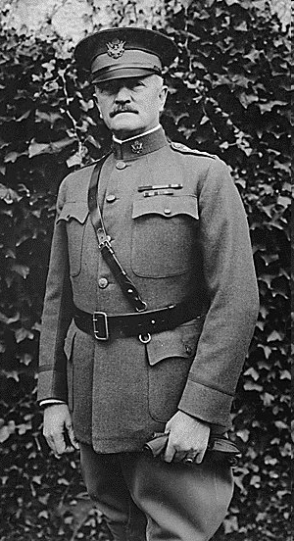
The United States Enters the Great War
By early 1918 the United States is able to mobilize 2 million men led by General John J. Pershing.
The Central Powers Collapse
With Russia gone, Germany moves most forces to Western Front
Engage in major fighting; Allies force Germans to retreat.
By the end of 1918 the Central Powers are being overwhelmed by the Allies.
Bulgaria surrenders on Sept. 29, 1918
Ottoman Empire surrenders on Oct. 30, 1918
Austria-Hungary surrenders on Nov. 3, 1918

Slide 15
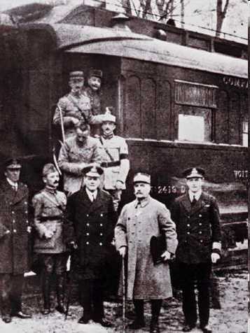
An Armistice is Signed
On November 11, 1918 Germany agrees to a cease fire and surrenders after signing an Armistice.
The document was signed on the eleventh hour, of the eleventh, of the eleventh month.
Germany was not at the mercy of the Allies.
America emerges as a world power.

Slide 16
World War I Statistics
Countries | Total Mobilized | Killed & Died | Wounded | Prisoners & Missing | Total Casualties | Casualties % of Mobilized
Allied Powers
Russia | 12,000,000 | 1,700,000 | 4,950,000 | 2,500,000 | 9,150,000 | 76.3
France | 8,410,000 | 1,357,800 | 4,266,000 | 537,000 | 6,160,800 | 76.3
British Empire | 8,904,467 | 908,371 | 2,090,212 | 191,652 | 3,190,235 | 35.8
Italy | 5,615,000 | 650,000 | 947,000 | 600,000 | 2,197,000 | 39.1
United States | 4,355,000 | 126,000 | 234,300 | 4,500 | 364,800 | 8.2
Japan | 800,000 | 300 | 907 | 3 | 1,210 | 0.2
Romania | 750,000 | 335,706 | 120,000 | 80,000 | 535,706 | 71.4
Serbia | 707,343 | 45,000 | 133,148 | 152,958 | 331,106 | 46.8
Belgium | 267,000 | 13,716 | 44,686 | 34,659 | 93,061 | 34.9
Greece | 230,000 | 5,000 | 21,000 | 1,000 | 17,000 | 11.7
Portugal | 100,000 | 7,222 | 13,751 | 12,318 | 33,291 | 33.3
Montenegro | 50,000 | 3,000 | 10,000 | 7,000 | 20,000 | 40.0
Total | 42,188,810 | 5,152,115 | 12,831,004 | 4,121,090 | 22,104,209 | 52.3
Central Powers
Germany | 11,000,000 | 1,773,700 | 4,216,058 | 1,152,800 | 7,142,558 | 64.9
Austria-Hungary | 7,800,000 | 1,200,000 | 3,620,000 | 2,200,000 | 7,020,000 | 90.0
Turkey | 2,850,000 | 325,000 | 400,000 | 250,000 | 975,000 | 34.2
Bulgaria | 1,200,000 | 87,500 | 152,390 | 27,029 | 266,919 | 22.2
Total | 22,850,000 | 3,386,200 | 8,388,448 | 3,629,829 | 15,404,477 | 67.4
Grand Total | 65,038,810 | 8,538,315 | 21,219,452 | 7,750,919 | 37,508,686 | 57.6

