Slide 1
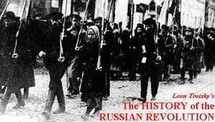
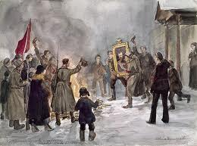
The Russian Revolution

Slide 2
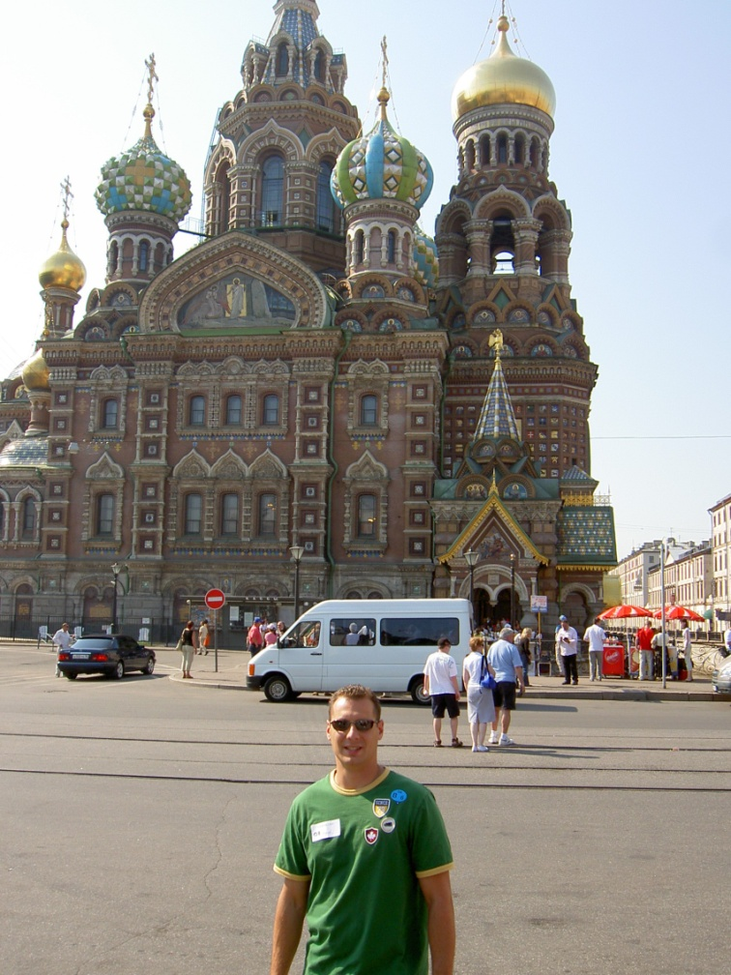
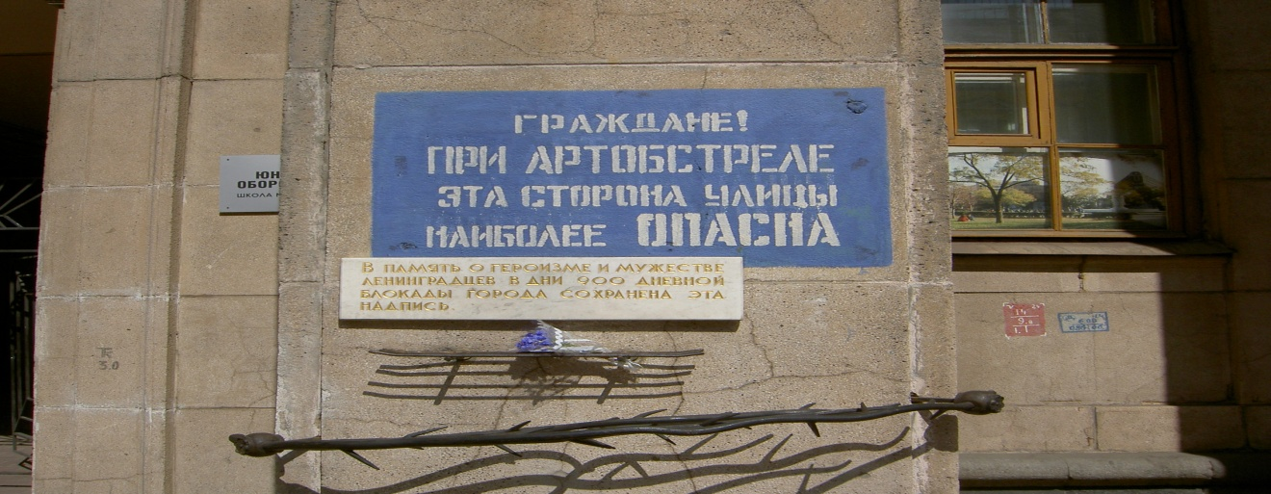
Russia
- Russians used to lives of hardship and suffering
- Sign still stands outside main market (remnant of WW2) when translated it reads; “Comrades! In the even of artillery fire, this side of the street is most dangerous”

Slide 3
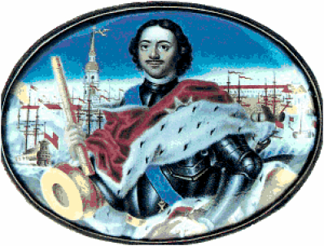
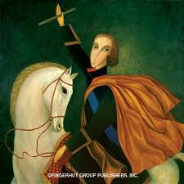
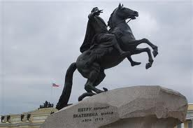
Famous Russian Tsars
‘Peter the Great’
- Moscow was too far inland to attract European trade and culture
- Peter travelled Europe, loved it! (Modeled St. Petersburg after Italy)
- In Amsterdam, Peter learned how to make ships, built a strong navy
- May 16, 1703, ‘Peter the great’ won Northern Russia from Sweden
(Which controlled the Baltic Coastline), the door was opened for Russia to trade with Europe (It took 21 years of war to win coastal area)
- Peter then began to construct a city for the ‘Tsars’

Slide 4
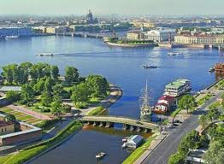
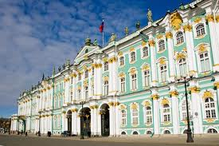
St. Petersburg
- Area Peter conquered consisted mainly of marshland and swamp
- Peasants from far off lands were forced to labour, dragging millions of tones of limestone and granite by hand into the marshland, sinking millions upon millions of wooden stakes into the swamp
- They transported billions of tones of earth (in sacks, carts and even in their pockets)
- City still called ‘Venice of the North’
- Millions of labourers were killed, (harsh work conditions and by packs of wolves who attacked anyone who stepped outside their tents at night)
- Most bodies are still buried beneath the great city
- Built great places for fortification against a Swedish attack

Slide 5
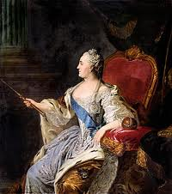
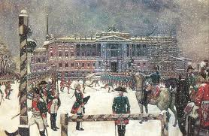
Catherine II (‘Catherine the Great’)
- Loved ‘Arts’ & Men (Even though she was married to Tsar Peter III)
- At age of 65 she had 22 year old boyfriends; she rewarded their affections with palaces and elevated them to high positions in the army or navy
- Unsure whether offspring were even from Peter III (Rumour that childhood measles left him sterile)
- As soon as Peter came to throne, planned on having his wife killed
- Coup d’etat army leaders informed Catherine who in turn killed her husband
- Became know as ‘Catherine the Great’ (built amazing palaces)
- ‘Hermitage Museum’ (Today, if you look at each item for 10 seconds, 24/7, it will take three years to see everything!)

Slide 6
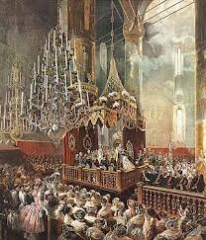
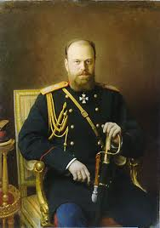
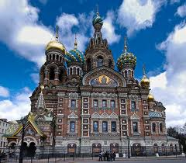
Tsar Alexander II (Nicholas’s grandfather)
- Most beloved Tsar in Russian history (compared to other Tsars)
- Revolutionary activist threw a bomb under his carriage on March 1st 1881
- Tsar was unhurt (carriage was built to be bombproof)
- ‘Jolted’ Tsar tried to help those around him (including the bomb-thrower)
- Suddenly, another assassin threw another bomb at his feet which exploded and tore off his legs and injured the rest of his upper body
- Tsar requested to be “Taken to his palace to die”
* The ‘Church of Spilled Blood’ stands where the Tsar was mortally wounded (His blood remains today underneath the alter)

Slide 7
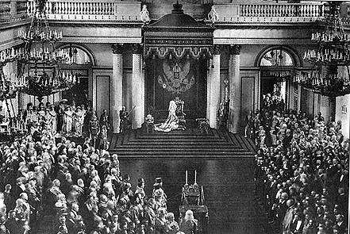
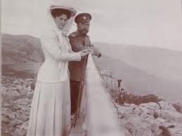
Last of the Romanovs: Nicholas II (& wife Alexandra)
- Only since the collapse of communism were ‘Top Secret’ Russian archives regarding the revolution and the murder of the imperial family released
- Nicholas became Tsar in 1894; he did NOT want to rule Russia
- Fell in love with German princess Alexandra (did not speak Russian)
- When his Father Alexander III died, became Tsar and was married within one week of the funeral
- Alexandra: “My wedding was the continuation of the funeral, only I was dressed in white” (Wedding cost an estimated $50 million U.S. dollars)

Slide 8
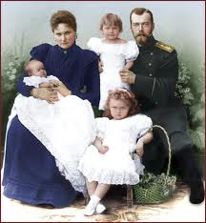
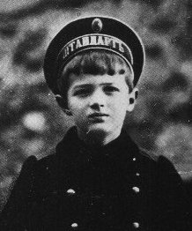
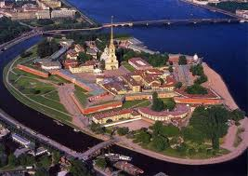
Evil Couple?
- After Wedding, peasants awaited gifts of food (symbolic Tsar feeding people)
- Crowd stampeded, soldiers opened fire killing 1300 (Tsar blamed)
- Alexandra seen as ‘snobbish’ and ‘unpopular’ (didn’t speak Russian)
- Four daughters born in late 1800s; however, no son heir (cursed?)
- Finally, a son was born in 1904 (three hundred cannon blasts to celebrate)
- ‘Alxis’, inherited Alexandra’s family curse of haemophilia

Slide 9
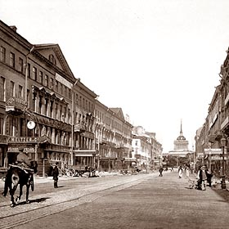
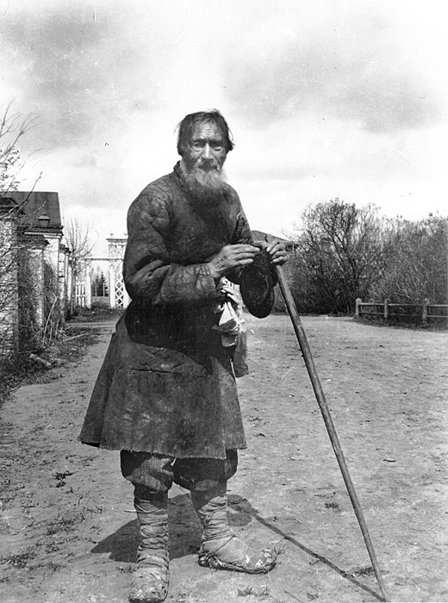
The Revolution of 1905
The creation of a discontented working class
Vast majority of workers concentrated in St. Petersburg and Moscow
Help from the countryside: poor peasants
No individual land ownership

Slide 10
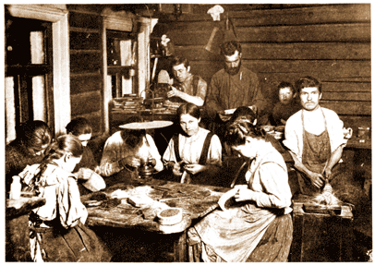
Russian peasants labor in broom-making sweatshop

Slide 11
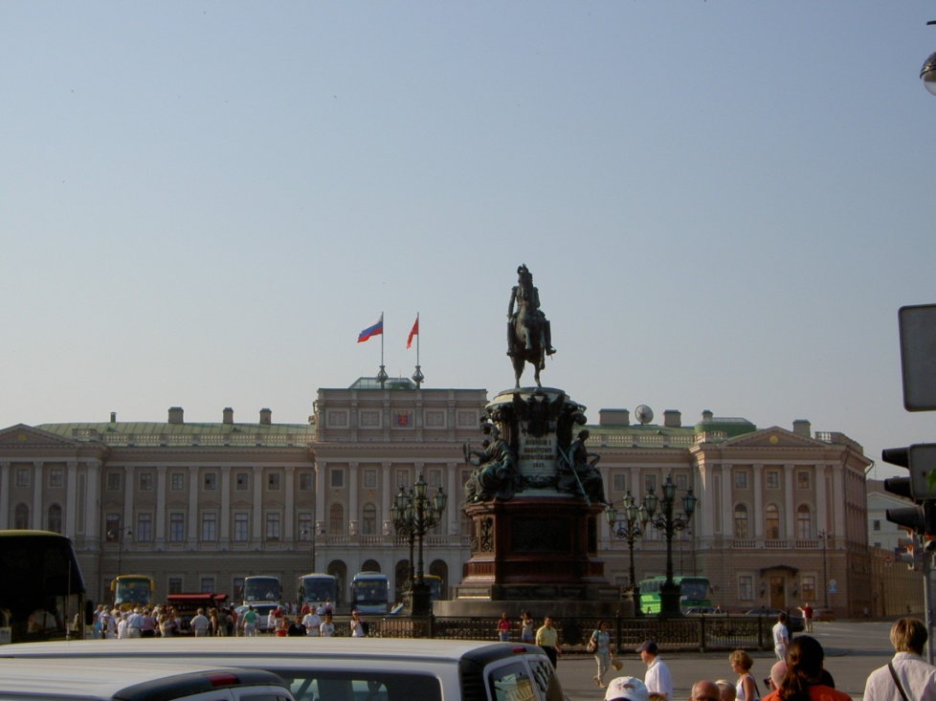
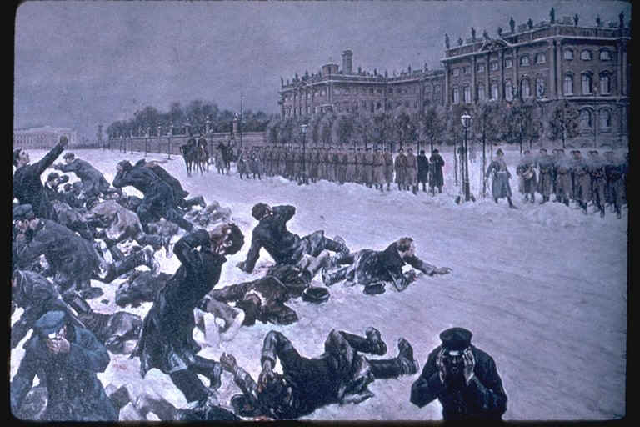
The First Revolution
- January 9th, 1905, ‘Bloody Sunday’ Thousands of striking workers petitioned outside the ‘Winter Palace’, with a petition of 150,000 signatures pleading the Tsar for: an elected assembly, voting rights, education and worker rights
- Tsar not in St. Petersburg to receive the demands; soldiers opened fire, killing many women and children
- Massacre devastated Tsar’s ‘fatherly’ image

Slide 12
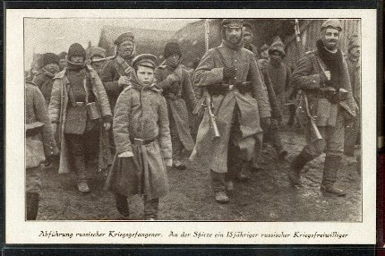
WW1
- Tragic family squabble
- Nicholas was cousin to King George V of England, while Alexandra was cousin to both the King of Britain and Kaiser Wilhelm II of Germany
- German chancellor often visited Russia to hunt with the Tsar
- Nicholas signed a treaty that entered Russia into a war which ended the lives of millions of Russians, and indirectly, his own life as well.
- During the war the name ‘St. Petersburg’ was changed to ‘Petrograd’ because it sounded German
- Tsar’s family (wife and son) mocked during the war for being ‘German’

Slide 13
Russian forces retreating following losses in WWI
WWI cost Russia nearly:
$22.3 billion
4 million dead (estimation)
2.3 million soldiers died
1.5 million civilian deaths

Slide 14
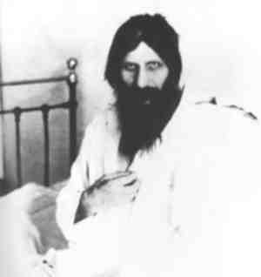
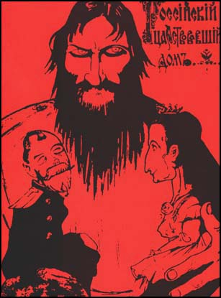
Rasputin
- Siberian party peasant, turned spiritual healer
- Alexis dying from a groin haemorrhage, in desperation Rasputin was called to the palace
- Rasputin predicted that boy would be well by morning (When boy woke up healthy, Alexandra fell under his spell)
Secret police observed Rasputin frequently partying and bringing over women to his apartment
- Alexandra dismissed anyone who spoke against her ‘unholy man’
- Rumour that Alexandra and Rasputin were having an affair
- Rasputin guided the Empress in guiding state affairs

Slide 15
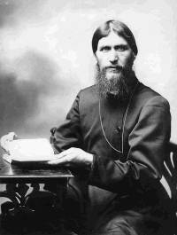
Rasputin’s Death
- Finally, a group of Russian Aristocrats, (along with members of the Romanov family), plotted to eliminate Rasputin on Dec. 17, 1916
- He was poisoned with wine, and later shot in the back…didn’t work
- Rasputin ran out of the palace but was shot again at the place gates and beaten to death
- His corpse was thrown into the river
- Rasputin’s body was found the next day; an autopsy revealed that he actually died from drowning

Slide 16
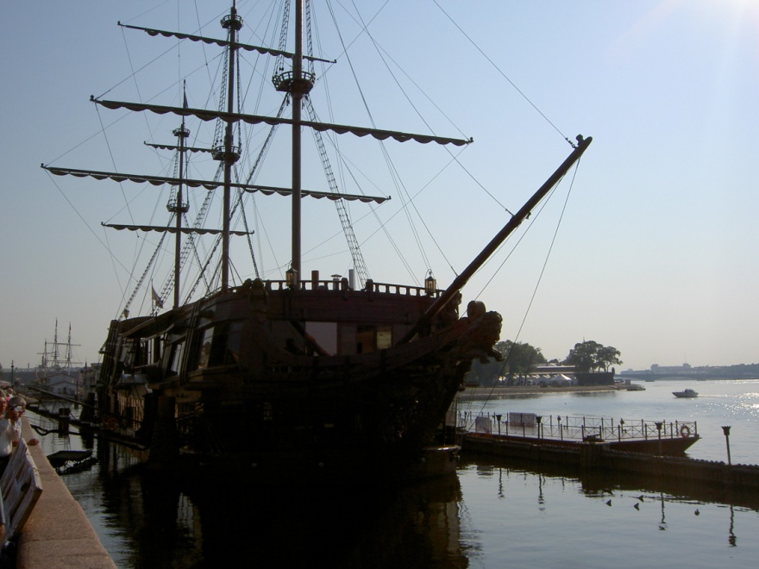
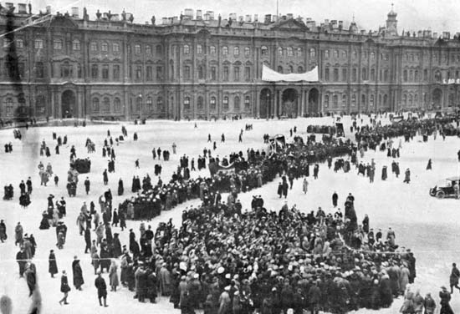
The Russian Revolution
- March 15, 1917, with his government and the war effort in total chaos, Tsar Nicholas abdicated causing the country to move towards a civil war between the Tsar’s former ministers (led by Alexander Karensky) and the “Soviets of Workers, Soldiers and Peasants Deputies”, better known as Lenin’s ‘Bolsheviks’
- The armed struggle began on October 24, 1917 when the Bolsheviks took control of Bridges, Railway stations, power and communications
- The next evening, the revolutionary cruiser AURORA fired a blank shot into the air to signal the occupation of the provisional government at the Winter Place

Slide 17
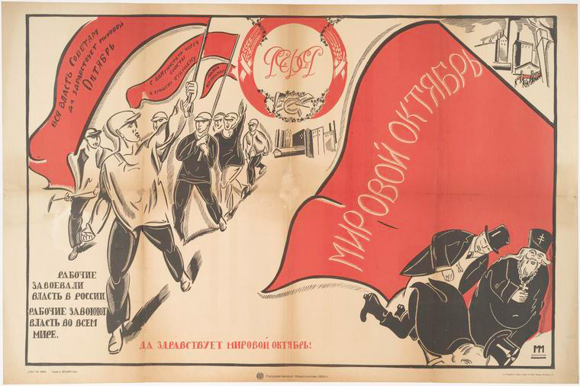
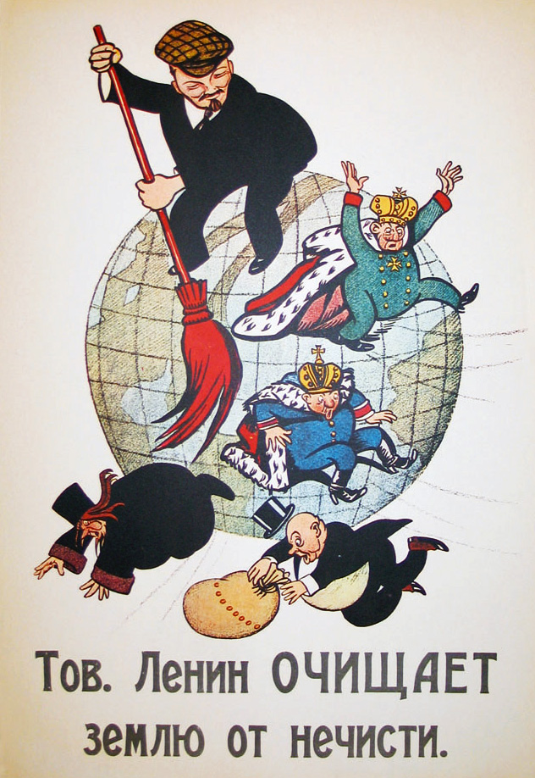

Slide 18
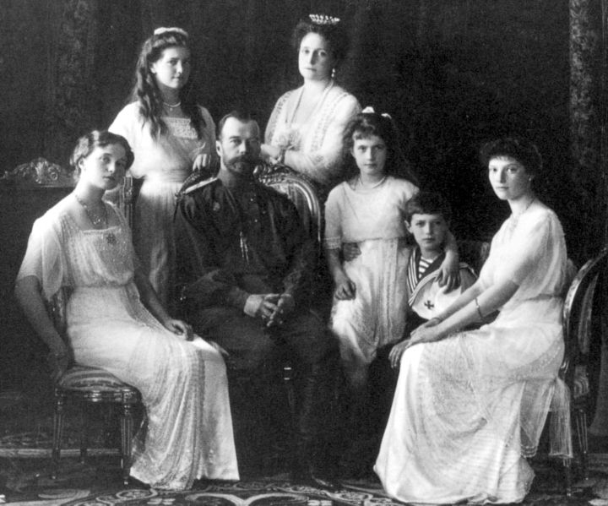
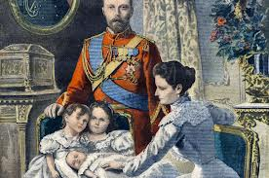
End of a Dynasty
- Since his abdication, Nicholas and his family had been held under house arrest at Alexander Palace in Tsarskoie Selo
- Nicholas hoped to fulfill his life’s desire and keep a farm
- Although the British Government offered the Tsar and his family asylum in March 1917, the King forced the British PM to withdrawal the invitation within one week due to: a) rising socialist concerns b) anticipated problems of having two Royal families living in the same country
- King George therefore, ‘passed death sentence on his cousin Nicholas’
- In August, 1917, in one of its last actions, the Karensky government decided to move the Royal family to Siberia for their safety

Slide 19
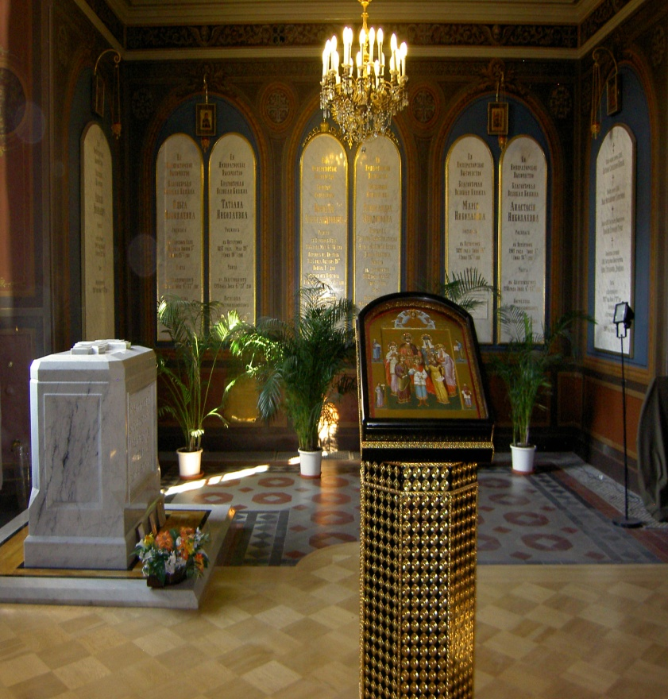
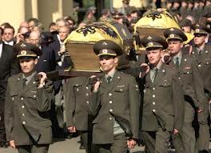
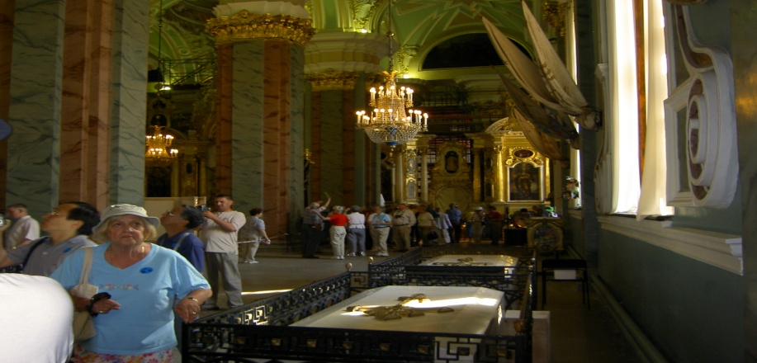
- They were led into the hands of the Bolsheviks who took them to the town of Ekaterinburg
- In 1918, with Russia still in a civil war, Lenin feared that the Royal family could become a rallying point for the enemies of his revolution
- The Royal family was executed on the night of July 16th, 1918 and their bodies hidden
- 80 years after their deaths, their bodies were confirmed by DNA testing and lowered into a crypt in the Cathedral of the Peter and Paul Fortress

Slide 20
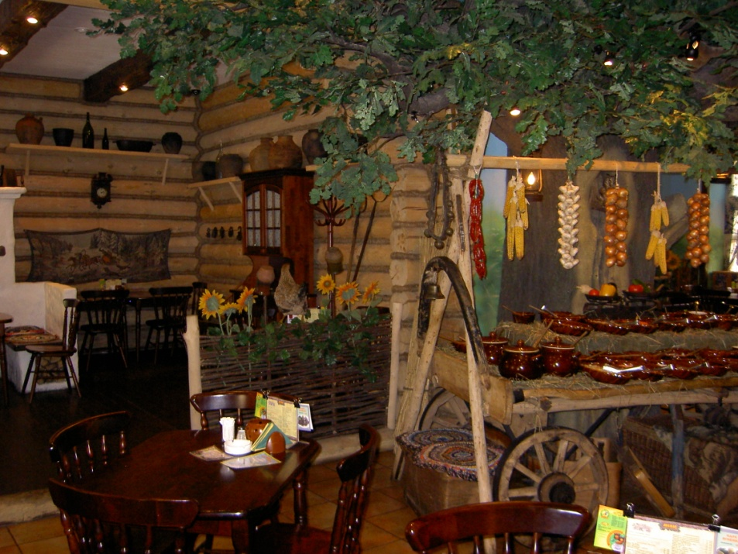
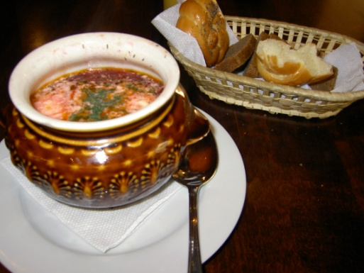

Slide 21
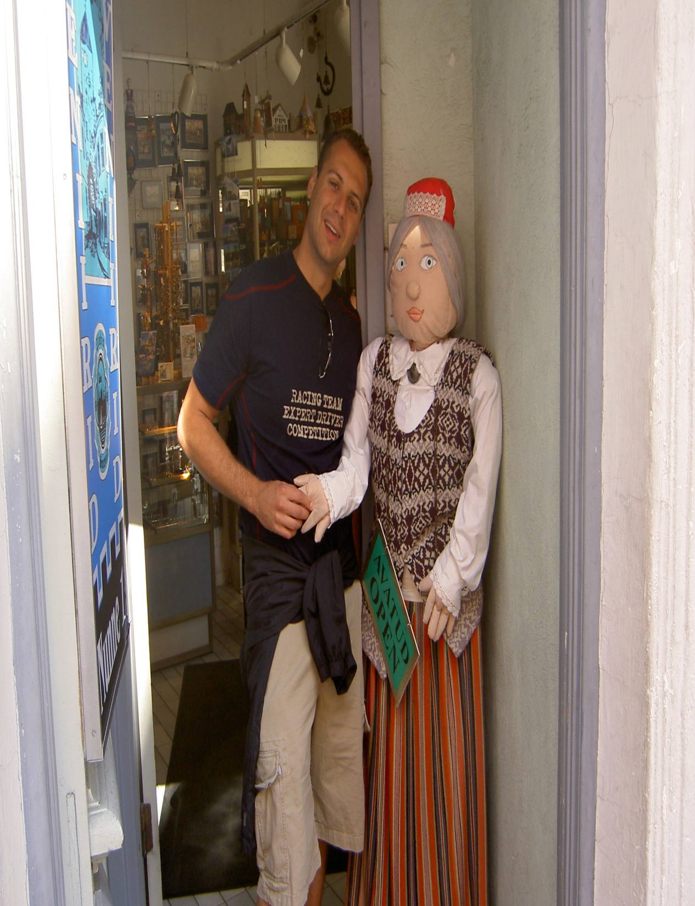
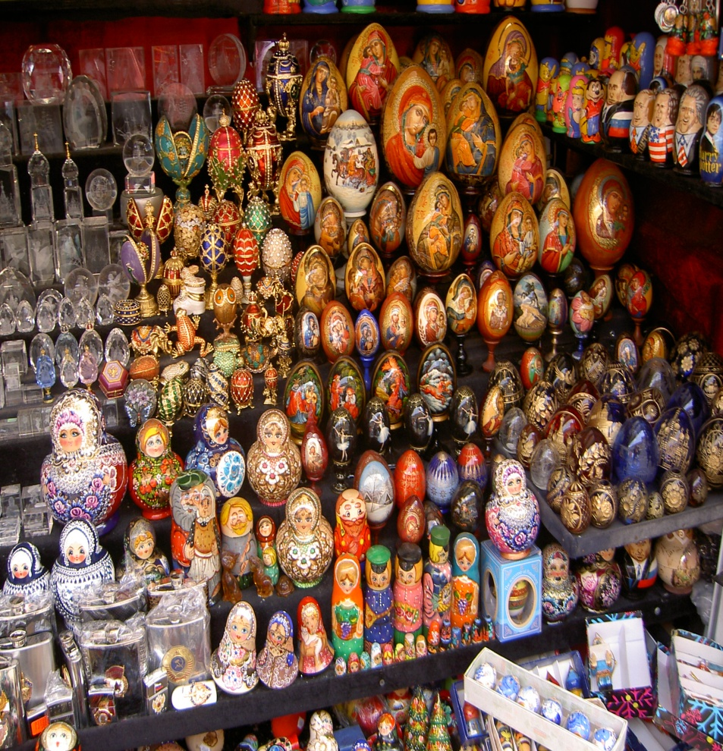

Slide 23
The Revolution
Vladimir Lenin
Leads the Bolsheviks in a Communist take-over.
New Economic Policy
“Land, Peace, Bread”

Slide 24
The Revolution
Joseph Stalin takes over Russian Communist Party in 1922 (after Lenin dies of a stroke).

Slide 25
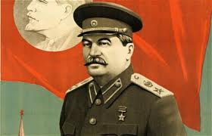
Stalin had 13 MILLION people killed and 8 MILLION arrested who disagreed with his ideas.

