Slide 1
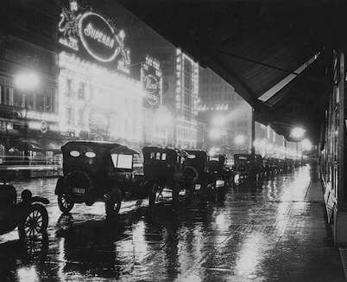
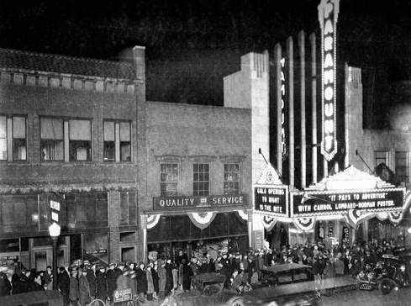
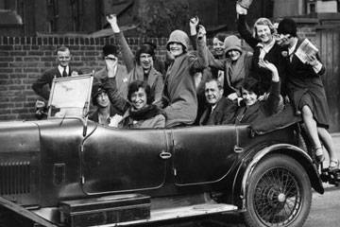
The Roaring 1920s

Slide 2
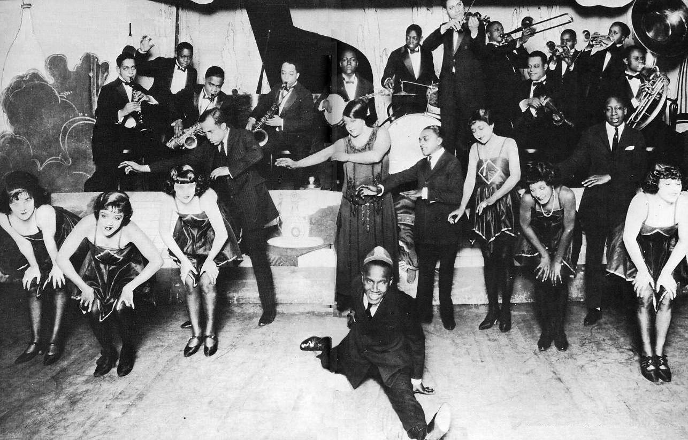
Pop Culture
Music of the day? JAZZ JAZZ JAZZ

Slide 3
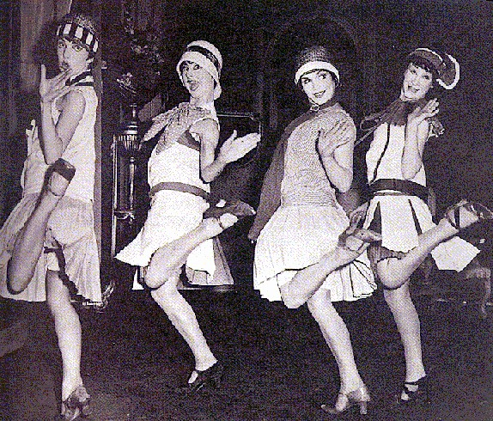
Women
Cut their hair short and the length of skirts got shorter too. These women were called ‘Flappers’. They were seen as rebellious!!!

Slide 4
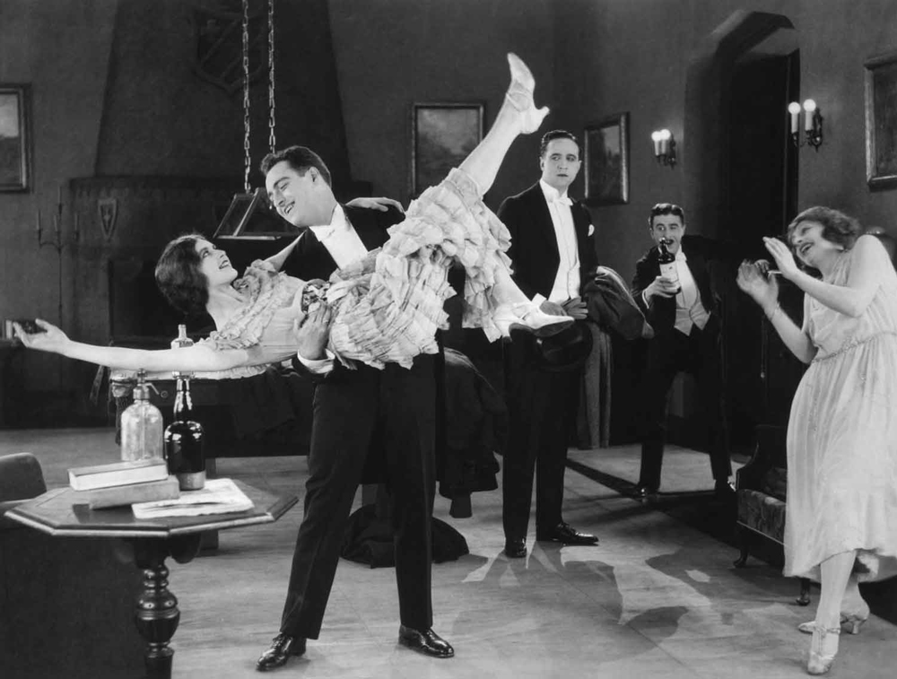
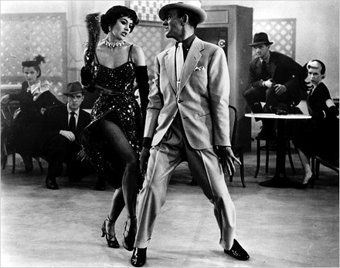
Miss America contest began in 1921
Dances such as the Charleston, the Black Bottom and the Shimmy

Slide 5
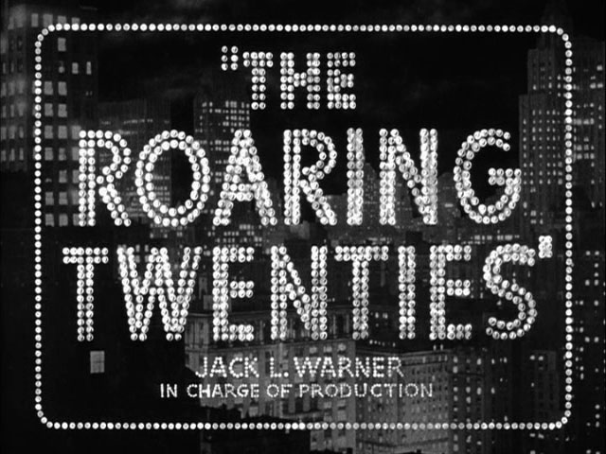
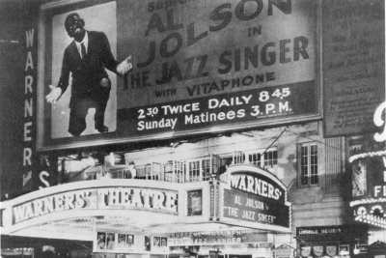
Movies
Motion features grew rapidly throughout the decade. Hollywood stars had huge audiences around the world. Talking pictures began in 1927 with the release of the ‘The Jazz Singer’

Slide 6
The Movies
It was, however, not possible to avoid the cultural impact of American movies on the silent screen.
Mary Pickford, one of the most popular stars of the 1920s, was born a Canadian as were many other popular entertainers.
The influence of Hollywood resulted in an increasing Americanization of Canada.
Mary Pickford

Slide 7
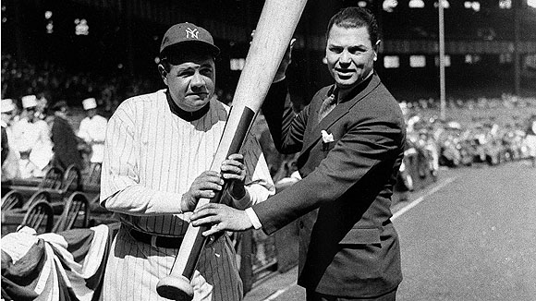
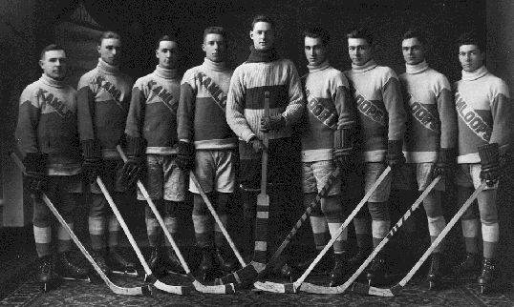
Spectator Sports
Sports became a big business
The National Hockey League formed and expanded
Football, baseball and basketball, boxing, tennis popular

Slide 8
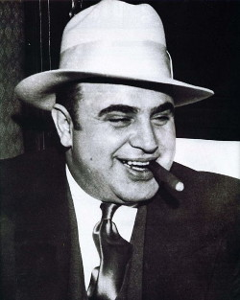
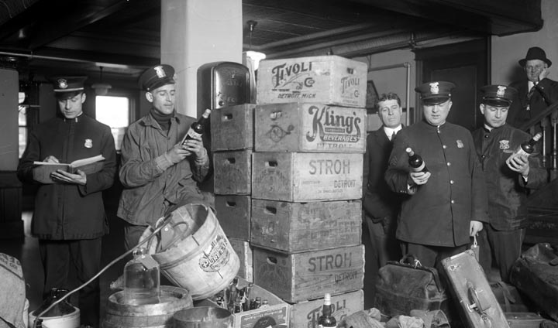
Prohibition
Alcohol was illegal, but speakeasies supplied it and in Canada, people engaged in rum-running
Gangsters like Dutch Schultz and Al Capone supplied ‘hooch’ illegally

Slide 9
Life in Canada 1920 -1939
The development of mass production allowed many Canadians to afford the purchase of an automobile.
A Model-T Ford could be purchased in the mid 1920s for less than $400.
Roads were improved and tourism as an industry rapidly expanded.

Slide 10
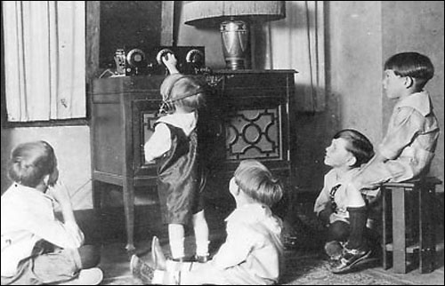
Other Technology
Radio
Telephone (party-lines...eavesdropping)
Washing machine
Refrigerator
Neon signs
Snowmobile

Slide 11
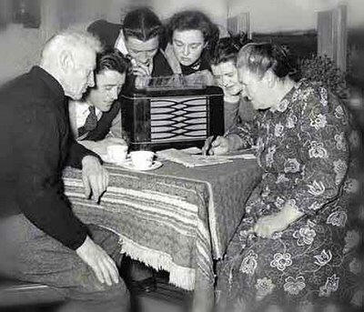
Life in Canada 1920 - 1939
The number of radio sets in use by Canadians expanded dramatically in the 1920s.
The CBC was first formed in 1932 as the Canadian Radio Broadcasting Commission.
This helped to reduce the powerful influence of American broadcasting.

Slide 12
Art in Canada Between the Wars
It was in the field of art that Canada retained a sense of nationalism.
The Group of Seven popularized paintings of Canada’s rural landscape, particularly, the rugged terrain of the Canadian Shield.
The art of Emily Carr captured the forests and Native villages of British Columbia.
Emily Carr

Slide 13
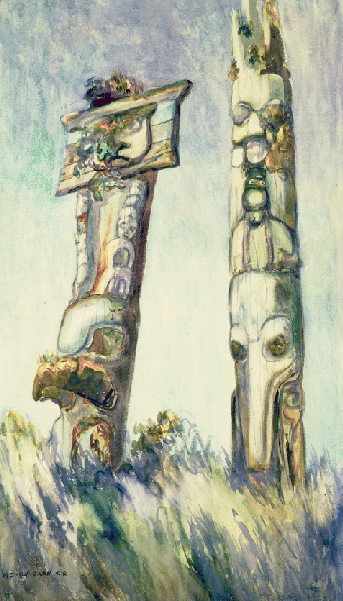
Emily Carr 1871- 1945
Emily Carr was both painter and writer.
Her paintings of West Coast landscapes and Native culture are characterised by intense colour and spiraling forms.
Haida Totems, Cha-atl,
Queen Charlotte Island
Notes:
British Columbia Archives PDP00560

Slide 14
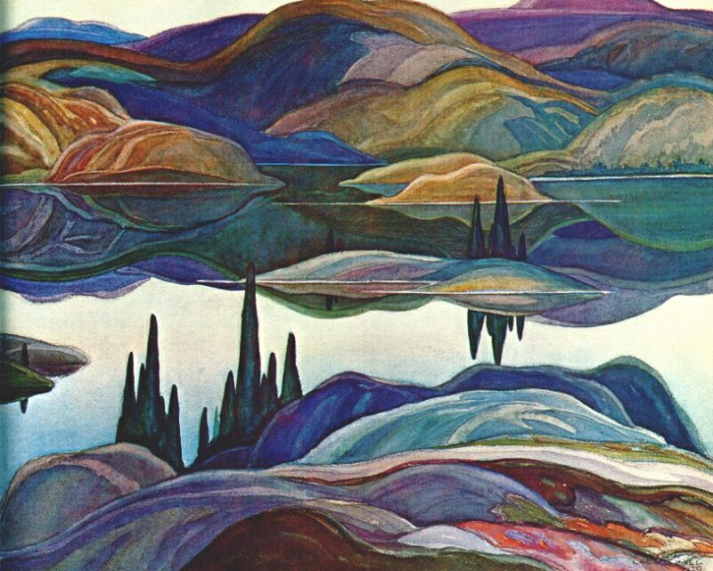
The Group of Seven
The most famous Canadian painters of the 1920s were the Group of Seven.
They painted the landscape of the Canadian Shield in a distinctly new and Canadian style.
They were at first criticized as the “Hot Mush School” because of the heavy layers of paint used in their paintings.

Slide 15
The Group of Seven
By the early 1920s the Group was well established in Canadian art circles.
The original seven were J.E.H. MacDonald, Lawren Harris, Franklin Carmichael, Arthur Lismer, F.H. Varley, Tom Thomson and Franz Johnston.
An eighth artist, A.Y. Jackson later joined the group.
A.J. Casson was invited to join in 1924.
Tom Thomson

Slide 16
Walter J. Phillips 1884 - 1963
Walter Phillips was not as was well known as members of the Group of Seven.
His watercolours and prints were more traditional and for many Canadians more accessible.
He did not seek, nor did he achieve, a revolution in art but rather he demonstrated the strength of the British influence, particularly in Western Canada.
Summer Night - 1931

Slide 17
Canadian Authors Between the Wars
Canadian poets of the era included A.J.M Smith and E.J. Pratt.
The novels of Morley Callaghan and Mazo de la Roche were popular in English Canada.
In Quebec Jean-Aubert Loranger and Robert Choquette achieved prominence and popularity.

Slide 18
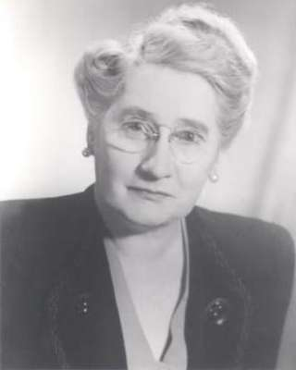
NOT SO ROARING.....
Despite earning the vote during the war...
1921 First women elected (Agnes Macphail)
Perception the women belonged in the home
Work: teachers, nurses, office clerks (low wages)

Slide 19
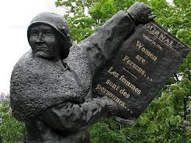
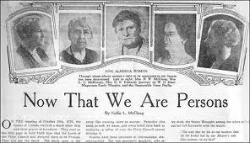
Person’s Case
Suffragist Emily Murphy was appointed a magistrate (Judge) in Alberta
Her appointment was challenged because only ‘persons’ can hold office and women were NOT ‘persons’
Supreme court ruled that women were NOT ‘persons’
Appeal to Privy Council in Britain which declared...
“To those who ask why the word ‘person’ should include females, the obvious answer is why should it not”
King forced to appoint a women senator to clarify the definition of ‘persons’

Slide 20
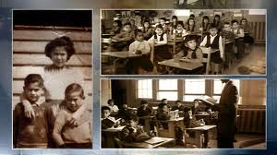
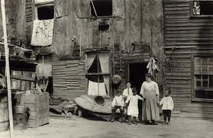
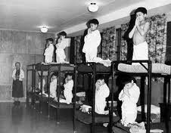
Aboriginal Nations
War contributions did NOT change their perception
Not ‘persons’, could NOT vote
Residential Schools
Slum Reserves

Slide 21
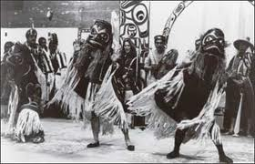
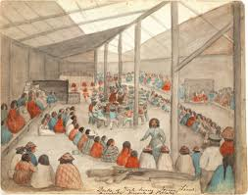
Aboriginal Challenges
1) Potlatch- celebrating births, deaths, marriages
Outlawed in 1884
BC chiefs arrested/Jailed in 1920s for allowing potlatches
2) Cut-off lands (Fed govt took land without consent)
3) Aboriginal Title (govt changed the ‘Indian Act’ so the consent for stolen land was not necessary)

Slide 22
African-Canadians ‘The UGLY’
N.S. (1918) Education Act (Separate schools)
Ontario (1921) Racially segregated seating in movie theatres
BC (1925) KKK branch emerged
‘Better’
Alberta (1924) city council voted against a bill to ban blacks from city parks and pools
1919 Brotherhood Union accepts blacks

Slide 23
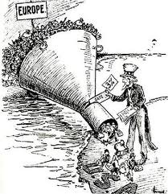
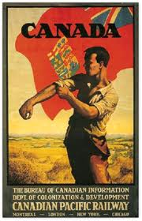
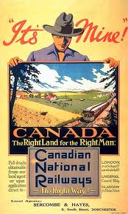
Asian Banned
In 1923 a law was passed banning Asian immigrants until 1947
Russians and eastern European immigrants restricted to prevent ‘socialist revolutions’

