Slide 1
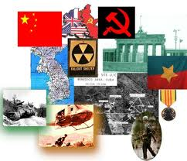
Cold War - Definition
A war with no direct military conflict but a conflict waged through various other means including:
    espionage
    propaganda
    economic warfare
    surrogate wars
    the space and arms race.

Slide 2
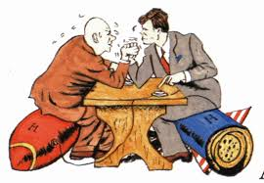
The Cold War
After World War Two the world is broken into two main groups.
Lead by
The Soviet Union
The United States

Slide 3
Cold War - Origins
After WWII, two Super Powers emerged - the United States and the Soviet Union (Russia). They engaged in a Cold War from 1945 - 1989.
  The United States was a CAPITALIST country. This meant that private individuals invested in businesses trying to make a profit.
  The Soviet Union was a COMMUNIST country. This meant that the government controlled the economy by owning the means of production and distribution such as farms, factories, stores and railroads.
When the fighting ended in Europe it was clear that the “uneasy alliance” between the Soviet Union and the western democracies would not last.
The explosion of the atomic bomb in 1945 made the secrets of this weapon of vital importance to the Russians.

Slide 4
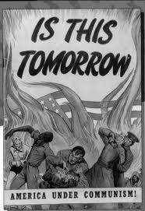
When Was The Cold War?
Period lasting from 1945 – 1989.
Characterized by tension and hostility between the Communist Soviet Union and its allies and the Capitalist and democratic United States and its allies.

Slide 5
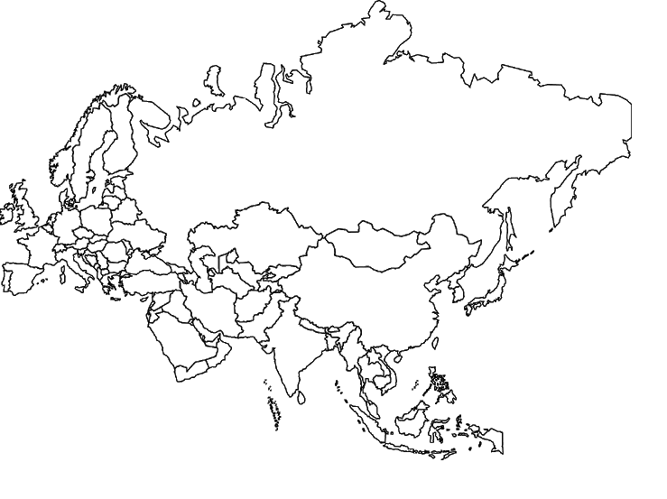
Eurasia=Europe and Asia

Slide 6
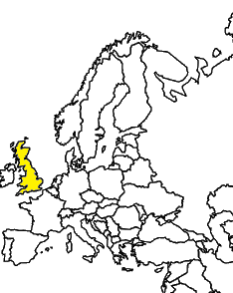
Allies push into Germany from the west, 1945.

Slide 7
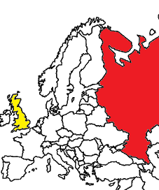
Soviets push in to Germany from the East.

Slide 8
When the two meet, the cold war begins!

Slide 9
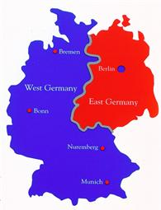
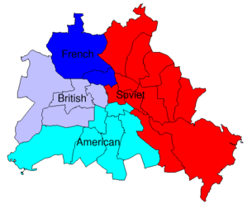
Berlin and Germany Split
Berlin

Slide 10
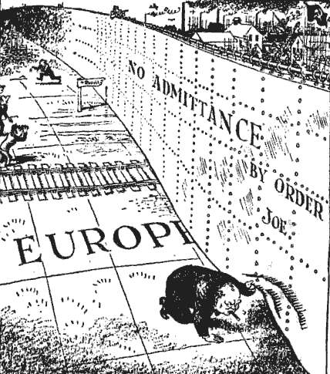
Europe – EAST AND WEST
Separated by the “Iron Curtain”
  Coined by Churchill to describe the break between East and West

Slide 11
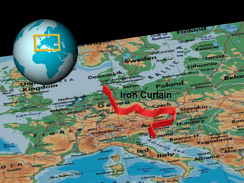

Slide 12
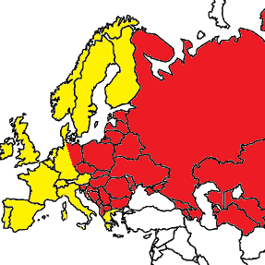
Germany is split in two. The Berlin wall becomes a symbol of the Cold War.
Mostly Capitalist
Multi-party system
Democratic
Communist
One-party system
Dictatorship

Slide 13
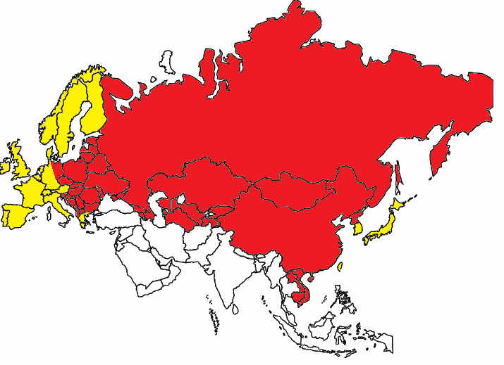
The Cold War becomes a global conflict: 1945-early 1990s

Slide 14
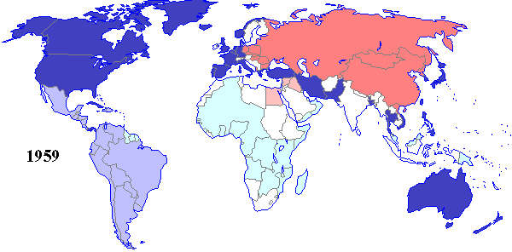
The bi-polar world

Slide 15
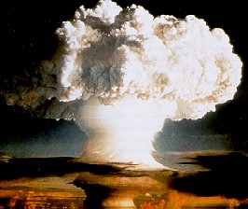
II. Cold War: Defined
THE STAKES ARE HIGH
(BOTH U.S. and Soviet Union hold capability to destroy each other)
1949 Soviet Union
successfully explodes an atomic
bomb
1952 1st Hydrogen Bomb tested
*Much more powerful than the
Atomic Bombs dropped on
Hiroshima and Nagasaki
*Precision Missile Launch

Slide 16
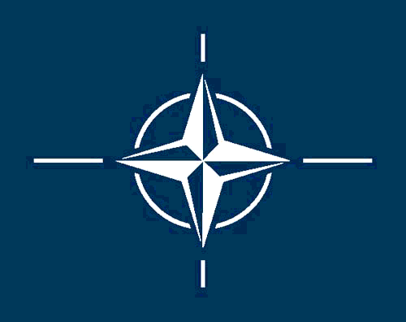

Competing Alliances
NATO (1949)
  US, Canada, and much of western Europe
  military alliance designed to oppose the USSR
Warsaw Pact (1955)
  Formed in response to NATO
  USSR and much of Eastern Europe

Slide 17
Containment doctrine
Rather than try to defeat communism, the US tried to contain it (prevent it from expanding)
The Domino Theory
  If the US allowed one country to be taken over by communism, other countries would follow
US strategists focused on places where communist forces might gain power

Slide 18
Truman Doctrine and Marshall Plan, 1947
Truman Doctrine: US would tolerate Soviet expansion to its 1947 limits (principle of coexistence) but would resist any further encroachment (principle of containment)
Marshall Plan: Economic aid to rebuild European economies. An instrument to aid non-communist states (economic imperialism?)

Slide 19
Berlin Airlift 1948 and the Wall 1961
Many were fleeing Soviet Berlin.
In 1948 the Soviets blockade all the ground links to West Berlin
  All supplies needed are ferried in to Berlin through air corridors from the West. Stalin eventually gives up.
Berlin Airlift (April 1948-May 1949)
1961 - Soviets decide to put up Berlin wall to keep people in.

Slide 20
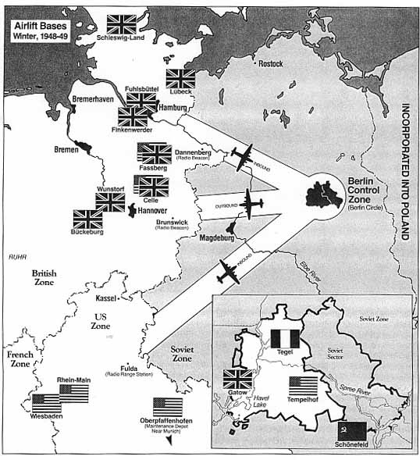
Berlin Air Lift

Slide 21
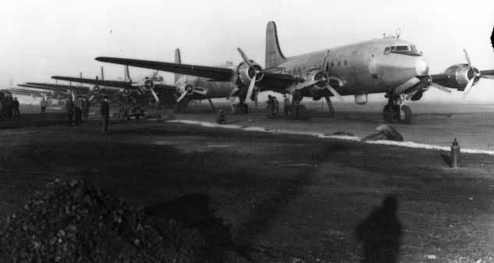
Planes lined up for take off.

Slide 22
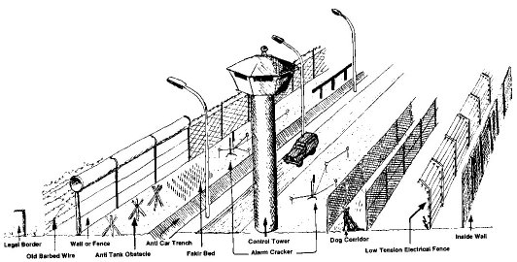
Berlin Wall

Slide 23
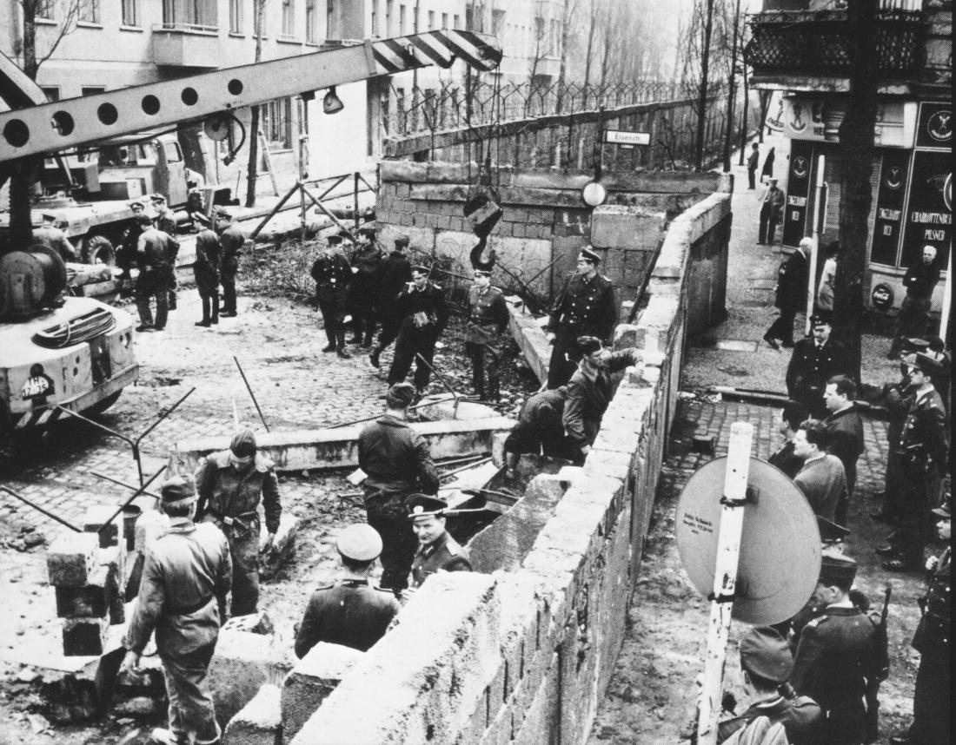
Building the Wall

Slide 24
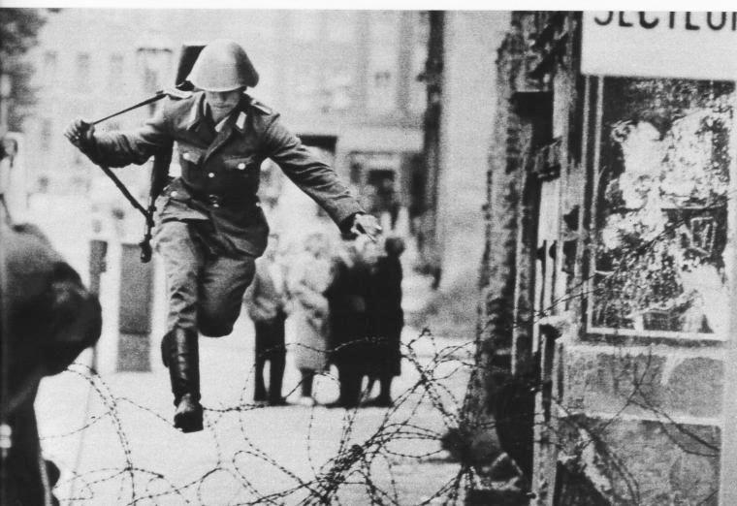
Defection from the East

Slide 25
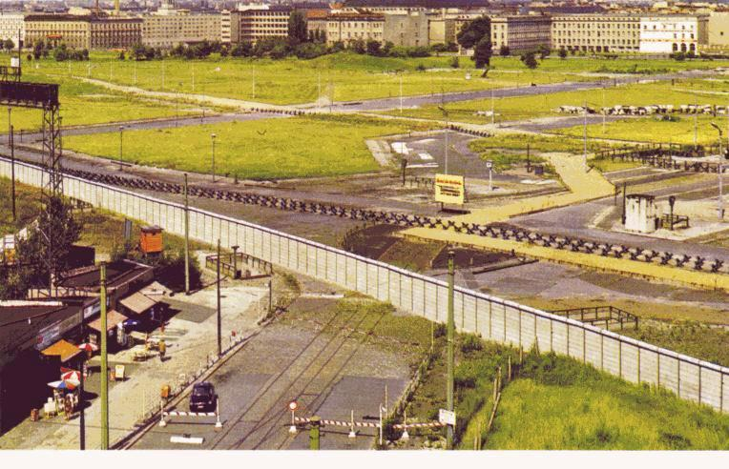

Slide 26
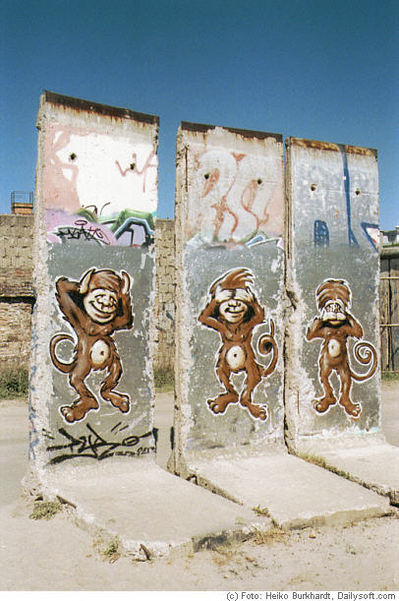
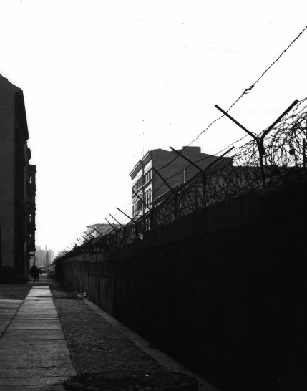

Slide 27
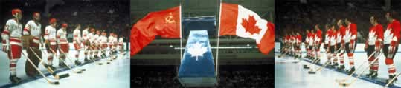
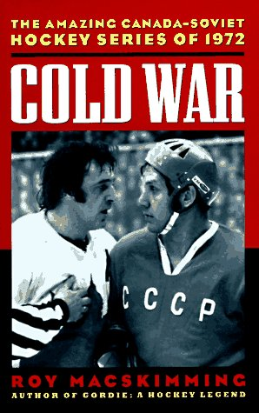
Canada and the Cold War
Caught in the Middle – USSR on top, USA underneath…main missile and bomber route. Wrong place at the wrong time.
Canada was involved in the Cold War as an ally to the United States & NATO.
Our alliance with them evolved naturally because of our geographic proximity, history of co-operation, similar economic and political systems, and integrated cultures

Slide 28
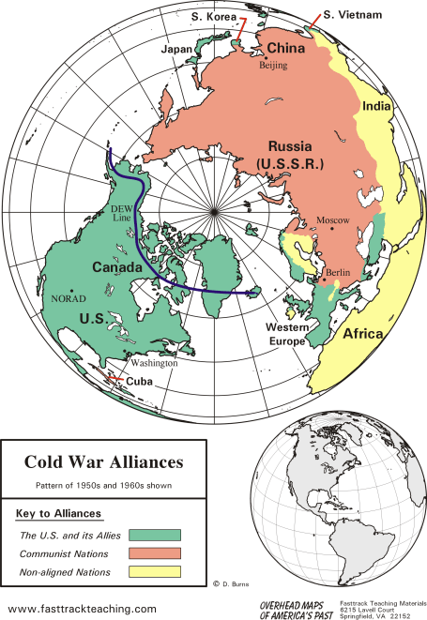
Canada in the middle

Slide 29
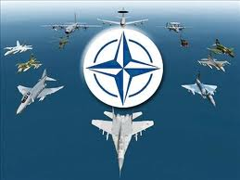
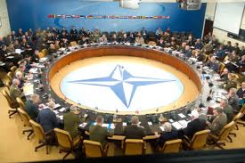
Cold War - NATO
North Atlantic Treaty Organization
  Canada had to agree to meet military commitments to NATO
  Canadian soldiers were permanently stationed in Europe in a state of war readiness
  all members agreed that nuclear weapons could be used if necessary in war against Soviets
    total nuclear war, it was agreed was only acceptable as a last resort

Slide 30
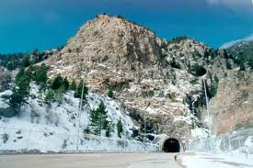
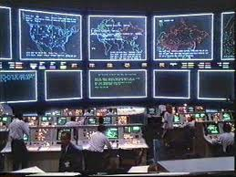
North American Defense
NORAD – North American Air Defense Agreement
HQ buried in Cheyenne Mountain, Colorado.
Centrally controlled and coordinated defense of North American Air Space
  Fighter forces
  Missile bases
  Air defense radar

Slide 31

North American Air Defence
Protection from Soviet Air Attack (bombers initially, then missiles)
North America was now just as vulnerable to Soviet attack as was western Europe.
In 1958 the United States and Canada formed NORAD to co-ordinate the air defence of the continent.
US built three lines of radar stations across Canada (built between 1950-57)
  The Pinetree Line
  The Mid-Canada Line
  DEW Line (in the artic) - Distant Early Warning Line
NORAD

Slide 32
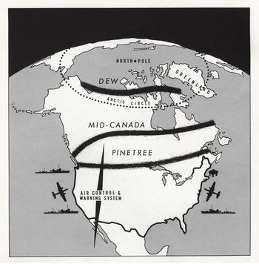
DEW Controversy
Many Canadians felt this defense system compromised our independence
Was this a necessary price of added security?

Slide 33
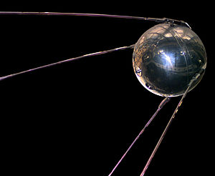
Sputnik
Sputnik 1 was the first artificial Earth satellite. It was a 585 mm diameter shiny metal sphere, with four external radio antennae to broadcast radio pulses.
The Soviet Union launched it into an elliptical low Earth orbit on 4 October 1957

Slide 34
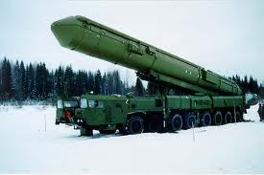
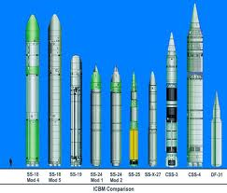
Cold War - NORAD
Both sides soon developed Inter-Continental Ballistic Missiles (ICBM)
Launched from silos or subs into space could reach one another’s cities in less than 30 minutes
DEW lines were rendered obsolete

Slide 35
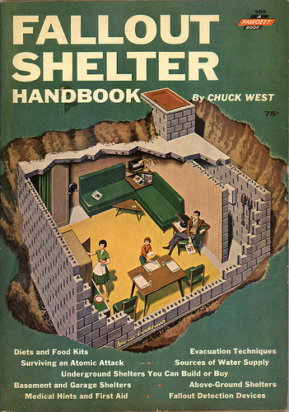
Towards a More Independent Defence Policy
The Canadian government would develop civil defence plans for citizens and those more fearful, would construct “bomb shelters”.
Canadians would also become more conscious of “communist” ideologies and sympathies.
Defence industries “screened” their workers and unions were eyed with a “watchful eye”.
1950’s Fallout Shelter Handbook

Slide 36
Cold War - Commonwealth of Nations
Clearly, NATO and NORAD were controlled by the USA
Canada joined the Commonwealth to link itself to other nations of the world - separate from the USA
    focus was not military
    rather, trade and aid

Slide 37

Cold War - Commonwealth of Nations
Colombo Plan, 1950
  provide aid to less developed countries
    experts gave technical assistance
    overseas students encouraged to travel to Canada (doctors; engineers; public administration)
    a nuclear reactor was sent to India for ‘peaceful purposes’ - oops...
Canadians used the Commonwealth as a forum to promote justice and human rights (ex. Spoke out against Apartheid in South Africa)

Slide 38
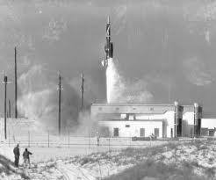
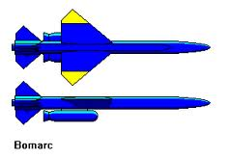
Missile Uproar
In the fall of 1958, Prime Minister John Diefenbaker agreed to accept 56 Bomarc missiles from the United States and deploy them in North Bay, Ontario and La Macaza, Quebec.
Canada soon discovered the type Bomarc missiles it received was designed to hold nuclear warheads. The missiles touched off anti-nuclear protests in the country, although Canada eventually accepted the nuclear warheads on New Year's Eve 1963.

Slide 39
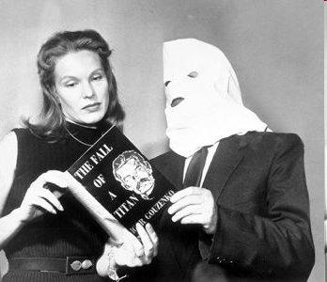
Canadian Spy Scandal
Igor Gouzenko
Canada was thrust into the Cold War world quickly and unexpectedly.
In September 1945, a young Russian named Igor Gouzenko walked into the newsroom of the Ottawa Citizen and announced he had proof of a widespread Soviet spy ring operating in Canada.
Gouzenko was a Russian clerk from Soviet Embassy that wanted to remain in Canada.
Gouzenko and family are given asylum and new IDs in Ontario.

Slide 40
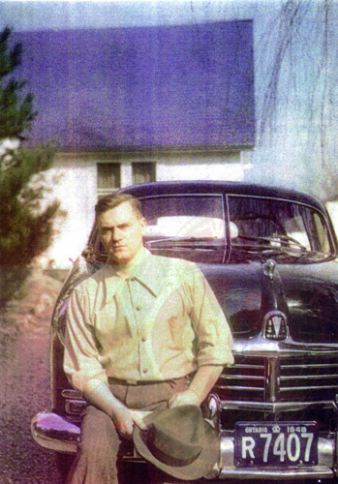
Cold War - The Gouzenko Affair
Newspaper headlines read: “It’s War! It’s Russia!”.
18 people were arrested with 8 eventually convicted of spying - likely trying to get Atomic Bomb secrets.
Gouzenko's allegations were a wake up call for Canada and the rest of the world. The event would cause a chain reaction of anti-Communist sentiments throughout the West.

Slide 41

Cold War - The Red Scare
The Americans, too were afraid of Communism and Communist spies.
Senator Joseph McCarthy lead a witch-hunt which tried to expose spying in America.
Long lists of potential communists were accused and interrogated and eventually found guilty - even if evidence was only a set of flimsy rumours.
The convicted lost their jobs and futures.

Slide 42
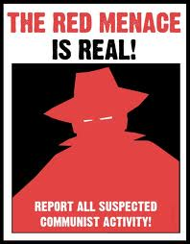
Cold War - Canada’s Red Scare
In Canada, artists, peace activists, union leaders and intellectuals were labelled ‘security risks’ and investigated by a special branch of the RCMP.
Some organizations refused to hire people who had been blacklisted.

Slide 43
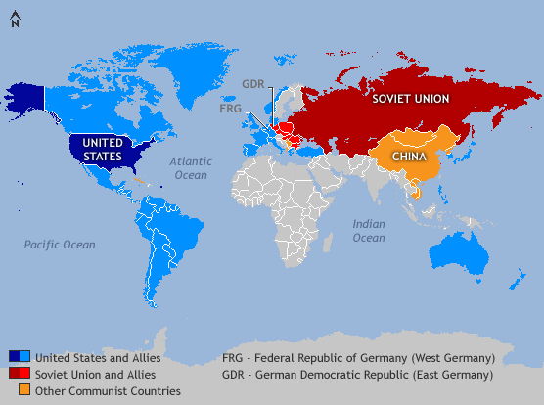
The Cold War World
The U.S.A. and Russia would square off as the world’s superpowers.
As a result of the escalation of nuclear weapons and differing political views, the two nations would confront each other with challenges for control of developing nations.
The superpowers would engage in small scale wars while continually endeavouring to gather secret information through espionage and spy rings.

Slide 44
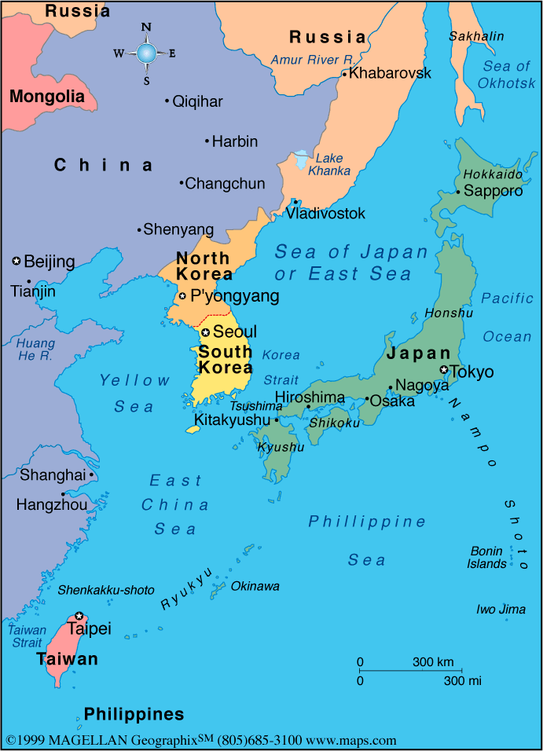
C-War Highlights: Korea (1950-53)
United Nations mission led by the US
Soviet forces attempted
to control the peninsula
After a 3 year battle
between UN troops
and communist forces,
the two sides agreed to
an armistice

Slide 45
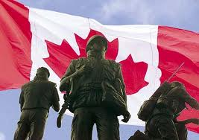
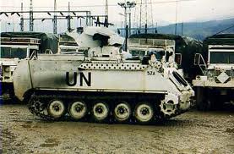
Peacekeeping milestone
In 1956, Egypt seized control of the Suez Canal and soon Britain, France and Israel became embroiled in a conflict with Egypt. The world seemed on the brink of war.
At the United Nations, Canadian Minister of External Affairs Lester B. Pearson proposed deployment of an international peacekeeping force to stabilize the situation while Britain and France withdrew their forces.
Pearson emerged from the Suez Crisis as hero, winning the Nobel Peace Prize for his role in resolving the conflict.
Although Canada made other attempts to have a voice in international matters, for the most part, it was drawn into the American sphere for much of the Cold War.

Slide 46
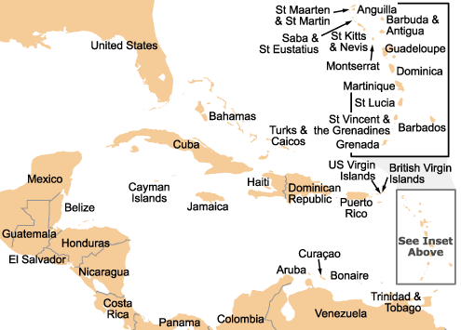
C-War Highlights: Cuba (1959-63)
After Fidel Castro
gained power, Cuba
developed relations
with the USSR
US and USSR used
Brinkmanship during
the Cuban Missile Crisis in 1963
Since then, the US has led a trade embargo against Cuba

Slide 47
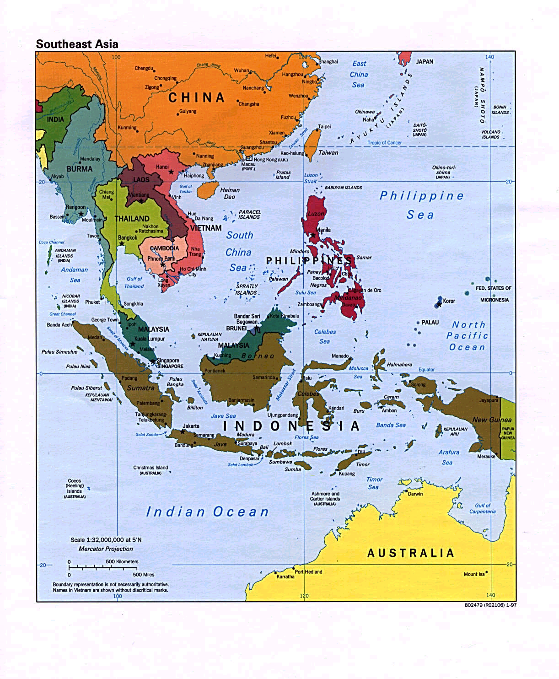
C-War Highlights: Vietnam (1964-73)
After France left Vietnam,
the US and other countries
divided Vietnam in 2 parts
Communist forces ran the
north half, while pro-USA
leaders controlled the south
Vietcong guerrillas attacked
the south and the US sent thousands of troops
After a decade of fighting, the US withdrew

Slide 48
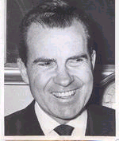

Decline of the bi-polar world
Détente (late 1960s-early 1980s)
  President Nixon established relations with the People’s Republic of China
  USSR leader Brezhnev developed better relations with the USA
The Gorbachev years (1985-1991)
  Realized the USSR’s weaknesses
  Led economic and political reforms
  This resulted in the collapse of the USSR

Slide 49
REVIEW: What were the causes of WW1?
In partners, apply your knowledge of WW1 causes to the Cold War situation
What do you find is similar? different?

Slide 50
Causes of WW1 and Cold War
1.Militarism
  Nuclear Arms Race…even worse
2.Alliances
  NATO and Warsaw Pact
3.Imperialism
  Spheres of influence
4.Nationalism
  Economic system instead of nations?

