Slide 1
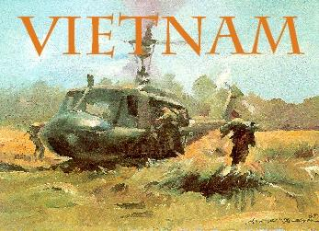

Slide 2
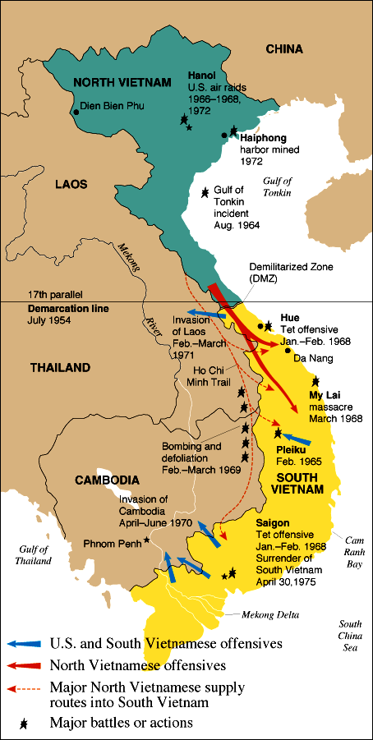
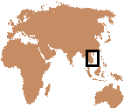
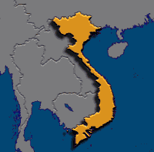
Where is Vietnam?

Slide 3
Why Did the United States Fight a War in Vietnam?
Basically to hold the line against the spread of world Communism. America paid for the war the French fought against Communist Vietnam as a part of the Truman Doctrine (1947) “to help free peoples to maintain their free institutions and their national integrity against … totalitarian regimes.” In the 1950’s, America became involved again.

Slide 4
Longest and Most Unpopular War
The Vietnam War was the longest and most unpopular war in American history. During the war:
58,000 Americans lost their lives.
The oldest man killed was 62 years old; the youngest, 16.
61% of the men killed were 21 or younger.
304,000 were wounded.
75,000 were severely disabled.
The United States spent over $200 billion dollars on the war.

Slide 5
Conflict Between France & Vietnam
The Vietnam War grew out of the long conflict between France and Vietnam.
In July 1954, after one hundred years of colonial rule, a defeated France was forced to leave Vietnam.
Nationalist forces under the direction of General Vo Nguyen Giap defeated the allied French troops at the remote mountain outpost of Dien Bien Phu in the northwest corner of Vietnam.

Slide 6
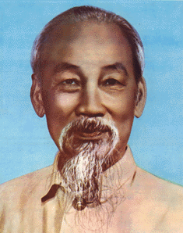
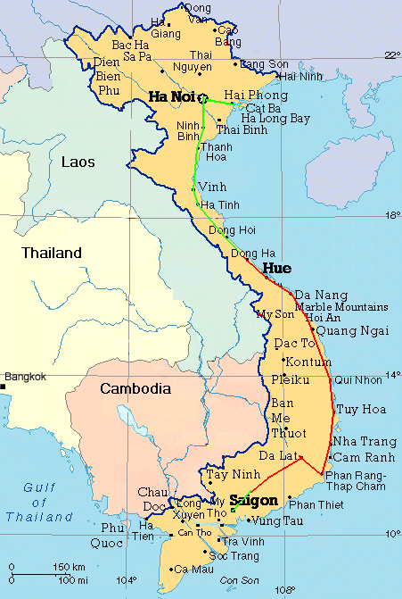
The Geneva Peace Accords
The Geneva Peace Accords, signed by France and Vietnam in the summer of 1954, provided for the temporary partition of Vietnam at the 17th parallel, with national elections in 1956 to reunify the country.
In the North, a communist regime, supported by the Soviet Union and the People's Republic of China, set up its headquarters in Hanoi under the leadership of Ho Chi Minh.

Slide 7
Opposition to Geneva Accords
The United States prevented the elections that were promised under the Geneva conference because it knew that the Communists would win.
Secretary of State John Foster Dulles thought the Geneva Accords granted too much power to the Communist Party of Vietnam.
He and President Dwight D. Eisenhower supported the creation of a counter-revolutionary alternative south of the 17th parallel.
This was accomplished through formation of the Southeast Asia Treaty Organization (SEATO).

Slide 8
A New Nation in the South
Using SEATO for political cover, the Eisenhower administration helped create a new nation in southern Vietnam.
In 1955, with the help of massive amounts of American military, political, and economic aid, the government of the Republic of Vietnam (South Vietnam) was born.
The following year, Ngo Dinh Diem, a staunchly anti-Communist figure from the South, won a dubious election that made him president of South Vietnam

Slide 9
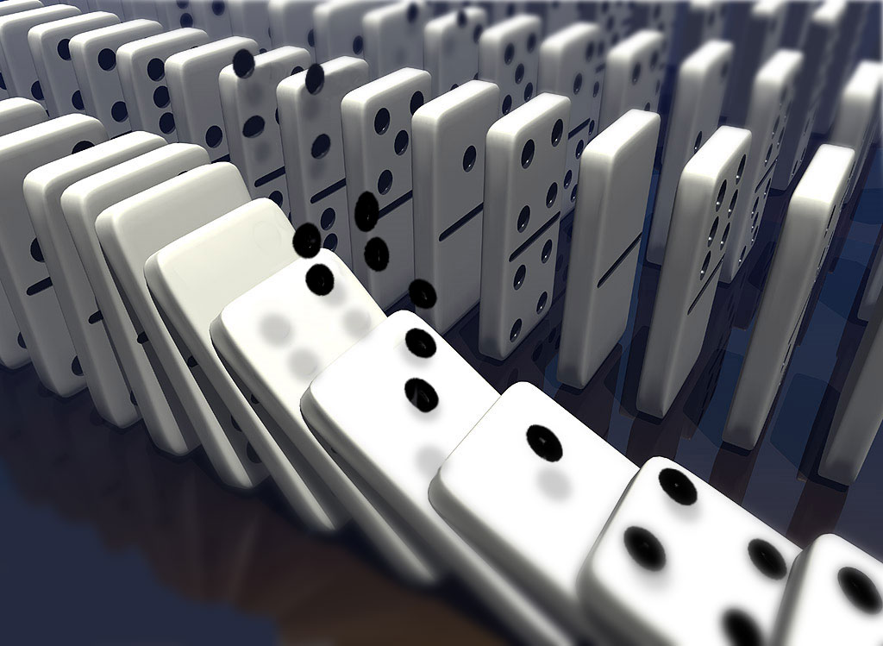
The Domino Theory
American policymakers developed the “Domino Theory” as a justification for the involvement. This theory stated, “If South Vietnam falls to the Communist, Laos, Cambodia, Thailand, Burma, India and Pakistan would also fall like dominos. The Pacific Islands and even Australia could be at risk”.

Slide 10
South Vietnam Under Diem
Diem claimed that his newly created government was under attack from Communists in the north.
In late 1957, with American military aid, Diem began to counterattack.
He used the help of the CIA (through Operation Phoenix) to identify those who sought to bring his government down and arrested thousands.
He passed a repressive series of acts known as Law 10/59 that made it legal to hold suspected Communists in jail without bringing formal charges.

Slide 11
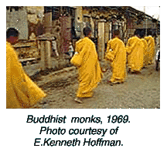
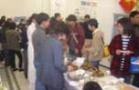
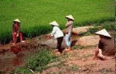
Opposition to Diem
The outcry against Diem's harsh and oppressive actions was immediate.
Buddhist monks and nuns were joined by students, business people, intellectuals, and peasants in opposition to Diem’s corrupt rule.
The more these forces attacked Diem's troops and secret police, the more Diem complained that the Communists were trying to take South Vietnam by force. This was "a hostile act of aggression by North Vietnam against peace-loving and democratic South Vietnam."

Slide 12
The National Liberation Front
The Communists supported the creation of a broad-based united front to help mobilize southerners in opposition to the government in South Vietnam.
On December 20, 1960, the National Liberation Front (NLF) was born.
It brought together Communists and non-Communists in an umbrella organization that had limited, but important goals
Anyone could join as long as they opposed Ngo Dinh Diem and wanted to unify Vietnam.

Slide 13
Washington White Papers
In a series of government "White Papers," Washington insiders denounced the NLF, claiming that it was merely a puppet of Hanoi. They called it the "Viet Cong," a derogatory and slang term meaning Vietnamese Communist.
The NLF, on the other hand, argued that it was autonomous and independent of the Communists in Hanoi and that it was made up mostly of non-Communists. Many anti-war activists supported the NLF's claims.

Slide 14
December 1961 White Paper
In 1961, President Kennedy sent a team to Vietnam to report on conditions in the South and to assess future American aid requirements.
The report, known as the "December 1961 White Paper," argued for:
An increase in military, technical, and economic aid
The introduction of large-scale American "advisers" to help stabilize the Diem regime and crush the NLF.

Slide 15
The Kennedy Response
As Kennedy weighed the merits of these recommendations, some of his other advisers urged the president to withdraw from Vietnam altogether.
In typical Kennedy fashion, the president chose a middle route.
Instead of a large-scale military buildup or a negotiated settlement, the United States would increase the level of its military involvement in South Vietnam through more machinery and advisers, but no military troops.

Slide 16
The Strategic Hamlet Program
To counteract the NLF's success in the countryside, Washington and Saigon launched an ambitious military effort in the rural areas.
Called the Strategic Hamlet Program, the new counterinsurgency plan rounded up villagers and placed them in "safe hamlets" controlled by the government of South Vietnam.
The idea was to isolate the NLF from villagers, its base of support

Slide 17
NFL Successes
This culturally-insensitive plan further alienated the peasants from the Saigon regime and produced more recruits for the NLF.
By the summer of 1963, because of NLF successes and its own failures, it was clear that the government of South Vietnam was on the verge of political collapse.

Slide 18
Buddhist Self-Immolations
Diem's brother, Ngo Dinh Nhu, had raided the Buddhist pagodas of South Vietnam, claiming that they had harbored the Communists that were creating the political instability.
The result was massive protests on the streets of Saigon that led Buddhist monks to self-immolation.
The pictures of the monks engulfed in flames made world headlines and caused considerable consternation in Washington.

Slide 19
Military Coup
By late September, the Buddhist protest had created such disloca- tion in the south that the Kennedy administration supported a coup.
In 1963, some of Diem's own generals approached the American Embassy in Saigon with plans to overthrow Diem.
With Washington's tacit approval, Diem and his brother were captured and later killed.
Three weeks later, President Kennedy was assassinated on the streets of Dallas.

Slide 20
Escalation of the Conflict
At the time of the Kennedy and Diem assassinations, there were 16,000 military advisers in Vietnam.
The Kennedy administration had managed to run the war from Washington without the large-scale introduction of American combat troops.
The continuing political problems in Saigon, however, convinced the new president, Lyndon Baines Johnson, that more aggressive action was needed.
After a dubious North Vietnamese raid on two U.S. ships in the Gulf of Tonkin, the Johnson administration argued for expansive war powers for the president.

Slide 21
Attack on American Ships
In August 1964, in response to American and South Vietnamese espionage along its coast, North Vietnam launched an attack against the C. Turner Joy and the U.S.S. Maddox, two American ships on call in the Gulf of Tonkin.
The first attack occurred on August 2, 1964.
A second attack was supposed to have taken place on August 4, but authorities have recently concluded that no second attack ever took place.

Slide 22
The Gulf of Tonkin Resolution
The Johnson administration used the August 4 attack to obtain a Congressional resolution, now known as the Gulf of Tonkin Resolution, that gave the president broad war powers.
The Resolution was followed by limited reprisal air attacks against North Vietnam.

Slide 23
Operation Rolling Thunder
In early 1965, the NLF attacked two U.S. army installations in South Vietnam, and as a result, Johnson ordered sustained bombing missions over North Vietnam.
The bombing missions, known as “Operation Rolling Thunder,” caused the Communist Party to reassess its own war strategy

Slide 24
Phosphorous & Napalm Bombs
“Operation Rolling Thunder” was backed up by phosphorous and napalm bombs – the latter causing dreadful burns to thousand of innocent civilians.

Slide 25
Operation Ranch Hand
When this failed to break down the jungle cover the USAF started “Operation Ranch Hand” – the defoliation program, using Agent Orange.
This deadly chemical cocktail, containing dioxin, killed off millions of acres of jungle to try to weaken the Vietcong – but left a horrendous legacy in Vietnam.
The dioxin got into the food chain causing chromosome damage to humans. There were hundreds of cases of children born with deformities.

Slide 26
Helicopters
Of all aircraft, the helicopter was the most useful, dropping platoons in the jungle clearings and out again. They were excellent air ambulances.

Slide 27
How did the North Vietnamese Fight Back Against the U.S. Invaders?
The North Vietnamese used classic Maoist guerrilla tactics. “Guerrillas must move through the peasants like fish through sea,” i.e., the peasants will support them as much as they can with shelter, food, weapons, storage, intelligence, recruits.

Slide 28
North Vietnamese Tactics
In areas held by the NLF, the Communists distributed the land to the peasants. (By 1973, the NLF held about half of South Vietnam.)
Their weapons were cheap and reliable.
The AK47 assault rifle out-performed the American M16
The portable rocket launcher took out many US vehicles & aircraft.
They recycled dud bombs dropped by the Americans. Deadly booby-traps could inflict huge damage on young American conscripts!

Slide 29
Tunnel Complexes
The Vietnamese built large tunnel complexes such as the ones at Cu Chi near Saigon. This protected them from the bombing raids by the Americans and gave them cover for attacking the invaders.

Slide 30
Search & Destroy Tactics
The United States countered with “Search and Destroy” tactics. In areas where the NLF were thought to be operating, troops went in and checked for weapons. If they found them,
they rounded up the villagers and burned the villages down.
This often alienated the peasants from the American/South Vietnamese cause.
As one marine said – “If they weren’t Vietcong before we got there, they sure as hell were by the time we left”.
The NFL often helped the villager’s re-build their homes and bury their dead.

Slide 31
Protracted War Strategy
After “Operation Rolling Thunder,” the Communist Party moved to a protracted war strategy: the idea was to get the United States bogged down in a war that it could not win militarily and create unfavorable conditions for political victory.

Slide 32
The War in America
The Vietnam War had a major impact on everyday life in America, and the Johnson administration was forced to consider domestic consequences of its decisions daily.
Since there were not enough volunteers to continue to fight a protracted war, the government instituted a draft.

Slide 33
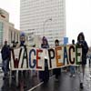
Anti-War Sentiments
As the deaths mounted and Americans continued to leave for Southeast Asia, the Johnson administration was met with the full weight of American anti-war sentiments.

Slide 34
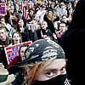
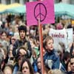
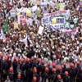
Anti-War Protests
Protests erupted on college campuses and in major cities at first, but by 1968 every corner of the country seemed to have felt the war's impact.

Slide 35
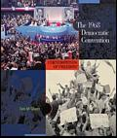
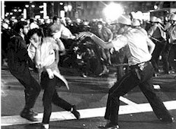
1968 Democratic Convention
One of the most famous incidents in the anti-war movement was the police riot in Chicago during the 1968 Democratic National Convention.
Hundreds of thousands of people came to Chicago in August 1968 to protest American intervention in Vietnam and the leaders of the Democratic Party who continued to prosecute the war.

Slide 36
The Tet Offensive
By 1968, things had gone from bad to worse for the Johnson administration. In late January, North Vietnam and the NLF launched coordinated attacks against major southern cities.
These attacks, known as the Tet Offensive, were designed to force the Johnson administration to the bargaining table.

Slide 37
The My Lai Massacre
A serious blow to U.S. credibility came with the exposure of the My Lai massacre (March 1968).
Hushed up at the time and only discovered by a tenacious journalist, this involved the killing of 400 men, women and children by US troops.

Slide 38
A Secret Plan to End the War
In late March 1968, a disgraced Lyndon Johnson announced that he would not seek the Democratic Party's re-nomination for president and hinted that he would go to the bargaining table with the Communists to end the war.
Negotiations began in the spring of 1968, but the Democratic Party could not rescue the presidency from Republican challenger Richard Nixon who claimed he had a secret plan to end the war.

Slide 39
Vietnamization
Nixon's secret plan involved a process called “Vietnamization.” This strategy brought American troops home while increasing the air war over North Vietnam and relying more on the South Vietnamese army for ground attacks.

Slide 40
Expansion to Laos & Cambodia
The Nixon years also saw the expansion of the war into neighboring Laos and Cambodia, violating the international rights of these countries in secret campaigns, as the White House tried desperately to rout out Communist sanctuaries and supply routes.

Slide 41
Campus Protests & Shootings
The intense bombing campaigns and intervention in Cambodia in late April 1970 sparked intense campus protests all across America.

Slide 42
Kent State
At Kent State in Ohio, four students were killed by National Guardsmen who were called out to preserve order on campus after days of anti-Nixon protest.

Slide 43
Jackson State
Shock waves crossed the nation as students at Jackson State in Mississippi were also shot and killed for political reasons, prompting one mother to cry, "They are killing our babies in Vietnam and in our own backyard."

Slide 44
The Christmas Bombings
In December 1972, the Nixon administration unleashed a series of deadly bombing raids against targets in North Vietnam’s largest cities, Hanoi and Haiphong.
These attacks, now known as the Christmas bombings, brought immediate condemnation from the international community and forced the Nixon administration to reconsider its tactics and negotiation strategy.

Slide 45
The Paris Peace Agreement
In early January 1973, the Nixon White House convinced Saigon that they would not abandon the South Vietnamese army if they signed the peace accord.
On January 23, therefore, the final draft was initialed, ending open hostilities between the United States and North Vietnam.
The Paris Peace Agreement did not end the conflict in Vietnam, however, as Saigon continued to battle Communist forces.

Slide 46
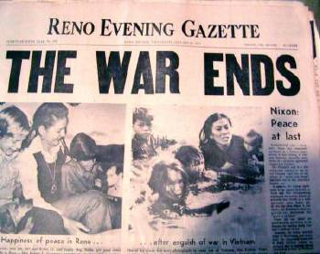

Slide 47
The Fall to Communism
From March 1973 until the fall of Saigon on April 30, 1975, the South Vietnamese army tried desperately to save the South from political and military collapse.
The end finally came when North Vietnamese tanks rolled south along National Highway One.
On the morning of April 30, Communist forces captured the presidential palace in Saigon, ending the Vietnam War.

Slide 48
Why Did the United States Lose the Vietnam War?
They underestimated the tenacity and organization of the North Vietnamese and the National Liberation Front.

Slide 49
Despite dropping more tonnage of high explosive on Vietnam than the whole of World War II, the Americans could not stop the movement of troops or supplies to the south along the Ho Chi Minh Trail.

Slide 50
The North Vietnamese conducted a “Peoples war” in which everyone played a part.

Slide 51
At first, most Americans supported the war. But by 1970, the Peace Movement had support from all parts of society and no government could ignore it.

Slide 52
After 1969, there were deep questions about the efficiency of US troops. There was a serious drug problem; desertion rates were high and morale low. Many troops were “time-servers,” i.e., counted the days until the tour was over.

Slide 53
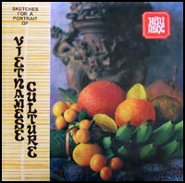
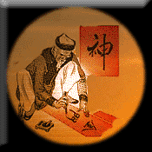
The US never really understood the culture of the Vietnamese people. Coca Cola, chewing gum, ball point pens, and ice cream cones could not dislodge their ancient beliefs.

Slide 54
America was not prepared to keep losing high numbers of casualties for such limited progress in a difficult jungle war, for which they were not suited.

Slide 55
The strength and resourcefulness of the NLF. For example, the highly complex Cu Chi tunnel system the U.S. never shut down.

Slide 56
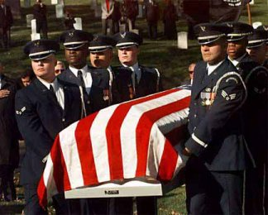

Slide 57
Sources
Battlefield Vietnam: A Brief History http://www.pbs.org/battlefieldvietnam/history/index.html
Vietnam Revision Guide http://www.learnhistory.org.uk/vietnam/ustactics.htm

