Slide 1
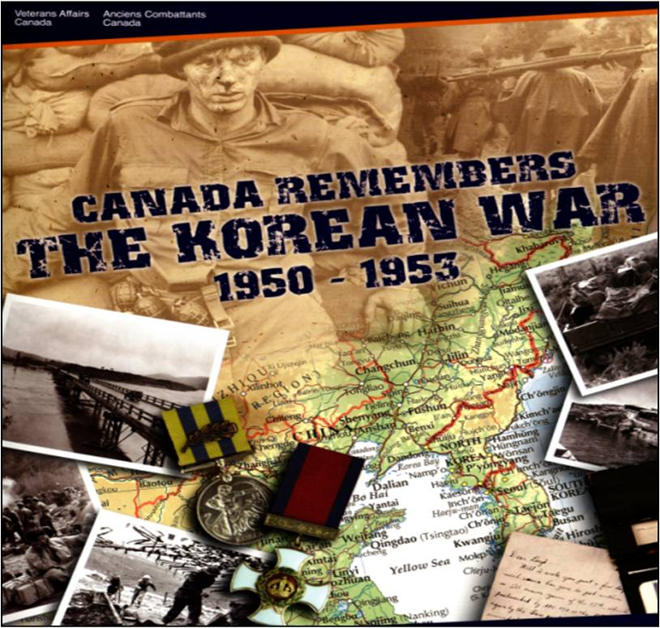
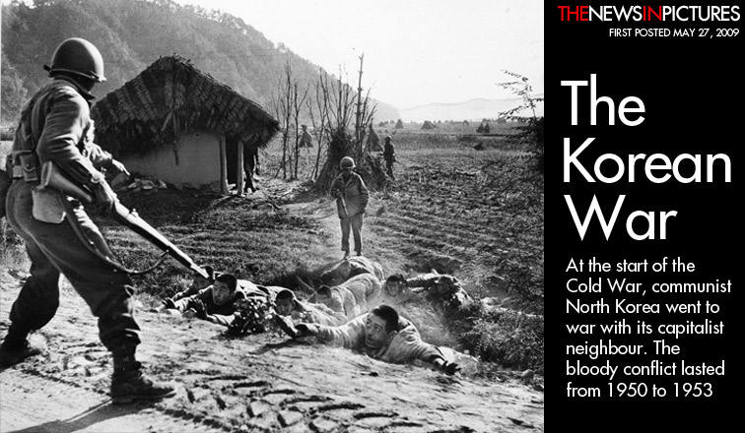
The Korean War
And
The Suez Crisis
Topics:
Canada’s role during the
Korean War and Suez Crisis
Lester Pearson
Nobel Peace Prize
The Role of the UN

Slide 2
North Korea Invades South Korea…
In 1950, Communist North Korea, supported by Communist China invaded South Korea.
The US supported South Korea against this Communist aggression.
Under American influence the Security Council of the United Nations condemned the attack by North Korea and called on UN members “to render every assistance” to South Korea.

Slide 3
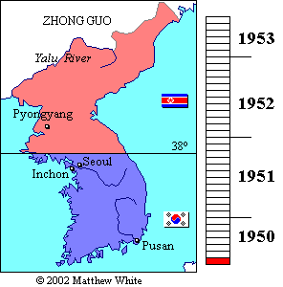
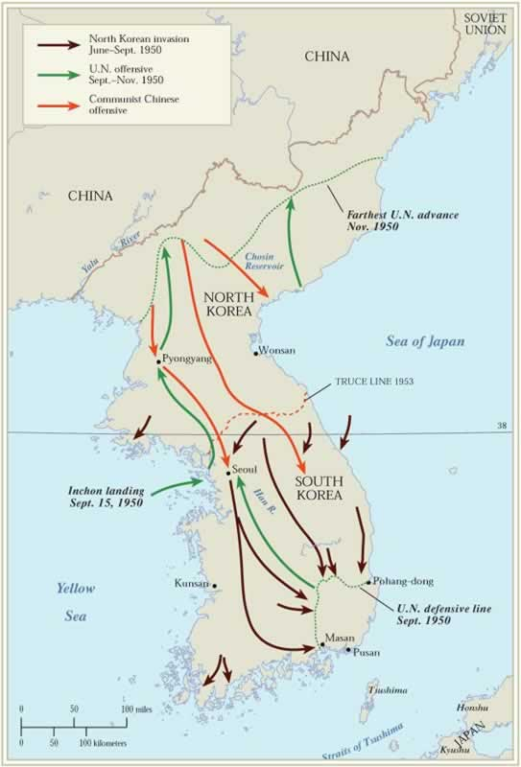

Slide 4
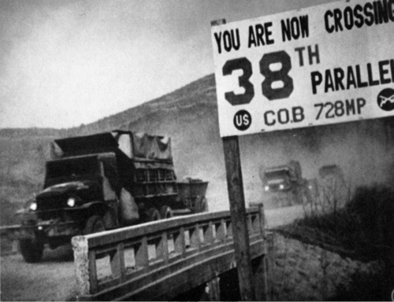
Canada ranked third in total aid to South Korea.
However, when the Korean War broke out between North and South Korea, Canada needed several months to bring its military forces up to strength.
Canada served in this UN police Action in Korea.
Canada had shown that it believed in and supported the goals of the UN and was willing to fight to support these goals.
Canada’s Role…

Slide 5

The Forgotten War
Canada sent over 25,000 troops to fight in Korea.
There were 1,558 Canadian casualties including 516 dead.
Korea has often been described at “The Forgotten War” because most Canadians are not as familiar with the history of the war as the Canadian contributions in two world wars.

Slide 6
The Korean War 1950-1953
At first UN troops fought only North Korea (who were armed by the Soviets.
The UN forces had to fight a massive Chinese army that entered the war to support the North Koreans.
However, neither side was able to defeat one another.
The war, much like the first World War, settled into a war of limited movement.
When the war ended the Koreans were divided in much the same way they had been before the war.

Slide 7
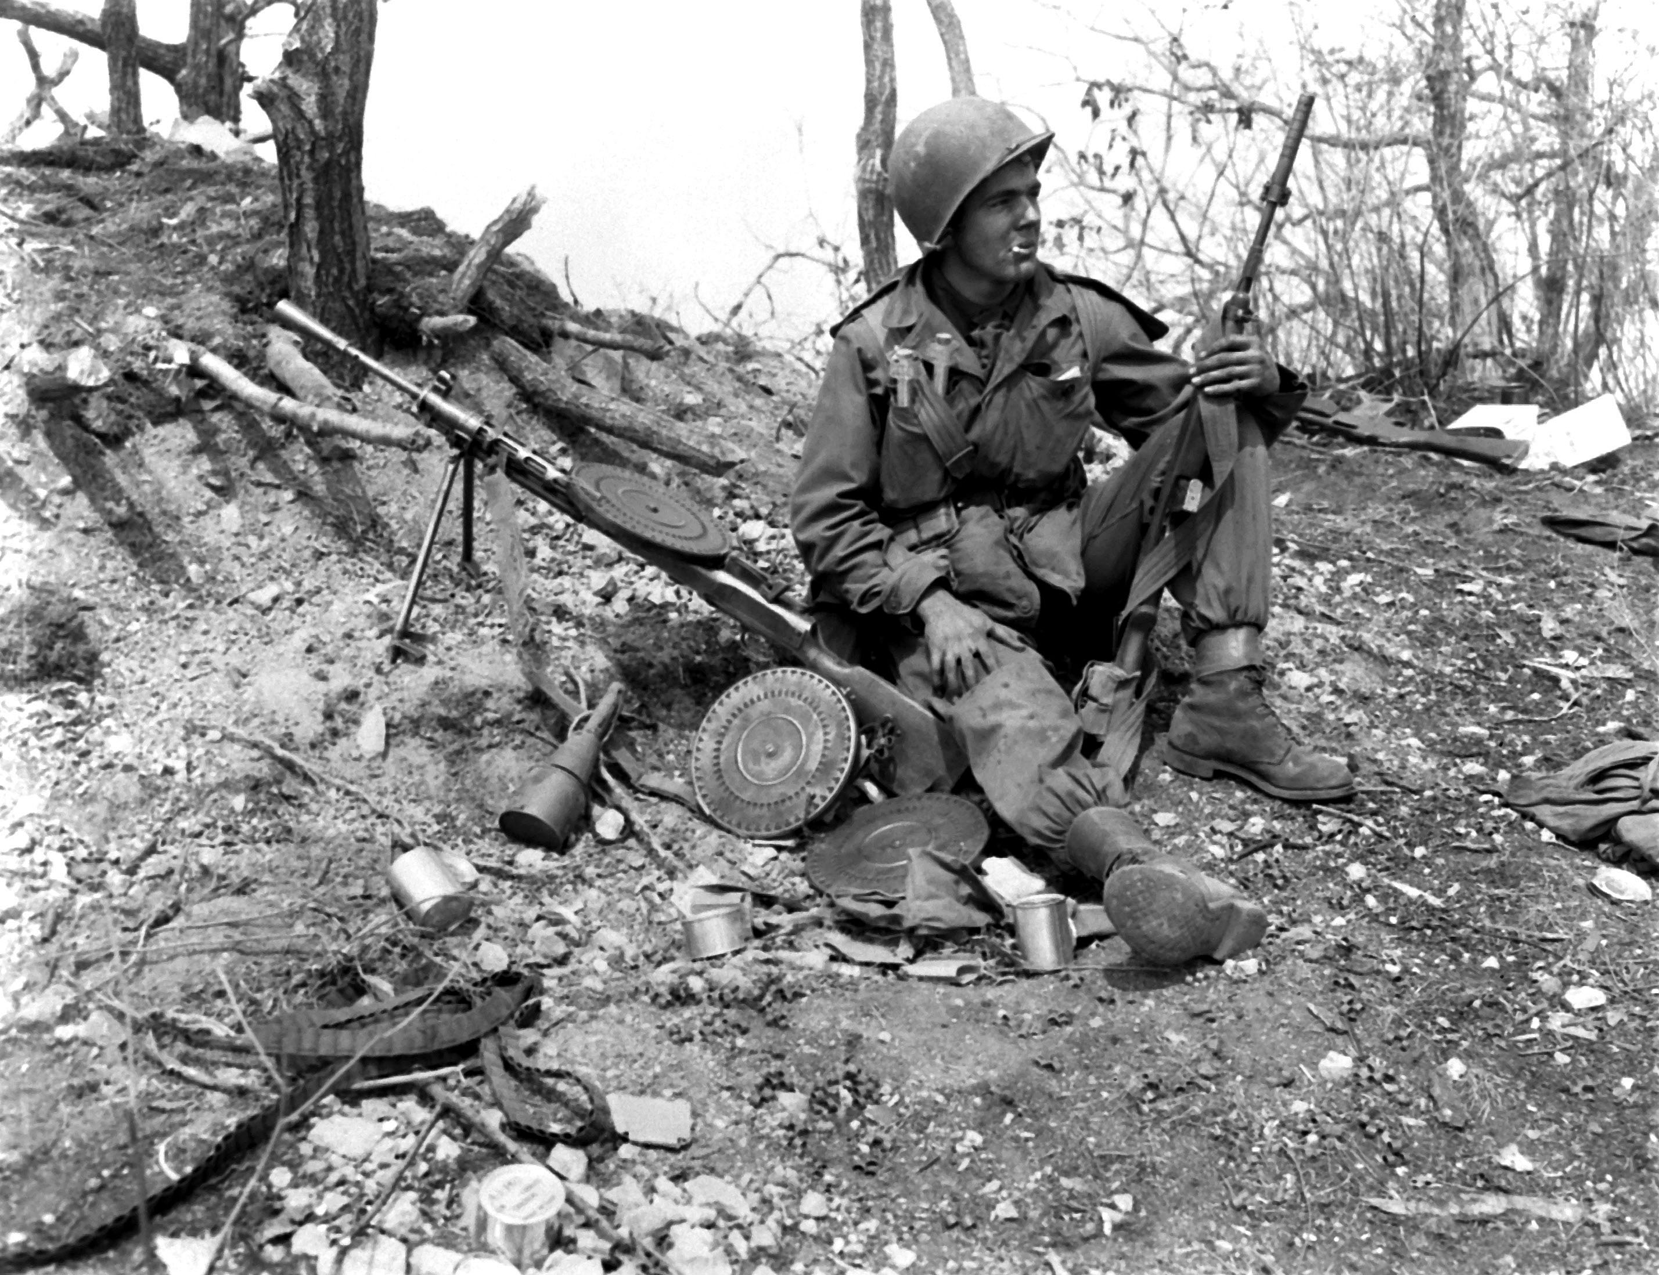

Slide 8
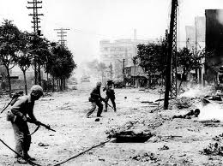
Aftermath…
Canadian troops were asked to stay in Korea until 1955 to help maintain the uneasy truce.
Through this collective war effort the UN ensured the independence of South Korea.

Slide 9
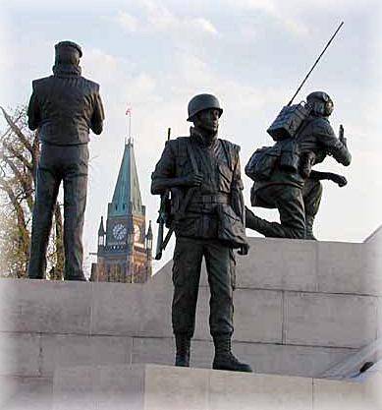
The Suez Crisis:
A Canadian Success
In 1956, a crisis occurred in the Middle East when President Nasser of Egypt seized control of the Suez Canal from a British/French company.
The Suez canal was an important waterway connecting the Mediterranean and the Red Sea to the Indian ocean.

Slide 10
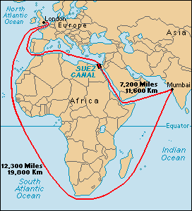
The Suez is the busiest inter-ocean waterway in the world.
Tankers carrying petroleum products accounted for about 70 percent of the total tonnage.
However, when President Nasser of Egypt decided to take control of the canal; this act meant a crucial loss for the French and British owners.

Slide 11
Tensions Increase
Israel forces supported by French and English troops, agreed to attack Egypt in order to capture the canal. The United States also supported Israel which in turn caused the Soviet Union to react.
In response to this attack, the Soviet Union supported the countries of Iraq, Syria, and Egypt.
When the Soviet Union declared its support for Egypt, the world was once again faced with the possibility of a major war.
Colonel Abdel Nasser

Slide 12
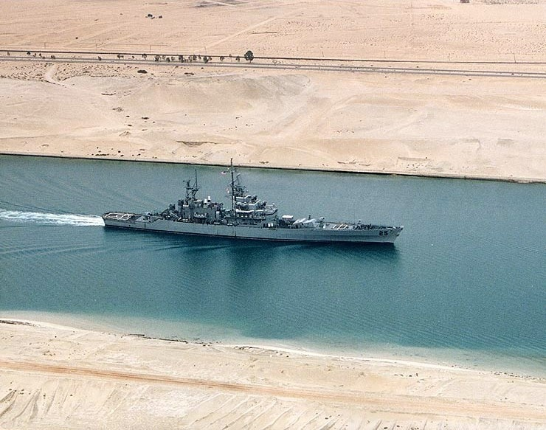

Slide 13
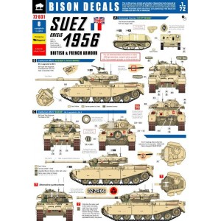
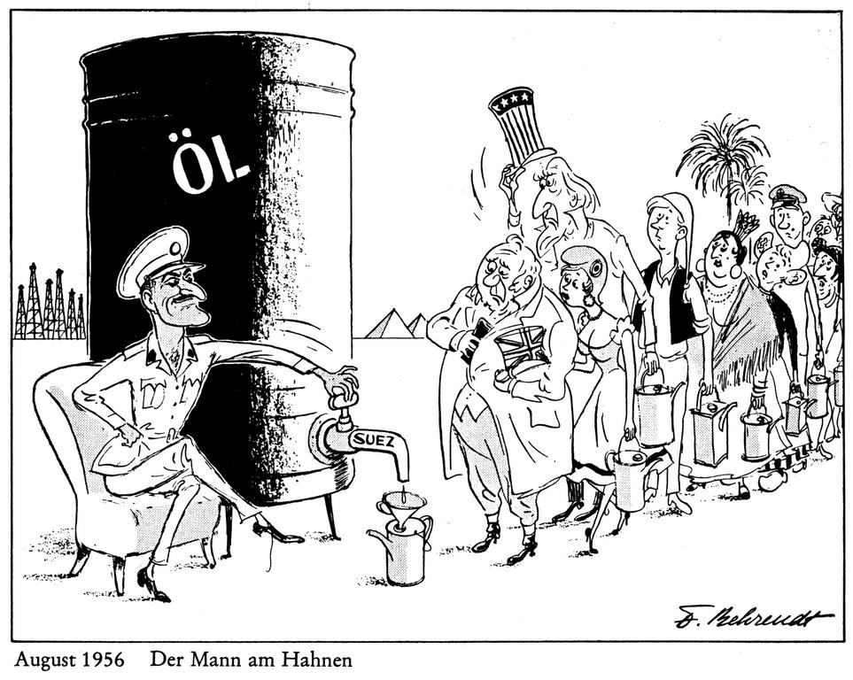

Slide 14
Lester Pearson
Lester Pearson was Canada’s Secretary of State for External Affairs and very opposed to the British and French decision to go to war in Egypt.
He believed that the United Nation’s motion for a cease-fire was inadequate and proposed that an international United Nations force be sent to the region.

Slide 15
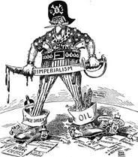
Lester Pearson
Lester Pearson came up with a strategic plan.
Lester called an all night emergency meeting.
At this meeting it was decided that a special UN peacekeeping force would patrol the border areas.

Slide 16
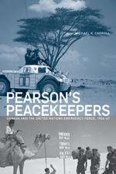
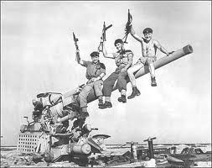
Pearson suggested forming a United Nations Emergency Force (UNEF) that would take up positions between combatants, keeping them apart while a settlement was worked out.

Slide 17
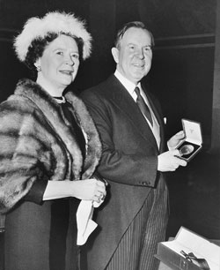
Canada’s Role
Canada sent over 800 soldiers and the UNEF force grew to about 6000.
Lester Pearson was awarded the Noble Peace Prize in 1957 for his resolution of the Suez Crisis.
This was a great honour for Canada.

Slide 18

Pearson Becomes PM!
Lester Pearson became the PM of Canada in 1963.
Pearson’s values were based on three principals:
Ignorance creates fear and fear is an enemy of peace.
Hunger and poverty are danger to peace.
Human begins make effort to prepare for war, yet they prepare for peace very poorly.

Slide 19
Canada’s Importance as a Peace Keeping Nation
Since 1956 Canada has continued to contribute small numbers of troops to various parts of the world where problems have been experienced.
These included Lebanon - 1958, Cyprus – 1964, and

Slide 20
Canadian Peacekeeping
Traditionally, peacekeepers supervise cease-fires and observe the movements of the opposing forces in an attempt to bring calm to an area and to facilitate a negotiated settlement to disputes.
Peacekeepers seldom have the capability to enforce the terms of a cease-fire or agreement.
The peacekeepers’ main powers are the moral authority of the UN and the legitimacy awarded by the support of the international community.
The success of a peacekeeping mission depends on the cooperation of the parties in conflict. A peacekeeping mandate does not include imposing a ‘solution’ on unwilling parties.

Slide 21
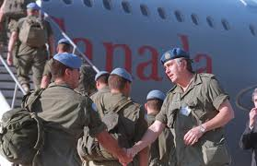
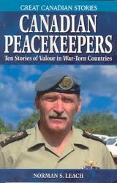
Evolution of Peacekeeping
The peacekeepers’ responsibilities now include such elements as disarming military forces, providing security to the population, organizing elections, forestalling conflicts, encouraging peace settlements, training and leading local de-mining teams, protecting humanitarian aid convoys, and performing civil functions.
The evolution of peacekeeping has led to numerous debates concerning the use of peacekeeping and peace building as tools to deal with conflicts in the international community.

Slide 22
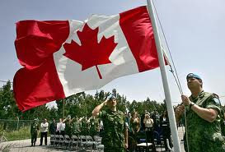
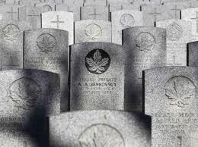
Canada as Leader in UN Peacekeeping
Canada has always been a strong supporter of the United Nations and of peacekeeping, and has participated in almost every mission since its inception.
The Canadian Forces are recognized worldwide as being among the finest peacekeepers.

Slide 23
Important Canadians at the UN related to Peacekeeping
Lester B. Pearson – Nobel Peace Prize, Suez 1956
Maj. Gen. (ret’d) Lewis MacKenzie – Chief of Staff for the United Nations Protection Force in Yugoslavia (UNPROFOR) in 1992.
General Maurice Baril – Senior military advisor to UNSG Boutros-Boutros Gali and head of the Military Division of the UN DPKO from 1992 to 1997.
Lt. Gen. Roméo Dallaire – Commander of the UN Observer Mission Uganda-Rwanda (UNOMUR) and the UN Assistance Mission for Rwanda (UNAMIR) between 1993 and 1994.
Justice Louise Arbour – Chief Prosecutor of War Crimes before the International Criminal Tribunal for the former Yugoslavia and Rwanda from 1996 to 1999, now UN High Commissioner for Human Rights.
Louise Fréchette – Former Canadian Permanent Representative to the UN, first Deputy SG of the UN from 1997 to 2005.
Carolyn McAskie – Head of Peacebuilding Commission since May 2006.
Brig. Gen. (ret’d) Gregory Mitchell – Former Commander of the multinational Stand-by High-Readiness Brigade (SHIRBRIG) in Sudan and Deputy Force Commander for the United Nations Mission in Sudan (UNMIS) between 2004 and 2006.

Slide 24
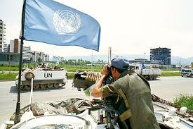
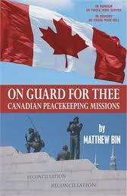
Contributing to a better World
While the Canadian Forces have played a leading role in international peacekeeping, many Canadian civilians have also made significant contributions.
Politicians and diplomats, for example, have been active in negotiating peace in a number of countries.

Slide 25
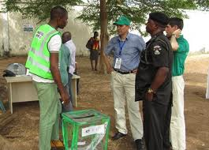
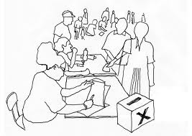
Policing Functions
Members of the Royal Canadian Mounted Police and other Canadian police forces have performed policing functions in countries including the former Yugoslavia and Haiti, helping to improve the stability in those countries.
Canadian police have also provided training for police forces, encouraging respect for human rights in the administration of justice and closer ties between the officers and the community.
Other Canadian civilians have played an important role in extending democracy around the world by preparing and monitoring elections in countries like Cambodia, El Salvador, and Angola.

Slide 26
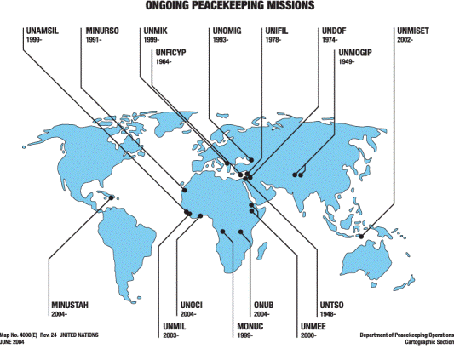
An Uncertain Future...
This ranks Canada 55thout of 108 troop contributing countries.
Canada’s financial contribution to the UN peacekeeping budget is minimal.
Canada contributed 3% of the 2006 assessed contributions to UN Peacekeeping Budget of about $4.75 billion.

Slide 27
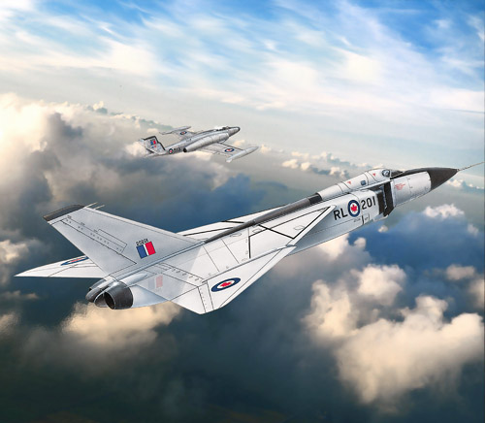
The AVRO Arrow

Slide 28
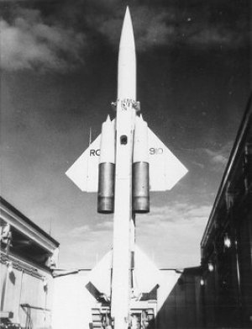
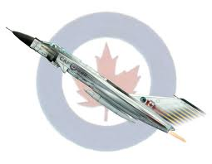
AVRO ARROW (1953)
Designed in Malton, Ontario by Avro Aircraft Limited (Canada), the Avro Arrow was an advanced technological and aerodynamic accomplishment.
Avro Arrow was the answer to the cold war Soviet bomber plane threat as it could travel Mach 2 (supersonic speeds – 2000+ km/h) and act as a primary interceptor.

Slide 29
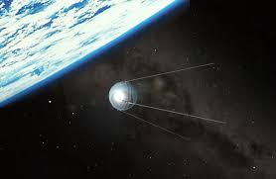
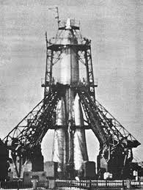
Sputnik
1957 the Soviets launch a satellite and they are now in space
The rocket that put it there could deliver at here could deliver a nuclear warhead so the interceptor jets (like the Avro Arrow) became useless
So both sides developed Intercontinental Ballistic Missiles (ICBMs)

Slide 30
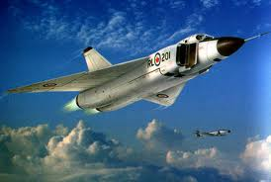
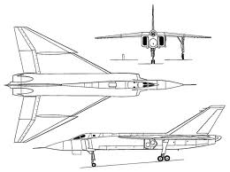
John Diefenbaker (Conservative)
Becomes new Prime Minister in 1957 Minister in 1957
Allows the project go on for another two years

Slide 31
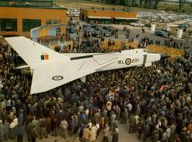
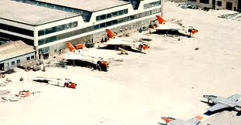
Scrapping the Arrow
In 1959 the was deemed No one wanted to buy it
It was no longer useful after
Sputnik showed they could deliver warheads by rocket
Canada purchase American BOMARC missiles BOMARC missiles

Slide 32
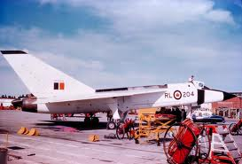
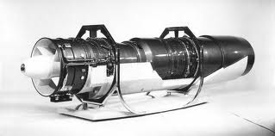
The ‘Brain Drain’ Begins…
After much debate, the Arrow was cancelled on February 20th, 1959. To that point it had cost over $300M.
It was thought that the NORAD and Bombarc missile system would replace the need for a fighter plane.
Over 15,000 people were out of work and both the US and Britain turned down the Canadian offer to buy the Arrow.

Slide 33
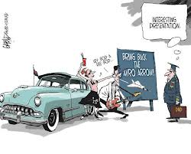
So...
This act creates a lasting feeling that America had taken over Canada America had taken over Canada
Resulted in the loss of thousands of jobs
Many high skilled workers went to work in the USA and NASA
The loss of the Avro Arrow has become the topic of great debate and myth making
It is ironic that most of the world’s minor conflicts since then have utilized jet fighters almost exclusively.

Slide 34
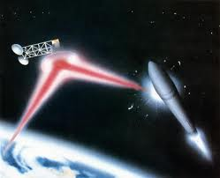
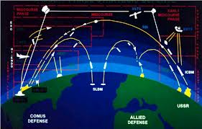
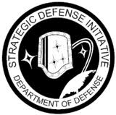
Strategic Defence Initiative (SDI)
Nicknamed ‘Star Wars’
US President Ronald began in1984
Lasers to destroy
Lasers to destroy ICBMs
Canada is asked to help

Slide 35
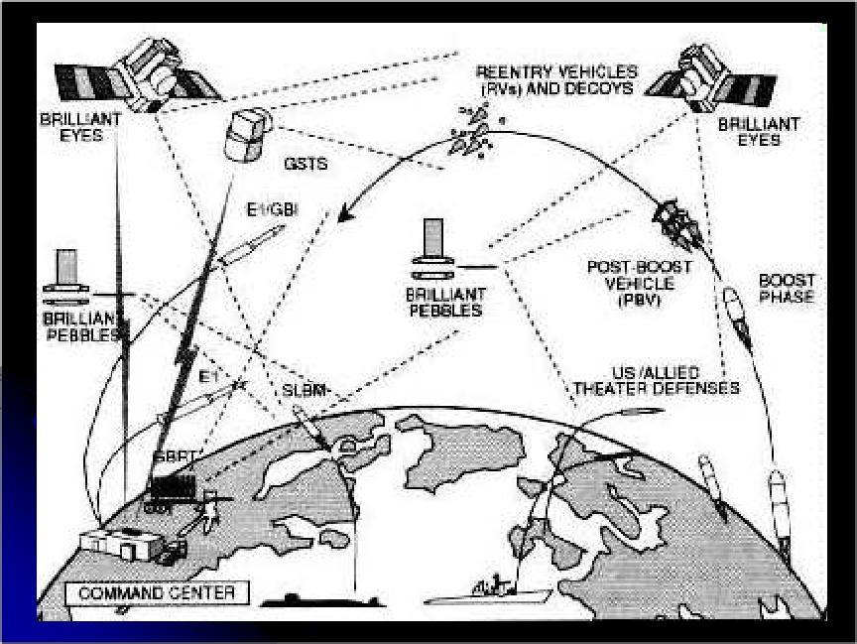

Slide 36
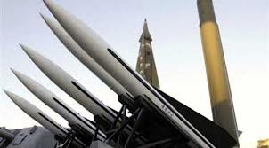
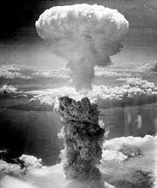
The Nuclear Issue in Canada
In the 1960’s tensions existed between the presidents of the U.S.A. and Canadian prime ministers, probably a result of a lack of total commitment by Canada to U.S. defence efforts.
Both Prime Ministers Diefenbaker and Pearson would have confrontations with Presidents Kennedy and Johnson.
Canada was hesitant during the Cuban missile crisis and Pearson was hesitant to allow nuclear warheads on American missiles on Canadian soil.

