Slide 1
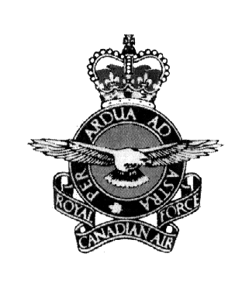
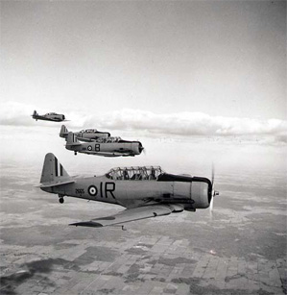
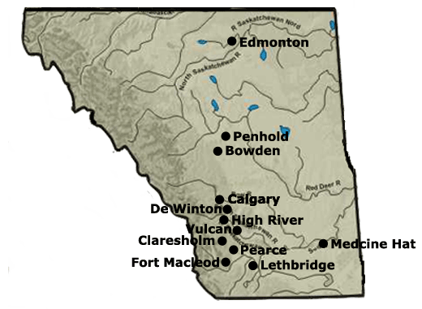
British Commonwealth
Air Training Plan (BCATP)
British Instructors would train pilots and other flight personnel from all over the Commonwealth in Canada

Slide 2
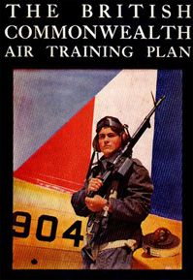
BCATP
Between 1940 and 1945, Canada would train 137,000 aircrew, more than England and all the rest of the Commonwealth combined.
*90,000 were Canadian

Slide 3
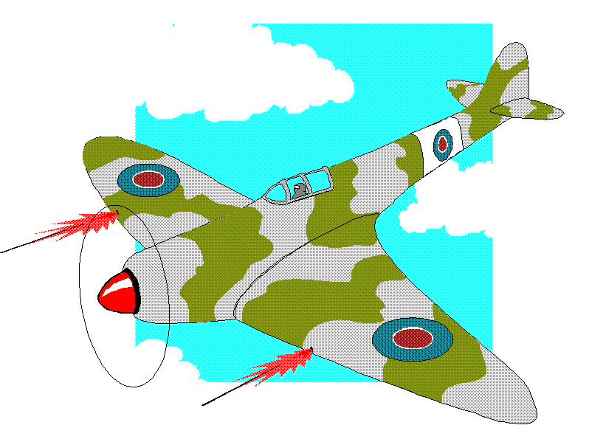
The Royal Canadian
Air Force
Many Canadians served with Britain’s Royal Air Force.
The RCAF expanded from one squadron of fighters during the Battle of Britain to forty-eight squadrons and and a bomber group serving overseas.
Nearly 250,000 Canadians saw service in the RCAF and 17,000 aircrew lost their lives.

Slide 4
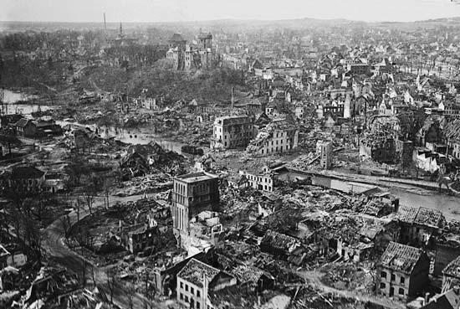
The Royal Canadian Air Force
One of the largest operations of the war was the bomber offensive against Germany.
The offensive was designed to destroy German military production as well as to undermine civilian morale.
Casualties among bomber crews were very high.

Slide 5
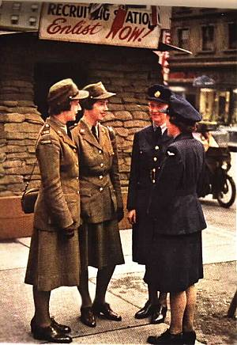
Women in the Air Force
In 1941 the RCAF formed the Women’s division (WD)
Women were not allowed to be in combat
They performed vital support roles
  Mechanics, clerks, cooks, welders, telephone operators, later flew replacement aircraft from Canada to England

Slide 6
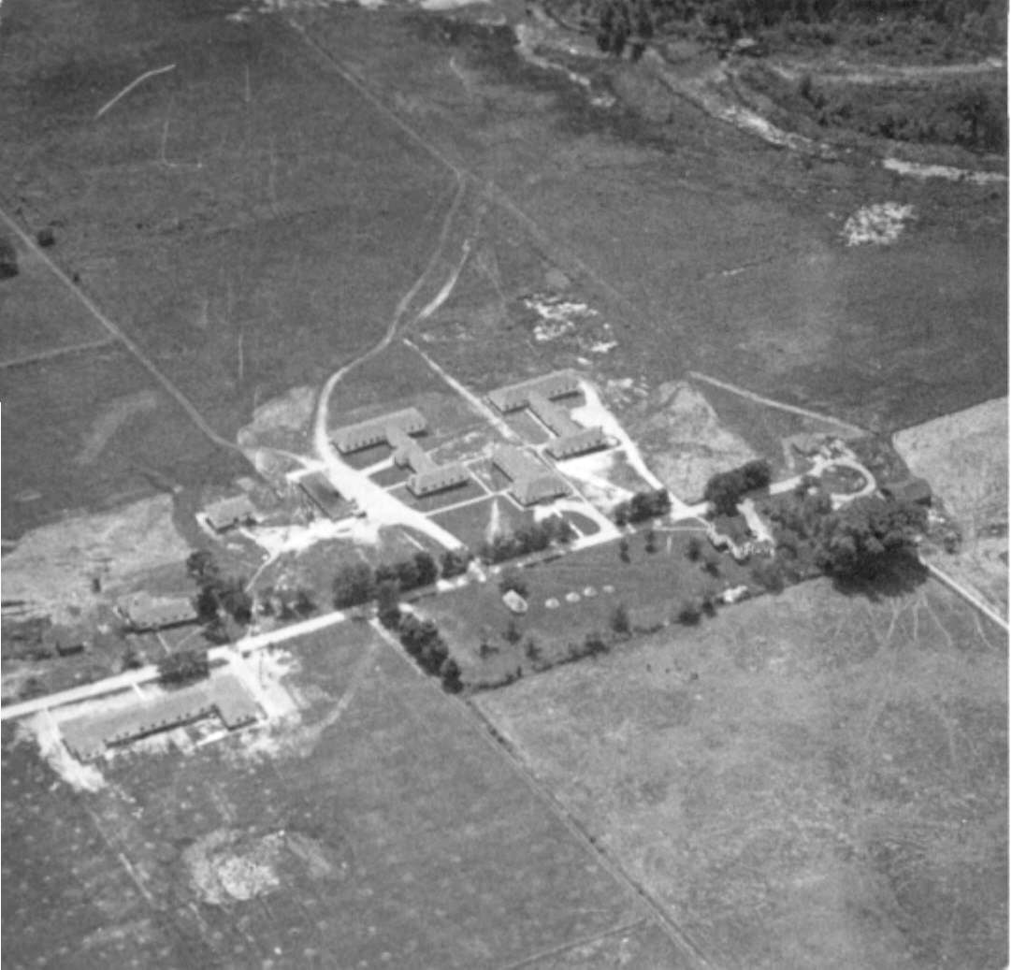
Top Secret: Camp X
Camp X, which operated in Oshawa, Ontario from 1941 to 1946, was a training camp responsible for training recruits for the Special Operations Executive of the British Security Coordination during World War II.
It was comprised of two sections, the Special Training School No. 103, which trained allied agents in the techniques of secret warfare, and Hydra, a network which communicated messages between Canada, United States, and Great Britain.

Slide 7
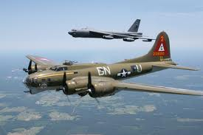
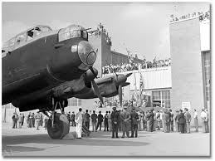
Bomber Command
Lancaster Bomber main 4 engine bomber during the war
Armament
  8 x 0.303 inch machine guns in nose, dorsal and tail turrets plus one 22,000 pound bomb or up to 18,000 pounds of smaller bombs

Slide 8
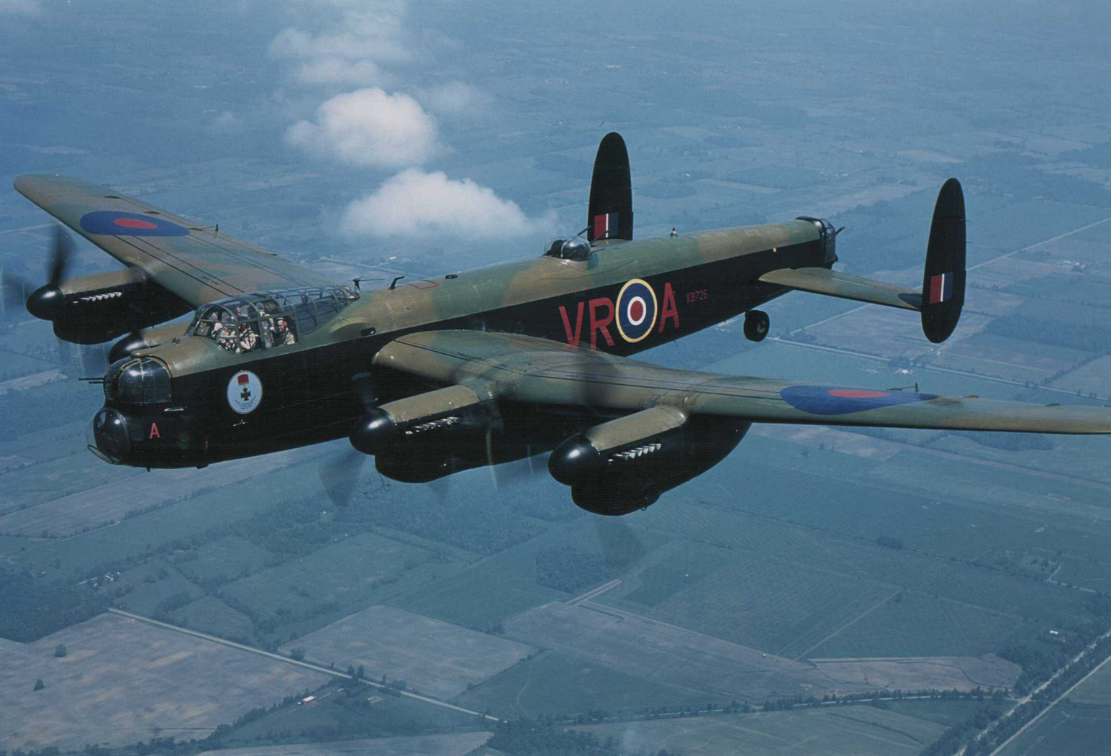

Slide 9
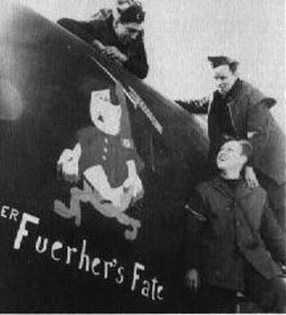
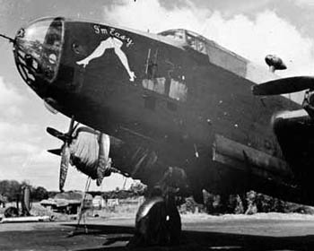
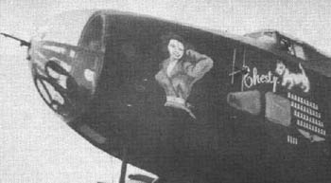
NOSE ART
Clip from Fog of War

Slide 10
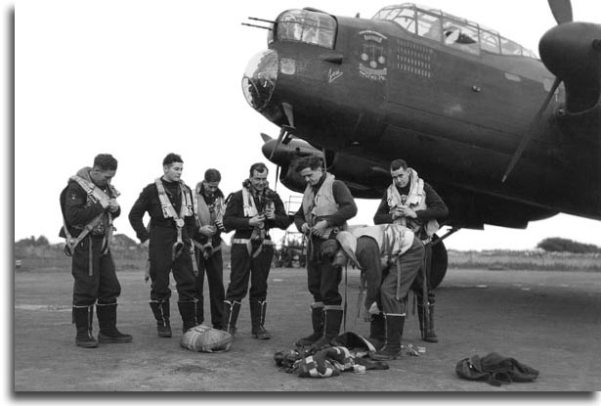

Slide 11
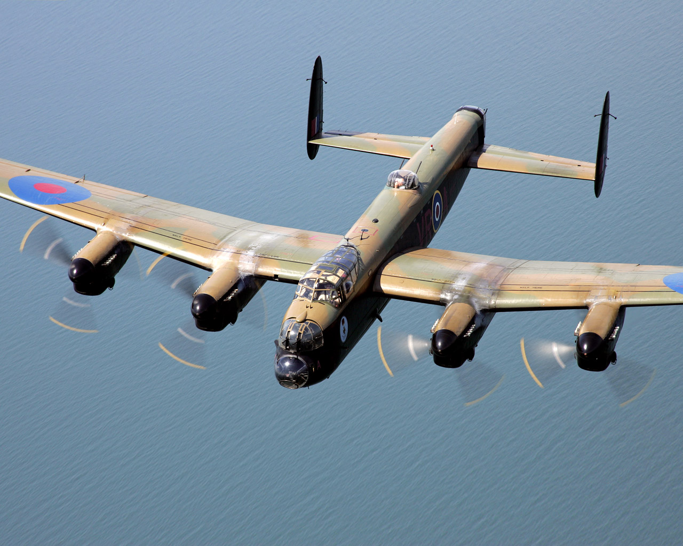

Slide 12
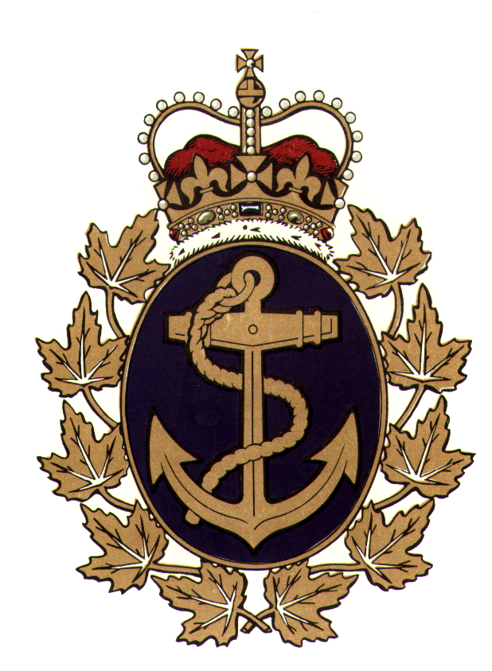
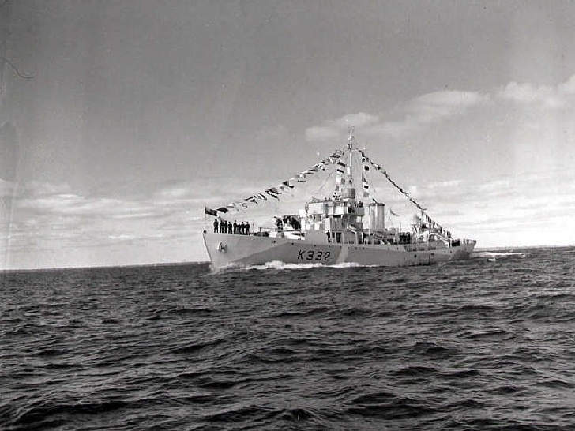
The Royal Canadian Navy
It was the task of the RCN to help keep open the vital Atlantic supply line to Britain.
The prewar naval establishment consisted of 13 ships and 20,000 men.
By the end of the war Canada’s navy was the third largest in the world with over 100,000 men and women and 400 ships.

Slide 13

Royal Canadian Navy
Canada’s warships were poorly outfitted with the result that in the early part of the war convoy losses were high.
It was not until 1943 that better training and more effective equipment finally turned the tide against the German U-Boat.
White Ensign Flown
by all RCN Ships

Slide 14
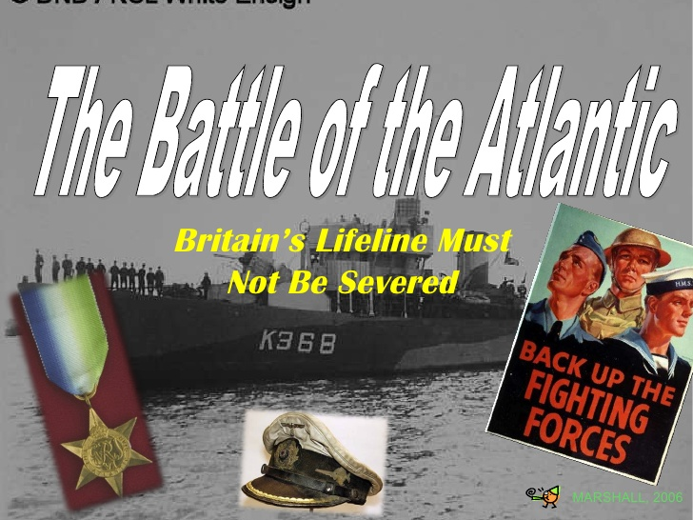

Slide 15
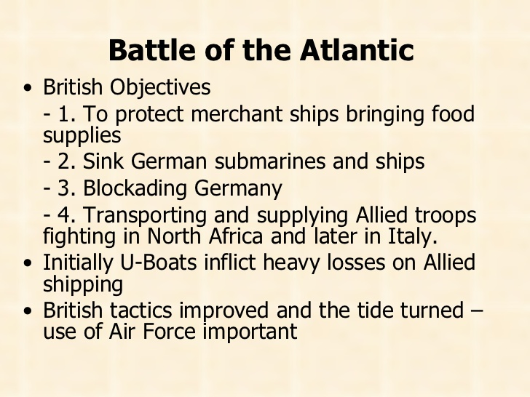

Slide 16
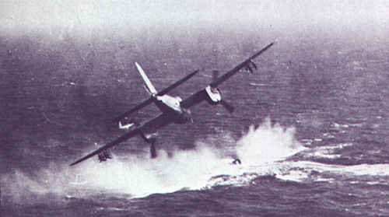
Battle of the Atlantic
Germany had come very close to winning World War I in the Atlantic.
There was fear that German submarines could again cut the vital supply line and starve Britain into submission.
Canada was unprepared for this important battle.
She began the conflict with a contribution of aging destroyers from the United States.
U-Boat threat
By May 1942 the British had the secret codes of the Germans
Airplanes could escort most of the way
Ships were built faster than sunk
Better training and equipment

Slide 17
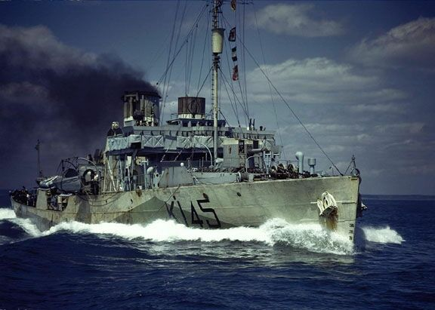
The Corvette
The requirement for a cheap, small but deadly opponent to the U-boat was met by the corvette.
Canada was to build and sail over 100 of these 190 ft. vessels.
Most Canadians sailors joined the corvettes untrained and learned their new trade on the job.
HMCS Ville de Quebec
and U-224

Slide 18
The Corvette II
Life in a corvette was often dangerous and always unpleasant.
Canada has preserved HMCS Sackville “The Last Corvette” as Naval Memorial.
Flower Class Corvette

Slide 19
The Convoy System
It was the job of the corvettes and the few destroyers sailed by Canada to escort the merchant ships safely across the Atlantic.
Convoy Forms in
Bedford Basin

Slide 20
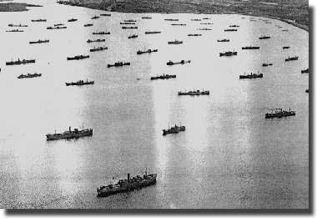
Convoy Assembling

Slide 21
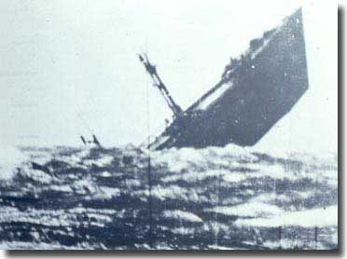
The fate of many ships

Slide 22
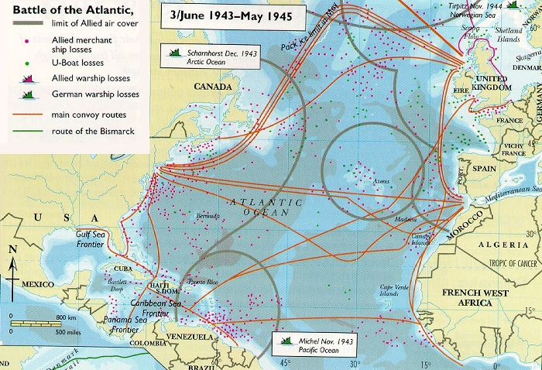

Slide 23
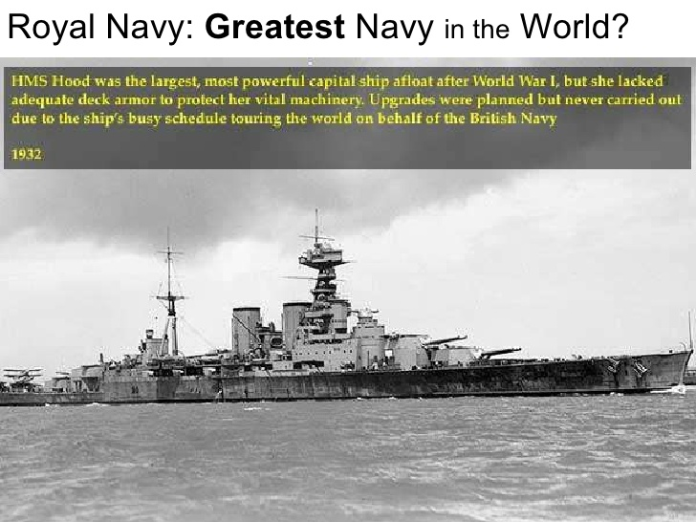

Slide 24
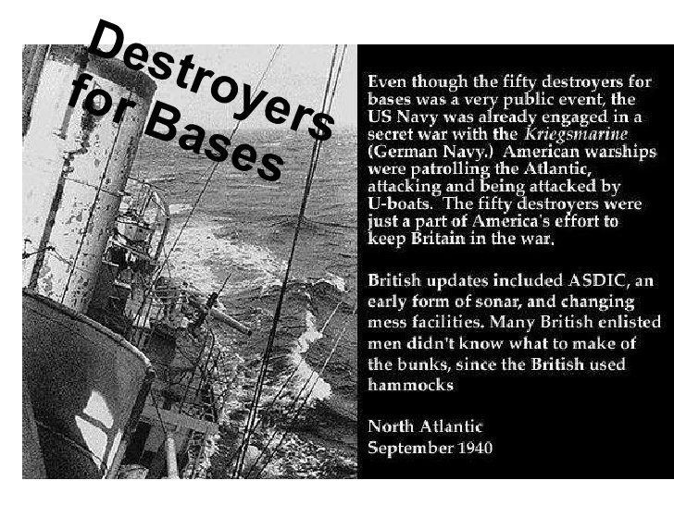

Slide 25
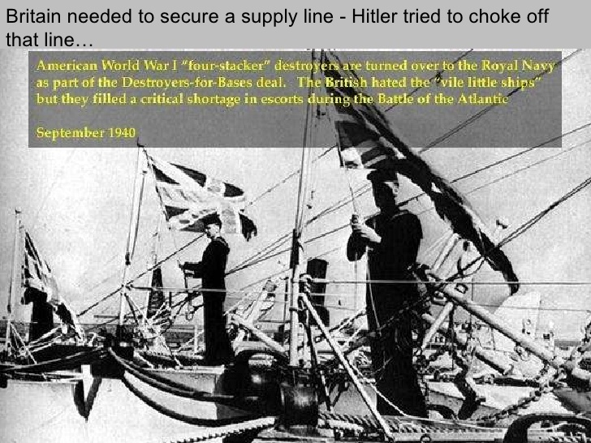

Slide 26
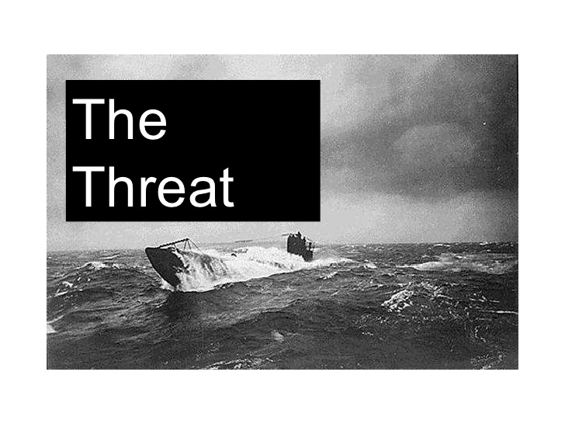

Slide 27
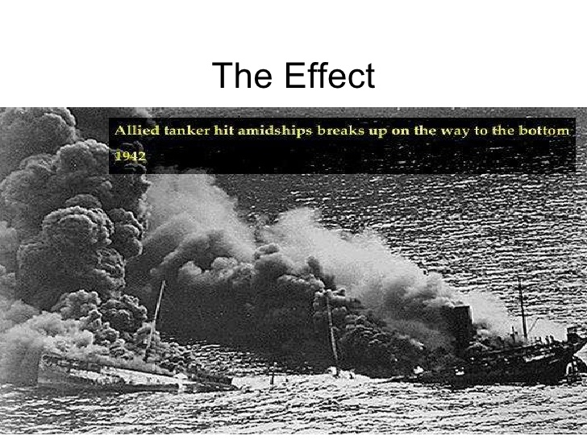

Slide 28
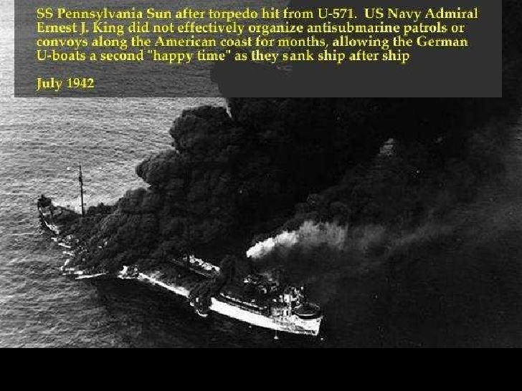

Slide 29
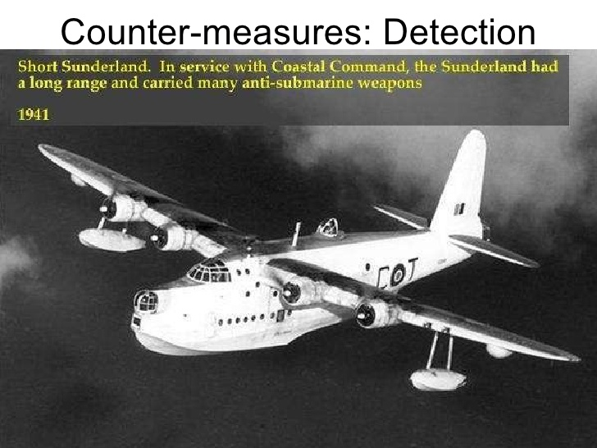

Slide 30
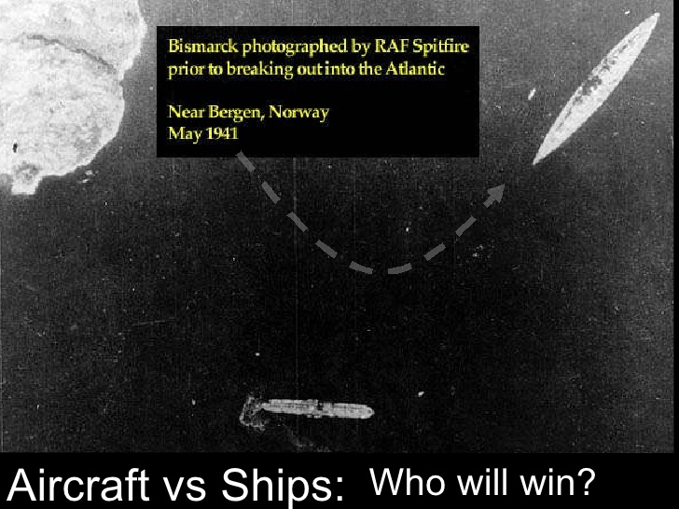

Slide 31
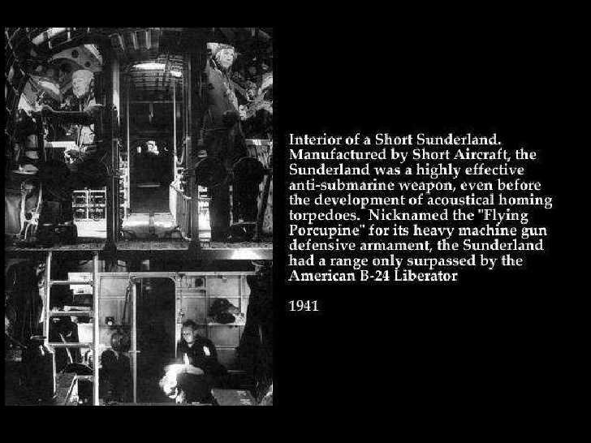

Slide 32
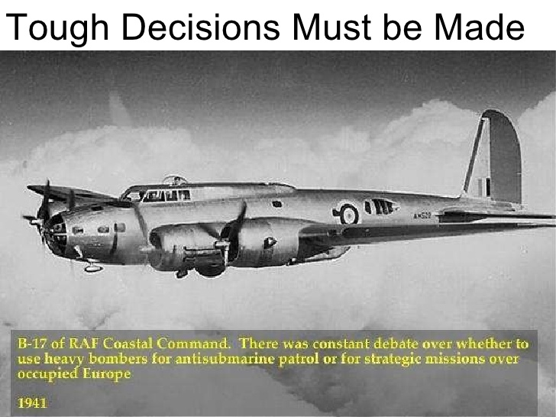

Slide 33


Slide 34
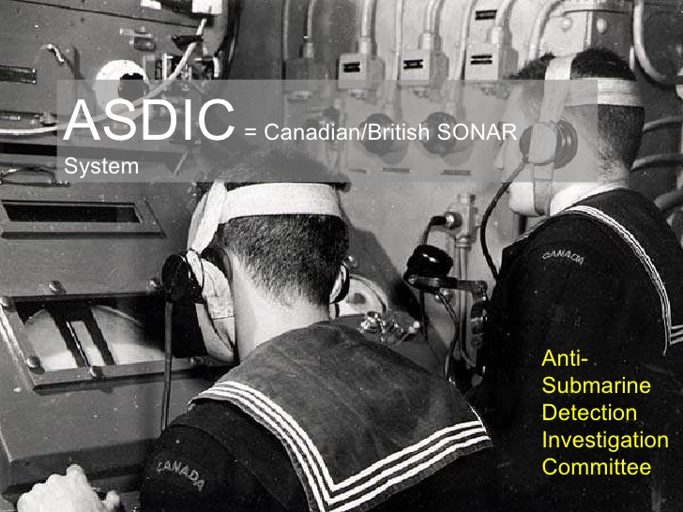

Slide 35


Slide 36
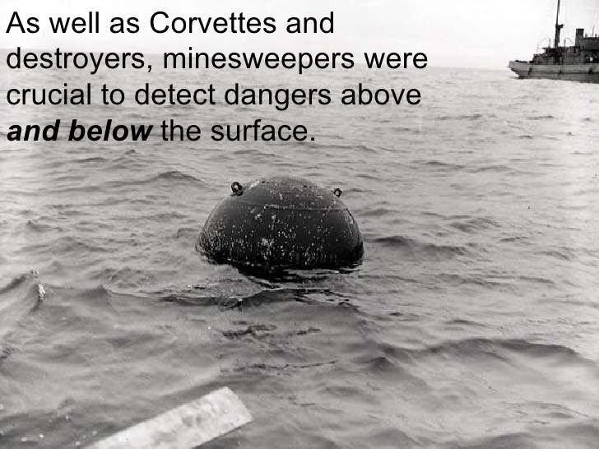

Slide 37
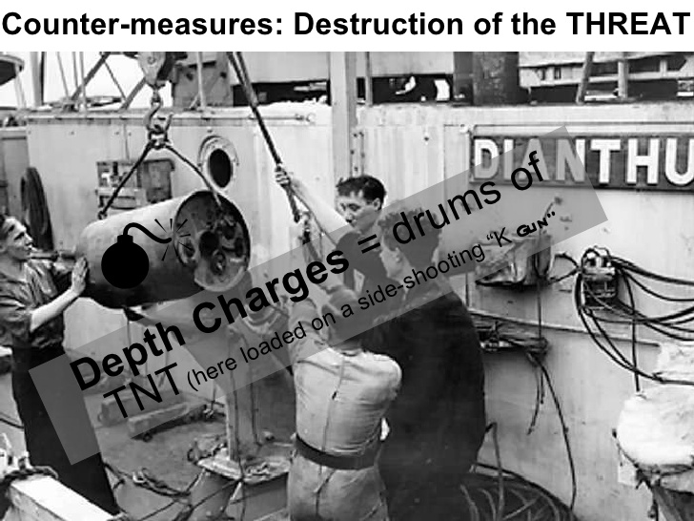

Slide 38
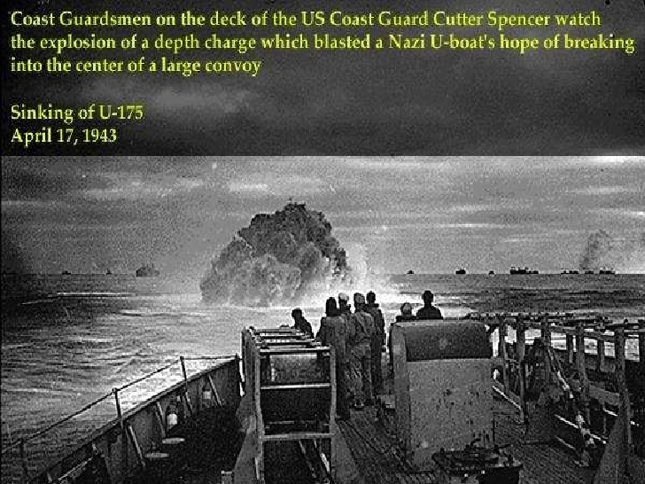

Slide 39
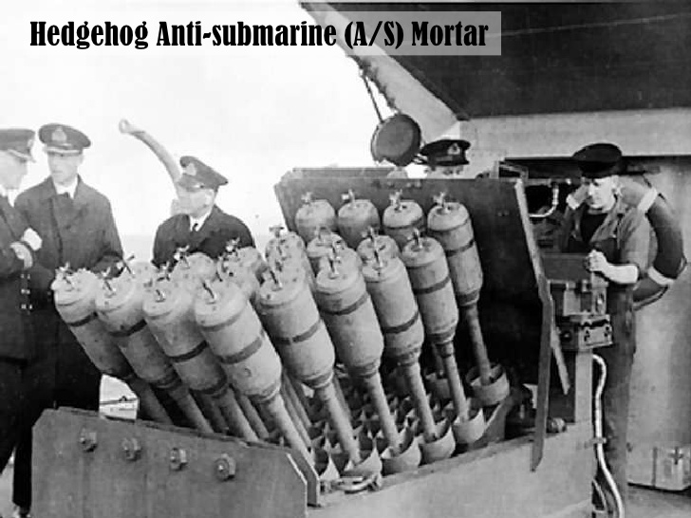

Slide 40
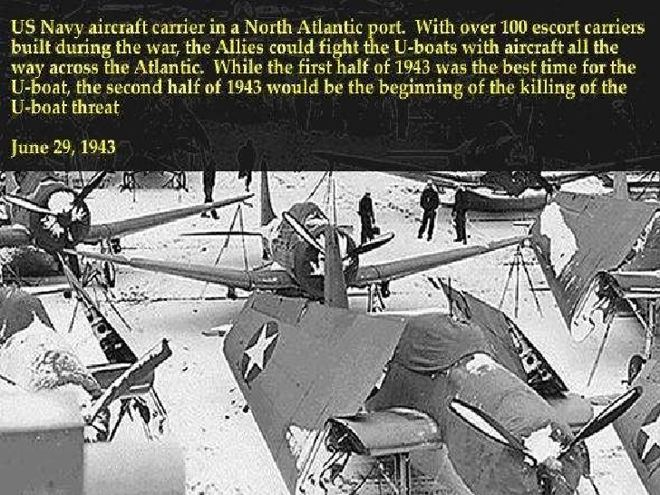

Slide 41
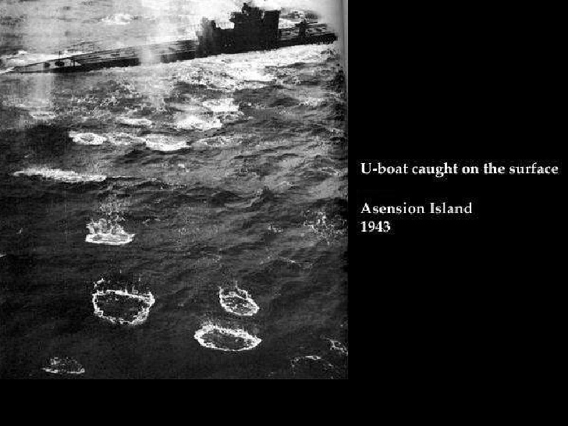

Slide 42
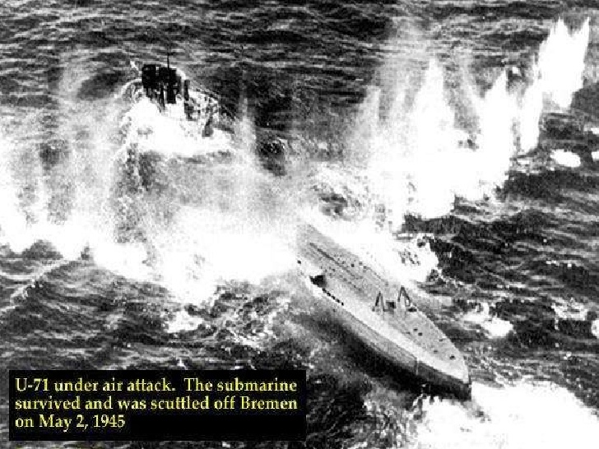

Slide 43
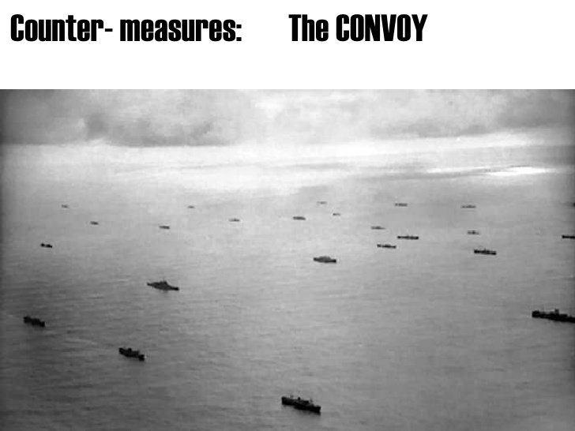

Slide 44
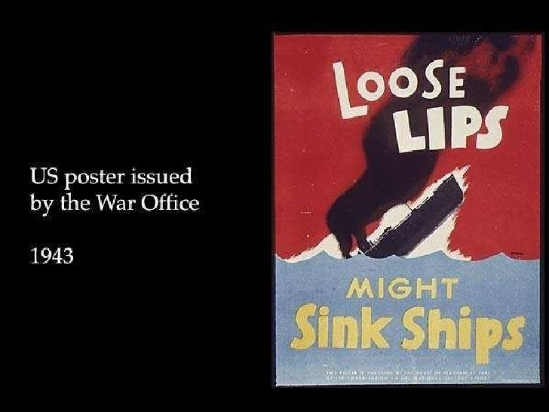

Slide 46
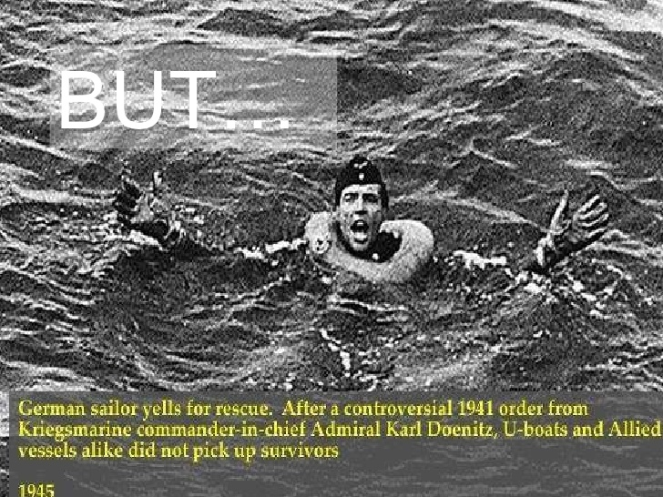

Slide 47
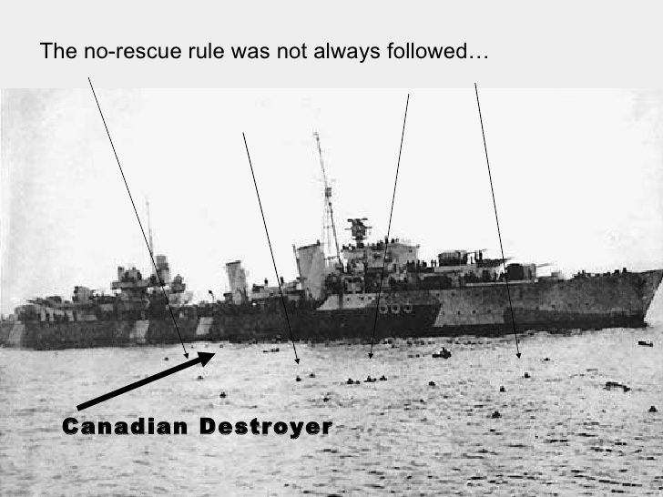

Slide 48
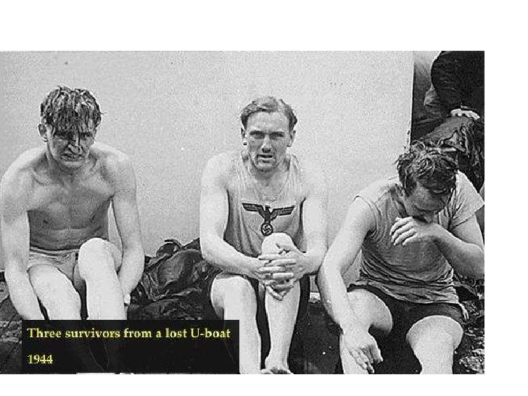

Slide 49
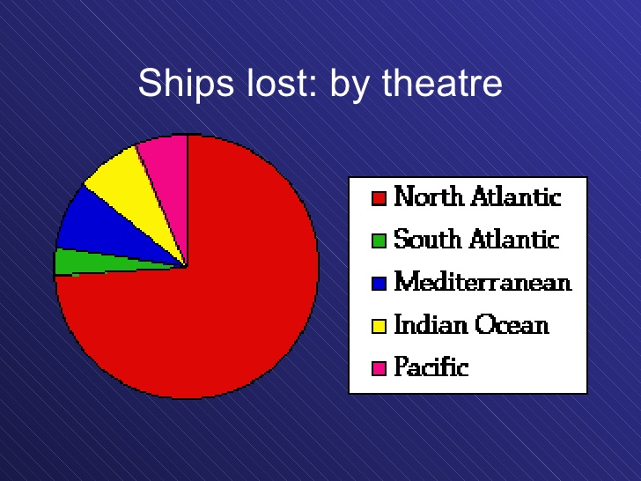

Slide 50
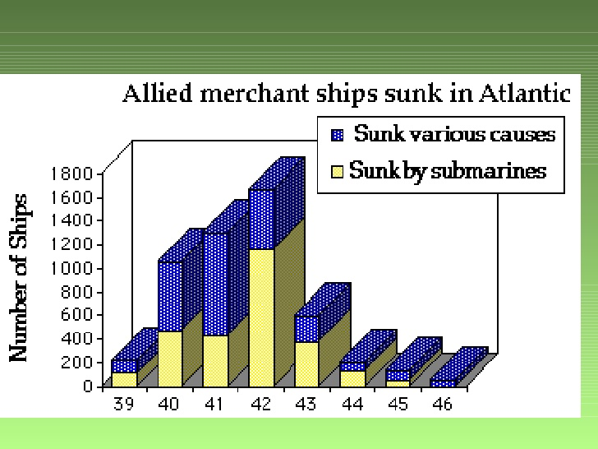

Slide 51
Conclusions
The U-boats were successful for the first half of the war
North American help was essential for Britain
The Allies used tactics and technology to drive the U-boats from the coasts
Germans countered with ‘wolf pack’ tactics
Conveys with naval security increased
Aircrafts chased U-boats to the center of the Atlantic
In the end Hitler failed to starve Britain

