Slide 1
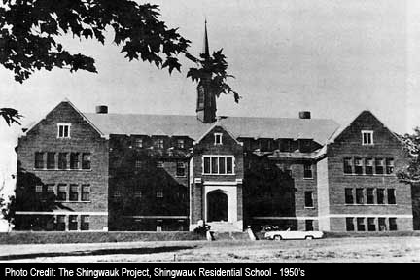
RESIDENTIAL SCHOOLS
A DARK CHAPTER IN CANADIAN HISTORY

Slide 2
Chronology from Assembly of First Nations Webpage:
1857 - Gradual Civilization Act passed to assimilate Indians. 1870-1910 - Period of assimilation where the clear objective of both missionaries and government was to assimilate Aboriginal children into the lower fringes of mainstream society 1920 - Compulsory attendance for all children ages 7-15 years. Children were forcibly taken from their families by priests, Indian agents and police officers. 1931 - There were 80 residential schools operating in Canada. 1948 – There were 72 residential schools with 9,368 students. 1979 – There were 12 residential schools with 1,899 students. 1980’s - Residential School students began disclosing sexual and other forms of abuse at residential schools. 1996 - The last federally run residential school, the Gordon Residential School, closes in Saskatchewan.

Slide 3
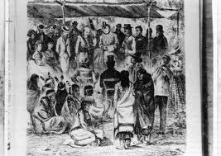
THE TREATIES
The Numbered Treaties 1871-1929 addressed education: “…maintain schools on reserves, as advisable, at peoples’ request.”
This ‘right’ supposedly guaranteed the FN to an ‘education’
The Treaties were agreed upon by both Natives and White People

Slide 4
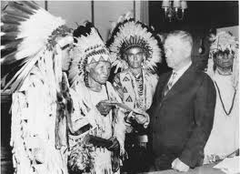
The INDIAN ACT 1876
It defined who could be an ‘Indian’
It ‘outlined what Indians could and could not do’
This legislation is NOT a part of Treaty. It is an arbitrary piece of legislation that greatly affected First Nations!
It was a clear statement of the federal government’s policy to act as guardians over Aboriginal peoples, giving them “protection” but with the ultimate goal of assimilation
The Indian Act was imposed on the Natives and they had NO SAY whatsoever.

Slide 5
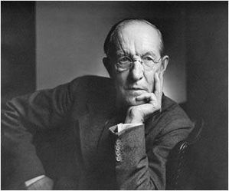
Duncan Campbell Scott
Duncan Campbell Scott, Deputy Superintendent of Indian Affairs from 1913-1932 stated: “The happiest future for the Indian race is absorption into the general population, and this is the object of the policy of our government. The great forces of intermarriage and education will finally overcome the lingering traces of native custom and tradition.”

Slide 6
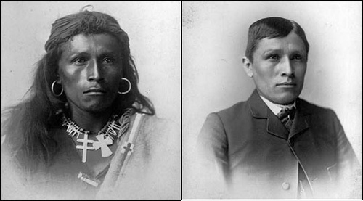
Education: Assimilation
Indian act gave the agents of the Dept. of Indian affairs almost dictatorial control over Aboriginal peoples’ lives, including education
Education became one of the ‘tools’ to ASSIMILATION!!!!
The government helped support the residential school system as far back as 1874.

Slide 7
Funding
Schools were funded by the federal government but were operated by the Catholic, Anglican, Presbyterian and United Churches

Slide 8
Residential Schools in Canada
By 1931 these organizations operated 80+ residential schools across the country, as well as day schools on some reserves
The schools were located in almost every province in Canada. Except for PEI, New Brunswick and Newfoundland.
There were 130 of them.
The Government Of Canada took over the residential schools officially on April 1, 1941, with the help of the churches.
Most schools closed by the mid 1970’s.
The last school closed in 1996.

Slide 9
The Process
Children were removed from their homes, often under threat of ‘law’

Slide 10
Separation
‘Assimilation’ worked best through separation from families, communities and culture
Separation from a traditional support system was a key strategy

Slide 11
Volunteer
Some families did see ‘education’ as progress and voluntarily sent their children

Slide 12
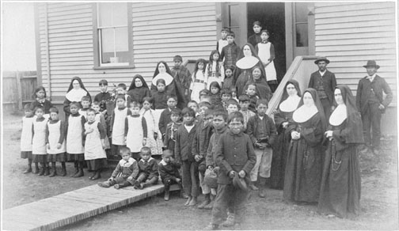
Who exactly went to these schools?
Every Aboriginal child between the ages of 5 to 15 years old.
Over the decades, thousands of Aboriginal children across Canada [First Nation, Métis and Inuit] passed through these schools.

Slide 13
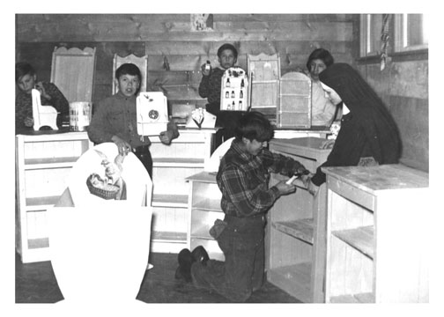
What did these children do there?
They learned “useful”
skills such as farming,
carpentry and domestic
skills.
The purpose?
To “teach” them white British skills instead of hunting and gathering.
They were also meant to promote economic self-sufficiency by teaching First Nations children to become farmers and laborers

Slide 14
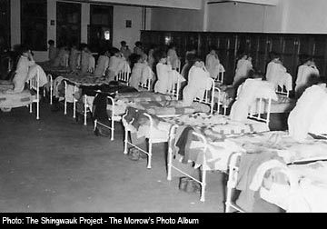
Christianity
The goal of the missionaries was to ‘convert the children to Christianity’.

Slide 15
Where were these schools located?
Residential Schools were located all across Canada.
In total there were 130 schools located across Canada.

Slide 16
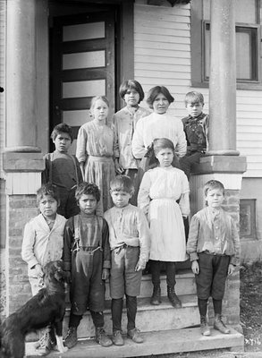
Attending The Schools
The Indian Act stated it was mandatory for status Indians to attend residential school.
Children as young as 6 would be removed from their families to attend school.
They would have to stay their for 10 months every year.
Some longer…. “When my Kokum attended Pelican Lake Residential School she told me that she did not get to go home for the summer. She stayed at the school for the whole school year.”

Slide 17
They Could Not…
Speaking their own languages was forbidden.
They could not practice any of their cultural activities.
They could not speak to other family members.
If they did any of these things they would get physically punished.

Slide 18
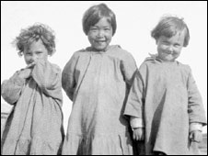
When They Arrived…
The students were only given one set of school clothes and one set of work clothes.
The students were assigned daily chores.
They were forced to get their hair cut very short, even for girls.
The children got their names changed and they had to go by the names the staff gave them.

Slide 19
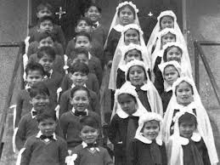
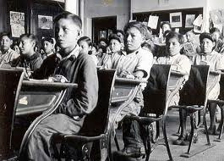
A Typical Day At Residential School
5:30 A.M: The boys got up to do morning chores such as milking cows, feeding animals.
6:00A.M: Everyone else got up and washed.
Breakfast: A hard porridge, made the night before with a piece of bread and milk.
Morning cleaning chores
Classes: 1 hour Religious studies, 2 hours academic studies.
Lunch: mused potatoes, carrots, turnips, cabbage and meat chunks.
Chores and work time

Slide 20
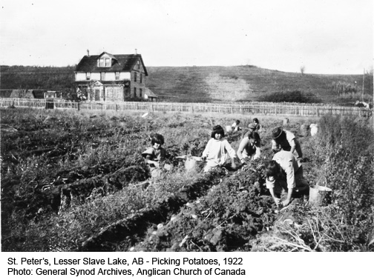
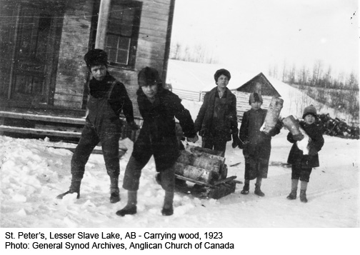
A Typical Day (Continued)
Lunch: mused potatoes, carrots, turnips, cabbage and meat chunks.
Chores and work time
Study hour
Supper
Clean up
Recreation time
Prayers
Bed time

Slide 21
Pelican Lake School
Sioux Lookout Ontario
Opened: 1911 Closed: 1973

Slide 22
All Of The Beds Were Very Close Together

Slide 23
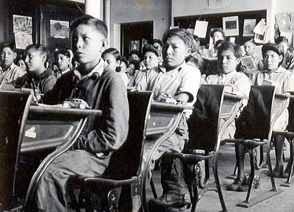
Classrooms

Slide 24
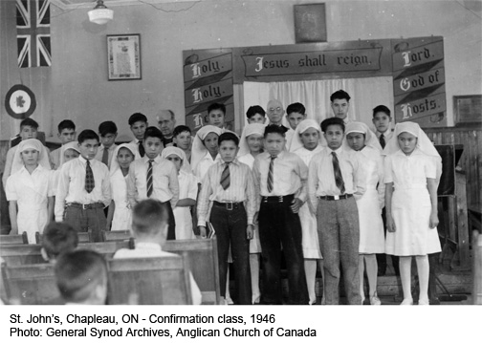

Slide 25
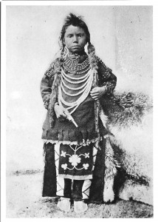
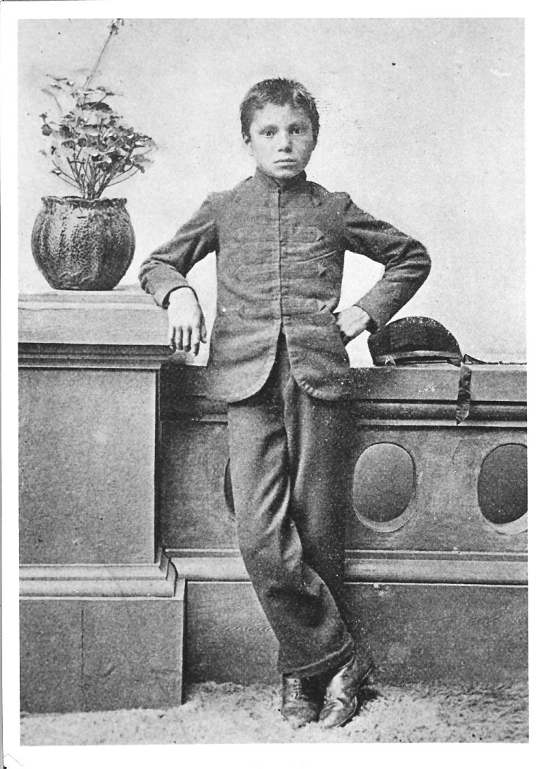
BEFORE
After

Slide 26
The Girls Chores
The Girls Were Expected To Sew

Slide 27
The Boys Chores
The Boys Had To Do Chores Such As Farming

Slide 28
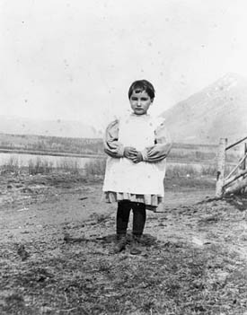
Disease
When there was a virus going around a lot of children caught it because of the poor living conditions.
This is a picture of a girl who never
returned home, she passed away
when cholera struck the her school in
1907.

Slide 29
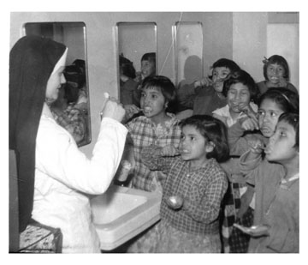
Abuse
A lot of them missed their families and wanted to go home
Some even tried to run away, most were found and returned to school
Some suffered physical abuse and for others mental abuse
Some survivors tell horrid stories such as staff physically and sexually abusing them

Slide 30
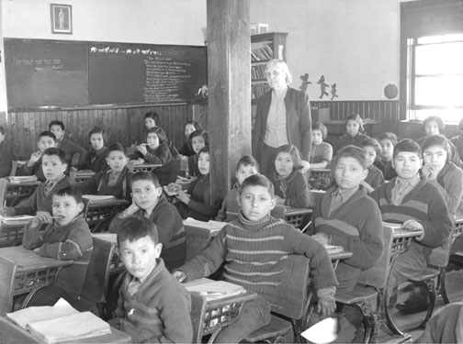
The following are examples of the type of punishments given to aboriginal children at residential schools:
For failing a test - no food for a day;
For not working hard enough - 4 hours of extra work (in school or garden);
For disobedience, and rude or disorderly conduct - no food or water for a day, a beating (with a stick on the back), extra garden work;
For speaking native language - (first offence) no supper - (second offence) no supper and beating - (third offence) considered disobedience and punished as such;
For going off by yourself (without another student present) - several hours of kneeling alone on a rock floor where all can see.

Slide 31
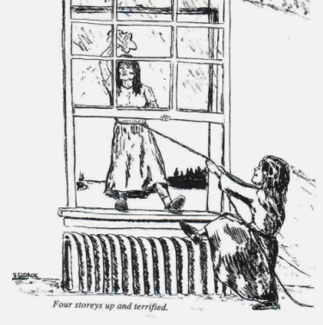
Discipline vs Abuse?
To accomplish this goal of assimilation, discipline was the answer in many missions. "Historians suggest that discipline was more harsh at residential schools than at other schools and would not have been accepted in Euro-Canadian institutions at the time. . . These methods included isolation cells, flogging and whipping, and humiliation."**
**From Residential School Update, AFN March 1998.

Slide 32
“Well, I'll give you a little example. When we started to go there, and I'd say we were nine or ten years old, we used to watch the movies every Sunday night. When we first saw the Indians getting killed, we were traumatized by that. Like how could they do that.., not knowing even that this is a movie and this is just a show. So we would cheer for the Indians because those were our people. Well, I don't know how many years later, it would be maybe three or four years later, when the Indians and the white guys were fighting, we were cheering for the white guys."
- Residential School survivor

Slide 33
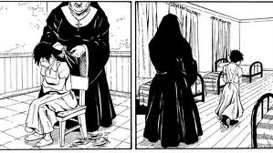
And there were other problems…
The children suffered years of excessive physical, emotional and sexual abuse in the schools.
The government tried to fix the problem by taking control away from the Church in 1969.

Slide 34
Residential School Legacy
Education for the most part was poor
very few students passed grade 9
over 40% of teaching staff had no professional training
Many children died from illnesses, fires, murder
Many children caught disease such as tuberculosis which destroyed their health
Physical and sexual abuse had long term effects on students
Children learned isolation, abuse, anti-aboriginal education, were unable to express love and unable to receive love for much of the year!!!!
The schools broke the connection between the children and their family and culture. It destroyed the central aspect of ‘relationship’

Slide 35
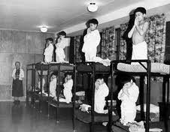
When They Grew Up…
When the survivors grew up and had their own families, many of them did not know how to parent for their own families
They were not taught any of this while at school
The school did not show love to the children, and with this some of the survivors do not know how to show love towards their families.
Many of the survivors have problems with drugs, alcohol, anger, depression and loss of culture and language.

Slide 36
Two Sides of the Story
Consider the following poem by Rita Joe, a Mi'kmaq poet, about attending the residential school in Shubenacadie, Nova Scotia:
I Lost My Talk
I lost my talk The talk you took away. When I was a little girl At Shubenacadie school. You snatched it away: I speak like you I think like you I create like you The scrambled ballad, about my world. Two ways I talk Both ways I say, Your way is more powerful. So gently I offer my hand and ask, Let me find my talk So I can teach you about me.
Notes:
Consider the following poem by Rita Joe, a Mi'kmaq poet, about attending the residential school in Shubenacadie, Nova Scotia: I Lost My Talk I lost my talk The talk you took away. When I was a little girl At Shubenacadie school. You snatched it away: I speak like you I think like you I create like you The scrambled ballad, about my world. Two ways I talk Both ways I say, Your way is more powerful. So gently I offer my hand and ask, Let me find my talk So I can teach you about me.

Slide 37
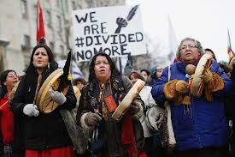
Inter-generational Effects
Residential School Survivors have long lasting Inter-generational negative effects:
- Identity crisis
- Unable to connect to family, culture
- Long term effects of physical, sexual and psychological abuse
- RCAP pointed directly at the residential schools as a major factor in the high rates of: substance abuse, suicide and family problems
Schools destroyed one of the most important values of the First Nations: Kinship and Family Relationships

Slide 38
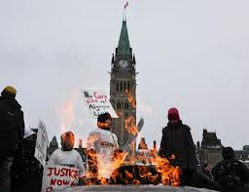
The inter-generational problems could include any one or more of many dysfunctional behaviors:
Anger
Lack of identity
Language loss
Substance abuse
Family
Community

Slide 39
Recent Developments
In 1999, the Government sponsored discussions across Canada that provided former students, government officials, and church representatives the opportunity to sit down together and develop solutions to residential schools issues.
This marked the first time the three parties were able to sit together and constructively discuss these issues.
It is estimated there are 86,000 people alive today who attended Indian residential schools, according to Statistics Canada.
14,477 Aboriginals have filed lawsuits against the Government of Canada

Slide 40
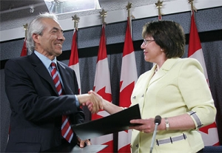
RECENT DEVELOPMENTS
November 2005: government offered $2 billion in payments to victims of residential schools
Paul Martin had gathered aboriginal leaders to discuss aboriginal education, housing, health care and economic opportunities
Under the KELOWNA ACCORD, each survivor would have
been eligible for $10,000 lump sum payment (plus $3000
for each year spent in schools)
$125 million offered to fund a healing program to help deal
with psychological issues

Slide 41
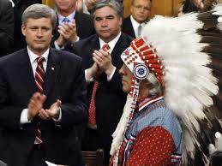
Attempts at Reconciliation
In 2008, The Canadian Government, Assembly of First Nations and the Churches have agreed to sign a “Agreement in Principal” to financially apologize to the survivors.
The payment the survivors get ($2 billion in total) is based on how many years they attended school.
Many survivors are still looking for healing while others do not like to talk about their experiences at residential school.
The payments the survivors get, does not erase the wrong-doing that the federal government and churches did.

Slide 42
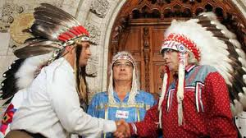
Righting the Wrongs
The Government of Canada delivered a Statement of Reconciliation to all Aboriginal peoples that included an apology to those who had experienced sexual and physical abuse while attending a residential school.
In particular, it mentioned that the Canadian government regretted the treatment of Aboriginal People:
"As a country, we are burdened by past actions that resulted in weakening the identity of Aboriginal Peoples, suppressing their languages and cultures, and outlawing spiritual practices."
The average payout is expected to be in the vicinity of $25,000. Those who suffered physical or sexual abuse may be entitled to settlements up to $275,000.

Slide 43
GENERAL INFORMATION
From 1996 to 2006, the aboriginal population has grown by 45 per cent. That is nearly six times faster than the non-aboriginal population.
73.7 per cent of all Aboriginal Peoples live off-reserve in Canada.
72.1 per cent of all non-reserve Aboriginal Peoples live in urban areas.
Ontario has the largest concentration of Aboriginal Peoples at 242,495, or two per cent of the province's population.
Winnipeg is home to the largest urban aboriginal population at 68,380 (10 per cent of the city's total population). Edmonton and Vancouver follow close behind.
Almost half, or 46 per cent of the aboriginal population, is aged 24 or under, compared with 31 per cent of the non-aboriginal population.
Notes:
People of aboriginal origin living on reserve: 285,625

Slide 44
Questions to Ponder
How did residential schools cause social problems in Aboriginal communities.
What might be the effects of offering money as compensation, for pain and suffering, to the survivors?
Is the term ‘Residential School Survivor’ appropriate? Explain your stand.
How should the abusers be dealt with?
How does the residential school experience of First Nations people in Canada compare to colonial domination in other countries? Name other countries that had similar or different colonial experiences – were the outcomes different for Indigenous people?
If the Canadian government had not imposed residential schools on First Nations, what different outcomes might have been possible for ‘treaty’ people (First Nations and Euro-Canadians)?

