Slide 1
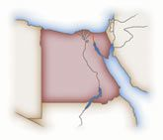
Question 11
What role did Canadians perform
during the 1956 Suez Crisis?
Canada was not involved
Canadian troops served as Peacekeepers
Canada provided food and aid to refugees of the crisis
Canada supported British actions to reclaim the Suez Canal from the Egyptians

Slide 2
What role did Canadians
perform during the 1956 Suez
Crisis?
b. Canadian troops served as Peacekeepers

Slide 3
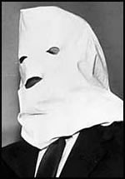
Question 12
Igor Gouzenko told Canadians about
what?
A Soviet spy ring in Canada
American plan to invade Canada
Soviet plans to support North Korea during the Korean War
The Warsaw Pact
Russian plans to launch satellites into space

Slide 4
Igor Gouzenko told Canadians
About what?
A Soviet spy ring in Canada

Slide 5
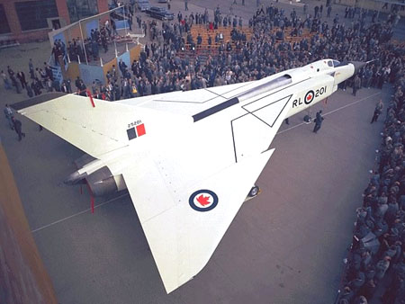
Question 13
Which Prime Minister cancelled
the Avro Arrow plane?
William Lyon Mackenzie King
Louis St. Laurent
John Diefenbaker
Lester B. Pearson

Slide 6
Which Prime Minister
cancelled the Avro Arrow
plane?
c. John Diefenbaker

Slide 7
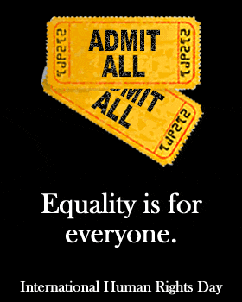
Question 14
The Bill of Rights was introduced in
1960 to protect the human rights of
Canadians. It failed. Why did it fail?
It applied only to federal laws. Provincial laws were exempt
It did not apply to people in Quebec
It was not included in Canada’s Constitution. News laws could be made that did not recognize the Bill of Rights.
All of the above
A and C only

Slide 8
The Bill of Rights was introduced in
1960 to protect the human rights of
Canadians. It failed. Why did it fail?
e. A and C only

Slide 9
Question 15
Internationally, the USA is a military
superpower. Canada does not have the
military strength of the USA, but Canada
has a strong economy, stable government
system and an vital role within international
organizations such as the United Nations.
In this context, Canada is a...
Capitalist society
Just Society
Middle Power
Nation of pacifists

Slide 10
Internationally, the USA is a military
superpower. Canada does not have the
military strength of the USA, but Canada
has a strong economy, stable government
system and an vital role within international
organizations such as the United Nations.
In this context, Canada is a...
c. Middle Power

Slide 11
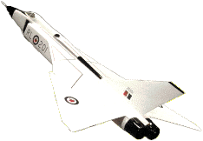
Question 16
Why was the Avro Arrow cancelled?
Too expensive
No buyers
Bombs were needed, not planes
Over budget
A Liberal project not wanted by the Conservative government
All of the above

Slide 12
Why was the Avro Arrow
cancelled?
f. All of the above

Slide 13
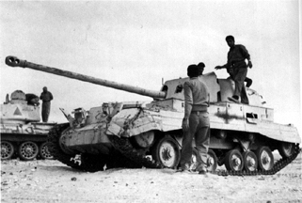
Question 17
During the 1956 Suez Crisis, Canada sent troops
into Egypt as peacekeepers. The Egyptians were
upset by one part of the Canadian soldiers’ gear.
What was the gear the Egyptians did not like?
The British elements on Canada’s Red Ensign flag
The Ross rifle that the Canadian soldiers carried
The battle uniforms were green and not desert brown
The symbol of the pyramids stitched into the soldiers uniforms

Slide 14
During the 1956 Suez Crisis, Canada
sent troops into Egypt as
peacekeepers. The Egyptians were
upset by one part of the Canadian
soldiers’ gear. What was the gear the
Egyptians did not like?
The British elements on Canada’s Red Ensign flag

Slide 15
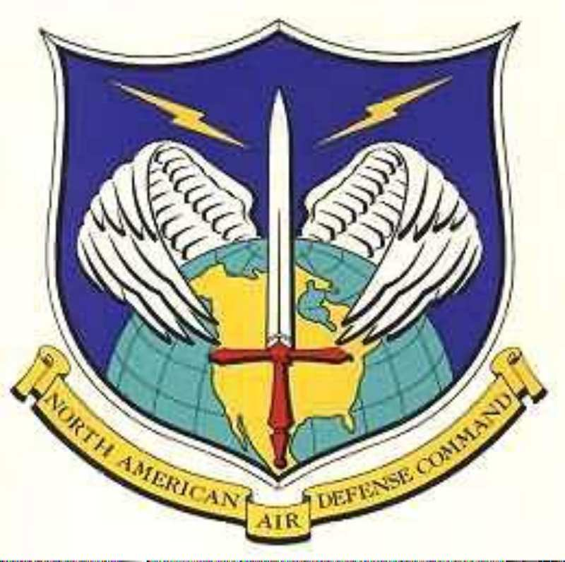
Question 19
In 1957 to offset the dangers of an USSR
missile attack on North America, Canada and
the USA established the North American Air
Defence Command (NORAD). What did NORAD
do?
It linked and coordinated USA and Canada’s missile defence systems
It established a central command station for the defensive systems underground in Colorado
It ensured military preparedness against a missile attack
All of the above

Slide 16
In 1957 to offset the dangers of
an USSR missile attack on North
America, Canada and the USA
established the North American
Air Defence Command (NORAD).
What did NORAD do?
d. All of the above

Slide 17
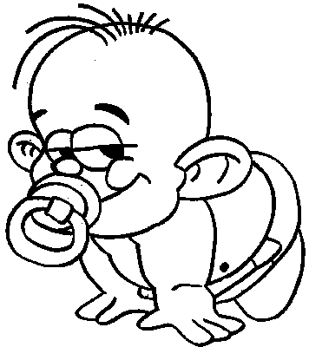
Question 20
Many babies were born after
WWII. What is this event called?
Baby boom
Great Baby Sweepstakes
Me Generation
Generation X

Slide 18
Many babies were born
after WWII. What is this
event called?
Baby boom

Slide 19
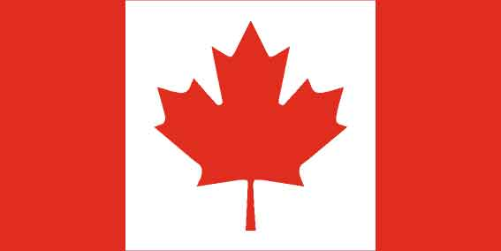
Question 21
In a bilingual Canada...
All Canadians speak both English and French
All people in Quebec speak both English and French
New immigrants to Canada must learn both English and French
There are two official languages: English and French
None of the above

Slide 20
In a bilingual Canada...
d. There are two official languages: English and French

