Slide 1
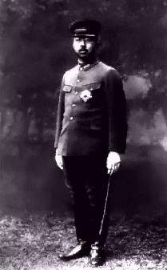
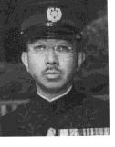
Hirohito
Emperor of Japan
World War II

Slide 2
Japanese Aggression… Prior to WW2
Japanese expansion in East Asia began in 1931 with the invasion of Manchuria and continued in 1937 with a brutal attack on China.
On February 24th, 1933, Japan stuns the world and withdraws from the League of Nations.

Slide 4
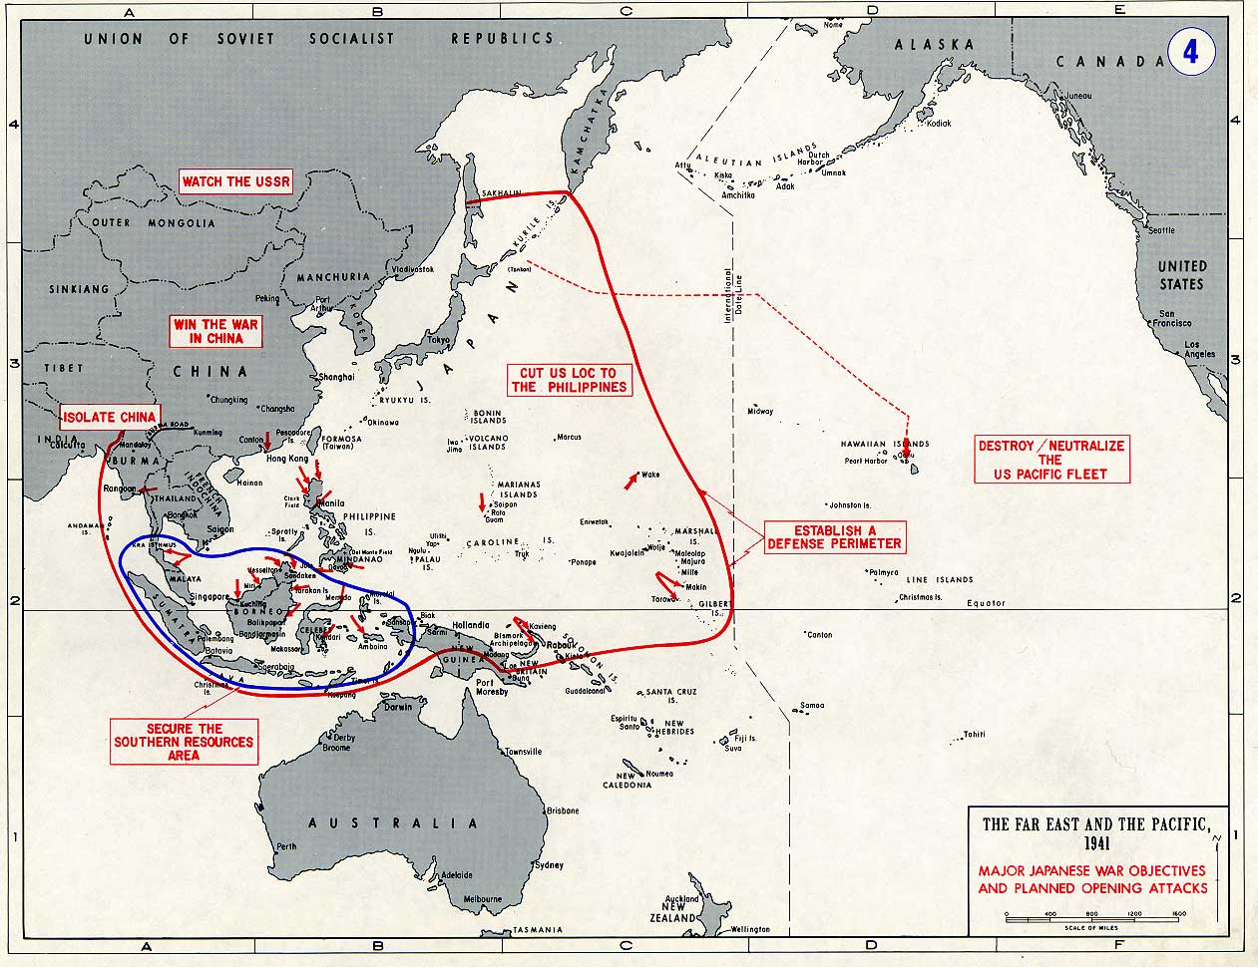

Slide 6
The Tripartite Pact
On September 27, 1940, Japan signed the Tripartite Pact with Germany and Italy, thus entering the military alliance known as the "Axis."

Slide 7
Embargo Against Japan
the United States, Britain and the Netherlands froze all Japanese financial assets. The effect was to prevent Japan from purchasing oil, which would, in time, cripple its army and make its navy and air force completely useless.

Slide 8
Japanese Strategy
Three Phases
Phase I: Surprise attacks, then strategic defense.
Knock out US fleet; seize vital areas; establish defensive perimeter.
Phase II: Strengthen perimeter; make any offensive action by the US prohibitively costly.
Phase III: Defeat and destroy any forces that attempt to penetrate the perimeter.
Long US LOC and natural strength of defense should almost guarantee success.

Slide 9
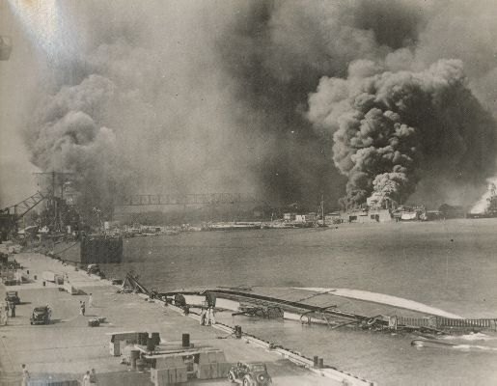
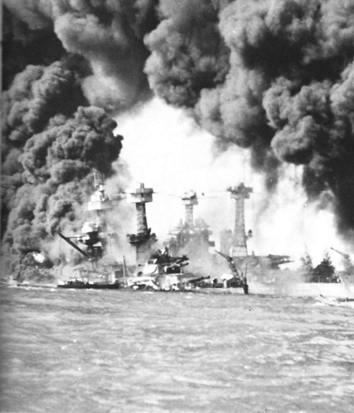
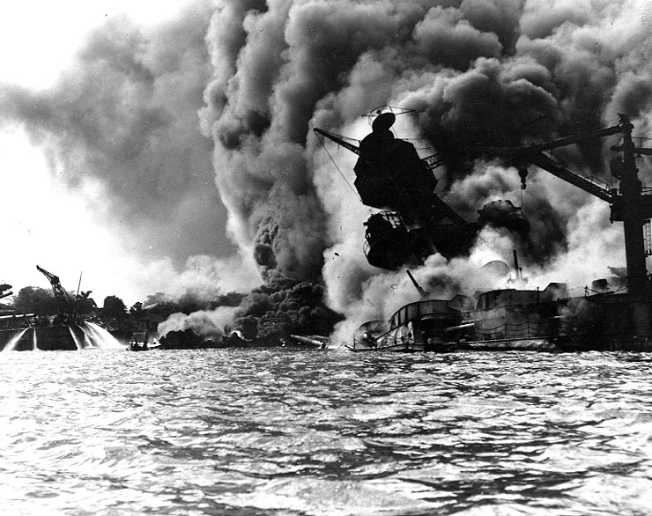
Japanese Bomb Pearl Harbour!
December 7, 1941, President Roosevelt declares it “The Day of Infamy”.

Slide 10
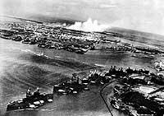
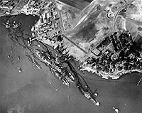
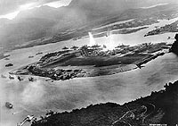
Damages

Slide 11
Pearl Harbor
Japan was working on expanding empire throughout the Pacific
The U.S. had a trade embargo on Japan to try and deter Japan from invading countries
U.S. was able to intercept and break Japan's secret codes
Intercepted the code about Pearl Harbor - sent the message on a slower telegram (by accident) to warn U.S. Navy about attack

Slide 12
Pearl Harbor Continued
It was a Sunday morning - U.S. military was taken off guard
2 full blown attacks on Pearl Harbor December 7, 1941
Impact/Damage on U.S.
o 2,400 U.S. military and civilians lost their lives
o 1,178 U.S. military and civilians wounded
o 18 ships and 350 planes sunk or damaged

Slide 13
Pearl Harbor Continued
Japan viewed as a stunning victory
December 8, 1941, U.S. declares war on Japan
December 11, 1941, Germany and Italy declare war on U.S.

Slide 14
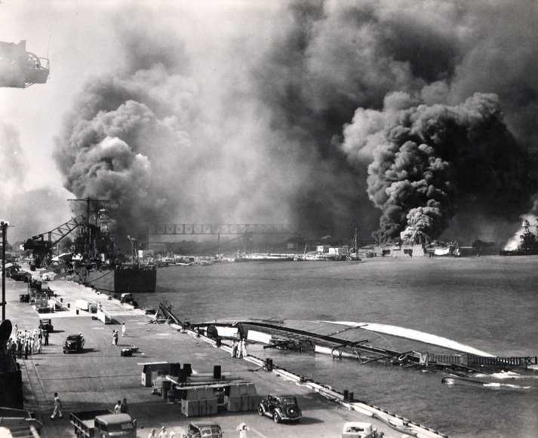
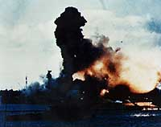
Pearl Harbour, December 7 1941 – intended to destroy the American navy and keep them out of the war.
The Japanese attack on Pearl Harbour brought the United States out of isolation and into the war.
The same day Japanese forces attacked the Philippines, Thailand, Hong Kong and Malaya.
Hitler declared war on the United States to support his Japanese allies.
By the end of 1941 Nazi Germany is at war with Russia, Britain and the United States.

Slide 15
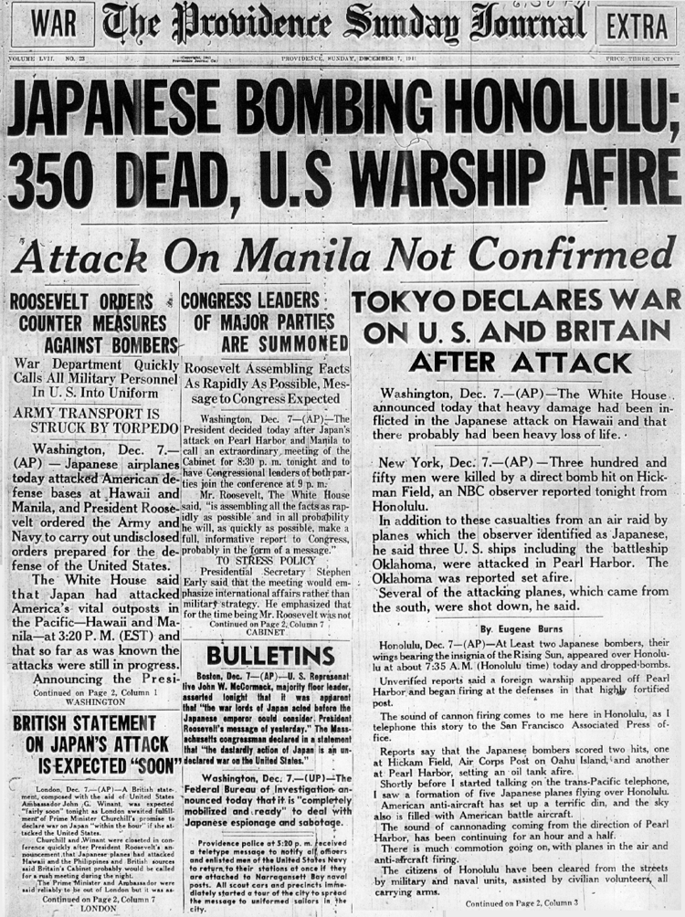

Slide 16
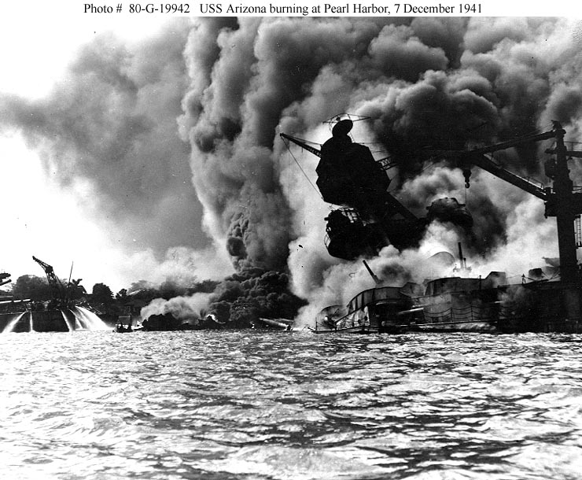

Slide 17
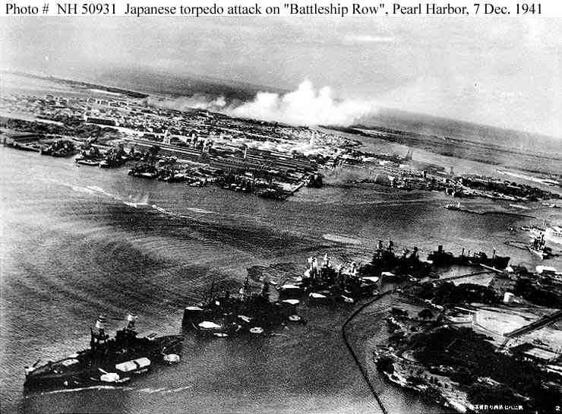

Slide 18
Tora-Tora-Tora

Slide 19
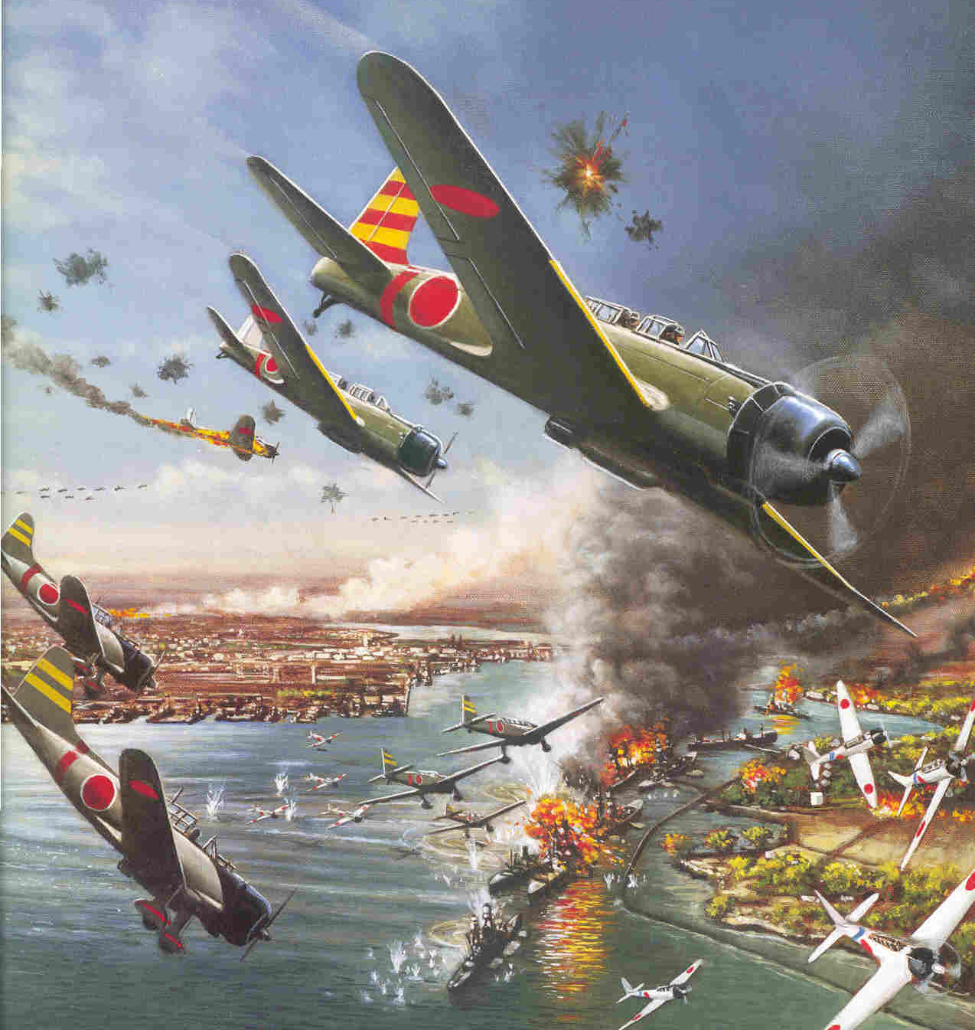
www.salem.k12.va.us/staff/dturner/Chapter%2013.ppt%202005.ppt

Slide 20
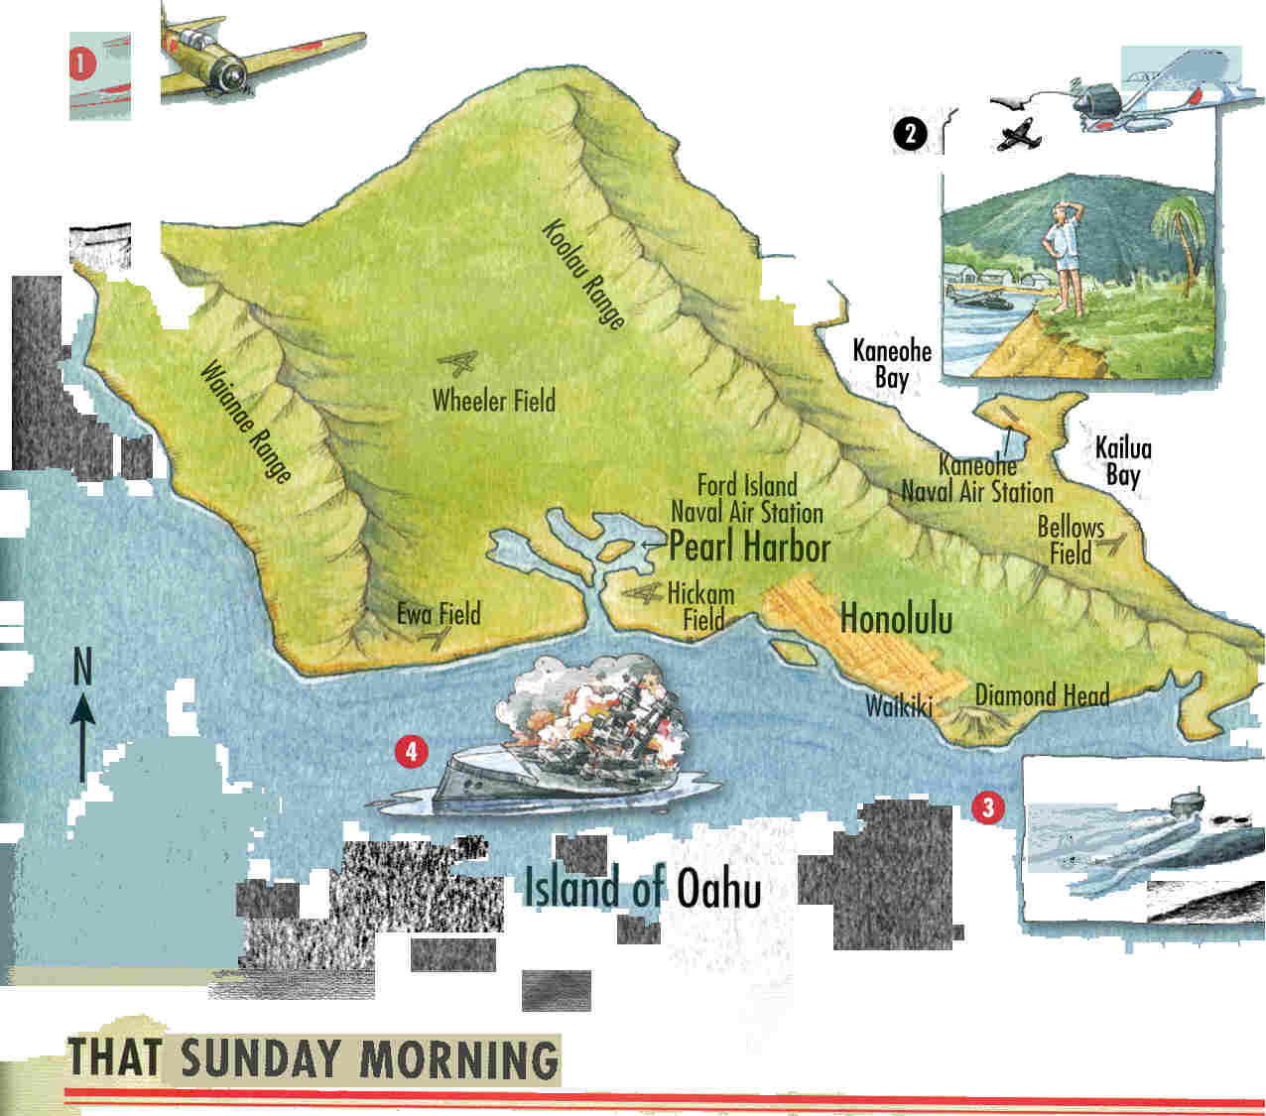
www.salem.k12.va.us/staff/dturner/Chapter%2013.ppt%202005.ppt

Slide 21
Battleship Row
www.myndrs.com/teachers/rscott/History/powerpoints/Hist12-nn-greatbattles-WWII.ppt

Slide 22
www.salem.k12.va.us/staff/dturner/Chapter%2013.ppt%202005.ppt

Slide 23
The End
Less than 2 hours after the first Japanese aircraft was spotted over Pearl Harbor, it was over.
As they made their way back to their carriers, all that was left behind was devastation.
None of the battleships had escaped. 3 were sunk, 1 had run aground, 3 cruisers badly damaged, 2 destroyers sunk, all aircraft either destroyed or damaged, 2500 serviceman killed, 1000 injured, 55 Japanese dead, 30 aircraft lost. A military triumph.
www.myndrs.com/teachers/rscott/History/powerpoints/Hist12-nn-greatbattles-WWII.ppt

Slide 24
FDR calls this “a date which will live in infamy”, and Congress declares that a state of war exists with Japan.
www.salem.k12.va.us/staff/dturner/Chapter%2013.ppt%202005.ppt

Slide 26
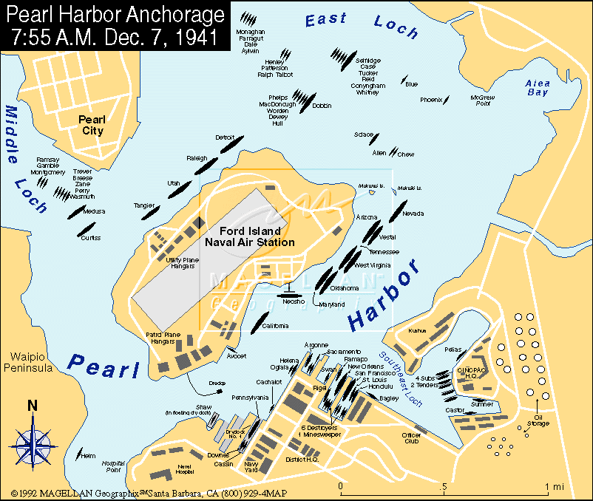

Slide 28
The Aftermath
www.myndrs.com/teachers/rscott/History/powerpoints/Hist12-nn-greatbattles-WWII.ppt

Slide 30
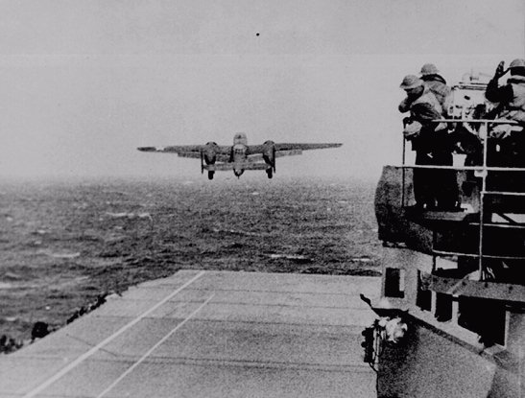
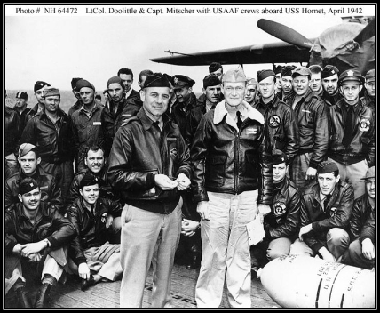
With only 450 feet of 'runway,' one of sixteen Army B-25 Mitchell bombers takes off from the deck of the USS HORNET on its way to take part in the Doolittle Raid, the first U.S. bombing raid on Japan. The all volunteer strike force, trained and led by Lt. Col. James Doolittle, flew 800 miles then bombed Tokyo and 3 other cities without opposition. The raid inflicted little damage but gave a big boost to Allied morale in the face of the seemingly unstoppable Japanese. April 18, 1942.
Doolittle’s Raid..short term response
www.salem.k12.va.us/staff/dturner/Chapter%2013.ppt%202005.ppt

Slide 31
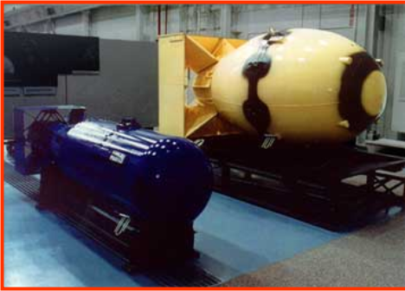
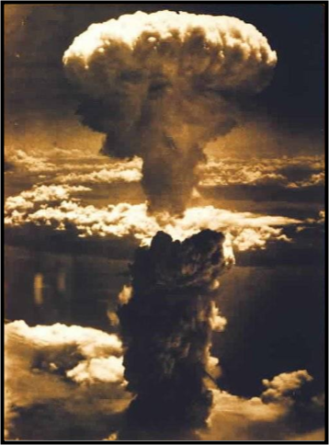
Long Term Response

Slide 32
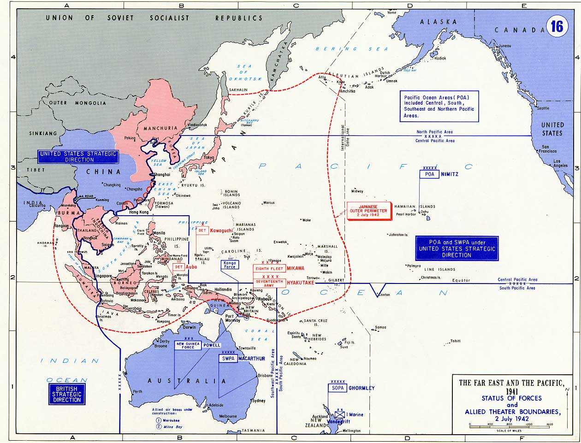

Slide 33
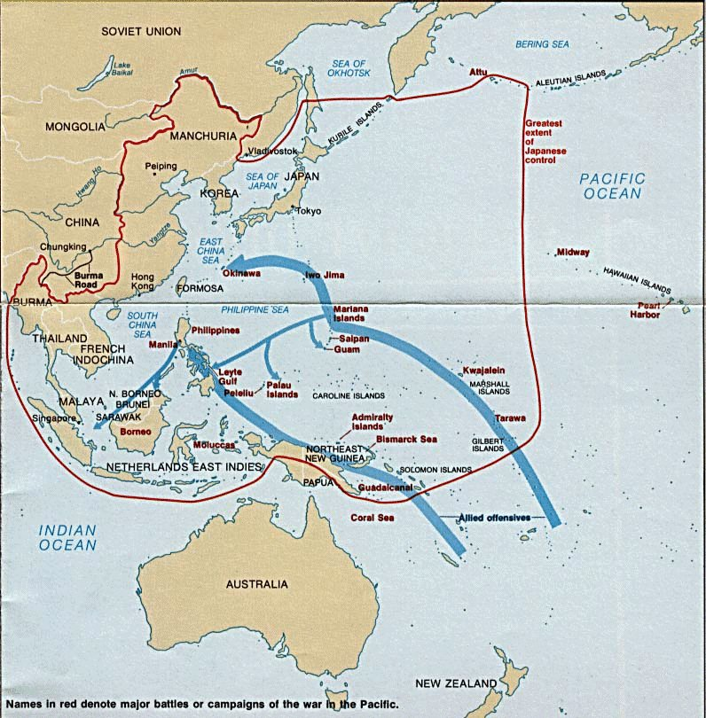

Slide 34
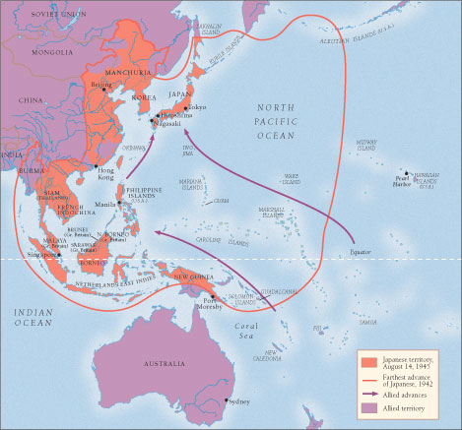
World War II in Asia and the Pacific
www.wsu.edu/~appleton/gened111/c37.ppt

Slide 35
Hong Kong
The British garrison in the colony of Hong Kong was threatened by Japanese expansion in China.
There was considerable debate about the ability of Britain to defend Hong Kong if the Japanese attacked.
In spite of these concerns Canada responded to Britain’s request for troops with two inadequately trained battalions.

Slide 36
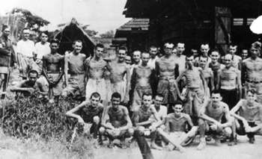
Canadians in Hong Kong
Canadian Troops sent to defend Hong Kong
The Japanese launched an assault on Hong Kong following the attack on Pearl Harbor.
After only seventeen days of fighting the colony fell into Japanese hands on Christmas day 1941
December 8, 1941- Japanese invasion of British Colony of Hong Kong
Dec 25, 1941 Hong Kong Falls
1975 Canadians are all killed or taken prisoner

Slide 37
The Battle of Hong Kong
Hong Kong surrendered on Christmas Day 1941.
Of the 1,975 Canadians, 290 were killed and 493 wounded. A further 260 died in the awful conditions of prison camps in Hong Kong and Japan.

Slide 38
Hong Kong
Japanese Attack
From China
British Line
Winnipeg
Grenadiers
Royal Rifles
Of Canada

