Slide 1
Skeletal and Muscle System
Lesson #1 Grade 8

Slide 2
Intro Activity
In pairs or groups of three write down all the names of bones that muscles that you currently know
Choose one student to be the ‘model’ and stick the pieces of paper to this person in the correct location
Once done, have teacher come and check your work (1 mark for name and 1 for location)

Slide 3
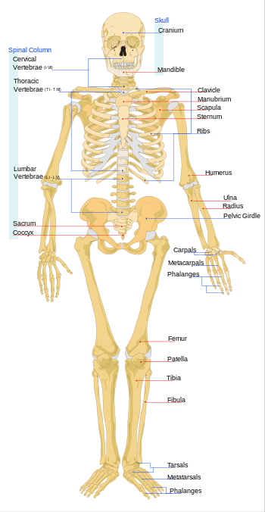
Function of the Skeletal System
1. Support
2. Shape
3. Protection
4. Movement (Muscle Attachment)
5. Blood Production and Storage

Slide 4
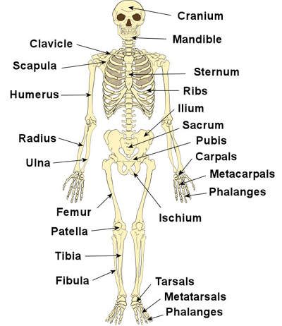

Slide 5
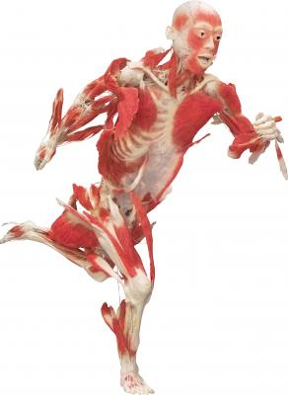
Function of the Muscle System
1. Creates Movement
2. Protects Organs
3. Pumps blood
4. Aids Digestion
5. Aids blood flow

Slide 6
