Slide 1
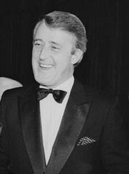
Brian Mulroney
Eighteenth Prime Minister of Canada from September 17, 1984, to June 25, 1993.
Leader of the Progressive Conservative Party of Canada from 1983 to 1993.
After retiring from politics, Mulroney resumed his earlier career as a lawyer and business consultant.

Slide 2
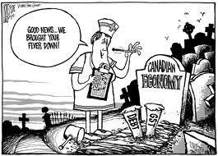
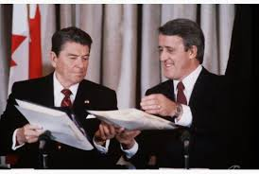
The Mulroney Era: Closer Ties with the United States
Brian Mulroney work to improve Canada’s relationship with the U.S.A.

Slide 3
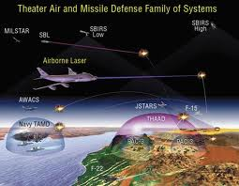
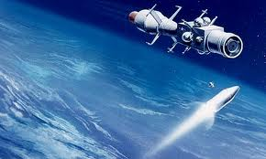
Star Wars defence plan
Canada, as a NORAD partner, was asked to be part of the American Star Wars defence plan that would put military defence satellites into space.
Mulroney, after much controversy, said no but left the door open for Canadian companies to bid on contracts in the project.

Slide 4
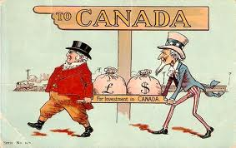
Closer Ties with the United States
Mulroney dismantled Trudeau’s FIRA, the Foreign Investment Review Agency, designed to monitor unsuitable investment in Canada by foreign companies.
Mulroney replaced FIRA with Investment Canada, an agency designed to encourage suitable investment in Canada.

Slide 5
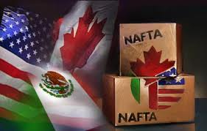
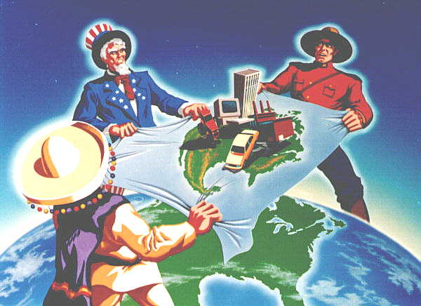
NAFTA
Mulroney and the Conservatives initiated NAFTA, the North American Free Trade Agreement, with the U.S.A. to remove tariffs on goods crossing the Canadian-U.S. border.

Slide 6
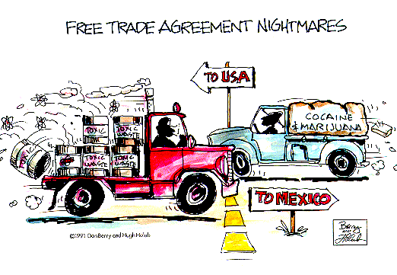

Slide 7
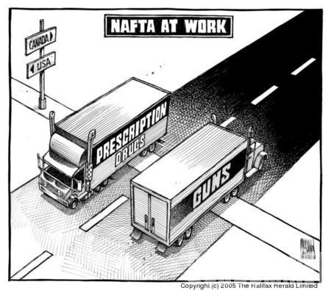
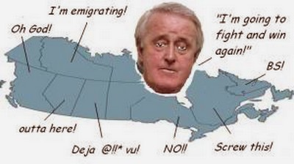
It was hoped that Canada would attract more business from south of the border and have access to the larger American market.
Canadian businesses feared the potential competition from bigger, more multi-national American businesses.
Some feared that Canadian businesses would move farther south into Mexico where labour was cheaper and anti-pollution laws are less stringent.

Slide 8
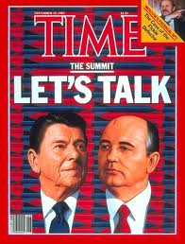
The End of the Cold War
A change in leadership in the U.S.S.R. brought change to the communist world.
The U.S.S.R.’s President Mikhail Gorbachev’s policies of “glasnost” and “perestroika” brought sweeping economic, social, and political reforms, to the U.S.S.R.
Censorship was loosened and greater freedom of speech was allowed.
East Germans, Czechs, Poles, Hungarians, and Romanians demanded similar reforms.

Slide 9
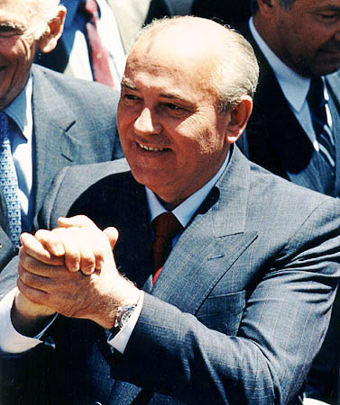
Mikhail Gorbachev
Was the last General Secretary of the Communist Party of the Soviet Union and the last head of state of the USSR, serving from 1985 until its collapse in 1991.
His attempts at reform — perestroika and glasnost — as well as summit conferences with United States President Ronald Reagan, contributed to the end of the Cold War.

Slide 10
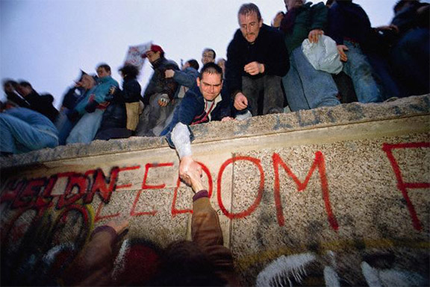
Fall of the Berlin Wall – Symbolic end of the Cold War

Slide 11
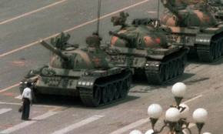
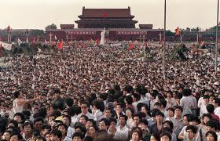
In November of 1989 the Berlin Wall fell but China who experimented with perestroika was more reluctant with increased freedoms as evidenced in Tiananmen Square where the military squared off with demonstrating students and citizens.
The result indicated China was not as ready as the U.S.S.R. to chart a new domestic path.

Slide 12
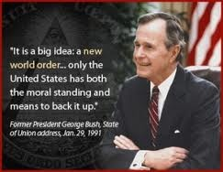
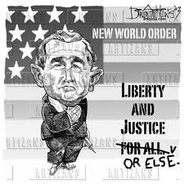
The New World Order
Recent decades have seen Canada active in the Persian Gulf, Yugoslavia, Africa and Afghanistan.
Canadian naval forces participated in the Gulf activities and Canadian CF-18’s participated in the bombings in Yugoslavia.
After the Gulf War, President George Bush of the U.S.A proclaimed a New World Order that would see the U.S.A. taking a more active role as a global police force rather than peacekeeping.

Slide 13
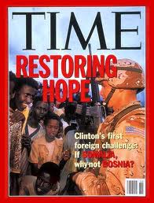
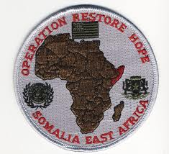
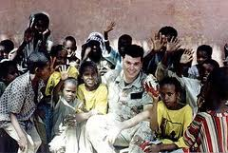
Assisting Developing Nations
Canadian troops participated in Operation Restore Hope in Somalia (Africa), ravaged by civil war, under the auspices of the United Nations.
A teenager was arrested and tortured by the Canadian forces.
Compounding the act was efforts made at a cover-up that tarnished the reputation of Canadian forces.
The air borne squadron that was involved was completely disbanded as a consequence.

Slide 14
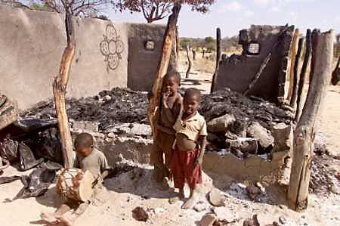
Operation Restore Hope: Somali Children in Bombed Out Home

Slide 15
The RAWANDA Genocide
In Rawanda, Canadian General Romeo Dallaire, commanding U.N. peacekeepers requested a large multi-national force to disarm the warring factions in that country.
His requests were not responded to and the world was horrified to learn that a million people had been killed within a few weeks.

Slide 16
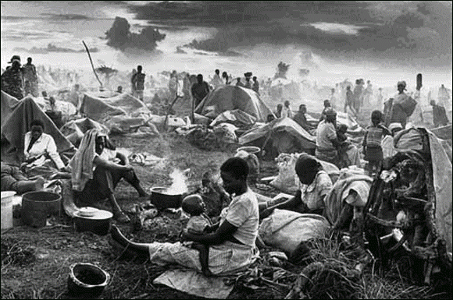
Rwandan Refugee Camp

Slide 17
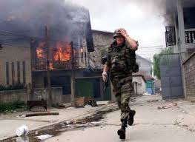
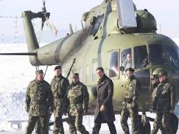
International Prestige?
Canada’s participation in these conflicts gave rise to questions about Canada’s involvement and commitment to international events and agencies.
Some suggested that Canada should not have been involved in Yugoslavia, a problem interpreted by some as a domestic affair in a sovereign country.
Others stated that Canadians had a duty to see that the Serbian-Albanian conflict did not spread.

Slide 18
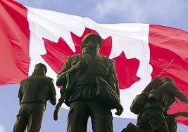
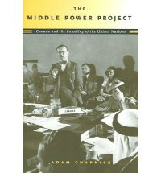
A Proud Middle Power
Others suggested that Canada is unable to defend herself with its inadequate military forces and we, therefore, must rely on NATO, and hence, must meet our commitments to that organization.
Some suggest that we redefine our independence and part of our relationship with the U.S.A and not commit to a “lock-step” adherence to U.S. foreign policy.

Slide 19
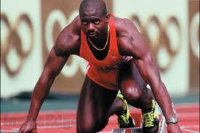
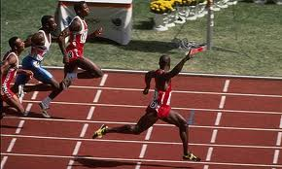
Ben Johnson 1988

Slide 20
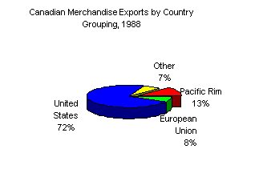
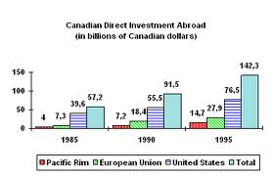
Team Canada
The 1990’s saw Canada actively try to expand its trade initiatives.
Canada eagerly organized “Team Canada”, a trade mission to Asia and Latin America to secure deals for investment and exports.
Canada has signed free trade deals with Chile and Israel.

Slide 21
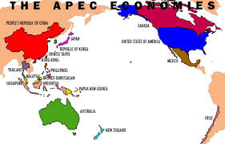
APEC
Canada has joined APEC, the Asia Pacific Economic Cooperation Group, to promote freer trade among Pacific countries.
Canada has embraced the idea, albeit with some opposition, of globalization, the process by which regions and countries of the world are becoming interconnected in many facets of life and economy.
Globalization has been speeded up by modern communication technologies.

Slide 22
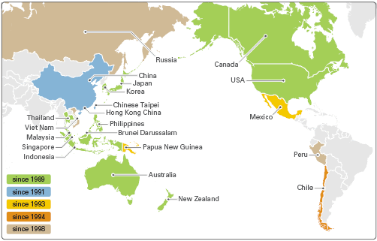
The Countries of APEC

Slide 23
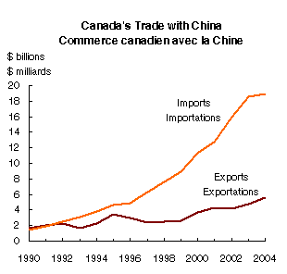
Canada’s Trade With China
What does the chart suggest about
Canada’s trade with China?

Slide 24
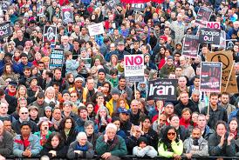
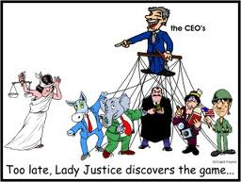
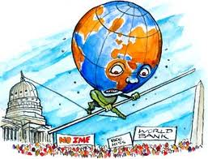
Proponents of globalization say that it will raise living standards for everyone, large corporations will invest in less industrialized countries, and jobs will be created for more people.

Slide 25
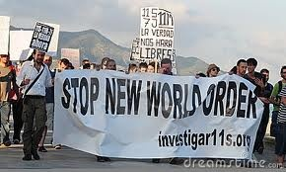
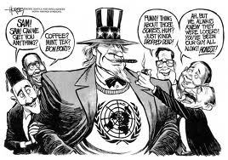
Opponents of globalization
Opponents, who insist globalization is fraught with optimism, say the Canadian economy will suffer from failed initiatives, the global economy is unstable, workers will lose jobs, corporations will relocated to countries with cheaper labour, and that other cultures are at risk from the domination of the ways and cultures of Western countries.

Slide 26
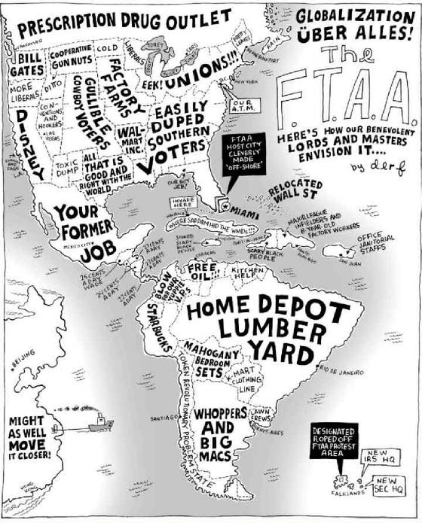
“Globalization as the Americans See It”

Slide 27
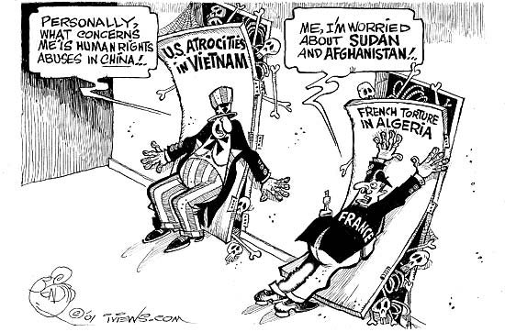
A New Era of Globalization
To Canada’s credit, it has insisted upon a commitment to human rights packages in countries with which it has made trade deals.

