Slide 1
The League of Nations

Slide 2
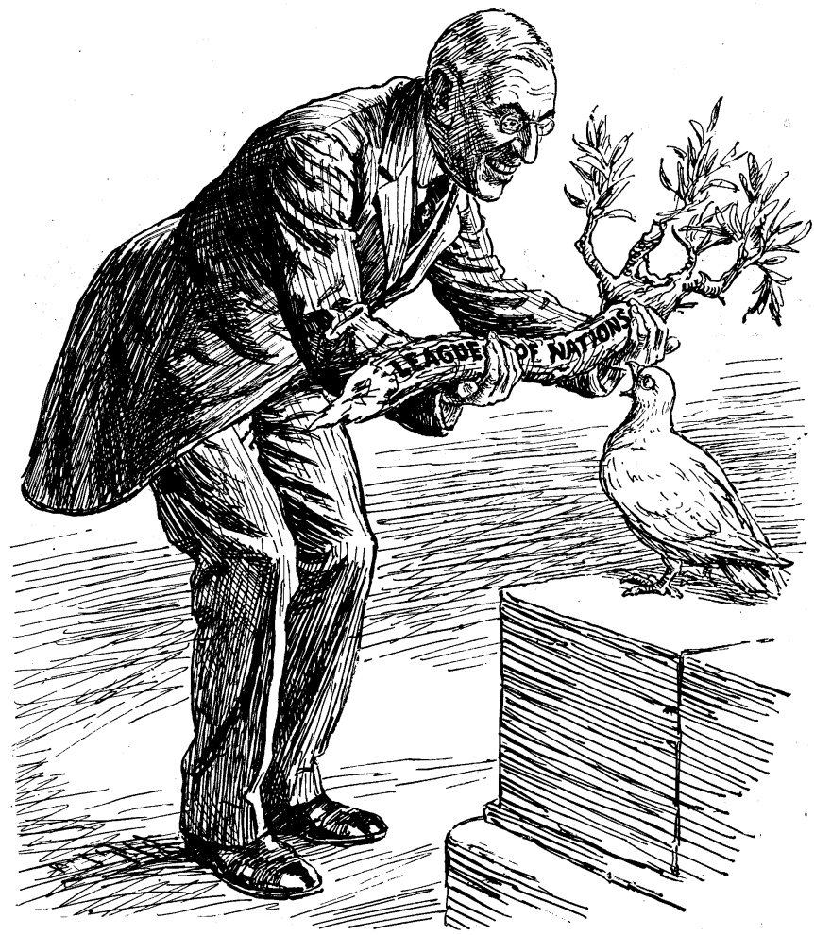
The League of Nations
An idea of American President Woodrow Wilson following the first world war
An international police force made up of representatives of many countries
An organization that would allow disputes to be settled without resorting to war, based in Geneva (neutral).

Slide 3
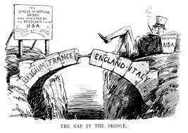
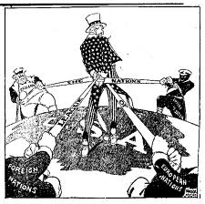
Wilson’s party lost the election in 1919. His opponents promised to follow a policy of isolationism (staying out of international affairs). And so America did not join the League of Nations…

Slide 4
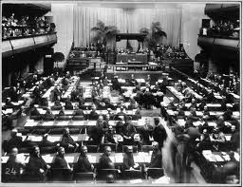
Aims of the League
Discourage aggression from any country
Encourage co-operation in business and trade
Encourage disarmament
Improve working and living conditions for people across the world

Slide 5
When it opened, some countries were not members of the League:
America:- had become isolationist Germany:- As a defeated country who was blamed for staring the Great war, Germany was not invited to join Russia:- Were not invited to join the League, mainly due to their Communist government

Slide 6
Successes in the 1920s
With the League’s help over 400 000 prisoners of war were returned home
The slavery Commission brought about the freeing of over 200 000 slaves in British-owned Sierra-Leone and organized raids against slave owners and traders in Burma
The Health Committee worked hard to defeat leprosy and malaria. It later became the World Health Organisation
Sweden accepted the League’s decision to give the Aaland islands to Finland. The two countries thereby avoided going to war for them
The League divided Upper Silesia between Germany and Poland after a plebiscite showed a clear divide. Both countries accepted this decision.

Slide 7
1929 Wall Street Crash!
This is MAJOR turning point for the league: *Many members of the League were now focussed on solving domestic problems. *The crash created a depression in Europe causing unemployment and poverty. Dictators rose to power as they promised a solution to problems. These were new problems for the League to face

Slide 8
The 1930s…
Were BAD for the League: *The 1930s are always seen as bad for the league by comparison with the 1920s. *There were three huge failures for the League in the 1930s:
The Japanese invasion of Manchuria
The failure of the disarmament conference
The invasion of Abyssinia by Italy

Slide 9
Failure #1: Manchuria
There was an explosion on the Manchurian railway that ran though China. The Japanese depended on this railway to transport goods into their country, whose natural resources and agriculture were limited by their mountainous terrain.
The Japanese invaded China on the grounds that it needed to safeguard its railway. However, they later also bombed Shanghai
China appealed to the League for help and the League ruled that the Japanese should return Manchuria to Chinese rule.
But Japan continued to invade new areas of China
The League discussed sanctions but its member were not prepared to send troops to enforce its decision…

Slide 10
Why did it fail?
*Japan was too far away *The League were worried about offending Japan who was an important member of the League *Britain and France were more concerned about the problems resulting from the depression in their own countries *Russia, the only country with troops and resources enough to combat the problem quickly in the region, was not a member of the League

Slide 11
Failure # 2 Disarmament Conference
July 1932 Germany walked out after the other countries failed to agree to all countries disarming to its level December 1932 An agreement was finally reached to treat the Germans equally January 1933 Germany announced that it was coming back February 1933 Hitler started to re-arm Germany anyway in secret October 1933 Hitler walked out of the Conference permanently and soon after withdrew Germany from the League of Nations

Slide 13
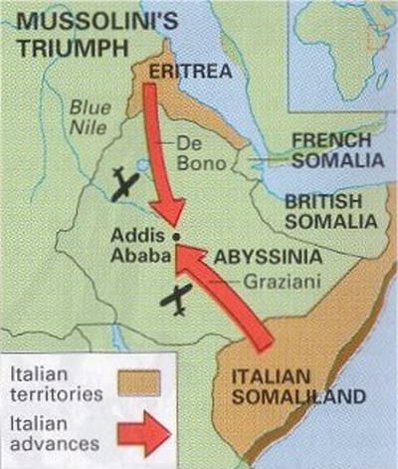
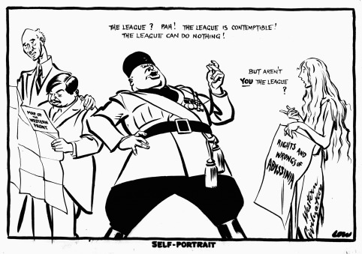
Failure 3: Mussolini’s invasion of Abyssinia 1935
Italy also wanted revenge after an embarrassing failed attempt to take Abyssinia in 1896
Like Japan, Italy was an important member of the League
Like Japan, Italy wanted to expand its empire
Unlike Japan, Italy was right on the League’s doorstep
Unlike Japan, Abyssinia had borders with British colonies
UNLIKE Japan, the League could not claim the problem was too far away to deal with.
This would be a very real test for the League

Slide 14
So what did the League do?
Very little… *The League was anxious to keep Italy on side. Italy was their best ally against Hitler. *Britain and France signed an agreement with Mussolini about standing united against Germany and the problem in Abyssinia was not even discussed *There was much talking and negotiating but nothing was actually done to discourage Mussolini *Eventually a committee reported to the League that neither side was responsible for the conflict at the oasis. The League put forward a plan that would give Italy some of Abyssinia. But Mussolini rejected it.

Slide 15
What were the reasons for the League of Nations’ failures during the 1930s?
Self-interest
Absence of important countries
Lack of Troops
T.Of V was unfair
Decisions were slow
Sanctions were ineffective

Slide 16
Exam-style questions
What were the main aims of the League of Nations? What was the structure of the League of Nations? Why did America not join the League of Nations? Explain how the views of Britain, France and America differed as to how the League should be run Explain why some countries were not members of the League when it opened. Explain the successes that the League had during the 1920s Explain why the League failed to deal with Abyssinia/Manchuria effectively To what extent was the League of Nations a complete failure/ how successful was it at keeping peace

