Slide 1
Jeopardy
Choose a category.
You will be given the answer.
You must give the correct question.
Click to begin.

Slide 2
Choose a point value.
Choose a point value.
Click here for Final Jeopardy

Slide 3
Causes
of WWII
Wartime
Politics
War in
Europe
War in
the Pacific
Canada’s
Home front
Misc
10 Point
10 Point
10 Point
10 Point
10 Point
10 Point
20 Points
20 Points
20 Points
20 Points
20 Points
20 Points
30 Points
30 Points
30 Points
30 Points
30 Points
30 Points
40 Points
40 Points
40 Points
40 Points
40 Points
40 Points
50 Points
50 Points
50 Points
50 Points
50 Points
50 Points

Slide 4
Part 1:This term describes the specific form of dictatorship that emerged prior to WWII
Part 2: Name the ‘Big Three’ Dictators that emerged prior to WWII

Slide 5
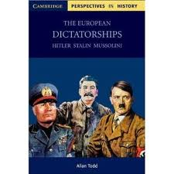
Totalitarianism
Stalin, Hitler, Mussolini

Slide 6
Part 1: This term refers to the unwillingness of western countries to intervene in Europe affairs
Part 2: this policy allowed aggressive countries to get what they wanted

Slide 7
Isolationism
&
Appeasement

Slide 8
Part 1: Failure of this organization in places like Abyssinia, contributed to start of war
Part 2: Germany resentment towards this treaty helped Hitler gain power

Slide 9
League of Nations
&
Treaty of Versailles

Slide 10
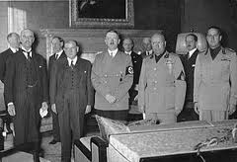
The Sudetenland was given to Hitler during this conference

Slide 11
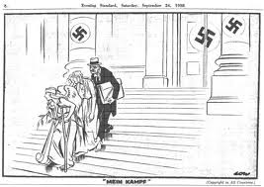
Munich conference

Slide 12
List several domestic changes instituted by Hitler as he became a dictator

Slide 13
Kristallnacht – Nov 9th, 1938 Hitler encouraged Germans to destroy Jewish property/business
Nuremburg Laws– These laws stripped Jews of property, professions and citizenship
Weimer Republic – Name of democratic government set up in Germany…ended by Hitler
Night of the long knives – June 1934, Hitler brutally oppressed any opposition
Gestapo – Name of the secret police force under the direction of the SS
Enabling Act– This legislation gave Hitler absolute power in Germany

Slide 14
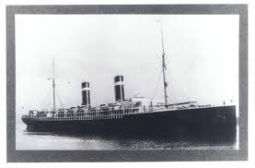
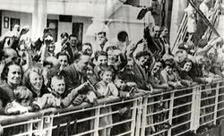
This ship carrying hundreds of Jews was turned away by Cuba, U.S & Canada

Slide 15
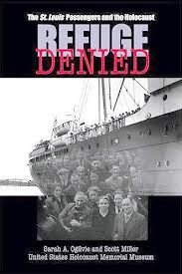
St. Louis

Slide 16
___ % of Quebec voted against conscription during the plebiscite

Slide 17
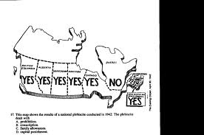
80 percent of Canada had answered yes out of the nine provinces but 70 percent of Quebec said no.

Slide 18
This conference established the Allied Control Council after the war

Slide 19
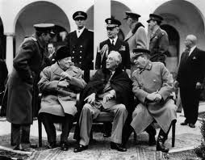
Potsdam

Slide 20
this man was the NAZI Minister of Propaganda during WWII

Slide 21
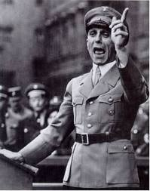
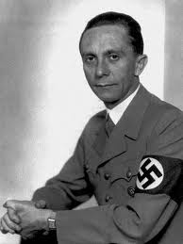
Joseph Goebbels

Slide 22
Identify and explain the significance of the NRMA

Slide 23
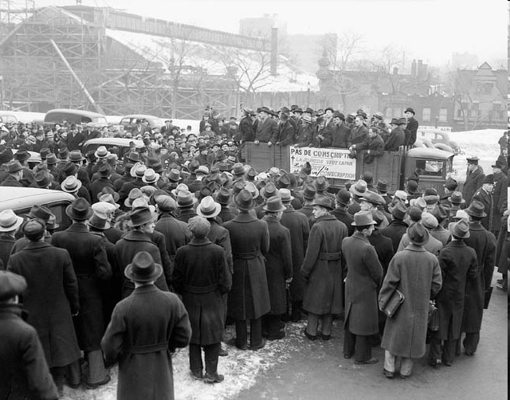
The National Resources Mobilization Act allowed the government to call men for the defense of Canada but not overseas service.
* Allowed King to establish Japanese internment camps

Slide 24
Part 1: This is the German word used to describe ‘lightning war’:
Part 2: The invasion of this country signaled the beginning of the WWII

Slide 25
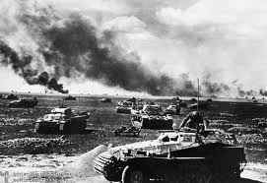
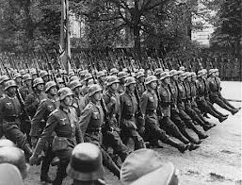
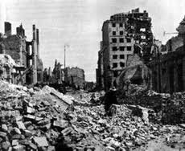
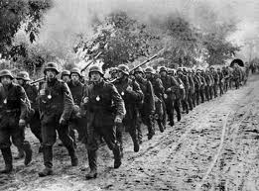
Blitzkrieg
&
Poland

Slide 26
Part 1: Name used for the German air force prevalent in the Battle of Britain:
Part 2: Germany attempted to cut off valuable supply lines during this battle:

Slide 27
Part 1: Name used for the German air force prevalent in the Battle of Britain: Luftwaffe
Part 2: Germany attempted to cut off valuable supply lines during this battle: Atlantic

Slide 28
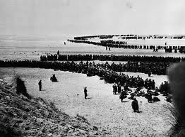
allied troops were miraculously evacuated from this beach in 1940

Slide 29
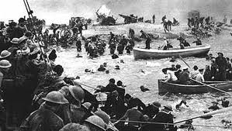
Dunkirk

Slide 30
majority of Canadian forces landed on this beach on June 6th 1944

Slide 31
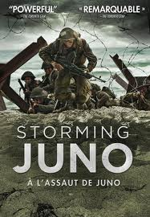
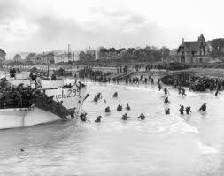
Juno

Slide 32
On June 22nd 1941, Hitler broke his 1939 agreement during this Operation:

Slide 33
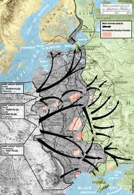
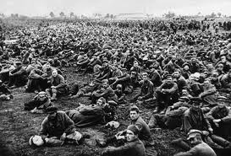
Barbarossa

Slide 34
Canadians experienced their first active fighting of WWII here

Slide 35
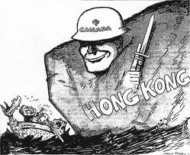
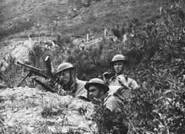
Hong Kong

Slide 36
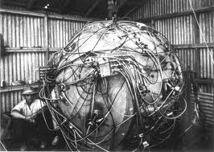
Name given to top secret experiment in the US to develop the atomic bomb

Slide 37
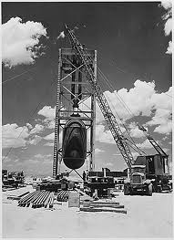
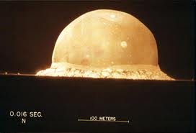
Manhattan Project

Slide 38
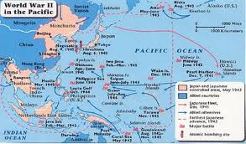
This term describes the capture of strategic points throughout the Pacific ocean:

Slide 39
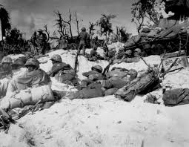
Island Hopping

Slide 40
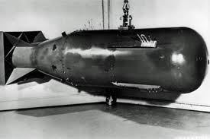
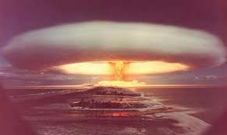
This man ordered the bombings of Hiroshima and Nagasaki

Slide 41
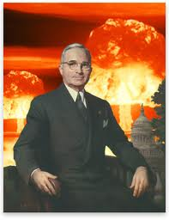
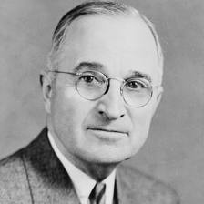
Harry S. Truman

Slide 42
Part 1: 1931, Japan invaded this Chinese province _____________
Part 2: the US naval base at Pearl Harbour was attacked by Japan on this day_______________

Slide 43
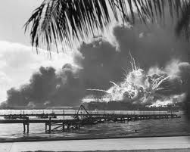
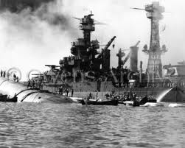
Manchuria
Pearl Harbour : December 7th, 1941

Slide 44
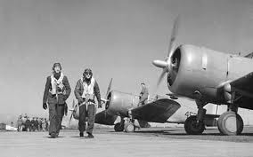
This is a program offered in Canada to help with the air war effort

Slide 45
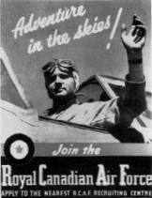
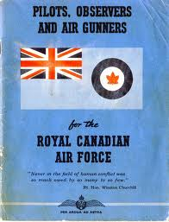
BCATP

Slide 46
Question 1: This American–born engineer who was King’s Minister of Munitions & Supply
Question 2: Canadian Minister of Finance and responsible for financing the war effort

Slide 47
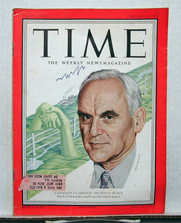
Clarence Howe : This American–born engineer who was King’s Minister of Munitions & Supply
J. L. Isley: Canadian Minister of Finance and responsible for financing the war effort

Slide 48
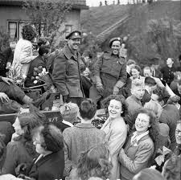
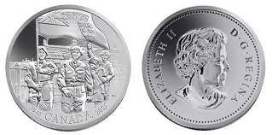
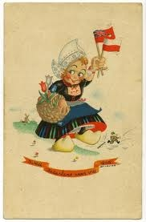
This is the country that Canadian troops freed from the Nazis

Slide 49
Holland

Slide 50
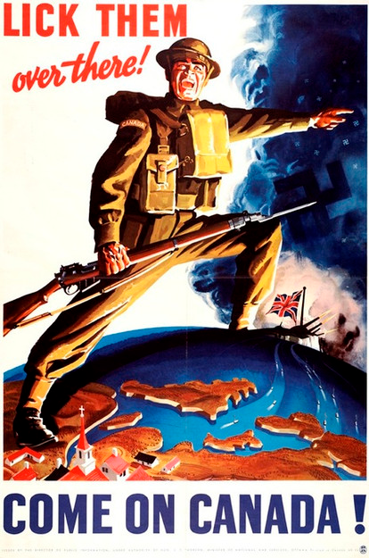
This is the date that Canada entered WW2

Slide 51
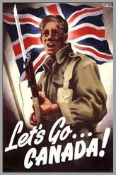
Sept 10 1939

Slide 52
This was an agreement between King and FDR that helped Canadian industry and contributed to the Lend-Lease program from the US

Slide 53
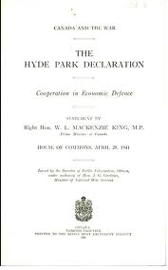
Hyde Park Agreement

Slide 54
This was the bloodiest battle of the eastern front in WWII

Slide 55
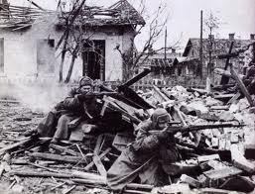
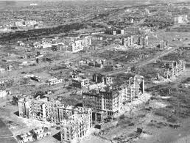
Stalingrad

Slide 56
Hitler wanted to take over the Soviet Union for lebensraum or this…

Slide 57
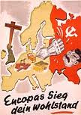
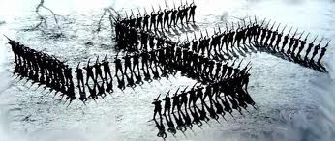
living space

Slide 58
Canadian victory here, allowed the allies to push north to Rome

Slide 59
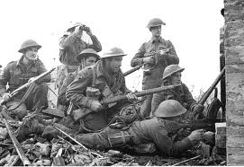
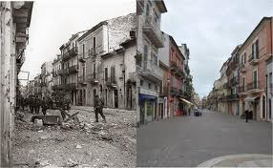
Ortona

Slide 60
The Battle of El Alamein was important for the control of this waterway

Slide 61
Suez Canal

Slide 62
Prime Minister King claimed that Canada is a ‘Fire Proof House’ in 1940 when this agreement was signed by US President Roosevelt to ensure American support in the defense of the continent

Slide 63
In 1940 President Roosevelt and Prime Minister King signed the Ogdensburg Agreement which ensured American support in the defense of the continent

Slide 64
Final Jeopardy
Make your wager

Slide 65
WW2 was a total war which involved of mobilization of over ____________ million people & resulted in the deaths of ______ million people.

Slide 66
WW2 was a total war which involved of mobilization of over ____100____ million people & resulted in the deaths of __63____ million people.

