Slide 1
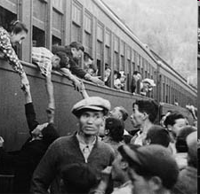
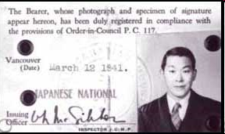
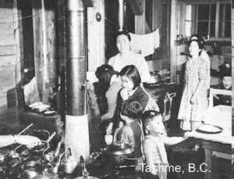
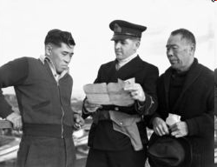
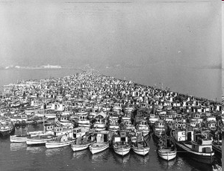
Canadian Japanese Internment Camps

Slide 2
War on the Home front
QUESTION 1: What is more important to you: Civil liberties (democracy, individual freedoms, rights etc.) OR National Security
QUESTION 2: Would this change during war? Why or why not?

Slide 3
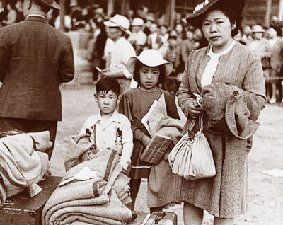
Treatment of Japanese Canadians

Slide 4
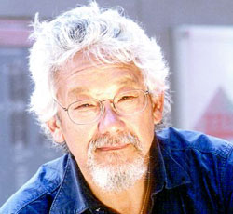
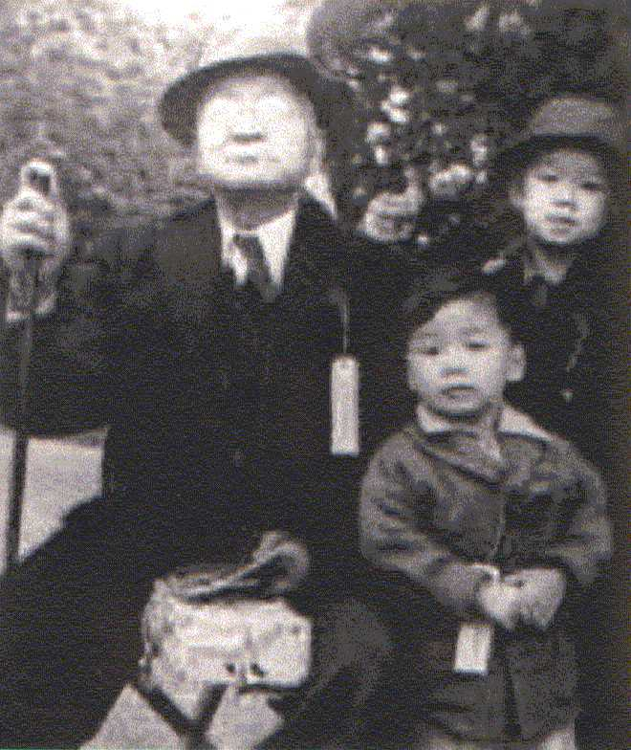
WWII – Japanese Internment
At the start of World War II, nearly 23,000 people of Japanese descent lived in Canada, most in British Columbia.
Nearly 75% held Canadian citizenship, and over 13,000 were Japanese-Canadians (i.e., they were born in Canada).
Many Japanese-Canadians owned land, worked hard and dutifully paid taxes.

Slide 5
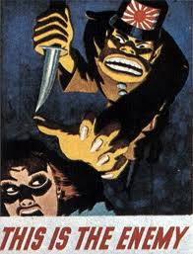
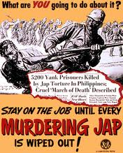
Canadian Sentiment…
Common belief held was that the Japanese are unable to assimilate into Canadian society as easily as those of European heritage.
Prime Minister Mackenzie King himself expressed a belief in “the extreme difficulty of assimilating Japanese persons in Canada”

Slide 6
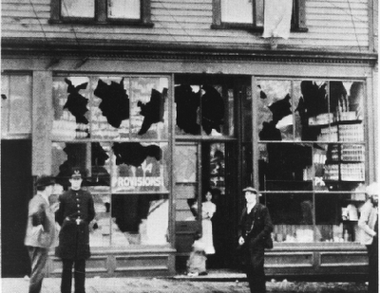
Do we need proof?
Japanese submarines are known to have been operating off the coast of British Columbia
Although RCMP and Canadian military evaluations suggested no imminent threat by Japanese Canadians, this assessment is not universally accepted, as there exists no guarantee of the loyalty, or passivity of Japanese-Canadians.

Slide 7
WWII – Japanese Internment
Japanese had always faced racism in British Columbia. Highly conscious of their British heritage, whites enacted laws excluding “undesirables” (e.g., prohibition on working on any provincial project)
In 1941, members of the non-Japanese population of British Columbia, including municipal government offices, local newspapers and businesses called for the internment or imprisonment of Japanese.
Many Japanese worked in the fishing industry. Some Canadians expressed fear that the Japanese fishermen were charting the coastline for the Japanese navy. As a result, 1,200 Japanese fishing boats were confiscated by the Government of Canada.

Slide 8
What should be done?
Resentment against Japanese Canadians exploded into panic and anger in British Columbia.
1,200 fishing boats were seized by the Canadian navy in fear of spying
The war offered a convenient excuse for Canadians to address the Japanese Canadian question.

Slide 9
TOWN HALL MEETINGS
“Due to the increasing suspicions of the Japanese Canadians and following Canada’s declaration of war on Japan, what should be done with the Japanese Canadians living in British Columbia?”

Slide 10
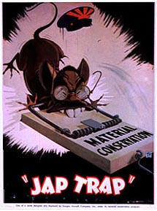
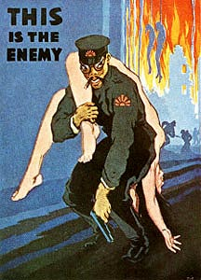

Slide 11
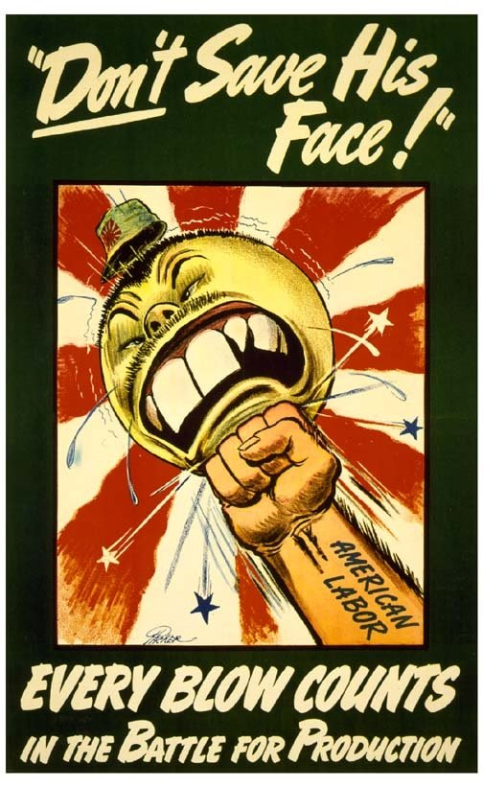
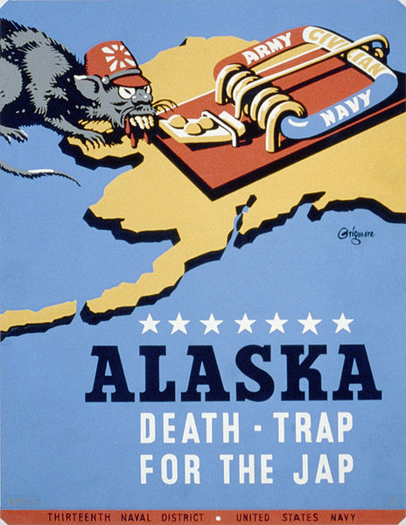

Slide 12
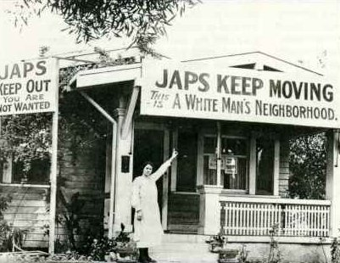
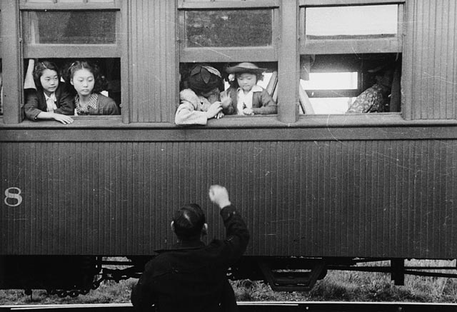

Slide 13
Minoru

Slide 14
The Canadian War Measures Act
1914 – “gave the government sweeping powers to ensure the security, defence, peace, order, and welfare of Canada.”
Used to imprison CANADIANS of German, Ukrainian, and Slavic descent in WWI.
1939- War Measures Act invoked- this allowed for the internment of enemy aliens

Slide 15
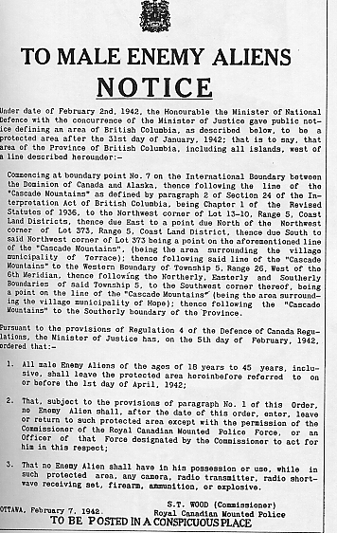
All Japanese Canadians were treated as enemies, whether they lived in internment camps, road camps, or farms.

Slide 16
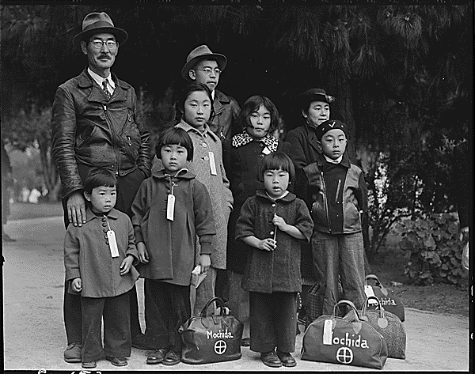
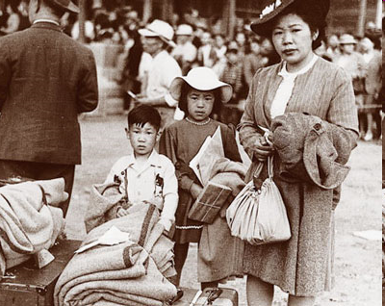
Japanese Internment in Canada
■ The movement of 23,000 Japanese Canadians during the war was the largest mass exodus in Canadian history.

Slide 17
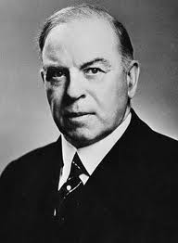
King’s Decision
In spite of he RCMP assurances that there was no evidence of Japanese disloyalty or Fifth Column activity, King made no attempt to stop relocation via the War Measures Act. Why?
In her book, The Politics of Racism: The Uprooting of Japanese Canadians During World War Two, Ann Sunahara describes Prime Minister King
King was an astute politician who often changed positions to suit popular opinion. Thus he was swayed by the unfounded paranoia from B.C. & the racism of west coast politicians like MP Ian MacKenzie.
In a quote to Vancouver Sun MacKenzie declared "It is the government’s plan to get these people out of B.C. as fast as possible. It is my personal intention, as long as I remain in public life, to see they never come back here. Let our slogan be for British Columbia: ‘No Japs from the Rockies to the seas.”
Canadians benefited financially buying confiscated property

Slide 18
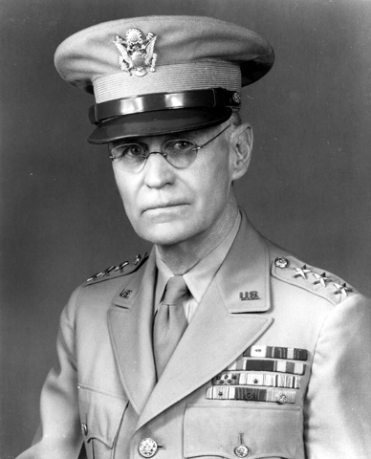
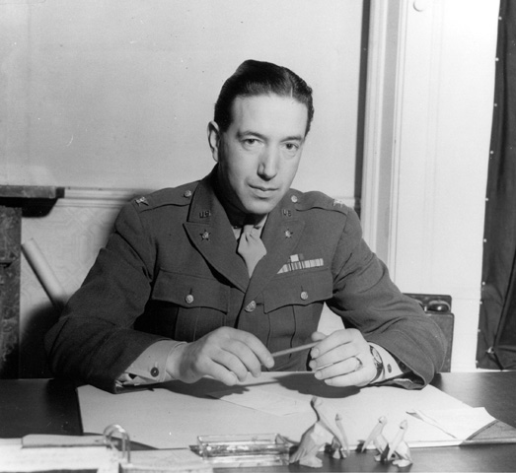
Discrimination was rampant:
"A Jap's a Jap. It makes no difference whether the Jap is a citizen or not." — General John L. DeWitt, Commander, Western Defense Command, 1942
"I am determined that if they have one drop of Japanese blood in them, they must go to camp." — Colonel Karl Bendetsen, Administrator, Wartime Civil Control Administration, 1942

Slide 19
Internment Timeline
1941 (December 8): 1,200 Japanese Canadian fishing boats are impounded. Japanese language newspapers and schools close.
1942 (January 16): Removal begins of Japanese immigrant males from coastal areas.
1942 (February 24): All male Japanese Canadian citizens between the ages of 18 and 45 ordered to be removed from 100-mile-wide zone along the coast of British Columbia.
1942 (February 26): Mass evacuation of Japanese Canadians begins. Some given only 24 hours notice. Cars, cameras and radios confiscated for “protective measures”. Curfew imposed.
1942 (March 4): Japanese Canadians ordered to turn over property and belongings to Custodian of Enemy Alien Property as a “protective measure only”. Eventually these assets were sold and proceeds used to pay for the interment
1942 (March 25): British Columbia Security Commission initiates scheme of forcing men to road camps and women and children to “ghost town” detention camps.

Slide 20
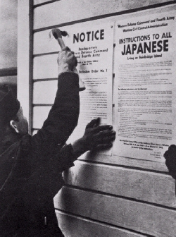
WWII – Japanese Internment
Bowing to public pressure, the Government of Canada issued War Time Measures Act on 24 February 1942 forcing Japanese-Canadians and Japanese in Canada on 24 into “protective areas” (i.e., internment camps) for “their own safety”.
All property that could not be carried would be taken into “protective custody.” These items effectively became the property of the Canadian government.

Slide 21
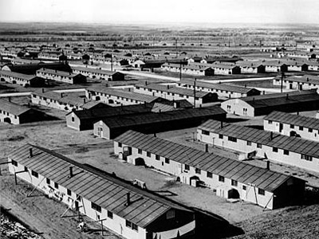
WWII – Japanese Internment
There were ten internment camps in Canada. The camps included three road camps, two Prisoner of War (POW) camps, and five self- supporting camps scattered throughout Canada.
The camps were not surrounded with barbed wire, but living conditions were primitive and crowded with no electricity or running water.

Slide 22
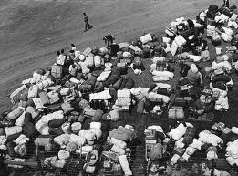
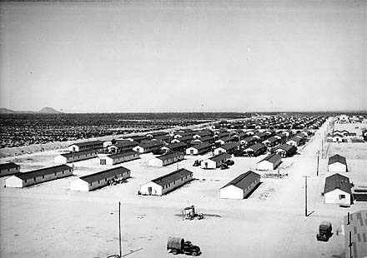
WWII – Japanese Internment
Canada sent Japanese males to (1) road camps in the British Columbian interior, (2) sugar beet projects on the Prairies, or (3) internment in a POW camp in Ontario.
Women and children were moved to six towns in the interior of British Columbia. In these towns, the living conditions were desperately poor. Citizens of wartime Japan sent supplemental food shipments through the Red Cross.

Slide 23
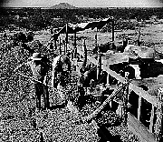
WWII – Japanese Internment
Under the pretence of homeland protection, Japanese-Canadians were
(1) denied their basic rights,
(2) issued special clothing,
(3) stripped of their personal belongings and property,
(4) relocated into camps, and
(5) forced into manual labour.
As well, Japanese schools were closed, Japanese newspapers were shut down and a dusk-to-dawn curfew was imposed.
These actions were similar to to the Nazi impoverishment and relocation of Jews to ghettos prior to WWII.

Slide 24
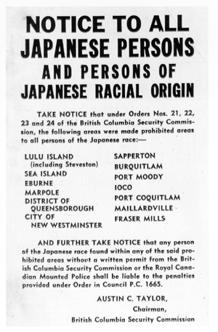
This notice was posted in all coastal areas.

Slide 25
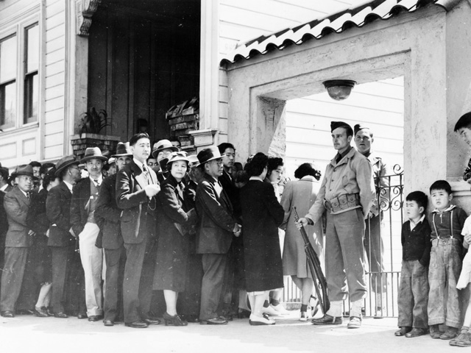
Registration of all Japanese-Canadians, both resident aliens and citizens, was the first step toward forced removal.

Slide 26
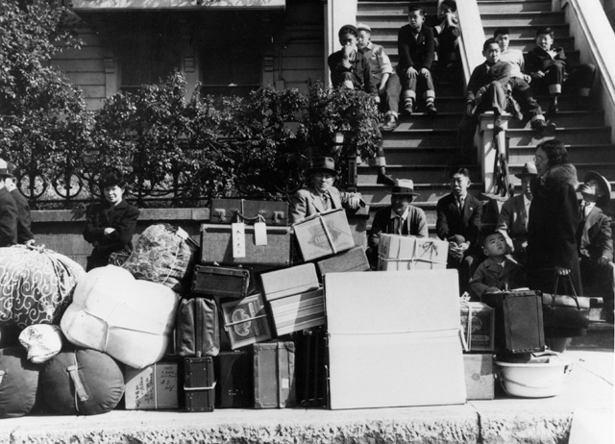
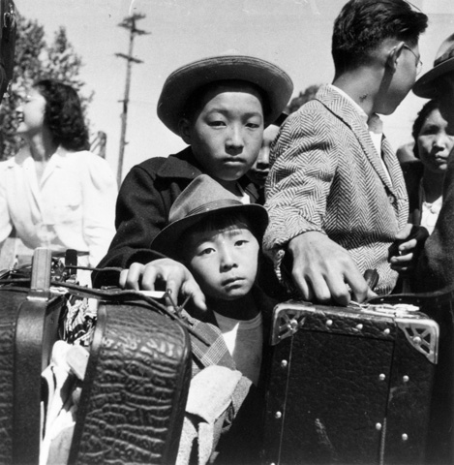
Removal
The order to prepare for the move to the assembly centers left little time for packing, selling household goods, or locating safe storage for precious personal possessions.
Allowed to take only what they could carry, Japanese Canadians headed for the camps had no room for toys, precious heirlooms, or other personal treasures.
Family pets were left behind.

Slide 27
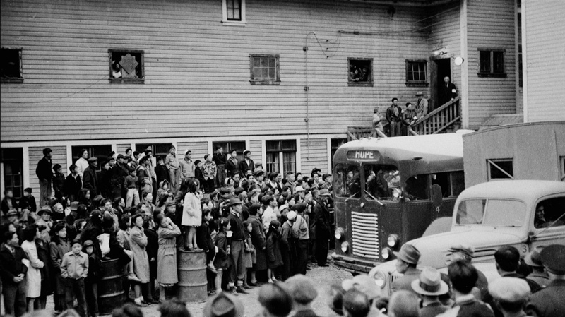
They had no rights and could not legally refuse to obey. Men, women, and children were photographed and fingerprinted, and given an identification number.

Slide 29
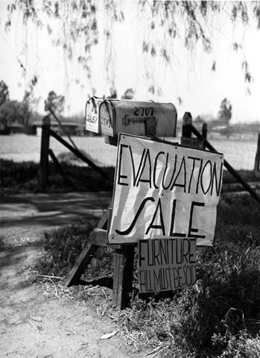
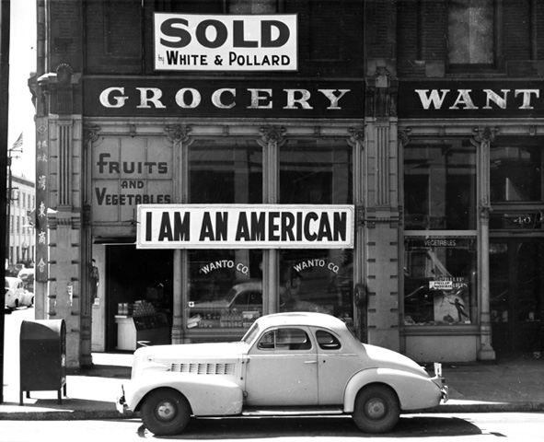
For thousands of Japanese-Canadian (and Japanese-American) homeowners and small businessmen, moving out also meant selling out — quickly, and at an enormous loss.

Slide 30
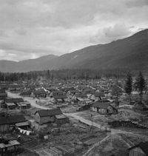
The federal government sold off all Japanese-Canadian-owned property left behind: homes, farms, fishing boats, businesses and personal property at bargain basement prices.
To add insult to injury, the government then deducted the proceeds of these sell-offs to pay for any welfare received by the owner while unemployed in a detention camp.

Slide 31
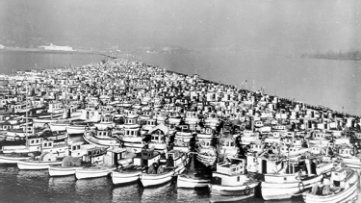
This photograph shows Japanese fishing boats seized by the government and corralled at Annieville Dyke of the Fraser River.
Japanese fishermen were evacuated first in response to the rumors that they might actually be operating as spies, gathering information on coastal waters and areas. They were subsequently displaced to work camps without any warning.

Slide 32
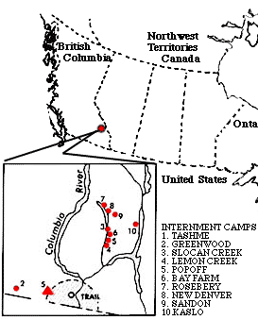
By October 1942, the Canadian government had set up 8 internment camps in interior BC. They were in Kaslo, New Denver, Tashme, Roseberry, Slocan City, Lemon Creek, Sandon, and Greenwood.
Tashme was named after the 3 leading BC's security commisioners; Taylor, Shirras, and Mead.

Slide 33
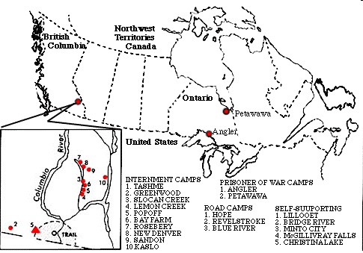
Canadian Internment Camps

Slide 34
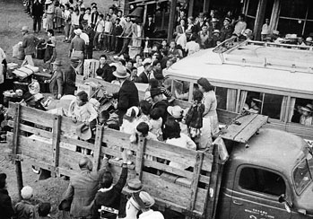
Leaving for the camps

Slide 35
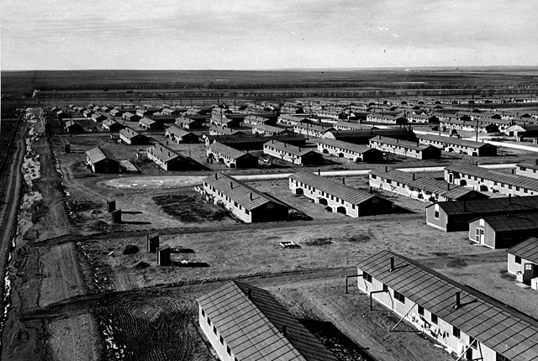
By the end of 1942, more than 22,000 men, women, and children of Japanese ancestry had been uprooted from their homes. Their final destinations would be camps in the interior of BC.

Slide 36
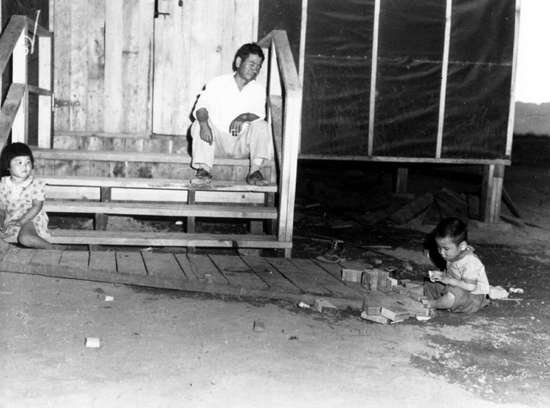
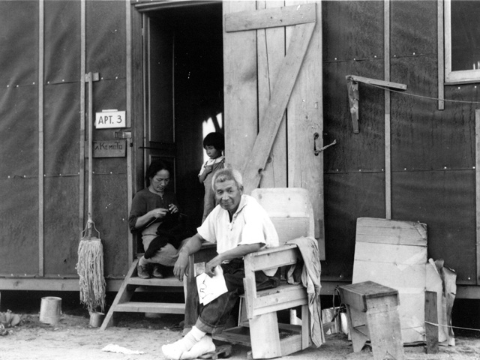
Hastily built, with tarpaper walls and no amenities, the barracks were hot in summer and cold in winter. Most did not meet minimal standards for military housing.
A visiting judge noted that prisoners in federal penitentiaries were better housed.

Slide 37
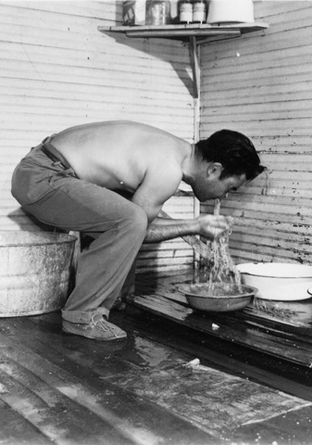
"There was a lack of privacy everywhere. The incomplete partitions in the [latrine] stalls and the barracks made a single symphony of yours and your neighbors' loves, hates, and joys. One had to get used to snores, baby-crying, family troubles... The sewage system was poor, [and] the stench from the stagnant sewage was terrible." —Mine Okubo

Slide 38
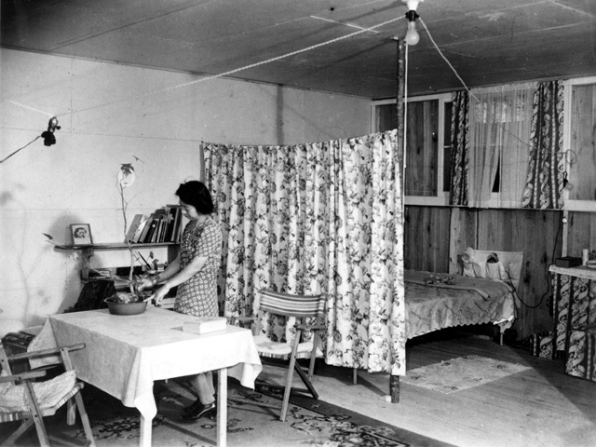
Despite the starkness of their barracks apartments, evacuees did their best to give them a homey touch and find a bit of privacy." Nisei: The Quiet Americans

Slide 39
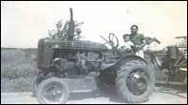
The war caused a large labour shortage for farmers, especially sugar beet farmers. The Security Commission Council organized sugar beet projects to combat the labour shortage. This gave the Japanese males a choice.
The choice was to work in road camps as slaves or go to the beet camps and be with their families. Working in the beet camps was the choice taken by the majority of Japanese married men.

Slide 40
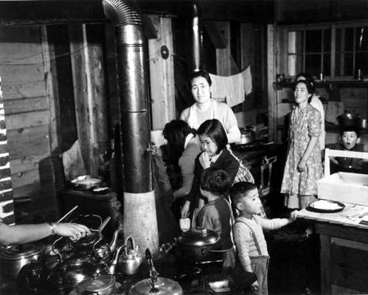
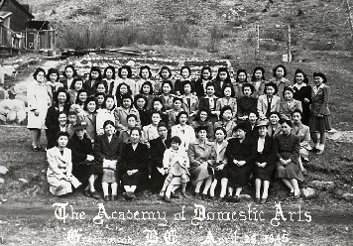
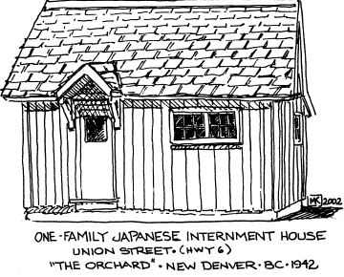
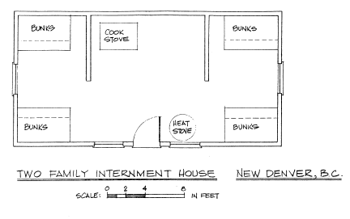

Slide 44
Camp Conditions continued
Hundreds of women and children were squeezed into livestock buildings
Slept on beds covered in straw for comfort
Conditions were so poor that food packages were sent from Japan through the Canadian Red Cross to those suffering in the camps

Slide 45
Conditions in the Camps
Housed in huts with two bedrooms and a kitchen
shared by two families
No electricity or running water until 1943

Slide 46
End of the War
In 1945, the government extended the Order in Council to force the Japanese Canadians to go to Japan and lose their Canadian citizenship, or move to eastern Canada.
Even though the war was over, it was illegal for Japanese Canadians to return to Vancouver until 1949.
Public protest would eventually stop the deportations, but not before 4000 Japanese left the country.
New Japanese immigrants were barred from entering Canada until 1967

Slide 47
WWII – Japanese Internment
Japanese-Canadians who remained in Canada were not allowed to resettle in British Columbia. Rather, they were ordered to disperse eastward.
Their homes and property was not returned. These items had been sold long ago by the Government of Canada. The Japanese did not receive compensation for the sale of their properties.
Japanese-Canadians were given the right to vote in 1949.

Slide 48
WWII – Japanese Internment
On 22 September 1988, Canadian Prime Minister Brian Mulroney offered a formal apology from Canada to the internees.
The Canadian government also provided compensation. The package included (1) $21,000 to all surviving internees, and (2) the re-instatement of Canadian citizenship to those who were deported to Japan.

Slide 49
August 26, 1988
On this date, the Terms of Agreement between the Government of Canada and the National Association of Japanese Canadians was signed.

Slide 50
1) An acknowledgement that the treatment of Japanese Canadians before and after WWII was unjust and a violation of human rights.
2) A pledge to ensure that the Government, to it’s full power would prevent events such as these from occurring again.
3) Recognize the determination of Japanese Canadians, that despite their hardships, continue to remain committed & loyal to Canada and contribute to the nation.

Slide 51
Redress
Monetary redress for those who were interred, relocated, deported or lost property based solely on their Japanese ancestry.
Individual amount was $21,000 tax free.
$12 million was given to the Japanese community through the NAJC.

Slide 52
$24 million for a Race Relations Foundation.
The names of those Japanese Canadians convicted under the WMA would be cleared.
Canadian citizenship would be reinstated.
$3 million given to the NAJC for the administration of the redress process.

Slide 53
Discussion Questions:
It is important to note that Canada is at war with Japan, Germany, Italy and Austria. Why then were only Japanese-Canadians held against their will?
Is $21,000 for each individual directly wronged an acceptable redress to the issue? Would it be enough to compensate the many losses incurred?
Was the government justified in relocating the Japanese Canadians during WWII?
Under what circumstances would Canada do this again?
Can you think of any other examples of a population being forced to move, relocate, or live in an area away form everyone else?

Slide 54
Justified?
YES
Prime Minister Mackenzie King took necessary precautions to ensure national security of Canada and North America, as the US had also interned Japanese-Americans
Despite no evidence of threat, there was no guarantee of loyalty or passivity of the Japanese Canadians to homeland Japan
Canadians felt that Japanese-born Canadians showed too much sympathy for Japan and that there was a chance that some of them might form a fifth column (espionage).
“Japan was aggressively expanding in the Pacific (islands of Attu and Kiska). Moreover, American and Canadian governments were more alarmed as a Japanese submarine had fired on telegraph station and lighthouse in British Columbia”.
The interment, deportation and relocation of the Japanese Canadians was for their own safety and was legal through War Measure Act
NO
Japanese Canadians were judged solely on the basis of their racial ancestry, and not their citizenship.
Internment based on racist and xenophobic public sentiment
RCMP and Canadian military evaluations suggest no imminent threat to national security and the J-C are law abiding citizens
The Japanese Canadians were harshly mistreated, property was seized and sold and used to pay for camps
Camps had terrible conditions
Food packages were sent from Japan through the Canadian Red Cross to those suffering in the camps
Canadian government spend 1/3 the per capita amount expended by the US on Japanese American internees
Notes:
Camps had terrible conditions (Housed in huts with two bedrooms and a kitchen; shared by two families; No electricity or running water until 1943; hundreds of women and children were squeezed into livestock buildings; slept in straw beds)

