Slide 1

What is propaganda?
The spreading of ideas, information, or rumor for the purpose of helping or injuring an institution, a cause, or a person.

Slide 2
Critical attributes of propaganda
Purposefully spreads information, ideas or rumors
Primary goal: to hurt or help someone or something
The primary target of propaganda is people's opinions rather than their knowledge.
Employs specific techniques to achieve the above.

Slide 3
Propaganda techniques
Bandwagon (appeals to feelings of loyalty, nationalism, a desire to win; obscures facts)
Doublespeak (words/phrases created to serve a political purpose, i.e., “axis of evil”, “classified”)
Euphemisms (make things sound better than they really are, i.e., “went to heaven” instead of “died”)

Slide 4
Fear (one of the most powerful human emotions, therefore this is one of the most powerful techniques used in propaganda)
Glittering Generalities (words or phrases that sound nice but are hard to define so they end up not really meaning anything)
Name-calling (all in the hope that the audience will reject the person or country, etc. based on the name-calling and not evidence)

Slide 5
Plain folks (“I’m like you” strategy – the propagandist wants you to believe that he/she is just like “common folk” – and therefore so are their ideas)
Testimonial (use of personal experience to convince others)
Transfer (Using the public’s trust (in the gov’t, for instance) to convince us of something the propagandist wants the public to believe)

Slide 6
Exemplars of propaganda

Slide 7
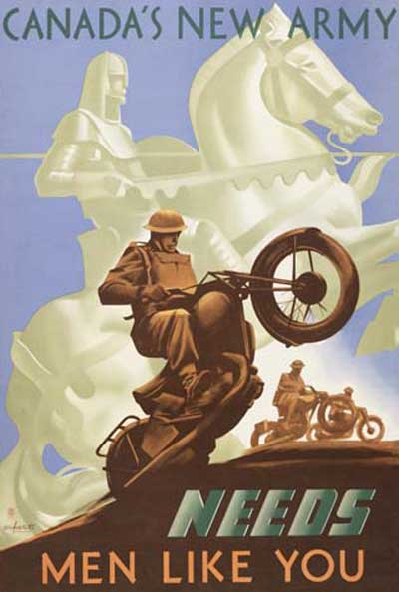

Slide 8


Slide 9


Slide 10
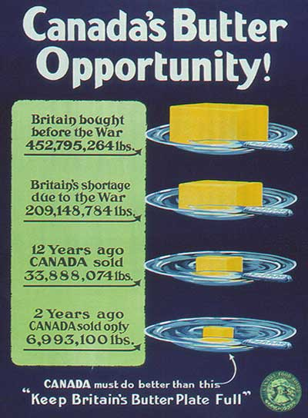

Slide 11
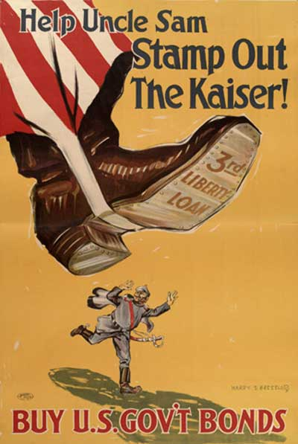

Slide 12
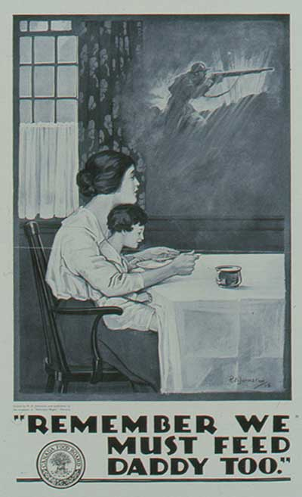

Slide 13
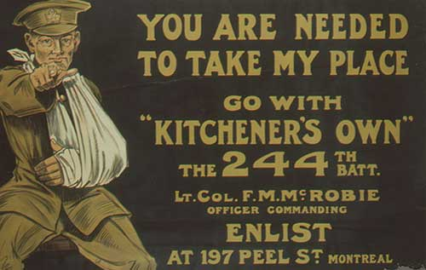

Slide 14
The Home Front
Families were Separated by the War

Slide 15
Contributions by Ordinary Canadians
The Canadian Patriotic Fund collected money for soldiers’ families.
The Military Hospitals Commission set up hospitals to care for the wounded.
The YMCA organized canteens and support services for soldiers on leave.
The Red Cross provided humanitarian aid and kept track of wounded soldiers.

Slide 16

Financing the War
The costs were enormous and to meet these expenses government introduced a temporary tax on personal income in 1917.(Income TAX)
Victory bonds were offered for sale at an interest rate of 5%.
The sale of bonds vastly exceeded expectations and raised $500 million in 1917.
Temporary Business Tax and Donations

Slide 17
Victory Bonds
By 1918 the war was costing Canada over one million dollars a day. Large sums were raised through the sale of Victory Bonds.

Slide 18
Food
The produce of Canada’s agricultural industry was one her most vital contributions to the war.
Farmers profited from the sale of wheat to war-torn France and Britain.
Over use of soil or grain mining was to help cause the dustbowl conditions of the 1930s.
1918 Prohibition- grains used for alcohol used for food

Slide 19
Enemy Aliens
German and immigrants from the Austro-Hungarian Empire were looked on by many Canadians with hostility and suspicion.
In 1915 over 8,000 “enemy aliens” were interned in camps.
The city of Berlin, Ontario was forced to change its name to Kitchener.
Rocks were thrown at German dogs

Slide 20
Domestic Enemies
People born in a Country that was at war with Canada:
Interned (forced to live separate from Cdns)
Fired from Employment
Name Changes
No German composed music was allowed to be played

Slide 21
The Armaments Industry
Canada was a major manufacturer of weapons and ammunition.
Col. Sam Hughes, the Minister of Militia, founded a Shell Committee to coordinate orders from Britain.
The Shell Committee was marked by corruption and inefficiency and was soon replaced by the Imperial Munitions Board headed by Joseph Flavelle.

Slide 22
Women and the War Effort
By 1915 women were filling jobs in all of Canada’s industries.
Many Canadian women served overseas as nurses and ambulance drivers.
There were many reforms improving the lot of women but the vote was denied to most until 1917.
Women’s groups campaigned against the use of alcohol.
PROHIBITION

Slide 23
The Halifax Explosion
1917
In 1917 war came suddenly and violently to Halifax, a naval port and departure point for overseas convoys.
Ships formed up in Bedford Basin and passed out though the harbour narrows on their way to the open sea.
The Mont Blanc a French munitions ship collided with the Imo a Norwegian ship in the Narrows.
The resulting explosion destroyed most of the north end of Halifax and killed or injured 11,000 citizens.

Slide 24
Halifax After the Explosion

