Slide 1
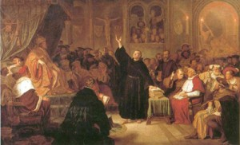
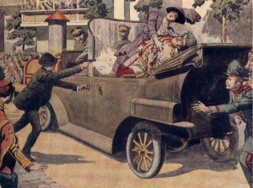
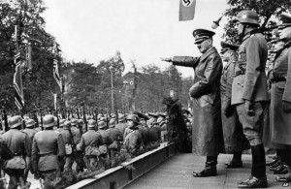
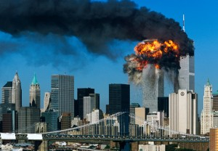
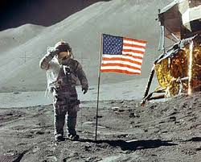
HISTORICAL SIGNIFICANCE: Some things ARE more important than others!

Slide 2
Brainstorm:
How do we decide if one event is more significant or important than another?
What makes events/people/places significant?

Slide 3
Rank in the order of historical significance (1 = MOST significant):
Start of WWII, 1939
Mr. Campbell Born, 1986
Terrorist attack on World Trade Centre, 2001
Pt. Grey Secondary opens, 1929
Canada becomes a country, 1867
Justin Trudeau becomes PM, 2015

Slide 4
HOW DID YOU MAKE YOUR DECISIONS?

Slide 5
www.mrcampbellonline.weebly.com
Go there…
Click the Signfincance button

Slide 6
Now, Learn, Observe, Infer, and Conclude by Ranking & Ordering
95 Thesis
”The Divine Right of Kings”
Roman Catholicism
Trade Merchants
Imperialism
Humanism
Protestantism
Nations
“Kingly Virtues”
Feudalism
Reformation
Printing press
Three-field system
Economy

Slide 7
Setting Criteria: How do we determine Historical Significance?
The event/person:
Was important at the time
Had a lasting effect over a long period of time
Had an effect on a large # of people
Caused things to change
Other?

Slide 8
The MOST significant causes of the Renaissance and Reformation:
Look at your notes for “The Renaissance and Reformation”
Use your criteria for deciding significant to choose what you think are the TOP 3 causes for the ”Renaissance and Reformation”
For each of your top 3, explain WHY that cause was more significant than the others

Slide 9
3 Most Significant Causes of the “Renaissance and Reformation”
Ranking | Cause | Reason/Explanation
#1
#2
#3

