Slide 1
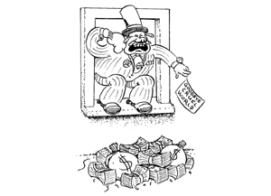
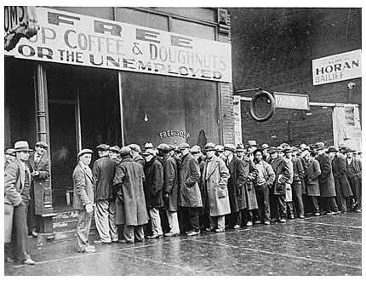
The Great Depression

Slide 2
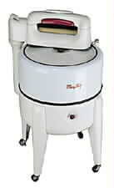
Canadian Economic Expansion in the 1920s
Primary industries such as pulp and paper and mining had experienced growth during the war and continued to expand through the 1920s.
Wheat did well during the war but the price fell in 1921 and did not recover until after 1924.
Manufacturing had also expanded and after the war began to produce a variety of consumer goods.

Slide 3
Problems in The Canadian Economy
Canadian prosperity in the 1920s depended mostly on resource industries such as pulp & paper and mining.
The Canadian economy was too closely linked to the United States and to European recovery.
Many Canadians and some parts of Canada did not share in the prosperity of the 20s.
"shinplaster"

Slide 4
Canada and the Crash of 1929
There was little market for the 1928 wheat crop and drought killed the 1929 crop.
As consumer spending slowed Canadian factories began to close and unemployment increased.
Mackenzie King and the Liberals had few solutions.
UNEMPLOYMENT RATE
1933 - 26.6%
1926 - 4.7%

Slide 5
The Business Cycle
Successive stages of prosperity followed by depression and then recovery are normal for the economy.
The 1920s were marked by unprecedented prosperity.
but
It was to be expected that prosperity would be followed by a recession.

Slide 6
The Business Cycle
DEPRESSION
RECESSION
RECOVERY
PROSPERITY

Slide 7
International Economic Problems
High tariffs brought on by excessive economic nationalism restricted the flow of exports.
Goods were overproduced for the domestic economy and unable to be sold abroad.
Easy credit practices made ordinary people vulnerable to fluctuations in the economy.
Buying stocks on credit or margin encouraged speculation.
TARIFF WALL
GOODS
FOR EXPORT
FOREIGN MARKETS

Slide 8
Psychological Problems
There was a belief that Canada and the United Sates had entered an era of “perpetual prosperity.”
Many Canadians, including farmers, shared neither the prosperity nor the optimism.
Even some factory workers found themselves unable to afford the goods they produced.

Slide 9
The Market Crashes
Prices of consumer goods remained too high in spite of indications that the market was slowing.
Artificially inflated stock prices did not represent the true value of the shares.
Sales of many consumer products slowed resulting in less production and layoffs.
Investors stopped buying stocks and began to sell off their shares.

Slide 10
The Stock Market Crash
On Tuesday October 29, 1929 panicky investors dumped over 16 million shares on the New York stock market. These shares were sold for rock bottom prices. “Black Tuesday” was the culminating event in several weeks of falling market values. It was not the cause of the Great Depression but marked the beginning of a period of economic decline which was to last until 1939.
SHARE SALES
SHARE VALUES

Slide 11
Causes of the Depression
Canada’s prosperity in the 1920’s had two great flaws:
1. Narrowly based: most Canadians could not afford cars, refrigerators, stocks and radios
- Canadian market could not absorb the products Canada made (overproduction)
- People started to sell their stocks as Canadian factories began to close
2. Canada was heavily dependent upon world economy:
- 80% of what Canada’s fields, forest, waters, and mines produced was exported.
- Europe post war debt (could not afford Canadian products)
- U.S. wanted loans repaid by Britain and France, but they could not afford it until Germany paid reparations imposed at Versailles.
- Prairie Provinces faced competition from other countries over wheat prices.

Slide 12
The Great Depression in Canada
Canadian market collapse quickly followed the failure of the New York market.
Tariff barriers were particularly hard on Canadian exports of raw materials.
The collapse of the wheat market was disastrous for Canada.
Drought on the prairies during the 1930s made the situation very difficult for farmers.
King promised NO help

Slide 13
The Election of 1930
Pressured by the provinces for federal financial relief King indicated that he would not provide “ a five-cent piece” for any province with a Tory government.
R. B. Bennett and his Conservatives swept to power on a promise of higher tariffs and an end to unemployment.

Slide 14
Richard Bedford Bennett
King’s unfortunate “five cent speech” helped him lose the election of 1930.
Bennett and the Conservatives promised to “blast (Canada’s) way back into the markets of the world” with high tariffs.
This policy offered some protection to industry in central Canada but did little for ordinary people.

Slide 15
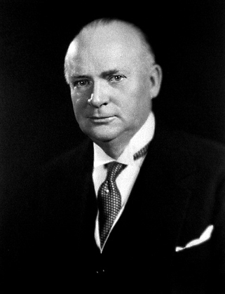
R.B. Bennett in Power
“I will end
unemployment
or perish in the
Attempt.”
Mackenzie King and the Liberals escaped into opposition just as the worst phase of the “Great Depression” plunged Canada into economic despair.
It was left to R.B. Bennett and the Conservatives to try and solve economic problems which reached well beyond Canada’s borders.

Slide 16
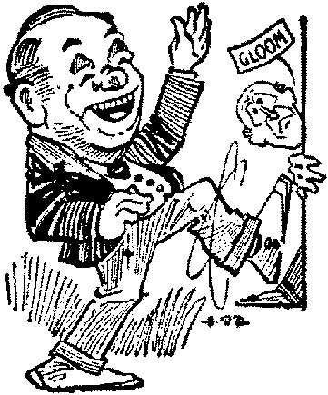
Unemployment and Relief
Factories closed and farmers walked away from the land.
Railway revenues fell sharply.
By 1935 10% of the Canadian population was on relief.
Mackenzie King and the Liberals had hesitated to act and R.B. Bennett had few new ideas.

Slide 17
Bennett is Blamed for the Problem
Farmers unable afford gasoline hitched horses to their cars and drove ‘Bennett Buggies.”
Unemployed men lived in “Bennett Boroughs.”
Newspapers used to cover men who slept on park benches were “Bennett Blankets.”
Deserted farms became “Bennett Barnyards.”

