Slide 1
5 Components of Fitness
PE 8 Knowledge Component

Slide 2
5 Components of Fitness
There are 5 components of physical fitness, and those components represent how fit the body is as a whole.
Total fitness is defined by how well the body performs in each of the 5 categories.

Slide 3
5 Components of Fitness
These 5 components measure your body's ability to use oxygen as fuel, your muscular strength and endurance, the flexibility of your joints and your total body fat.

Slide 4
5 Components of Fitness
Cardiorespiratory Endurance
Muscular Endurance
Muscular Strength
Flexibility
Body Composition

Slide 5
Cardiorespiratory Endurance
Ability of the heart, lungs, and blood vessels to use and send fuel and oxygen to the body
Long periods of moderate to vigorous activity
If you're weak in cardiovascular endurance, you'll need aerobic conditioning in the form of jogging, swimming or cycling.

Slide 6
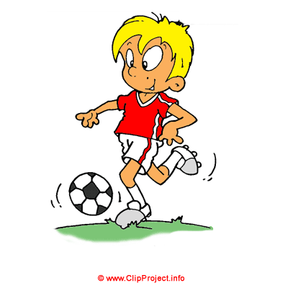
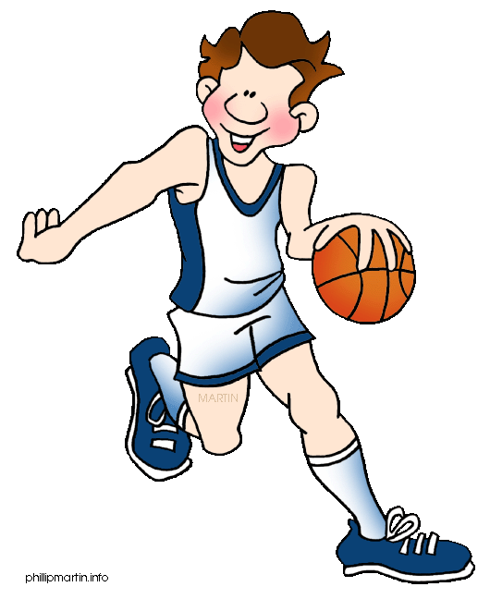
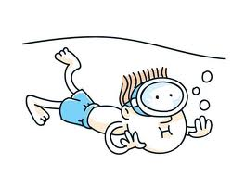
Examples of Cardiorespiratory Endurance
Basketball
Soccer
Running
Swimming

Slide 7
Muscular Endurance
Ability of a muscle or muscle group to repeat a movement many times or to hold a particular position for an extended period of time without becoming fatigued
A strength training exercise that uses low weight and high reps can help improve muscular endurance.

Slide 8
Examples of Muscular Endurance
Pilates
Push ups
Cycling

Slide 9
Muscular Strength
Amount of force a muscle can exert against heavy resistance
How much you can lift?
Strength training exercises can help improve muscular strength

Slide 10
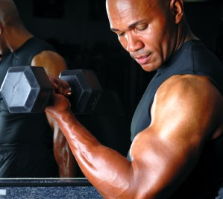
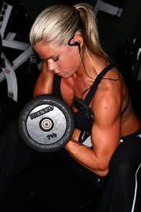
Examples of Muscular Strength
Weight lifting
Max lifting
Calisthenics

Slide 11
Flexibility
Is the degree to which an individual muscle will lengthen.
Yoga and pilates can help improve overall flexibility
Warming up and stretching before workouts, and cooling down and stretching after will prevent muscles from shortening. Flexibility often improves rapidly with practice.

Slide 12
Examples of Flexibility
Stretches
Yoga
Dynamic Warm-ups

Slide 13
Body Composition
All of the tissues that together make up the body
Bone, skin, fat, muscle tissue and body organs
Body composition is the amount of fat in the body compared to the amount of lean mass (muscles, bones etc.).
The more you exercise, the lower your body mass index should become as you lose weight.

Slide 14
Effective Fitness Programs
Once you've measured your 5 components of physical fitness, you can use this information to form a fitness regimen tailored to your needs.
An effective fitness program includes all 5 components of physical fitness. While it's acceptable to emphasize exercises for one or more weaker components, be sure not to neglect the others.

