Slide 1
Instructions for using this template.
Remember this is Jeopardy, so where I have written “Answer” this is the prompt the students will see, and where I have “Question” should be the student’s response.
To enter your questions and answers, click once on the text on the slide, then highlight and just type over what’s there to replace it. If you hit Delete or Backspace, it sometimes makes the text box disappear.
When clicking on the slide to move to the next appropriate slide, be sure you see the hand, not the arrow. (If you put your cursor over a text box, it will be an arrow and WILL NOT take you to the right location.)

Slide 2
Jeopardy
Choose a category.
You will be given the answer.
You must give the correct question.
Click to begin.

Slide 3
Choose a point value.
Choose a point value.
Click here for Final Jeopardy

Slide 4

Government
Philosophy
Executive &
Legislative
Branch
Judicial
Branch
Constitution
Elections
10 Point
10 Point
10 Point
10 Point
10 Point
20 Points
20 Points
20 Points
20 Points
20 Points
30 Points
30 Points
30 Points
30 Points
30 Points
40 Points
40 Points
40 Points
40 Points
40 Points
50 Points
50 Points
50 Points
50 Points
50 Points

Slide 5

What is the purpose of Government

Slide 6
Government refers to the bureaucracy (administrators and legislators) that control an area and the system by which it is organized
Government provides organization and security
E.g. People accept certain restrictions on their freedoms so that society may have order. Eg. Traffic regulations

Slide 7
Who is the governor General
& Explain the ROLE of the 3 branches of government

Slide 8
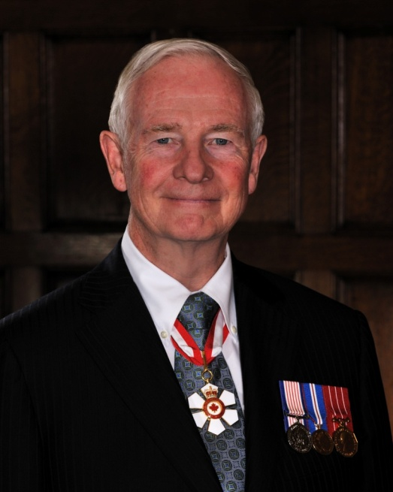
Government can be divided into 3 branches:
1) Legislative Branch: makes the laws
2) Executive Branch: implements (carries out) laws.
3) Judicial Branch: adjudicates (interprets and applies) laws
Governor General David Johnston

Slide 9
What is the difference between direct democracy and representative democracy

Slide 10

Direct: All eligible citizens participate in voting directly in all decisions that affect them
Representative: elected reps make decisions on citizens behalf

Slide 11
What is the difference between the following & concepts:
Intellectual freedom & equality Economic freedom & equality

Slide 12
Economic freedom: right of people to own property, business and to invest
Economic equality: right of everyone to have sufficient food, clothing and shelter
Intellectual freedom: right to think and feel what they wish
Intellectual equality: right to be protected from unacceptable expressions of intellectual freedom

Slide 13
Plot the following ‘isms’ correctly onto the political spectrum
Fascism Liberalism Communism Socialism Conservatism
Left wing Center Right wing
___________________________________________________________

Slide 14
Left wing Center Right wing
___________________________________________________________
Communism Socialism Liberalism Conservatism Fascism

Slide 15
What three components make up the Legislative Branch?

Slide 16
House of Commons
Senate
Governor General

Slide 17
a) How many seats are there in the House of Commons?
b) What is a CAUCUS
c) What is a Party Whip (why is it important)?

Slide 18
How many seats are there in the House of Commons?
308
b) What is a CAUCUS
The gathering of a party’s MPs to privately settle disagreements
c) What is a Party Whip (why is it important)?
Ensures that members abide by party decisions

Slide 19
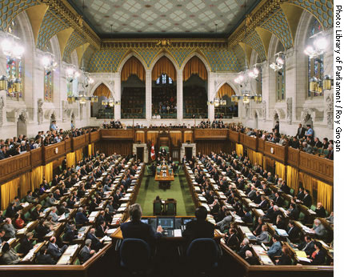

Explain the Role of the Senate
List the qualifications required to be a Senator
What are some criticisms of our Senate

Slide 20
ROLE | Qualifications | Criticisms
The Senate is appointed by the Gov Gen on the advice of the Prime Minister Gives second thought to HOC legislation Have a veto (rarely used) | Must be 30 yrs old. Own $4000 dollars in property Live in the province they represent. Canadian citizen | serves patronage for party in power Unequal distribution 2/3 are businessmen Veto power Appointed for life/hard to fire

Slide 21
List four powers for each level of government (Fed/Prov/Muni)

Slide 22
Federal | Provincial | Municipal
Foreign Trade and Relations Currency Defence Postal Service Immigration Communications Unemployment Criminal Law Aboriginal Peoples | Property and Civil Rights Marriage Licences Health and Welfare Education Alcohol consumption Natural Resources Hospitals Driver education and Licensing Provincial and Territorial Highways | Police and Fire Departments Streets and Roads Water and Sewage Transit Garbage and Recycling Libraries Recreation Local Programs

Slide 23
List & explain all the steps a bill must go through to become a law

Slide 24
First Reading
Second Reading
Standing committee (clarification) & committee of the whole
Third reading
Senate
Royal Assent

Slide 25

What are the 4 purposes of the Judicial Branch

Slide 26
Interpret and apply law
Protect society from criminals
Resolve private disputes
Ensure constitutional rights

Slide 27
How do you get to be a Judge?

Slide 28
Appointed by government in power
For a provincial judge, you must have been a lawyer for at least 5 years
For a federal judge- 10 years as a plasticising lawyer
Each candidate is asked if they are willing to serve
Names are submitted to Canadian bar association to determine:
Well qualified 2) qualified 3) Not qualified
Appointments are made by:
Lieutenant Governor (on advice of premier)
Governor General (on advice of Prime Minister)

Slide 29
Name and describe the two main types of LAW in Canada

Slide 30
Civil Law: Disputes over contracts, property and relationships (contracts, disputes)
Criminal Law: Laws contained in Criminal code (murder, assault, theft)

Slide 31
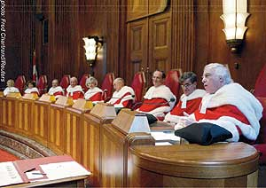
WHAT are PRECEDENTS and Why are PRECEDENTS important in our legal system?

Slide 32
Precedents are decisions of Judges in previous court cases. They guide decisions of future cases

Slide 33
Explain the origins of our laws in these two types of English Law
Describe Quebec’s system of Law and how it differs

Slide 34
English TRADITIONS
Common Law: Precedent
Statutory Law: parliament
Quebec: CIVIL LAW, based on Roman law and Napoleonic code

Slide 35
Describe 1 of 2 constitutional documents prior to Confederation

Slide 36
Royal Proclamation of 1763- ended wars between Br and Fr for control of NA
Declared Engl laws and institutions
2) Quebec Act 1774
- Restored Fr Civil code and language/Catholic religion

Slide 37
What are major the components of Canada’s constitution today?

Slide 38
BNA ACT (renamed Cdn Act)
Constitutional act of 1982- CCRF and Abor Rights and amendment procedures
Br Conventions- Cdn unwritten traditions

Slide 39

Describe 3 sections of the CCRF

Slide 40
Fundamental Freedoms
Democratic Rights
Mobility Rights
Legal Rights
Equality Rights
Official Languages Rights
Minority Education Rights
Aboriginal Rights

Slide 41
Describe the significance of the NOTWITHSTANDING Clause

Slide 42
“Notwithstanding”
This section of the Charter allows governments to pass laws which may interfere with
Fundamental Freedoms.
Legal Rights.
Equality Rights.
This action is only valid for five years after which it must be reaffirmed.

Slide 43
What is needed to change the constitution of Canada?

Slide 44
Amendment Formula:
-Need approval of 2/3 of provinces (7 out of 10 provinces) & approval of HOC and senate
- At least 50% of Canada’s population

Slide 45
Explain the concepts of minority, majority and coalition governments

Slide 46
Majority- Political party elected wins more than half the seats in the HOC
Minority- The government party has less than half the seats in the HOC
Coalition- Two or more parties join together to form a government

Slide 47
Explain the ‘first past the post’ system and its criticisms

Slide 48
The candidate with the most votes in a riding is declared the winner and the party with the most ridings wins the government
Criticisms:
Does not represent the majority of cdn wishes
Popular vote marginalized
Party with highest vote doesn’t always win election

Slide 49
Explain the concept of a PR electoral system & list criticisms

Slide 50
Proportional Representation
Voters vote for a party
% of votes equals % of seats in parliament
Criticisms:
Some areas wont have representation
Less majority governments

Slide 51
List and explain 3 ways to influence government besides voting

Slide 52
Interest groups- groups of individuals with a common goal
Mass media- covers issues that are important to society
Protest groups- rallies, parades, marches, demonstration and civil disobedience
Non governmental organizations- international pressure

Slide 53
List and describe the 6 stages in the election process

Slide 54
Dissolution- parliament dissolved by Gov Gen
Enumeration- Writ issued, voters list compiled
Nomination- selection of candidates
Campaigning- occurs from election writ to weekend before election
Balloting- 8am-8pm voting
Tabulation- boxes opened and votes counted

Slide 55
Final Jeopardy
Make your wager

Slide 56
Describe the concept of patriation

Slide 57
The transfer of control over Canada’s constitution from the British Government (BNA ACT), to the Canadian government in 1982. After patriation, the document was renamed the Constitution of Canada

