Slide 1
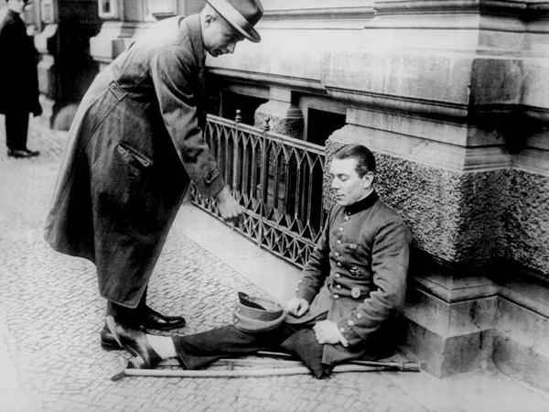
The Effects of War
Social Studies 11
A disabled First World War veteran begging on the streets of Berlin, 1923

Slide 2
International Effects
Approximately 10 million people died in battle, while almost 20 million are wounded
The war cost $200 billion, which left Europe near bankruptcy

Slide 3
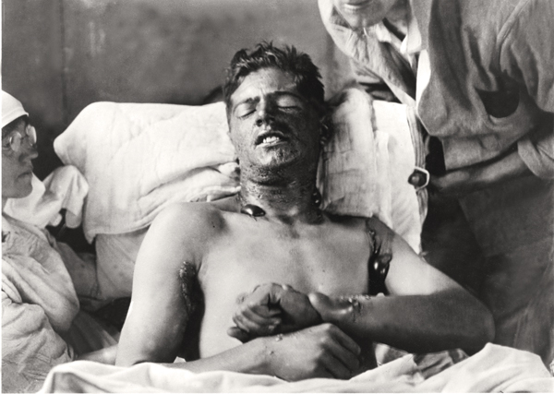

Slide 4
Geography
No other war had changed the map of Europe so dramatically—four empires disappeared: the German, Austro-Hungarian, Ottoman and the Russian
Four defunct dynasties, the Hohenzollerns (Germany), the Habsburg (Austria), Romanovs (Russia) and the Ottomans together with all their ancillary aristocracies, all fell during the war

Slide 5
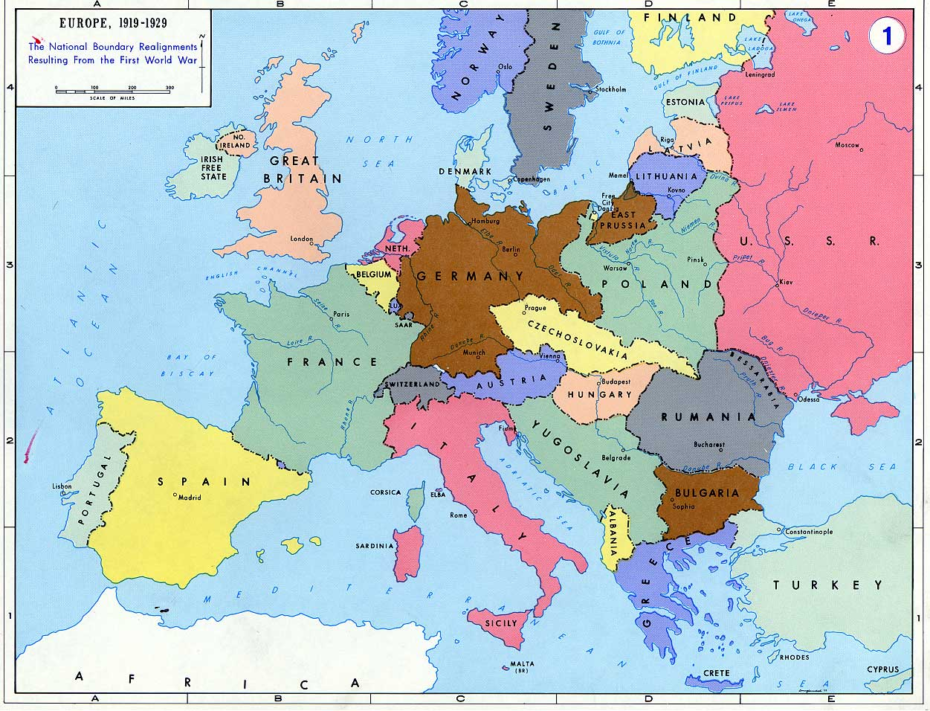
Maps Re-drawn

Slide 6
Historical Geography
Creation of Czechoslovakia, Yugoslavia, Romania and Bulgaria
Poland emerges as an independent nation
Russia becomes the world’s first communist country
Many refugees flee their homelands and locate in other areas

Slide 7
Canadian Autonomy
Before WWI, Canada, in the view of many, still belonged to Britain. Because of Canada’s contribution to the Allied war effort, a process started that would see Canada become an independent nation
Canada was given a separate seat at the Paris peace conferences and a separate signature from Britain. Eventually Canada was given a separate seat in the League of Nations

Slide 8
Canadian Economics
Significant economic growth during and after the war – Wartime Production
Cost of war to Canadians - $3 Billion – National debt was $150 million per year for four years
Introduction of Income Tax as “temporary measure” in 1917 in order to pay for the war

Slide 9
Socio-Cultural
Canada’s population increases due to immigration
Women gained recognition as workers during the war. As a result, Canadian women gained the federal vote in 1917
***Canada Matures as a Nation***

Slide 10
Military
Canadian troops gained world recognition for battle victories (Vimy Ridge & Passchendaele)
Over 60,000 Canadians killed and 178,000 wounded
Issue of conscription deepened the differences between French and English Canadians
New Military Technology

Slide 11
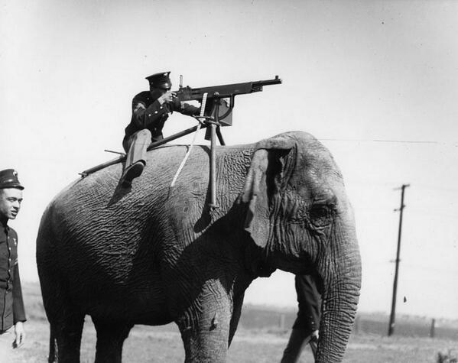
Necessity is the Mother of all Invention

Slide 12
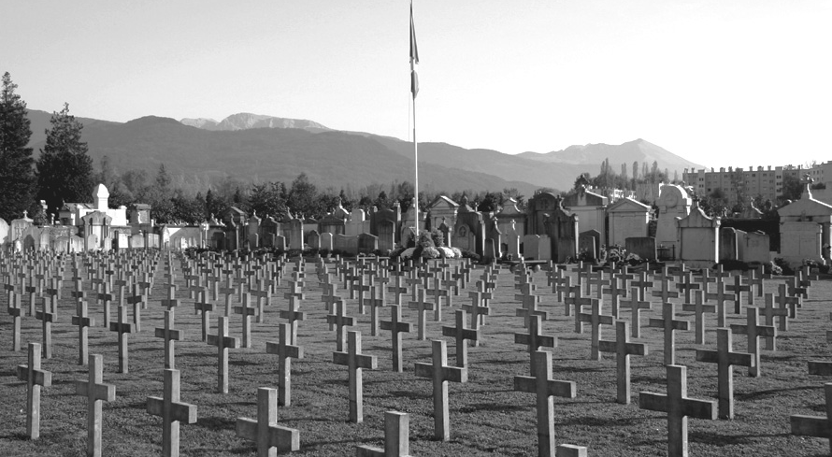
The Human Cost

Slide 13
Lasting Effects
Treaty of Versailles completely re-draws the map of Eastern Europe via the idea of self-determination
Although these changes were certainly not the primary cause for WWII, they did help to create a mindset among the German people which made war more likely.

