Slide 1
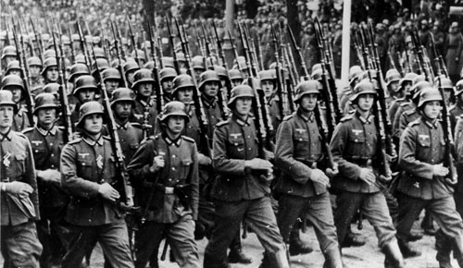
World War II Europe

Slide 2
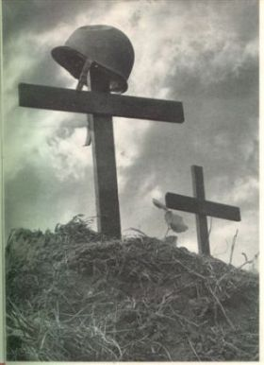
The Second World War in Europe
World War Two was history’s most devastating war and the first truly global conflict.
During the war 100 million people were mobilized.
War engulfed countries in Europe, Asia, Africa, The Middle East and the Pacific
By the end of the war 60 million people had been killed and the global balance of power had shifted away from Western Europe.
For the duration of the war (1939-1945) a person was killed every 10 seconds……

Slide 3
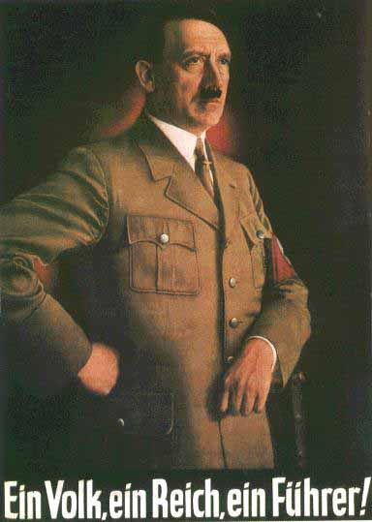
The Nazi Invasion of Poland
Poland was created by the Treaty of Versailles.
Hitler was determined to add Poland to his successes in the Rhineland, Austria, Czechoslovakia and Sudetenland.

Slide 4
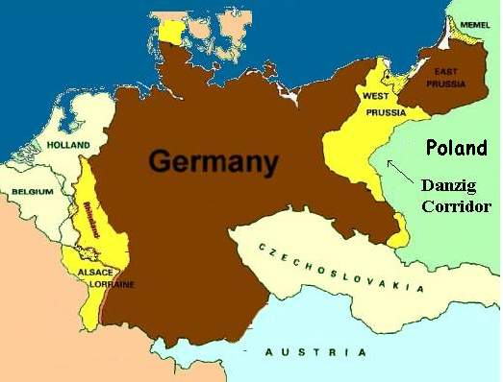
The Polish Corridor
Like many Germans Hitler found the existence of the Polish Corridor to be an abomination.
The “Corridor” had been created by the Treaty of Versailles to give Poland access to the sea.
It effectively split Germany in two.

Slide 5
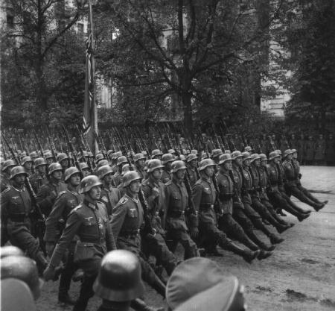
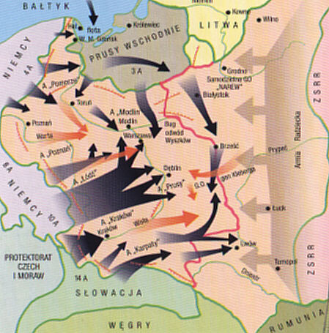
Why invade Poland?
An invasion of Poland would achieve all FOUR of Hitler’s key foreign policy aims:
1)Overturn the Treaty of Versailles
2)Create Lebensraum (Living Space)
3) Make an invasion of Communist Russia possible.
4) Unite the people of Germany

Slide 6
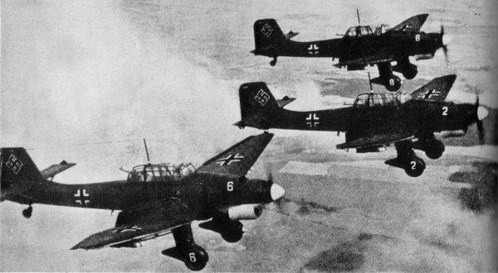
On September 1, 1939 Nazi planes attacked Poland
The Nazis employed “Blitzkrieg” (lightning warfare) techniques:
Luftwaffe dive bombers would destroy cities, wipe out defences and terrify civilians.
Panzer tank divisions rapidly encircled Polish defences and destroyed them quickly.

Slide 7
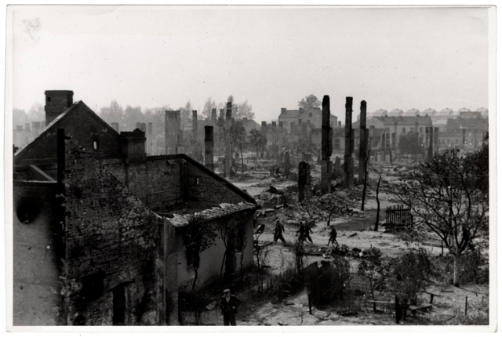
Warsaw - the Polish capital

Slide 8
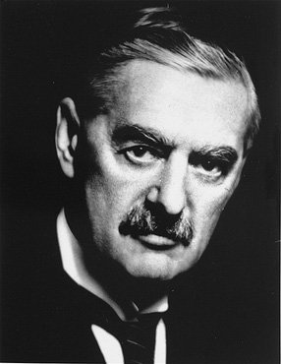
September 3, 1939.
For Chamberlain this was an unforgivable act of aggression and a direct challenge to Britain
Britain and her empire declared war on Germany.
France follows.

Slide 9
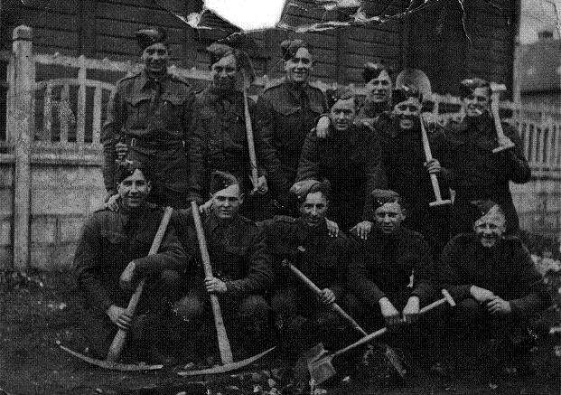
The “Phoney” War
Between September 1939 and April 1940 German forces remained in Poland. No soldiers, ships or planes were sent to attack Britain or France.
People in Britain and France started talking about a “phoney” war - one without actual fighting…
In reality Hitler had not expected the British and French to defend Poland. He was building up his military for the next phase.

Slide 10
April 1940
In April 1940 German troops occupied Norway and Denmark.
Hitler needed iron ore from Sweden.
He was concerned that the British might occupy neutral Norway and control the seas north of Germany.
Chamberlain resigned. Winston Churchill became the Prime Minister of Britain.

Slide 11
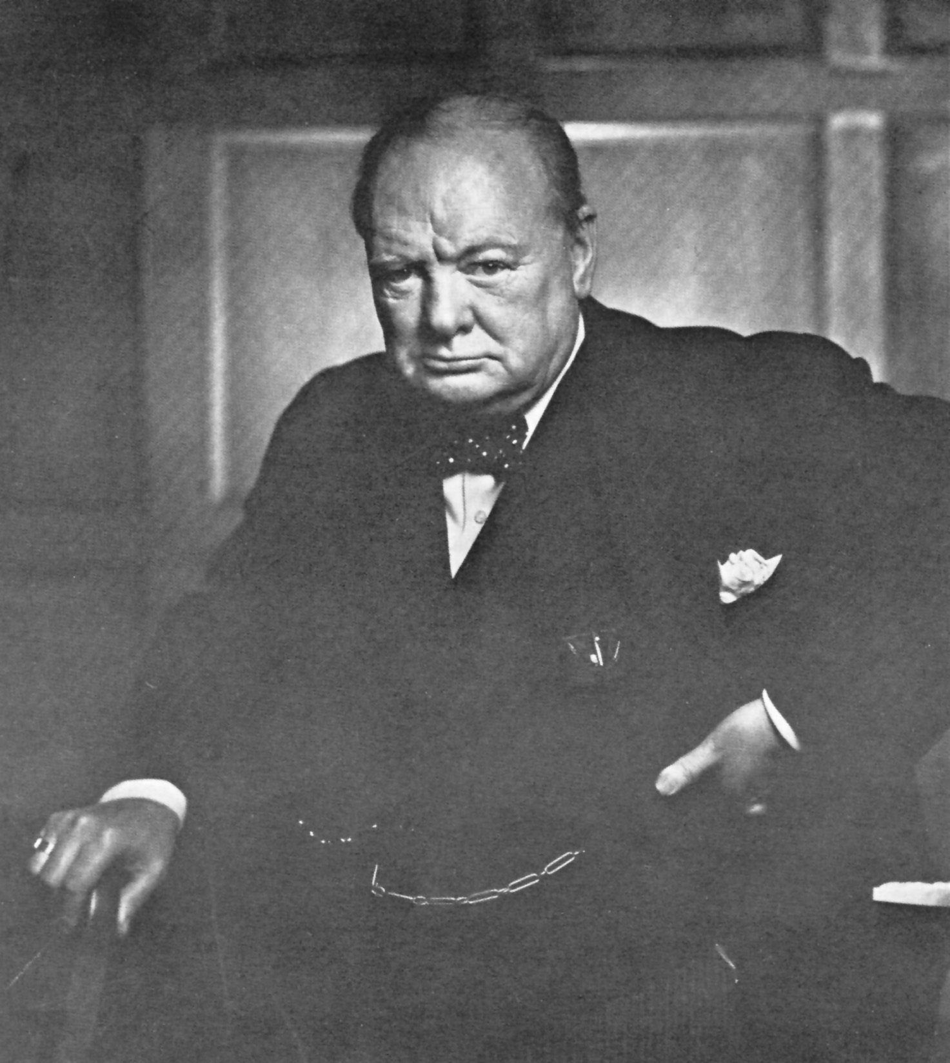
Winston Churchill
During World War One was the Secretary of State for War.
He was in charge of the navy during World War One.
He led parliamentary opposition to Chamberlain’s appeasement policy.
Was British Prime Minister from 1940-1945.

Slide 12
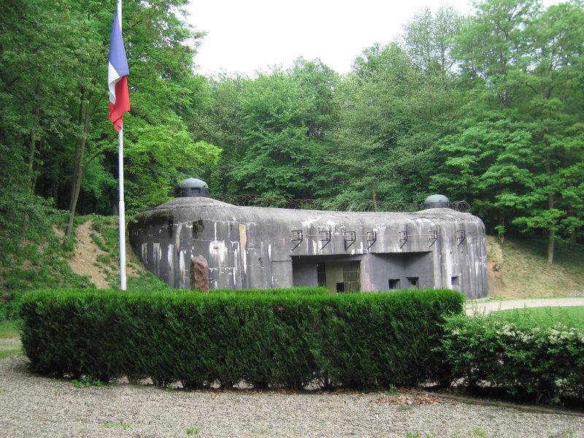
The Maginot Line
France had started building the Maginot line in 1930 to defend its borders.
It was the largest defensive fortification in World history.
It was designed to prevent a surprise attack and to slow down the German military long enough to mobilize the French army.
It had machinegun posts, anti-tank defenses, room for thousands of men and fortifications were linked by tunnels that ran for hundreds of kilometers.

Slide 13
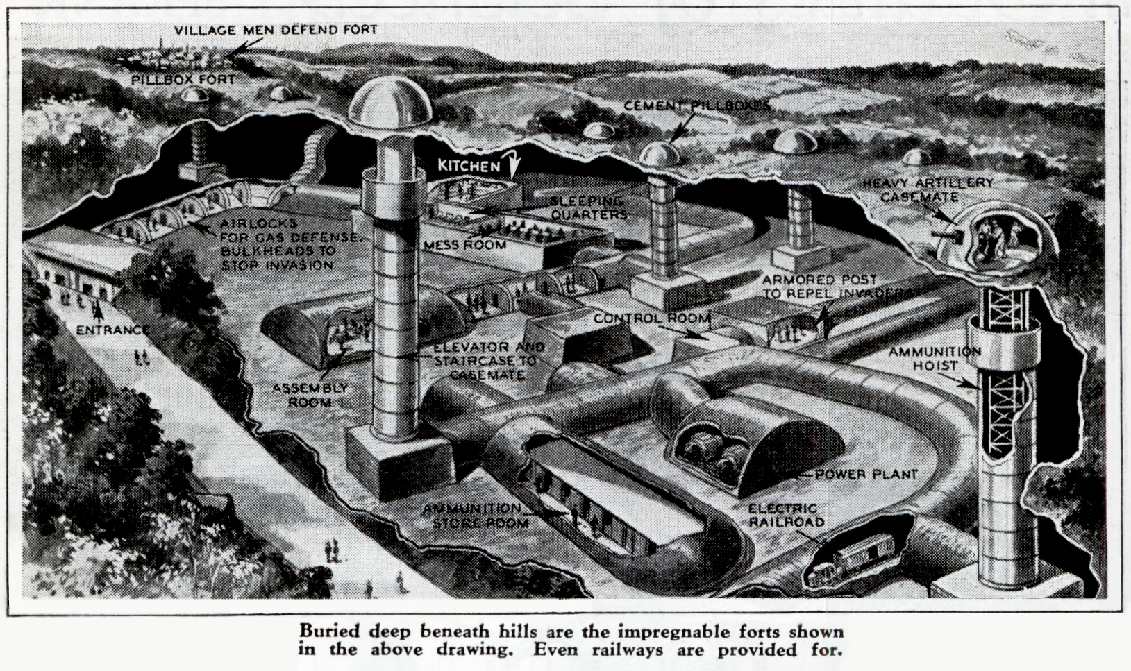

Slide 14
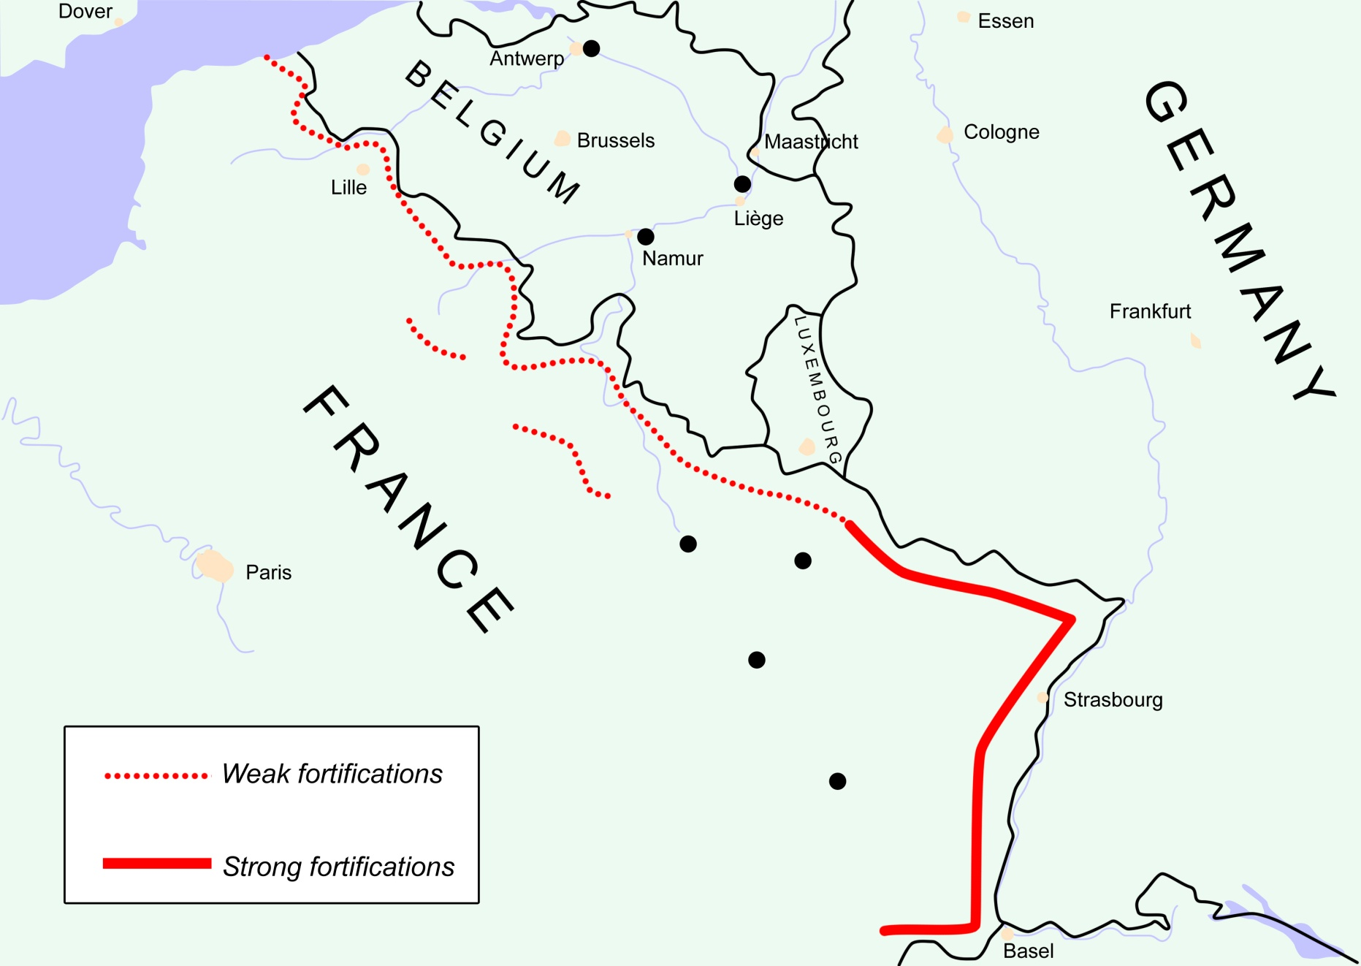
The Heavy Red line is the Maginot Line

Slide 15
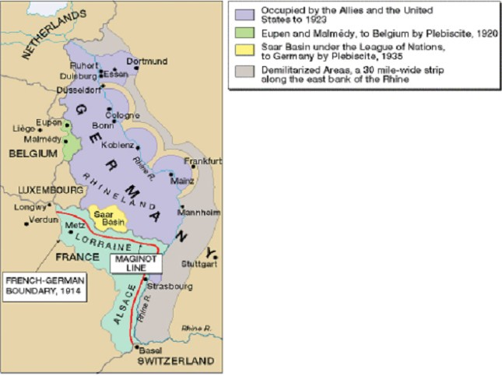
Map of the Maginot Line
The Maginot line only went to the border of Belgium.
The Nazis invaded through Belgium and the Ardennes. The German armies broke through French lines and moved across northern France.

Slide 16
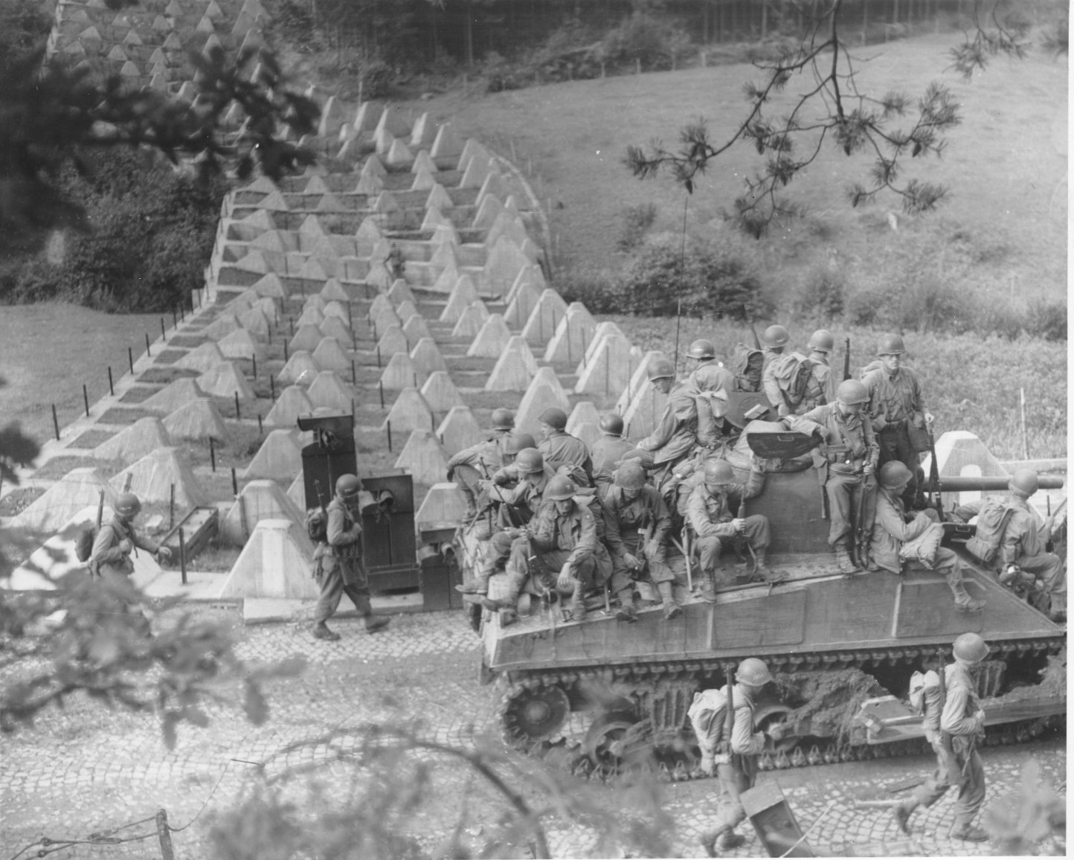
Crossing the Maginot Line

Slide 17
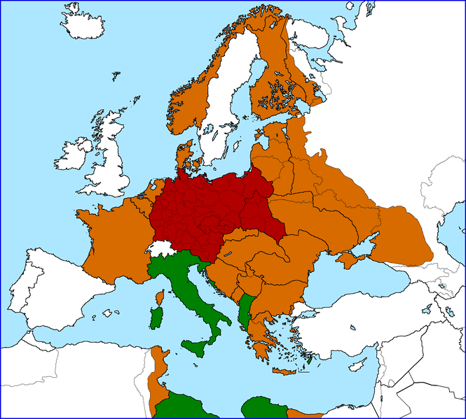
May to June 1940 Hitler’s forces quickly overran Western Europe
May - June 1940
Netherlands
Belgium
Luxembourg
France

Slide 18
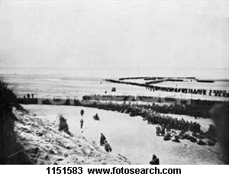

Slide 20
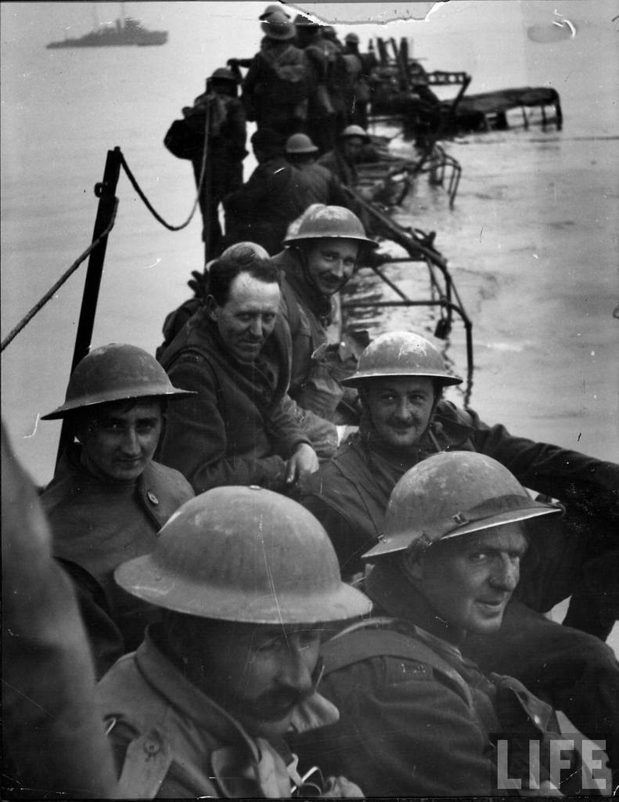
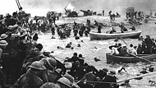
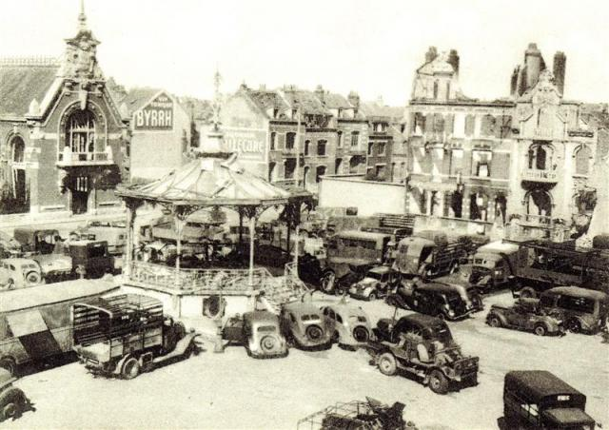
Dunkirk

Slide 21
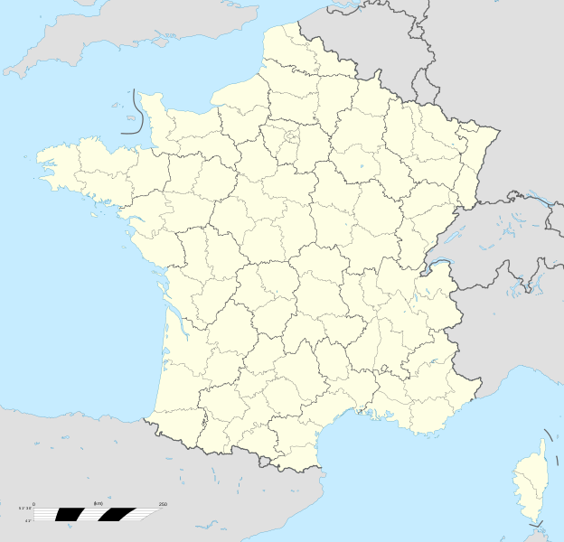
The “Miracle of Dunkirk”
As the German forces advanced over 500, 000 British soldiers were trapped on the beaches at Dunkirk.
They had to be rescued by small boats from the coast of Britain.
The German assault was halted by Hitler because the area around Dunkirk was marshland.
He was worried that the German tanks would get stuck in the marshes and the British would strike back.

Slide 22
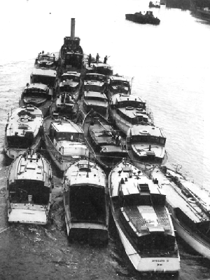
Dunkirk
From May 26th 1940, small ships transferred soldiers to larger ones which then brought them back to a port in southern Britain.
The beach at Dunkirk was on a shallow slope so no large boat could get near to the actual beaches where the men were. Therefore, smaller boats were needed to take on board men who would then be transferred to a larger boat based further off shore. 800 of these legendary "little ships" were used. It is thought that the smallest boat to make the journey across the Channel was the Tamzine - an 18 feet open topped fishing boat now on display at the Imperial War Museum, London.

Slide 23
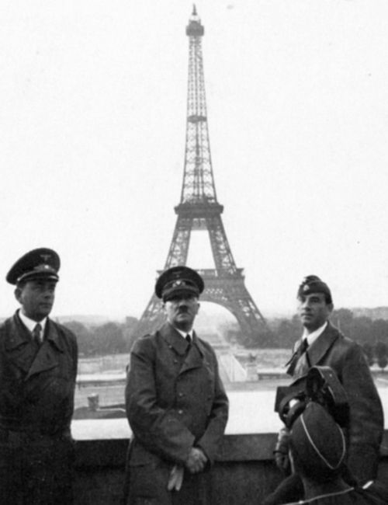
On June 22, the French signed an armistice with the Germans, who occupied three-fifths of France.
An authoritarian French regime under German control was set up to govern the rest of the country.
Led by Marshal Henri Pétain, it was named Vichy France.
Germany now controlled western and central Europe.

Slide 24
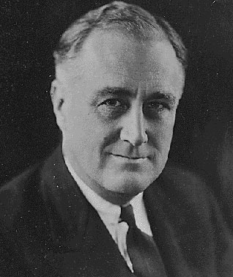
The British asked the United States for help.
The United States had a strict policy of isolationism.
A series of neutrality acts passed in the 1930s prevented the United States from involvement in European conflicts.
Though President Franklin D. Roosevelt denounced the Germans, the United States did nothing at first.

Slide 25
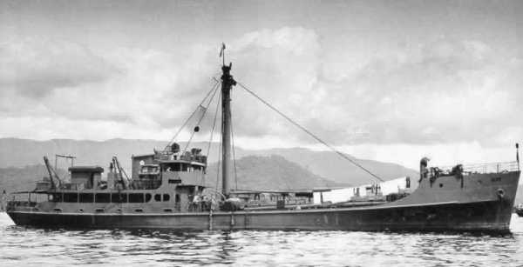
Roosevelt wanted to repeal the neutrality acts and help Great Britain.
Over time, the laws were slowly relaxed, and the United States sent food, ships, planes, and weapons to Britain.

Slide 26
Battle of Britain
www.memorial.ecasd.k12.wi.us/.../jbrantner/ushistory/WWII/ppts/Europe%20Falls%20to%20the%20Nazis.ppt

Slide 27
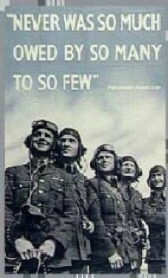

Slide 30
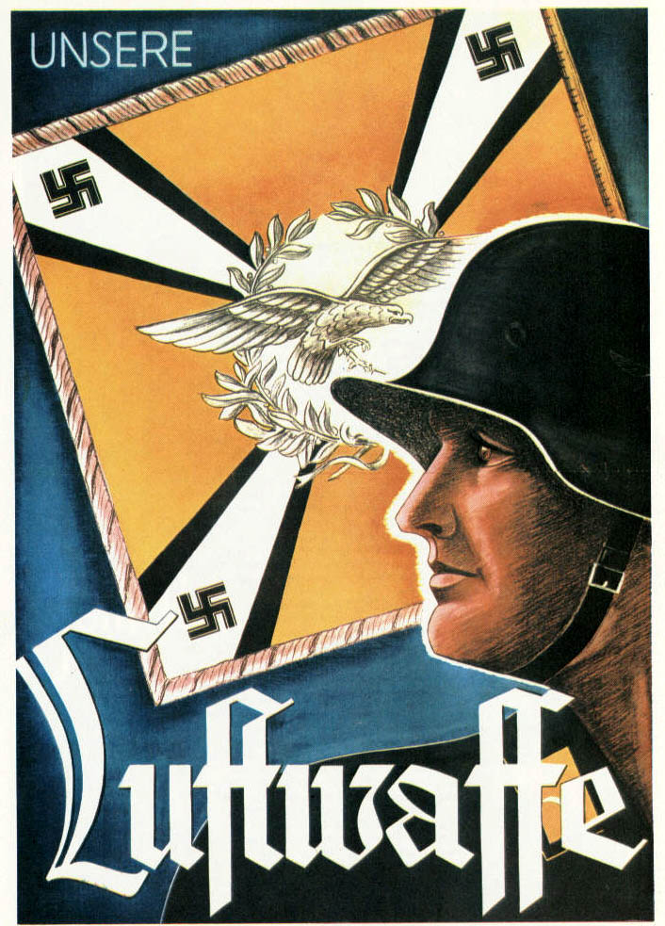

Slide 32
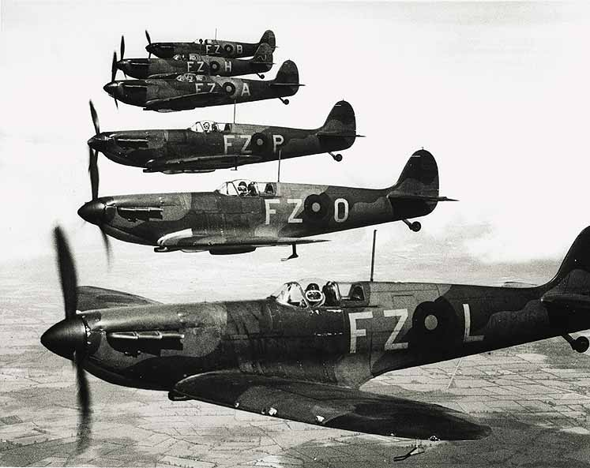

Slide 33
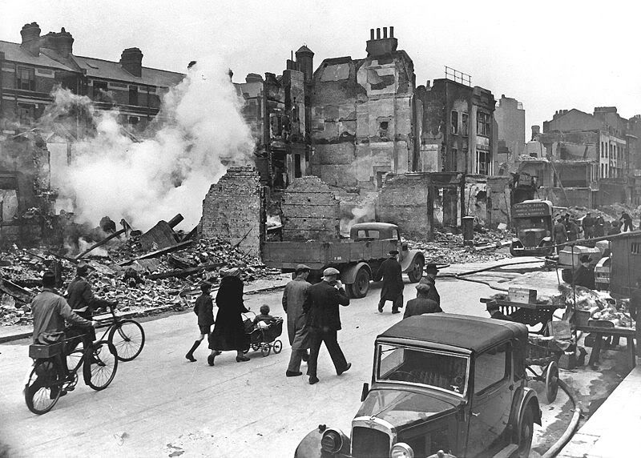
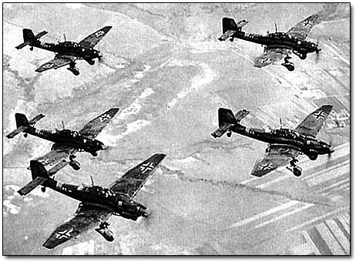
Having lost the Battle of Britain, Hitler postponed the invasion of Britain indefinitely at the end of September.

Slide 34
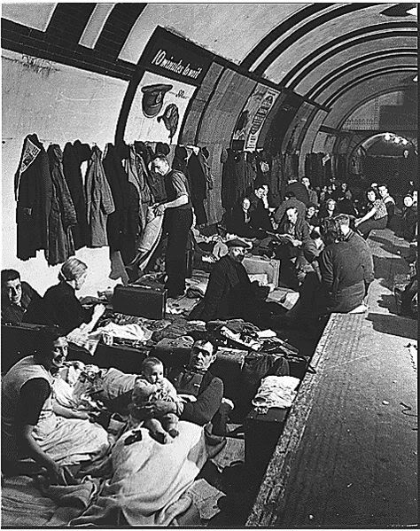
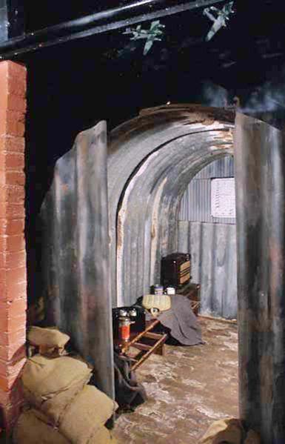
Bomb Shelters in London

Slide 35
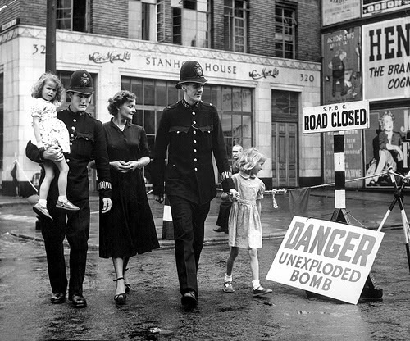

Slide 36
Battle of Britain
900+ planes lost in 3 months
Fighter pilot life expectancy measured in wks
www.memorial.ecasd.k12.wi.us/.../jbrantner/ushistory/WWII/ppts/Europe%20Falls%20to%20the%20Nazis.ppt

Slide 37
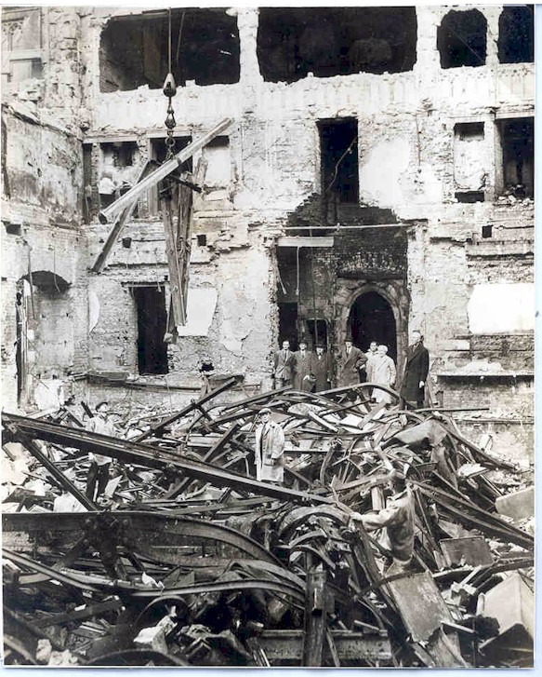
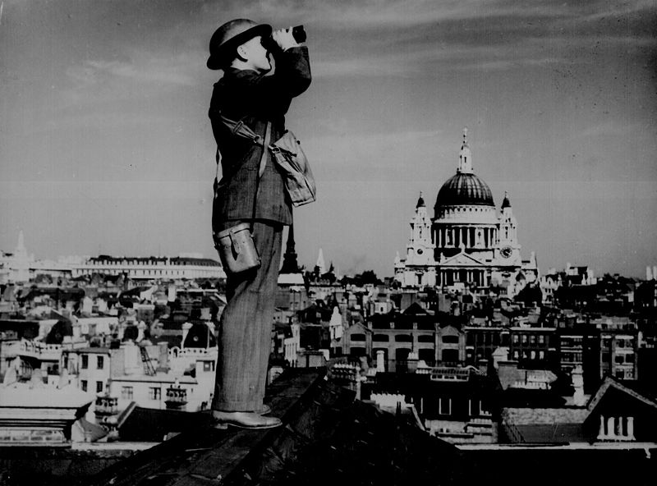
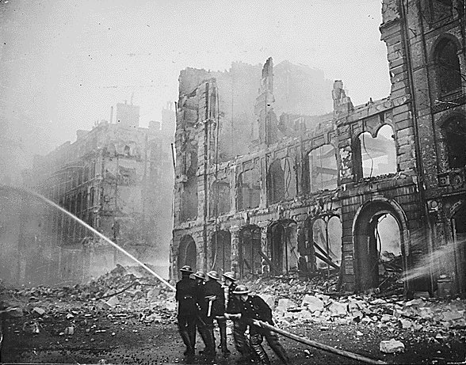
Blitz
www.memorial.ecasd.k12.wi.us/.../jbrantner/ushistory/WWII/ppts/Europe%20Falls%20to%20the%20Nazis.ppt

Slide 38
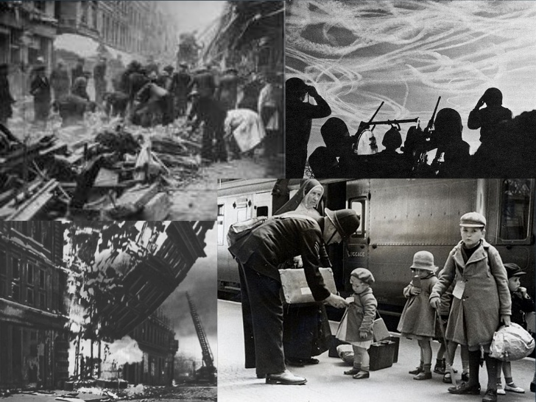

Slide 40
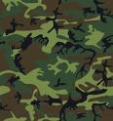
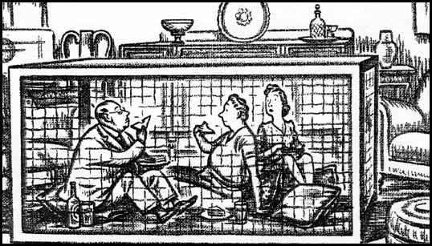

Slide 41
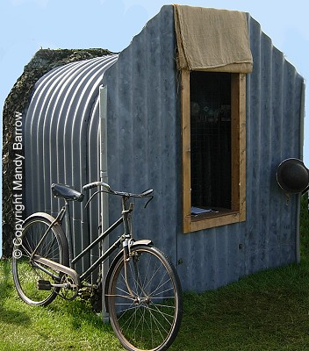
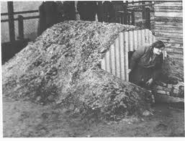
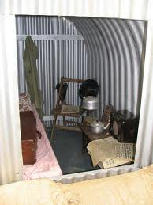
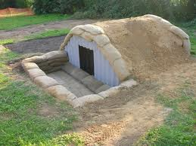
Anderson shelter

Slide 42
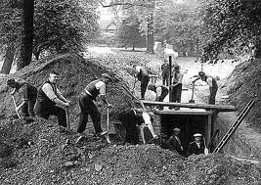
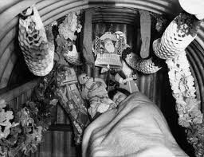
Anderson shelter facts
Anderson shelters were provided free for poor people. Men who earn £5 a week could buy one for £7.
The Anderson shelter was named after John Anderson.
When WWII just started, in September 1939, over 2 million families had Anderson shelters in their gardens. By the time of the Blitz about 2 and a quarter million families had shelters.

Slide 43
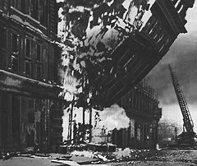
The “Blitz” (September 1940 – May 1941)
40,000 civilians killed.
One million homes destroyed in London alone.
Children were moved out of cities into the countryside

Slide 51
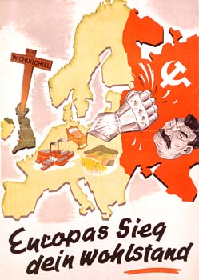
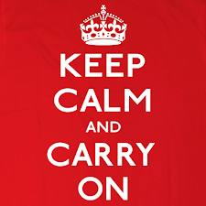
New Target: Russia!
In spite of the mounting casualties the British refused to surrender.
Posters told Londoners to “Keep calm and carry on!”.
Hitler abandoned his plan to conquer Britain and turned his attention to Russia…

Slide 52
Cartoonist’s View Prior To The Invasion
www.myndrs.com/teachers/rscott/History/powerpoints/Hist12-nn-greatbattles-WWII.ppt

Slide 53
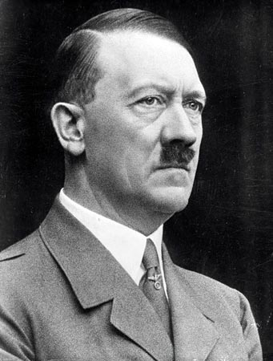
22 June 1941: Germany invades the U.S.S.R.
The long-anticipated clash between Nazism and Communism began in June 1941.
The invasion was called “Operation Barbarossa”
Hitler planned to enslave the Russian population and add the rich farmland and oil resources to the Nazi war machine.
Gain Russia’s rich oil resources

Slide 54
Hitler was confident of victory over Stalin
“We have only to kick in the door and the whole rotten structure will come crashing down”
Adolf Hitler

Slide 55
Operation Barbarossa
June 22, 1941 Hitler invades Russia with 3.5 million men.
Thought he would simply have to “kick in the door and the whole rotting structure would crumble”

Slide 56
The Nazis used a Big Boot..
3000 Tanks
5000 planes
An army of 3 million men.
Nazi troops were told to use ‘Blitzkrieg’ assaults.
In a country the size of Russia this meant slaughtering any captured Russians to avoid moving large numbers of prisoners around.
In some battles German soldiers drowned Russian civilians in swamps rather than ‘waste’ bullets. The Nazi forces had expected a quick victory but Soviet resistance (and the bitter Russian winter) stopped the Germans in the suburbs outside of Moscow.
The Nazi ‘take no prisoners’ approach had a weakness – Russians now knew they had to either kill or be killed.

Slide 57
Hitler was convinced that the way to defeat Britain was to first smash the Soviet Union.
He thought that the British were resisting only because they were expecting Soviet support.
He also thought that the Soviets could be easily defeated.
He planned to invade in the spring of 1941 but was delayed by problems in the Balkans.

Slide 58
After the Italians had failed to capture Greece in 1940, the British still held air bases there.
Hitler seized Greece and Yugoslavia in April 1941.
After a battle in Greece

Slide 59
Then Hitler invaded the Soviet Union in June 1941.
The attack on the Soviet Union stretched out for 1,800 miles.
German troops moved quickly and captured two million Russian soldiers by November.
The Germans were within 25 miles of Moscow.

Slide 60
However, winter came early in 1941 and, combined with fierce Russian resistance, forced the Germans to halt.
This marked the first time in the war that the Germans had been stopped.
The Germans were not equipped for the bitter Russian winter.
In December, the Soviet army counterattacked.

Slide 62
Not so easy…
Russia’s great ally, winter, saved the day
Winter 1941 stalls offensive
1942 - Battle of Stalingrad Germany suffers 300,000 casualties
By the Spring of 1943, the tide had turned and Germany was retreating in the East

Slide 63
Battle of Stalingrad cont…
Hitler forced Germans to stay put
Soviets used to their advantage and won
Soviets lost 1,100,000 people in this battle
Turning point in WWII
From that point on, Soviet army began to move westward towards Germany

Slide 66
Street Fighting

Slide 67
Outside and Inside

Slide 68
Russia was to prove difficult to “tame”..

Slide 70
Pearl Harbour, December 7 1941 – intended to destroy the American navy and keep them out of the war.
The Japanese attack on Pearl Harbour brought the United States out of isolation and into the war.
Hitler declared war on the United States to support his Japanese allies.
By the end of 1941 Nazi Germany is at war with Russia, Britain and the United States.

Slide 71
When Japan attacked Pearl Harbor the US became involved in the war.
Hitler thought that the US would be involved in the Pacific so he declared war on the Us
A new coalition was formed called the Grand Alliance.
It included Great Britain, the Soviet Union, and the United States.

Slide 72
The three nations agreed to focus on military operations and ignore political differences.
They agreed in 1943 to fight until the Axis Powers–Germany, Italy, and Japan– surrendered unconditionally.

