Slide 1
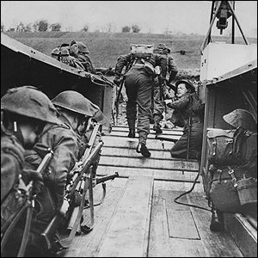
The Dieppe Raid
“Operation Jubilee”
Notes:
Text: Canadian Issues - 1942

Slide 2
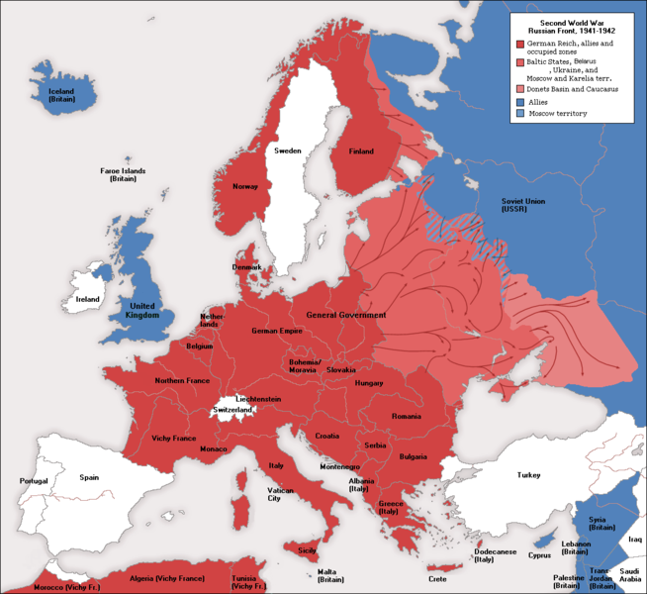

Slide 3
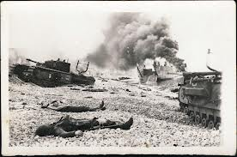
Dieppe: August 1942
Canadian soldiers sent to England at the beginning of the war had trained in the south of England for three years without seeing action against the enemy.
The Russians who had been carrying the brunt of the land war against Germany demanded that a “second front” be opened in the west.

Slide 4
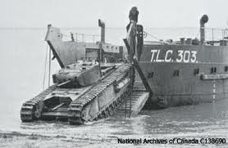
August 1942
It was decided that a “raid in force” against the coast of France would be an important prelude to a cross-channel invasion.
German defenses could be tested and the Russians appeased by the evidence of action.
5000 Canadians were selected to join 1000 British and American troops in an attack on the French port of Dieppe.
German Pillbox at Dieppe

Slide 5
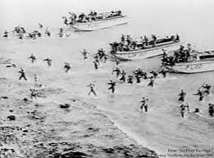
Why Canada?
Most Canadian troops had not yet fought in Europe as much of the war for Canada was being fought in Africa
Canadian troops were highly esteemed
British General Montgomery selects Canadians

Slide 7
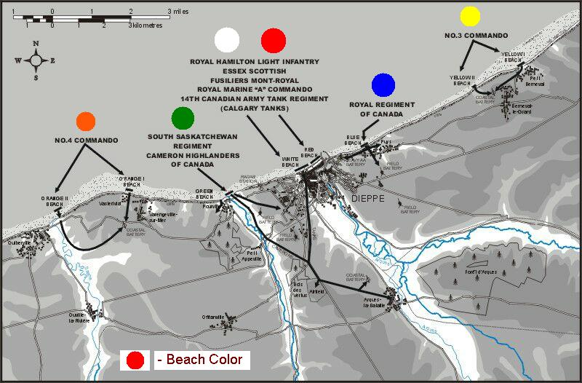
The Plan

Slide 8
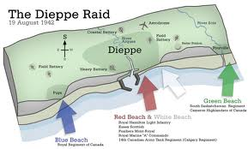
The Battle: August 19, 1942
Canadian ships were to have disembarked before dawn but delays kept them in port until early daylight
On the way to the raid, a Canadian ship met a German convoy and a battle ensued
    No element of surprise
They were killed easily by German machine gunners

Slide 9
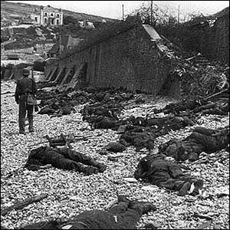
The Battle
Aug 19, 1942
Poor communications led commanders to believe that the first wave of troops made it to shore in good shape
They sent reinforcements who also became trapped
Tanks could not advance on the pebble beach because of a lack of traction
German troops were fully alert by the time allied troops struck the beaches where they came under withering fire.
Very few of the assaulting force escaped from the beach into the town.

Slide 10
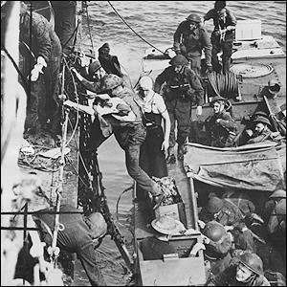
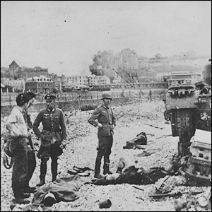
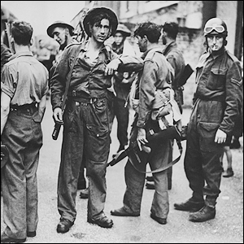

Slide 11
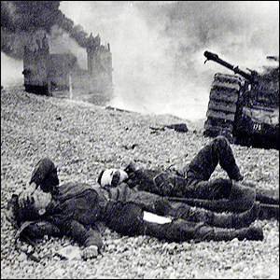
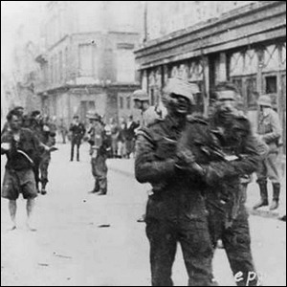
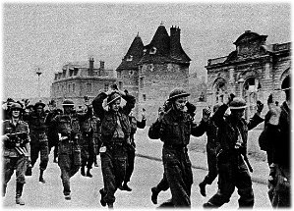

Slide 12
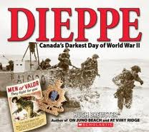
The Aftermath
The raid was a disaster
In total, 907 Canadian troops died in the nine-hour battle, while 586 were wounded and 1974 were taken prisoner
Some historians argue that the raid was a failure but it taught Allied forces what not to do next time

Slide 13
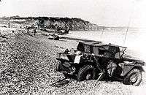
An abandoned scout vehicle after the failed Dieppe Raid

Slide 14
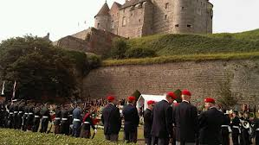
Dieppe: August 1942 V
The public were informed that “valuable lessons” had been learned.
By all reports Canadian troops fought bravely but the raid was badly planned and a complete tactical failure.
Dieppe remains for Canadians a bitter memory.
Canadian Monument at Dieppe

Slide 15
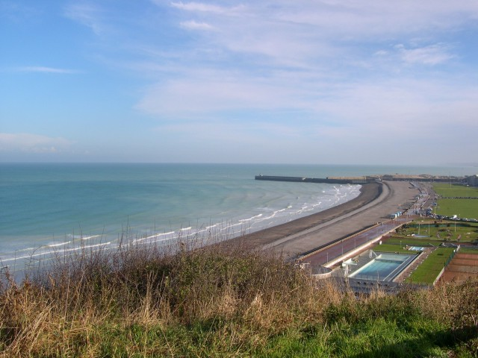
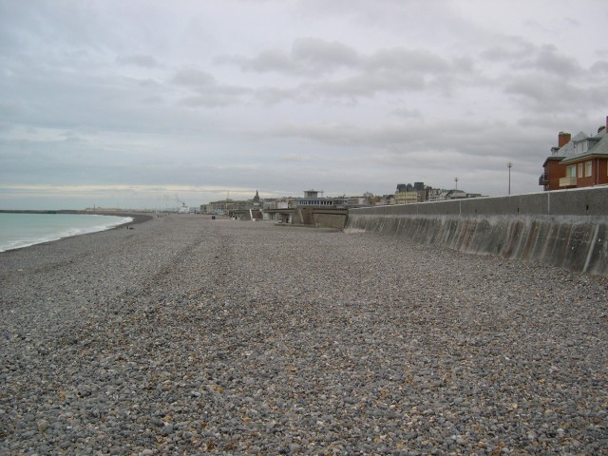
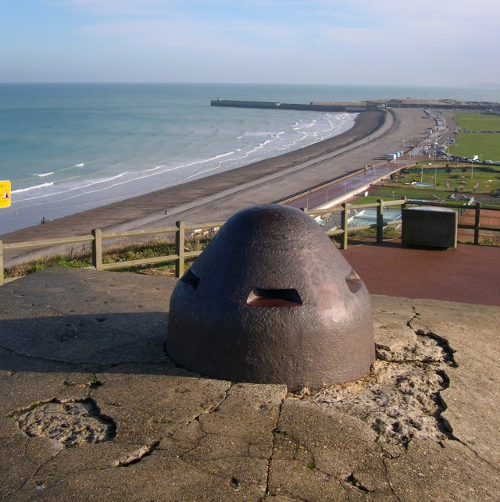
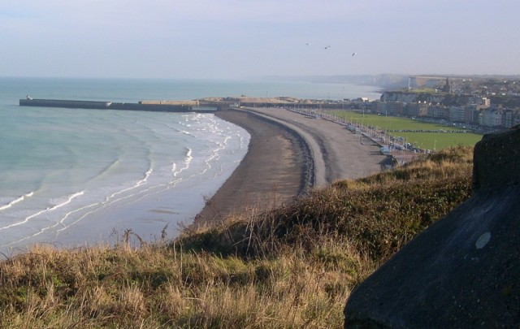
Dieppe Today

Slide 16

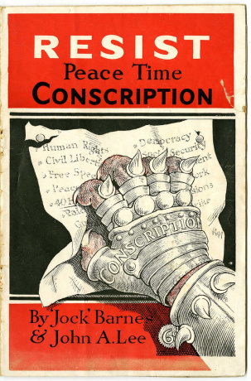
Conscription

Slide 17
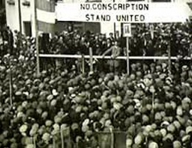
Conscription
This issue had badly divided Canada in 1917 and King did not wish to repeat the problem if it could be avoided. In 1939 he clearly stated that
“The present government believe that the conscription of men for overseas service will not be a necessary or effective step. No such measure will be introduced by the present administration.”

Slide 18
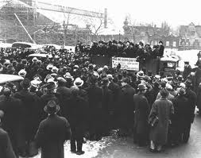
Conscription
The National Resources Mobilization Act allowed the government to call men for the defense of Canada but not overseas service.
These men were derisively referred to as “Zombies” but no amount of persuasion influenced many to go to war.
King felt trapped by his promise of 1939.

Slide 19
Conscription
The public mood in English Canada slowly shifted in favor of conscription.
King’s solution was to hold a national referendum or plebiscite and ask Canadians if they would release his government from its promise.
The measure was widely supported in English Canada but aroused outrage in Quebec.
64%
YES VOTES
CANADA
NO VOTES
QUEBEC
76%

Slide 20
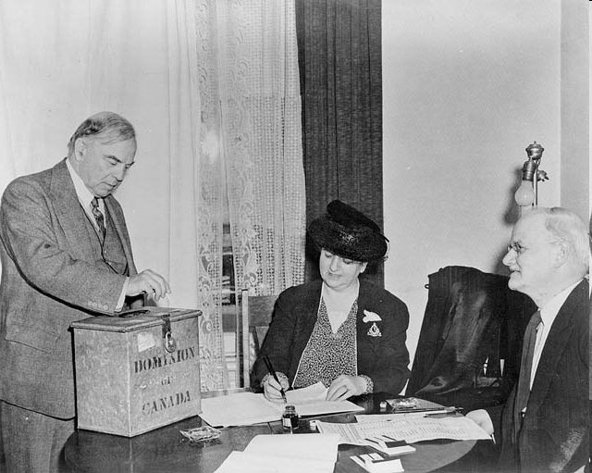
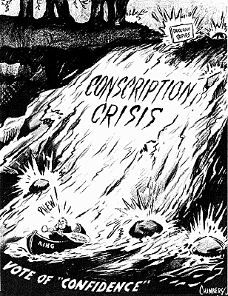
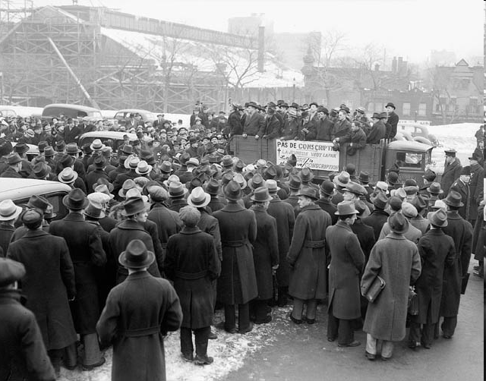
The Vote:
In 1942, King decided to hold a vote for/against conscription.

Slide 21
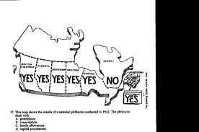
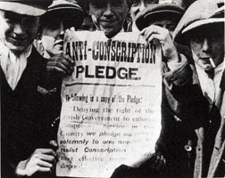
80 percent had answered yes out of the nine provinces but 70 percent of Quebec said no.
Very few recruits from this Conscription campaign actually ended up going to fight in World War 2

Slide 22
“Not necessarily conscription but conscription if necessary”
King now hesitated for fear of the reaction in Quebec.
By 1944 casualties in Italy and France were so numerous that volunteer replacement was inadequate.
It was finally agreed that a small number of men could be sent overseas.
12,000 NRMA conscripts are sent to Europe
1944
Zombies Approved
For Overseas Service
16,000
6,467
Soldiers Killed
in Action

