Slide 1
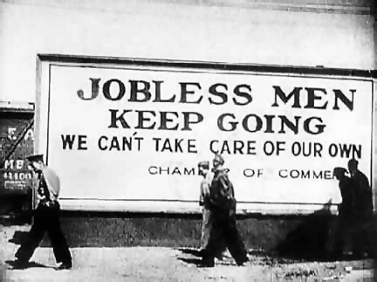
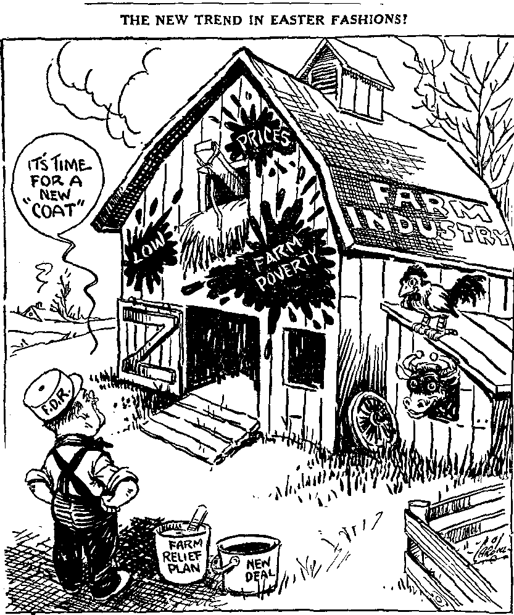
The Depression Continued
The Bennett New Deal

Slide 2
Review (Causes of the Depression)
Overproduction: Stockpiles of goods, workers laid off, workers had no money to spend on goods
Canada’s reliance on exports (timber, minerals and crops), other countries stopped buying from Canada
Dependence on USA (40% of our trade)
World wide Tariffs and trade protection
International Debt- WW1 foreign loans weren't paid back, Germany also couldn't afford reparations

Slide 3
The Bennett “New Deal”
F.D.R.
Franklin Roosevelt became president of the USA in 1933 on the strength of a promise of a “new deal for the working man.”
This “New Deal” involved a program of relief for the unemployed, economic recovery and reform.
Bennett attempted to borrow aspects of this plan, but for most Canadians it was too little too late.

Slide 4
Bennett’s New Deal - 1935
His promises included
Unemployment insurance, a minimum wage, health insurance and agricultural marketing boards.
Few of these promises were ever translated into policy.
but
Most Canadians felt these policies were too late to do much good.
Farm Family 1930s

Slide 5
Conditions in Canada in 1935
Unemployment by 1935 was ten times that of 1930.
Mortgage foreclosures and unemployment were the common lot of many Canadians.
Riots broke out in Regina on Dominion Day 1935.

Slide 6
“King or Chaos”
This slogan helped bring King and the Liberals back to power in 1935.
Bennett’s “New Deal” collapsed with the fall of his government.
Two new political parties, the CCF and Social Credit, elected MPs for the first time.
These “parties of protest” were a response to the failures of the Liberals and Conservatives.
Mackenzie King

Slide 7
The Cooperative Commonwealth Federation
The CCF was founded in Saskatchewan in 1933.
Its program was outlined in the Regina Manifesto.
The basic beliefs were that the government should own all important industries.
Business and the wealthy should be taxed to provide social benefits for the citizens.
Tax the Wealthy

Slide 8
Social Credit
This political movement was founded in Alberta and its first leader was William Aberhart or “Bible Bill.”
He followed the theories of a Major Douglas who believed that there should be more money in circulation to stimulate the economy.
Social Credit promised a “Basic Dividend” of $25 to each citizen over the age of twenty-one.
This never happened but Social Credit became the party of business and free enterprise.
$ 25

Slide 9
The Liberals after 1935
King and the Liberals returned to power just as the economy began to slowly improve.
The Purvis Commission convinced King that the federal government had to take some financial responsibility for unemployment.
The Rowell-Sirois Commission was appointed to investigate regional economic disparity.

Slide 10
The Great Depression and Canadian Isolationism
The Depression years turned Canada away from Europe and its problems.
R.B. Bennett became a strong advocate of Canadian nationalism but did not take an active role in world affairs.
When Mackenzie King returned to power in 1935 he also adopted the American policy of isolationism.

Slide 11
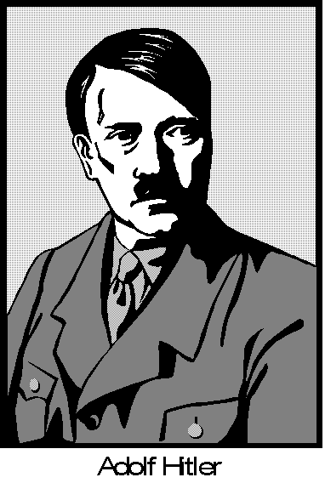
Canada and the World after 1935
The growing power and aggressive policies of Germany, Italy and Japan were not of great interest to the Canadian government.
Canada remained neutral during the Spanish Civil War and tried to prevent Canadians from enlisting to fight.
Jewish refugees fleeing Nazi Germany were not welcomed in Canada.

Slide 12

The End of the Great Depression
The Canadian economy improved slowly after 1935 but it was the approaching threat of a new war which eventually began to stimulate Canadian manufacturing and resource industries.

