Slide 1
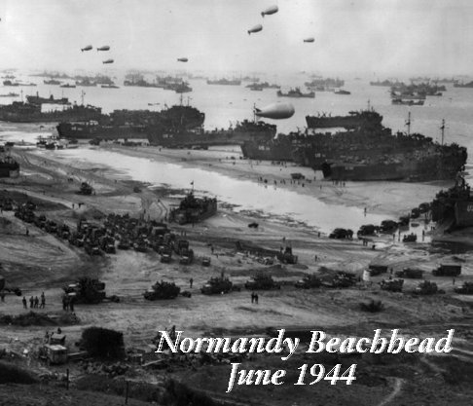
D-day invasion...
WINNING THE WAR

Slide 2
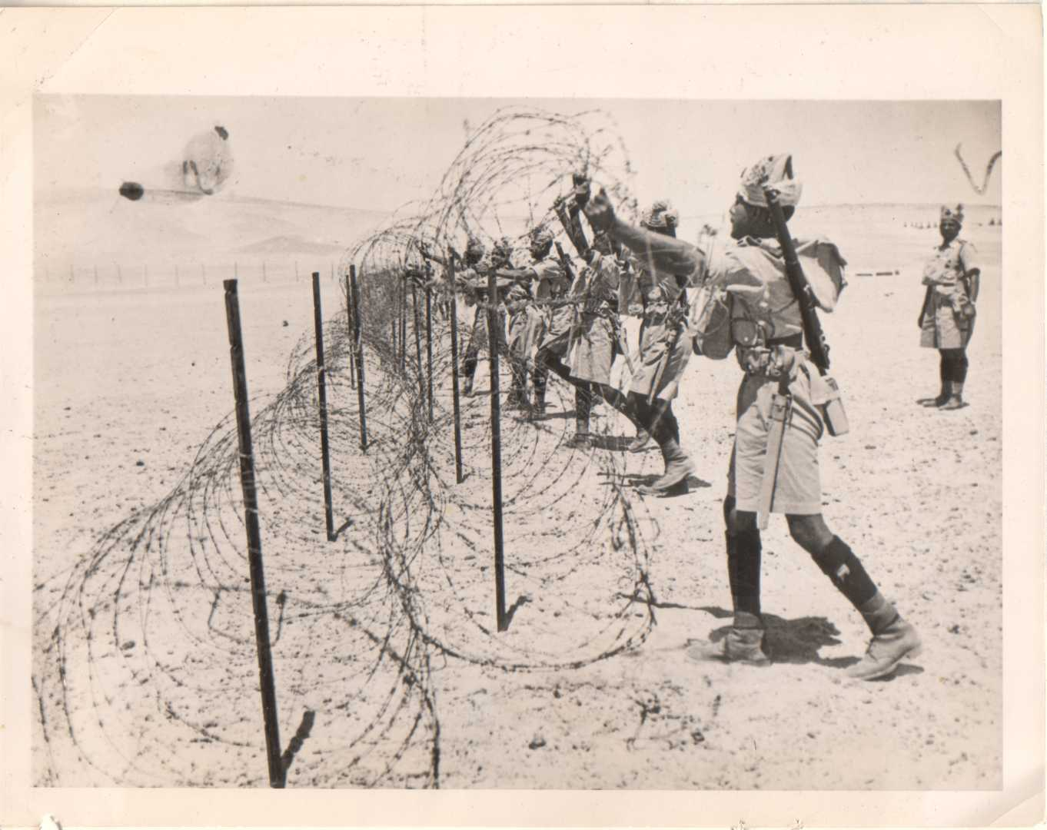
1942 Turning the Tide...
By the fall of 1942, the war had turned against the Germans.
In the summer of 1942, the British in North Africa had stopped the Germans at El Alamein.
The Germans retreated.
In November, British and American forces invaded French North Africa and forced the German and Italian troops to surrender by May.

Slide 3
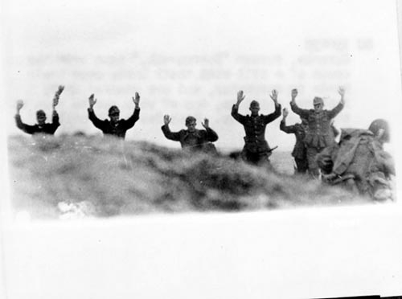
The Soviet Union counter attacked Hitler’s troops and cut off their supply lines.
Hitler realized he would not be able to defeat the Soviet Union
In May of 1942 the German troops surrendered and Hitler lost some of his most important troops.

Slide 4
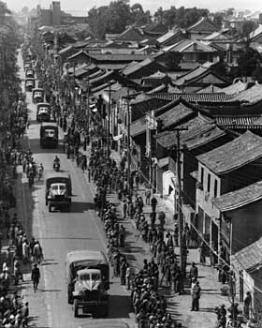
By early 1943, the tide had turned against the Axis forces.
In May, the Axis forces surrendered in Tunisia.
The Allies then moved north and invaded Italy in September.
Winston Churchill called Italy the “soft underbelly” of Europe.

Slide 5
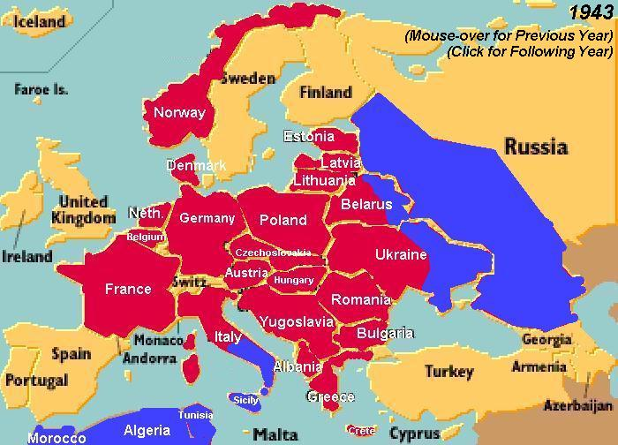
Time to plan an INVASION...
The Germans established a strong defense south of Rome.
The Allies had very heavy casualties as they slowly advanced north.
They did not take Rome until June 4,1944.
The Allies had long been planning a “second front” in western Europe.
They planned to invade France from Great Britain across the English Channel.

Slide 6
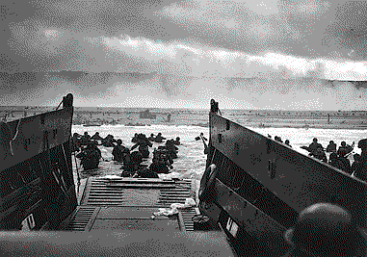
D-Day - June 6, 1944 Landing on Normandy Beach
It was the largest sea borne invasion in history.

Slide 7
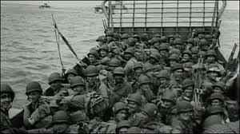
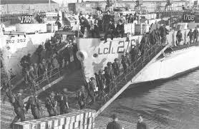
D-Day: The Invasion of Europe “Operation Overlord”
June 6th. 1944, the Allies returned to Europe. It would be the greatest amphibious invasion ever mounted-156,000 Canadian, British, and American troops went ashore in 24 hrs. They were the beginning of 2,000,000 more. The German entrusted with stopping the invasion was Field Marshall Erwin Rommel. The Allied Supreme Commander for Operation “Overlord” was General Dwight D. Eisenhower. In a phrase that became history; “…for the Allies, as well as for Germany, it will be the longest day.”
www.myndrs.com/teachers/rscott/History/powerpoints/Hist12-nn-greatbattles-WWII.ppt

Slide 8
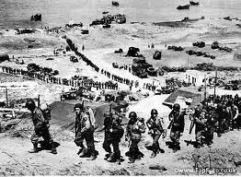
D-Day: June 6, 1944
The much delayed assault on the beaches of Normandy opened the “second front” in western Europe.
Juno beach was the successful target of the 3rd Canadian Division.

Slide 9
General Dwight D. Eisenhower, Supreme Allied Commander
General Eisenhower, an American, commanded all allied forces which assaulted the Normandy beaches on June 6, 1944.

Slide 10
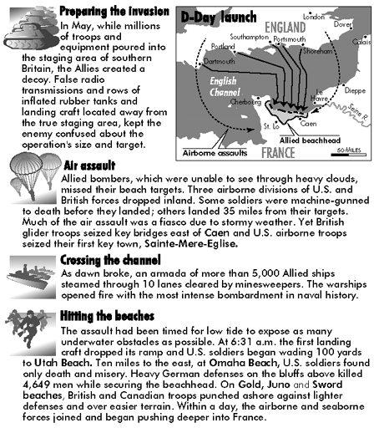

Slide 11
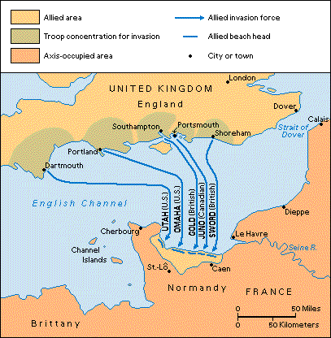
Normandy Invasion, D-Day
D – Day
Ø 60 mile stretch of beach
Ø 156,000 troops
Ø 4,000 landing craft
Ø 600 warships
Ø 11,000 planes
Ø Largest land-sea- air operation in history

Slide 12
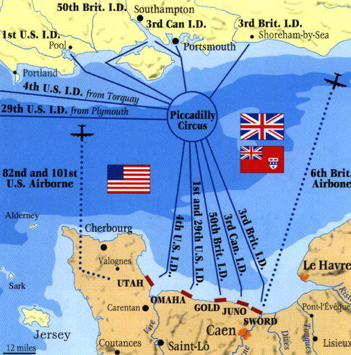
Operation Overlord
Secure the Normandy Coast for Allied Invasion
Area would provide the most direct overland route to Germany, also the most heavily fortified.
Sword = G.B.
Juno = Canada
Gold = G.B.
Omaha = U.S.
Utah = U.S.

Slide 13
General Eisenhower Speaks
Talking to his men, general Dwight D. Eisenhower, commander of the Normandy invasion, wished paratroopers luck before they dropped behind German lines in France on d-day.

Slide 14
Dropping In On Normandy
Talking to his men, general Dwight D. Eisenhower, commander of the Normandy invasion, wished paratroopers luck before they dropped behind German lines in France on d-day.

Slide 16
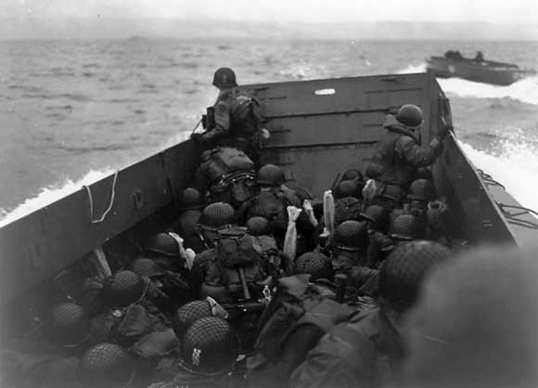
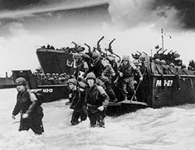

Slide 17
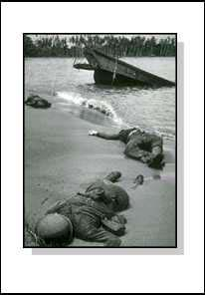
A total of 2,500 Americans died along with 3,000 British and Canadian troops , while German forces suffered between 4,000 and 9,000 total casualties on D-Day.

Slide 18
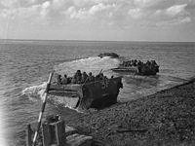
Juno Beach
Buffalo amphibious vehicles taking troops of the Canadian First Army across the Scheldt in Holland, September 1944.
Canadians on Juno Beach, June 1944.

Slide 19
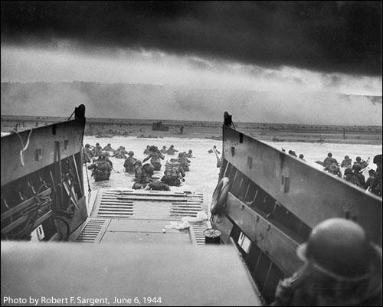

Slide 20
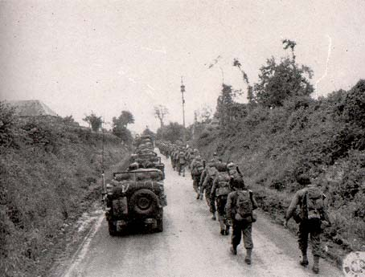
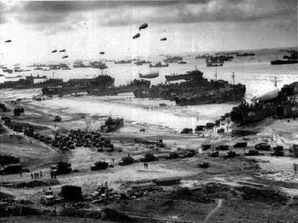
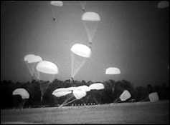
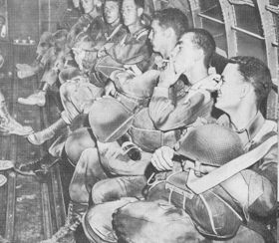

Slide 21
www.salem.k12.va.us/staff/dturner/Chapter%2013.ppt%202005.ppt

Slide 22
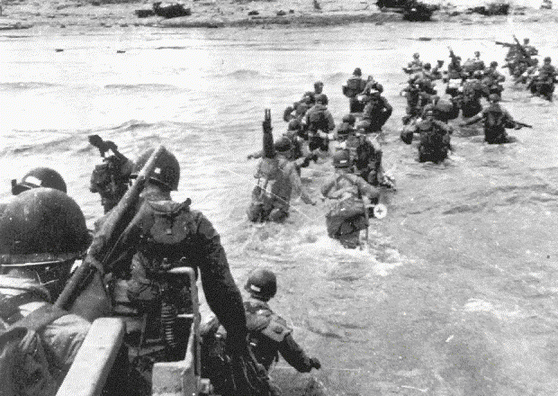
www.salem.k12.va.us/staff/dturner/Chapter%2013.ppt%202005.ppt

Slide 23
Normandy Defenses: The Bunkers
www.myndrs.com/teachers/rscott/History/powerpoints/Hist12-nn-greatbattles-WWII.ppt

Slide 24
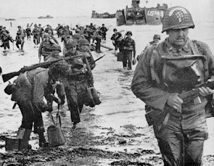
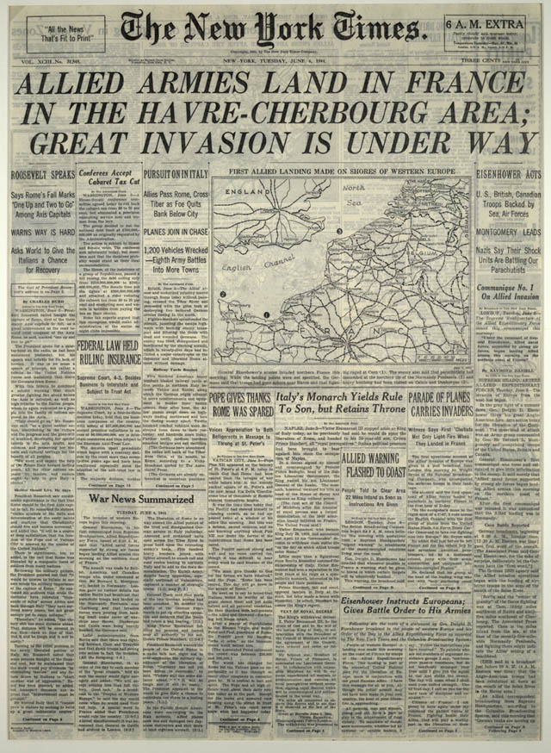
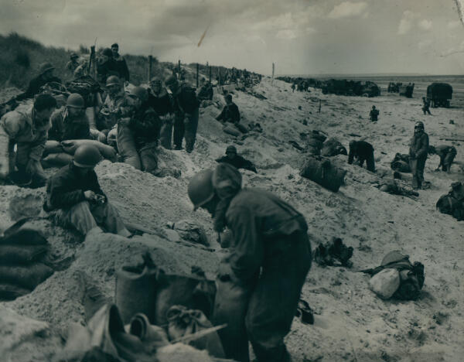

Slide 25
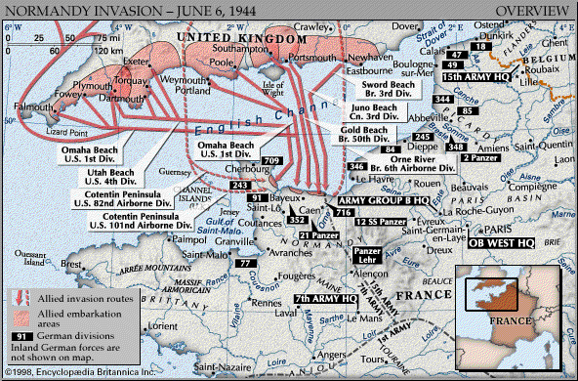
By the end of the of the entire Normandy Campaign, nearly 425,000 Allied and German troops were killed, wounded, or missing.

Slide 26
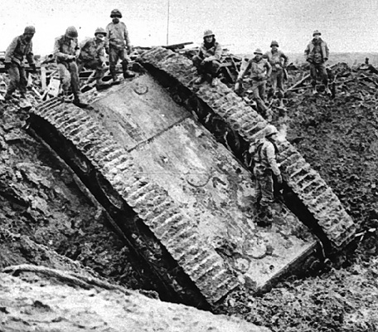
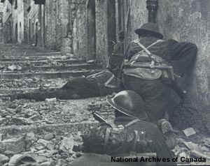
Normandy Invasion cont.
The battle continues…
During this time, Soviet Union was pushing into Poland and Allies were pushing North in Italy
3 million ally troops to attack
W/in 1 month, a million more troops
September 1944, France was freed from Nazi control

Slide 27
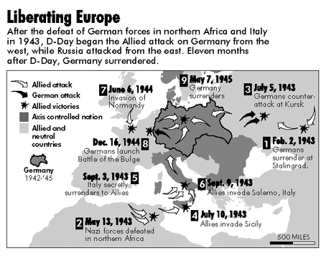
www.salem.k12.va.us/staff/dturner/Chapter%2013.ppt%202005.ppt

Slide 28
The Battle of the Bulge
The Battle of Ardennes, (Belgium)
16 December 1944 – 25 January 1945
German forces intended to split the Allied line.
G.B. and U.S. had 83,000 men. Germany over 200,000
G.B. and U.S.
80,987 casualties(10,276 dead, 23,218 missing, 47,493 wounded)
Germany
84,834 casualties (15,652 dead, 27,582 missing, 41,600 wounded
Allies keep moving into German Territory
http://www.prep.fairfield.edu/atschool/FacultyWebSites/rmauritz/The%20United%20States%20and%20the%20Second%20World%20War.ppt

Slide 29
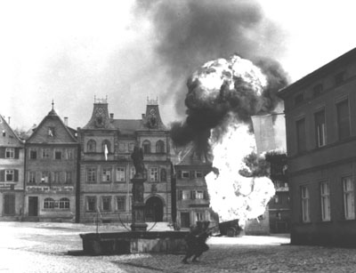

Slide 30
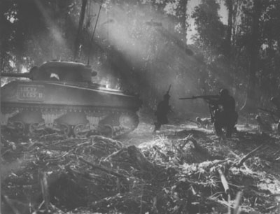

Slide 31
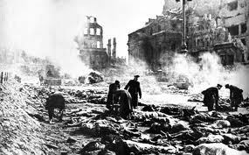
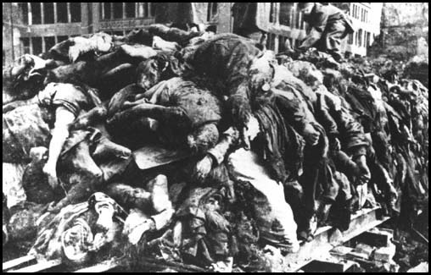
USA, Britain, France…onto Germany

Slide 32
’First Canadian Army’ in the Liberation of Holland

Slide 33
The War in North Western Europe: 1944-1945
Canadians were given the task of liberating the city of Antwerp and the Scheldt Estuary.
The destruction of the Dutch dikes which flooded the polders made progress slow and resulted in heavy casualties.
It was this loss of Canadian infantry which finally forced King to conscript National Resources Mobilization Act men.
Bronze Memorial - Stratford, Ontario

Slide 34
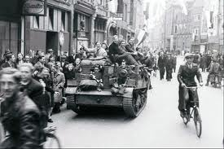
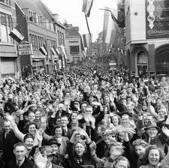
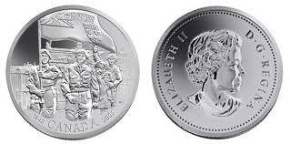

Slide 35
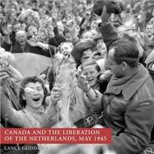

Slide 36
The Italian Campaign
Canadian troops joined the assault on Sicily in July of 1943.
Canadians continued to serve in Italy following the completion of the Sicilian campaign and the Italian surrender.
The battle for Ortona is particularly associated with the Canadian Corps.
Canadians also joined the forces which captured Rome in 1944.
Campochiaro, Italy, 1943

Slide 37
Rome captured June 4, 1944

Slide 38
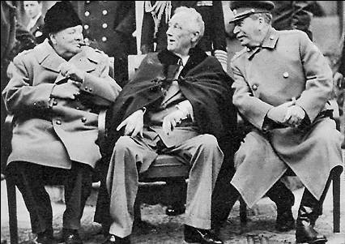
Yalta Conference
Yalta – “The Big 3”
Took place February 1945 before WWII was over
Roosevelt, Stalin and Churchill met in Yalta in the Soviet Union to discuss post WWII
Set up United Nations

Slide 39
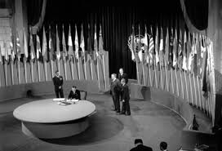
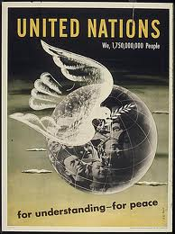
April 1945, "United Nations" formed in San Francisco.
www.salem.k12.va.us/staff/dturner/Chapter%2013.ppt%202005.ppt

Slide 40
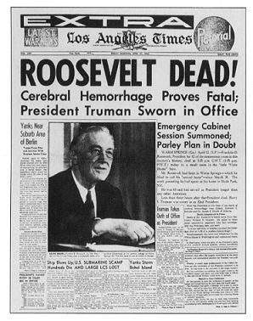
April 12, 1945
At the beginning of his 4th Term, President Franklin D. Roosevelt passes away
The U.S. went through a major grieving period
Harry S. Truman, as Vice-President, takes the role as President

Slide 41
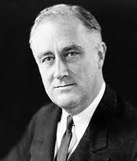
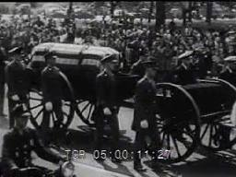
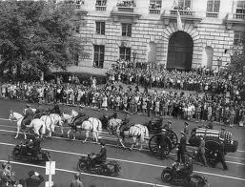
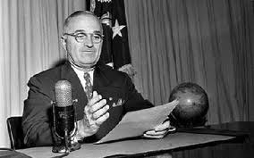

Slide 42
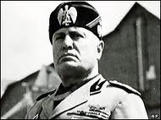
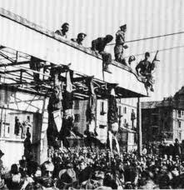
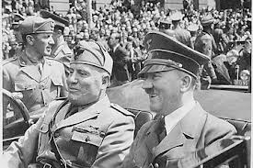
The End of Benito Mussolini
28 April 1945, Benito Mussolini, and sixteen of Mussolini's body-guards are assassinated in the village of Giulino di Messegra, on Lake Como, Italy.

Slide 43
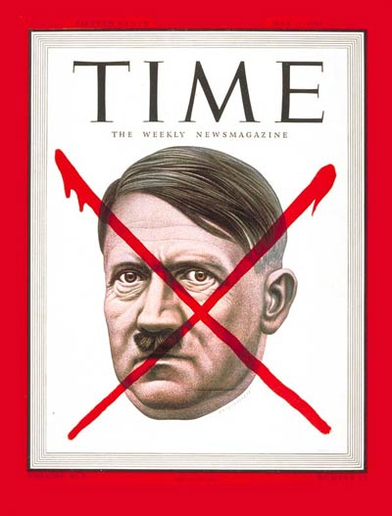
The end of Hitler
30 April 1945, Adolf Hitler, Eva Braun, Goebbels and his wife commit suicide (gun shot and cyanide) in the bunker under the Reich Chancellery in Berlin, Germany
Cover of Time magazine May 7, 1945

Slide 44
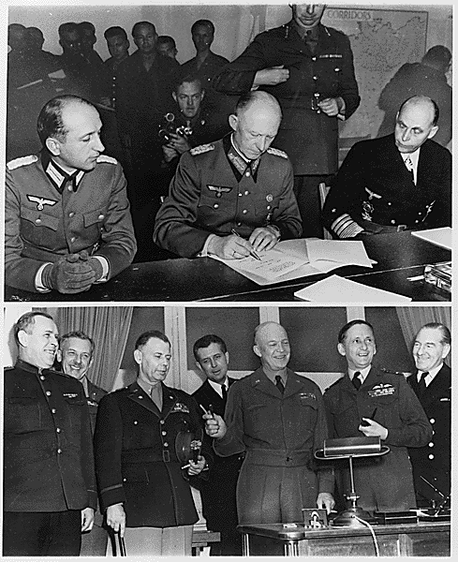
Berlin surrounded
9 million Allied troops approached Berlin from all sides
Germany Surrenders!
Victory in Europe
8 May 1945,
V-E Day - Victory in Europe is celebrated.
www.salem.k12.va.us/staff/dturner/Chapter%2013.ppt%202005.ppt

Slide 45
May 1945

Slide 46
V-E Day
May 8, 1945
General Eisenhower accepted a surrender by the Third Reich
V-E day = Victory in Europe day
1st part of War was over
War in Europe Ends
The United States still has the battle in the Pacific

Slide 48
Potsdam
July – August 1945
Truman, (Churchill and then Clement Atlee) and Stalin met in Potsdam, Germany
Drew up a blueprint to disarm Germany and eliminate the Nazi regime

Slide 49
Potsdam Continued
Divided Germany into 4 sections (occupied by France, Britain, U.S. and Soviet Union)
Berlin to be divided up in East (or Soviet Germany)
Set up the Nuremberg Trials to persecute Nazi leaders
Japan must “unconditionally surrender”

Slide 50
Some Casualties of World War II
Prisoners
Homeless

Slide 51
Nuremberg Trials
International tribunal court tried Nazi officials
Over 23 nations tried Nazi war criminals in Nuremberg, Germany
12 of the 22 defendants were sentenced to death
200 other officials were found guilty, but give lesser sentences

Slide 52
Germany At The End Of WWII

