Slide 1
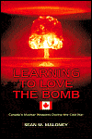
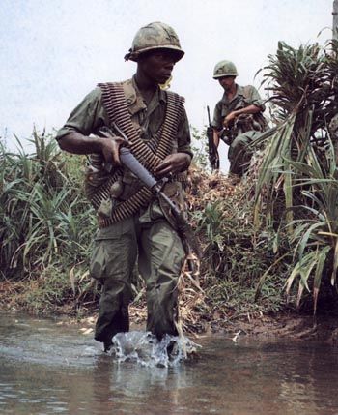
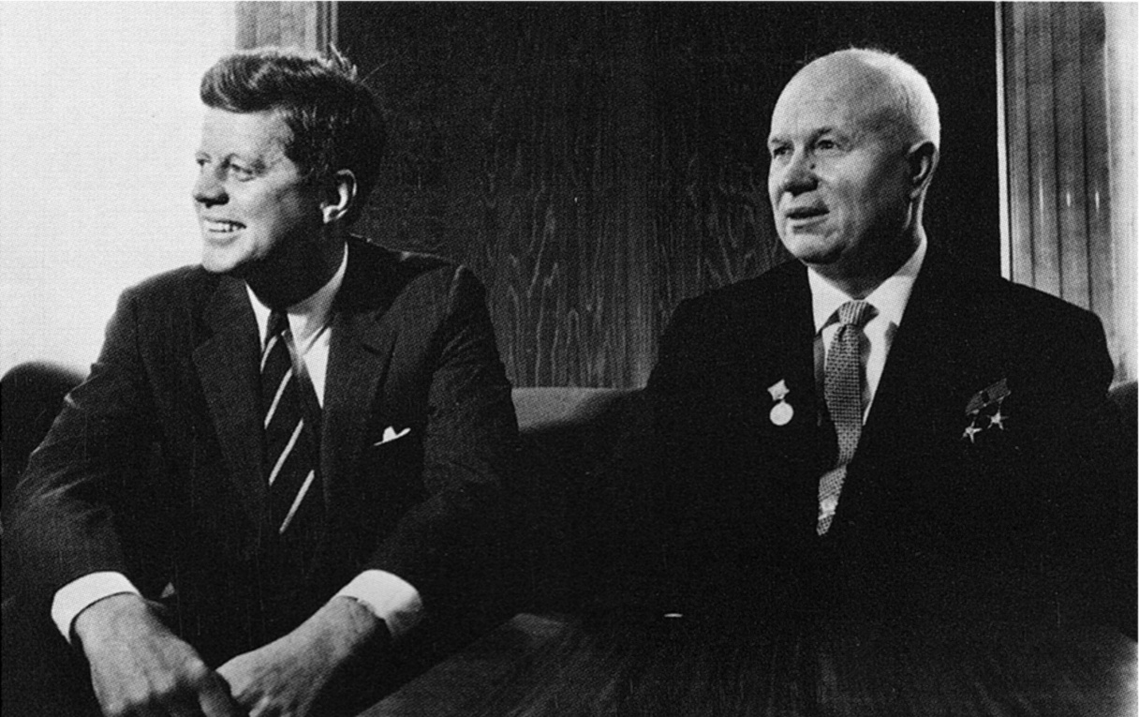
Cuban Missile Crisis
& Vietnam
Diefenbaker and Pearson Years

Slide 2
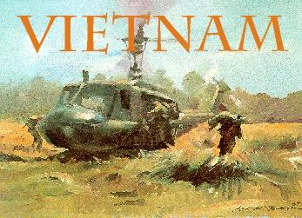
The Vietnam War 1955-1975
Canada did not participate in the Vietnam War although some Canadian weapons companies provided equipment to the U.S. military.
Many Canadians were unimpressed with the killing of civilians by American troops.

Slide 3
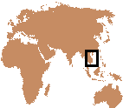
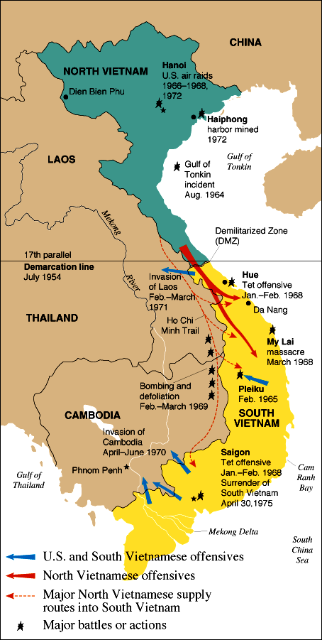
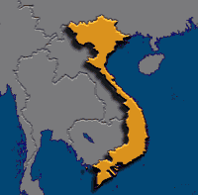
Where is Vietnam?

Slide 4
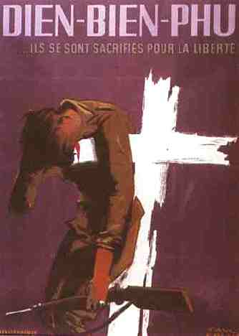
Conflict Between France & Vietnam
The Vietnam War grew out of the long conflict between France and Vietnam.
  In July 1954, after one hundred years of colonial rule, a defeated France was forced to leave Vietnam.
  Nationalist forces under the direction of General Vo Nguyen Giap defeated the allied French troops at the remote mountain outpost of Dien Bien Phu in the northwest corner of Vietnam.

Slide 5
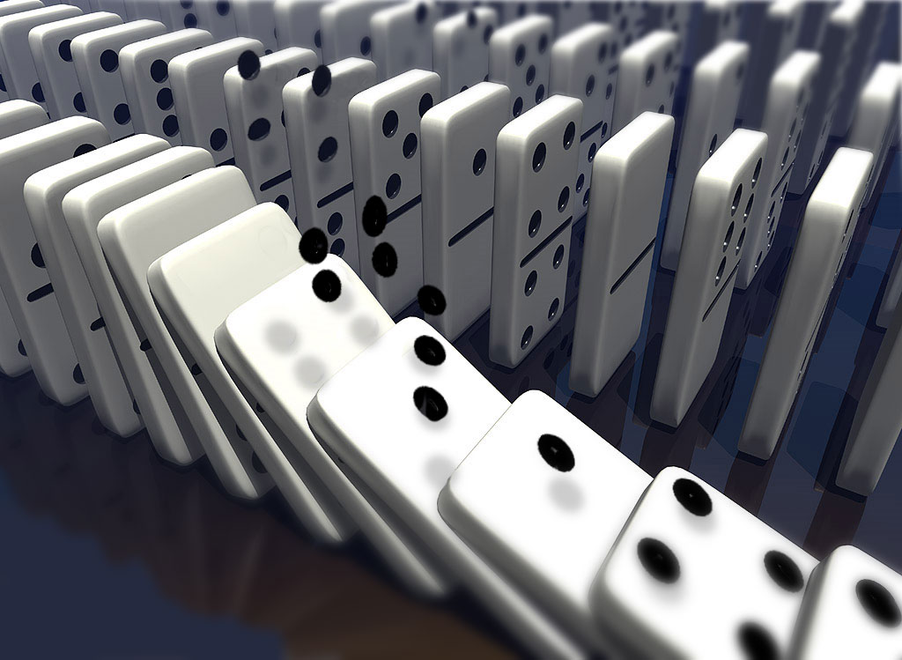
The Domino Theory
American policymakers developed the “Domino Theory” as a justification for the involvement. This theory stated, “If South Vietnam falls to the Communist, Laos, Cambodia, Thailand, Burma, India and Pakistan would also fall like dominos. The Pacific Islands and even Australia could be at risk”.

Slide 6
Why Did the United States
Fight a War in Vietnam?
Basically to hold the line against the spread of world Communism. America paid for the war the French fought against Communist Vietnam as a part of the Truman Doctrine (1947) “to help free peoples to maintain their free institutions and their national integrity against … totalitarian regimes.” In the 1950’s, America became involved again.

Slide 7
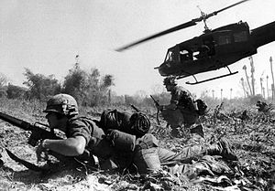
US Military Involvement
U.S. combat units were deployed beginning in 1965. Operations spanned international borders, with Laos and Cambodia heavily bombed. American involvement in the war peaked in 1968, at the time of the Tet Offensive. After this, U.S. ground forces were gradually withdrawn as part of a policy known asVietnamization.

Slide 8
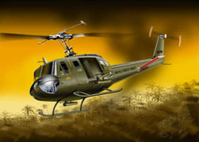
Helicopters
Of all aircraft, the helicopter was the most useful, dropping platoons in the jungle clearings and out again. They were excellent air ambulances.

Slide 9
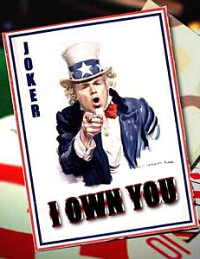
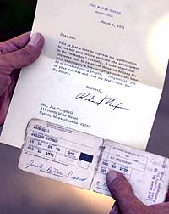
The War in America
The Vietnam War had a major impact on everyday life in America, and the Johnson administration was forced to consider domestic consequences of its decisions daily.
Since there were not enough volunteers to continue to fight a protracted war, the US government instituted a draft.

Slide 10
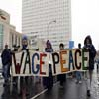

Anti-War Sentiments
As the deaths mounted and Americans continued to leave for Southeast Asia, the Johnson administration was met with the full weight of American anti-war sentiments.

Slide 11
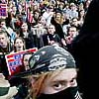
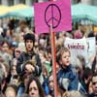
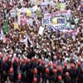
Anti-War Protests
Protests erupted on college campuses and in major cities at first, but by 1968 every corner of the country seemed to have felt the war's impact.

Slide 12
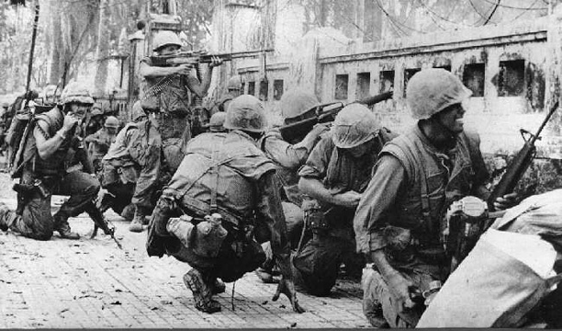
The Tet Offensive
By 1968, things had gone from bad to worse for the Johnson administration. In late January, North Vietnam and the NLF launched coordinated attacks against major southern cities.
These attacks, known as the Tet Offensive, were designed to force the Johnson administration to the bargaining table.

Slide 13
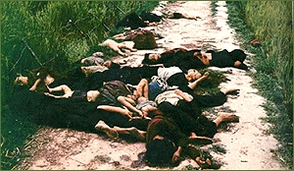
The My Lai Massacre
A serious blow to U.S. credibility came with the exposure of the My Lai massacre (March 1968).
Hushed up at the time and only discovered by a tenacious journalist, this involved the killing of 400 men, women and children by US troops.

Slide 14
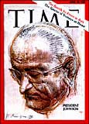
A Secret Plan to End the War
In late March 1968, a disgraced Lyndon Johnson announced that he would not seek the Democratic Party's re-nomination for president and hinted that he would go to the bargaining table with the Communists to end the war.
Negotiations began in the spring of 1968, but the Democratic Party could not rescue the presidency from Republican challenger Richard Nixon who claimed he had a secret plan to end the war.

Slide 15
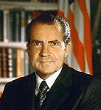
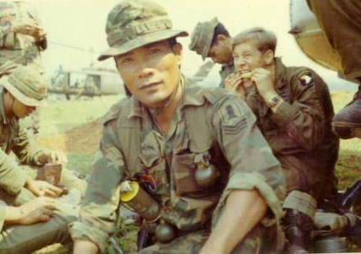
Vietnamization
Nixon's secret plan involved a process called “Vietnamization.”
This strategy brought American troops home while increasing the air war over North Vietnam and relying more on the South Vietnamese army for ground attacks.
U.S. military involvement ended on 15 August 1973 as a result of the Case–Church Amendment passed by the U.S. Congress

Slide 16
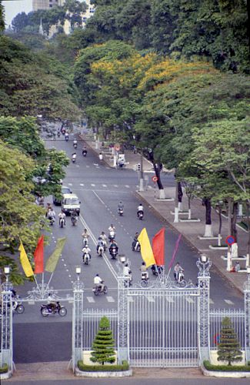
The Fall to Communism
From March 1973 until the fall of Saigon on April 30, 1975, the South Vietnamese army tried desperately to save the South from political and military collapse.
The end finally came when North Vietnamese tanks rolled south along National Highway One.
On the morning of April 30, Communist forces captured the presidential palace in Saigon, ending the Vietnam War.

Slide 17
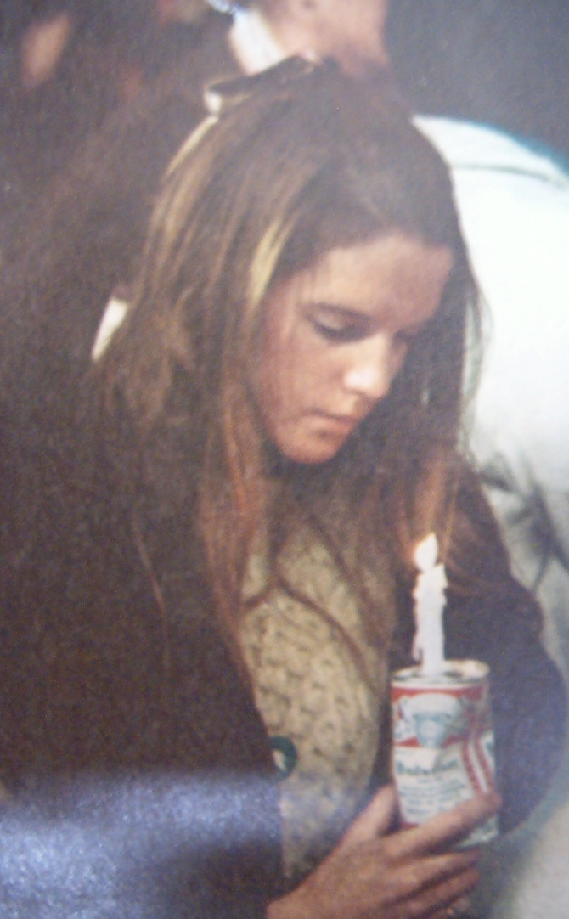
Longest and Most Unpopular War
The Vietnam War was the longest and most unpopular war in American history. During the war:
  58,000 Americans lost their lives.
    The oldest man killed was 62 years old; the youngest, 16.
    61% of the men killed were 21 or younger.
  304,000 were wounded.
  75,000 were severely disabled.
  The United States spent over $200 billion dollars on the war.
  Estimates of the number of Vietnamese soldiers and civilians killed vary from 1 to 3.1 million.[
  Some 200,000–300,000 Cambodians killed

Slide 18
Canada: The Election of 1957
The Liberals led by the ageing St Laurent were confident of victory.
The new Conservative leader, John Diefenbaker, brought a dynamic style to the election platform.
He rallied Canadians against Liberal taxes and “tight money” policies.
The voters returned 112 Conservatives to 105 Liberals.
St Laurent resigned and was replaced by Lester Pearson who now demanded that Diefenbaker resign.

Slide 19
John Diefenbaker
John Diefenbaker was a western Canadian of German descent.
He was a criminal lawyer by profession and styled himself as a champion of ordinary Canadians.
“The Chief” was a powerful speaker who won the loyalty and admiration of many Canadians.

Slide 20
The Election of 1958
Diefenbaker called another election in 1958 and won a landslide victory with 208 seats to the Liberal 49.
He had convinced Canadians of Liberal arrogance and aroused fears that the Americans were taking over our economy.
The Diefenbaker Conservative government was, however, inexperienced and widely criticized.

Slide 21
The Diefenbaker Government
His vision of the nation was a “Canada of the north.”
He wanted to open the north for development with “roads to resources” and to provide jobs for all Canadians.
His government also began a massive irrigation project on the South Saskatchewan river and constructed the Trans-Canada Highway.

Slide 22
The Diefenbaker
Government
Diefenbaker was most proud of the Canadian Bill of Rights which was passed in 1960 giving written form to constitutional conventions.
Until the entrenched Charter of Rights and Freedoms was incorporated into our constitution in 1982 this document was the only written expression of our democratic freedoms.

Slide 23
The Diefenbaker Era
Farmers were delighted when surplus wheat was sold to the People’s Republic of China.
However, a down-turn in the North American economy between 1959 and 1962 increased unemployment and undermined the Conservatives.
Under the Conservative government of John Diefenbaker Native people were given full voting rights.
Native Canadians

Slide 24
Diefenbaker and the United States
Diefenbaker made himself very unpopular with our American neighbors.
When the Avro Arrow was replaced by Bomarc missiles he refused to arm them with nuclear warheads.
Canadian support of the Americans during the Cuban Missile Crisis of 1962 was, at best, hesitant.
BOMARC
Notes:
This picture of the BOMARC is a DND photo but I have also located the number 110220 which may be NAC. There is also a possibility on this slide or the next to show a picture of the AVRO ARROW.

Slide 25
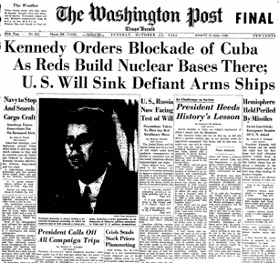
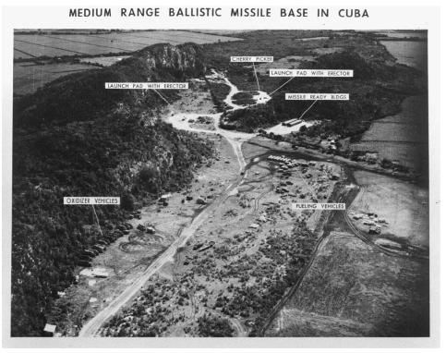
The Cuban Missile Crisis

Slide 26
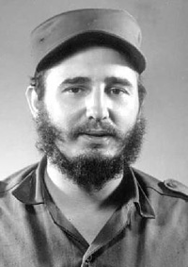
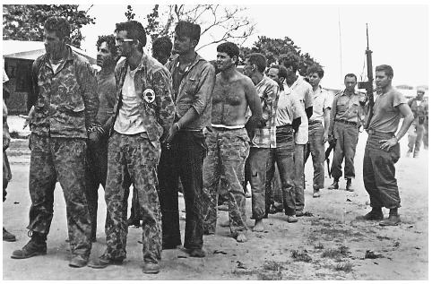
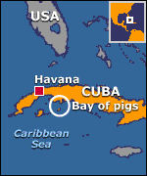
Cuban Missile Crisis
In 1958, Fidel Castro overthrew the US backed government of Cuba and made it a Communist country.
Cuba is less than 150 km from Florida.
The US mounted a failed invasion of Cuba in 1961 in an attempt to overthrow the Communists.
This prompted the Cubans to turn to the Soviets for support.

Slide 27
Setting the Stage
The Truman Doctrine
The Marshall Plan
Containment
The Domino Theory
The Berlin Blockade
The Berlin Wall
Why are these events so important when trying to understand the Cold War?

Slide 28
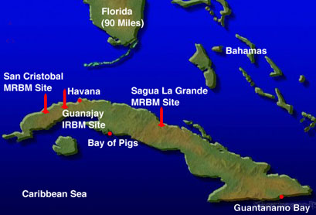
The Bay of Pigs Invasion
The 1961 Bay of Pigs Invasion was an unsuccessful attempt at invasion following the Cuban Revolution that saw Fidel Castro come to power
It was planned and funded by the United States
The invasion was carried out by armed Cuban exiles in southwest Cuba.
This action accelerated a rapid deterioration in Cuban-American relations worsened by the Cuban Missile Crisis the following year.

Slide 29
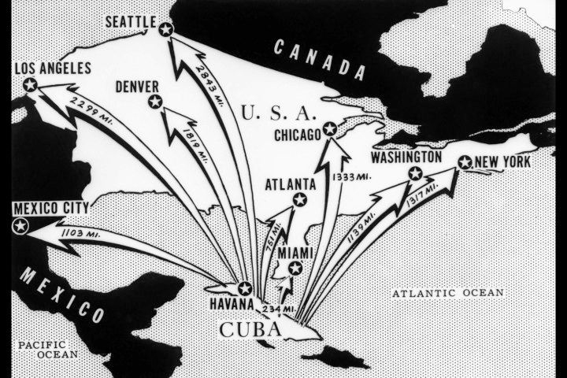
The Cuban Missile Crisis – A Chronology
October 14: U2 recon. flight over Cuba spots sites installing nuclear missiles
October 15: Presence of missiles is confirmed
October 16-22: President Kennedy is notified, EXCOMM is created and secret deliberations on what should be done begin
October 22: Kennedy tells the nation of his plan for blockade and quarantine

Slide 30
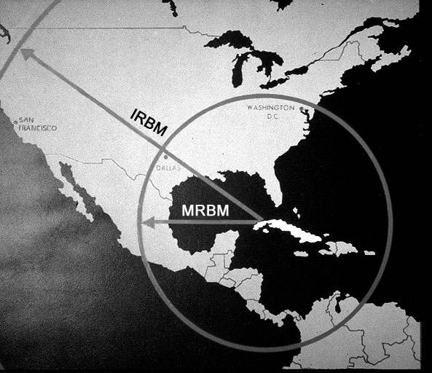
Range of Weapons

Slide 31
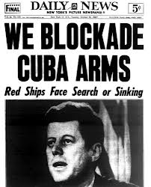
Chronology Continued
October 24: Naval quarantine begins and successfully changes course of many Soviet ships
October 25: One Soviet ship challenges naval quarantine; Kennedy lets it pass
October 25: At the UN, Adlai Stevenson directly challenges the Soviet ambassador to admit to the existence of missiles
When the ambassador refuses, Stevenson wheels out pictures of the missile sites

Slide 32
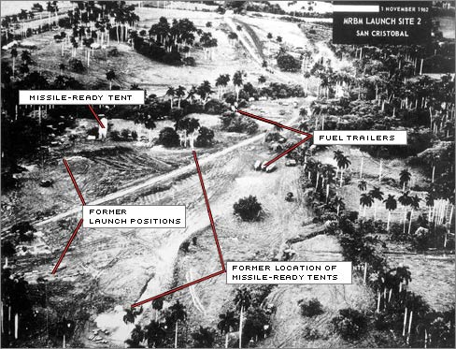
The Aerial Photos

Slide 33
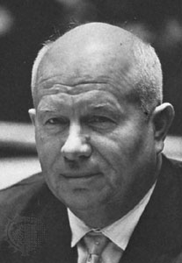
Why Cuba Mr. Krushchev?
Brinkmanship
An opportunity to close the missile gap—Currently far behind U.S. in terms of number of missiles
Protect Cuba – Castro had begun relations with the USSR
Reciprocity: The U.S. has missiles pointing at the Soviets (ie. Turkey)

Slide 34
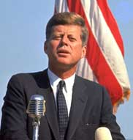
The American Response
Kennedy and Congress had already passed a resolution stating the placement of nuclear weapons in Cuba would no be tolerated
They realized they had to act quickly before the missiles were active
They had a number of choices at their disposal – This has become known as the “Escalation Ladder”

Slide 35
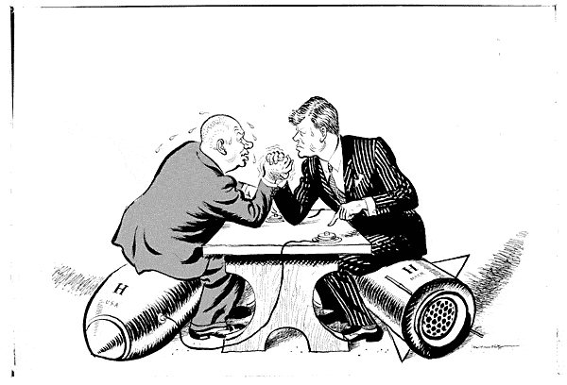
The Escalation Ladder
Do Nothing
Go to the United Nations
Naval Blockade
Strategic Air strike
Full Invasion of Cuba

Slide 36
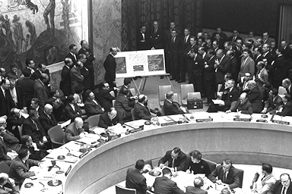
Why was
“Do Nothing” not an option?
The Truman Doctrine prevented it
The weapons were too dangerous to American safety
Kennedy would be perceived as weak by the Soviets – This could empower them to make another move on Berlin or another contentious European location
Kennedy would be committing political suicide at home

Slide 37
Go to the UN?
PROS
Using the United Nations for diplomacy which is good
Validates the United Nation’s role in global politics
CONS
Takes too long
Could appear indecisive
Too many interest groups
Russia and the United States both have veto powers on the Security Council – hard to reach a consensus
DECISION:
Good option in conjunction with another choice

Slide 38
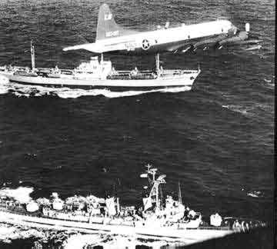
Naval Blockade
PROS
Its not war and it is a show of strength without missiles
A Naval quarantine is an effective way of turning away missiles
CONS
Puts the United States in direct confrontation with the USSR
Sinking a soviet ship is an act of war
DECISION:
Safer than an air strike or full invasion

Slide 39
Strategic Airstrike
PROS
Will effectively knock out Soviet missiles
Good show of American strength
CONS
When Soviet missiles are destroyed it is likely that Soviet soldiers will die as well – this is an act of war
DECISION:
Option number two but would prefer not to use it

Slide 40
Invasion
PROS
The United States secures Cuba and ensures nuclear safety from the country
The United States sends a clear message to the Soviets to stay out of the west
CONS
A full invasion would surely kill Soviet soldiers which would be considered an act of war
The nuclear consequences could be disastrous
DECISION:
Too risky, can only be used as a last resort

Slide 41
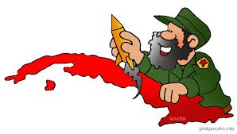
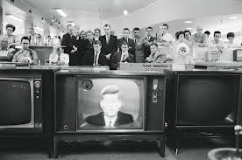
What Happened?
On October 26 the Soviet Union offered to withdraw the missiles in return for a U.S. guarantee not to invade Cuba or support any invasion.
On October 27 the USSR called for the withdrawal of U.S. missiles from Turkey in addition to the demands of the 26th.
The crisis peaked on the 27th, when a U-2 (piloted by Major Rudolph Anderson) was shot down over Cuba and another U-2 flight over Russia was almost intercepted when it strayed over Siberia all the while Soviet merchant ships were nearing the quarantine zone.
Kennedy responded by publicly accepting the first deal and then sent Robert F. Kennedy to the Soviet embassy to privately accept the second deal.
The fifteen Jupiter missiles in Turkey would be removed six months later.

Slide 42
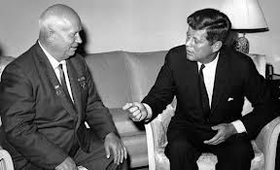
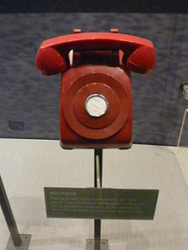
Calling the bluff.....
The Soviet ships turned back, and on October 28 Khrushchev announced that he had ordered the removal of the Soviet missiles in Cuba.
The decision prompted then Secretary of State Dean Rusk to comment, "We were eyeball to eyeball, and the other fellow just blinked.“
Satisfied that the Soviets had removed the missiles, President Kennedy ordered an end to the quarantine of Cuba on November 20.
The ‘Hot-line’ was established between Washington and Moscow to help avoid future emergencies.

Slide 43
Canada: The End of Conservative Power
A devaluation of the Canadian dollar in 1962 was very unpopular.
Diefenbaker, a unilingual Canadian, did not have much support in Quebec.
His refusal to accept American nuclear warheads for Canada’s Bomarc missiles divided his cabinet.
In 1963 a discredited Conservative party was defeated by Lester Pearson and the Liberals.

Slide 44
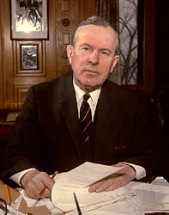
Lester B. Pearson
Lester Bowles "Mike" Pearson (23 April 1897 – 27 December 1972)
A Canadian statesman, diplomat and politician who was made a Nobel Laureate in 1957.
Fourteenth Prime Minister of Canada from April 22, 1963, until April 20, 1968

Slide 45
The Liberals and Lester “Mike” Pearson
Pearson was a successful career diplomat and a striking contrast to the more politically comfortable John Diefenbaker.
His government undertook many reforms including a medical insurance plan and the Canada Pension Plan.
Relations with the Americans improved and the Bomarc missiles were equipped with nuclear warheads.

Slide 46
Canadian Nationalism and the Liberals
Unification of the three Canadian military services were carried out under the Liberals.
It was hoped that this would improve their efficiency but it was also intended to end a strong connection with British military tradition.
The Bilingualism and Bicultural Commission was established in 1963 to study the relations between French and English Canadians.
In 1964 the Liberals adopted the new Canadian flag in spite of a storm of protest. **************

Slide 47
Post-War CCF Party
The largest number of seats held by the CCF (Cooperative Commonwealth Federation) was 28 in 1945.
They had success at the provincial level in Saskatchewan where the formed government for twenty years.
In 1961 they became the New Democratic Party under the leadership of T.C. (Tommy) Douglas.
Tommy Douglas

Slide 48
Social Credit Party
Support for this party was mainly in Alberta and British Columbia where they formed government for many years.
In 1962 they elected federally 26 MPs from Quebec and 4 from the West.
The Quebec leader was Real Couette who eventually formed his own party Le Railliement des Creditistes or simply “Creditistes.”

Slide 49

The Nuclear Issue
The Canadian government continued to struggle with the question of whether or not to accept nuclear weapons on Canadian soil.

