Slide 1
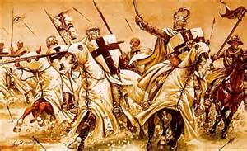
The Crusades
A Brief History of Holy War in Medieval Europe

