Slide 1
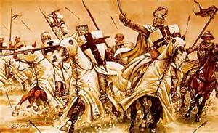
The Crusades
A Brief History of Holy War in Medieval Europe

Slide 2
What is a “Crusade”?
Definition
Leaving us with some questions:
A medieval military expedition, one of a series made by Europeans to recover the Holy Land from the Muslims in the 11th, 12th, and 13th centuries(Apple dictionary).
1. Why would the Christians want to go to war with the Muslims?
2. How did these wars benefit/not benefit Christians?
3. How were these wars Historically Significant?

Slide 3
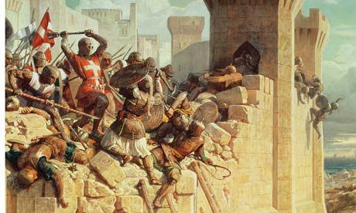
What do you SEE/THINK/WONDER?
Set up your chart and investigate the picture.

Slide 4
Answers
The Crusaders wanted to go back to the origin spot of their religion: Their “Holy Land” Located in Jerusalem
These wars benefited the Christians by:
Giving them the ability to be atoned (forgiven) for their sins
Allowing leaders to conquer (and tax) new lands
Giving kings political favour with the pope
They didn’t benefit the Christians because:
Lots of people died
Disease may have been brought home
The Christians did not really win back the holly land
They were important because:
They lasted so long
They fought with another religion over the same places
These types of fights are still happening today

