Slide 1
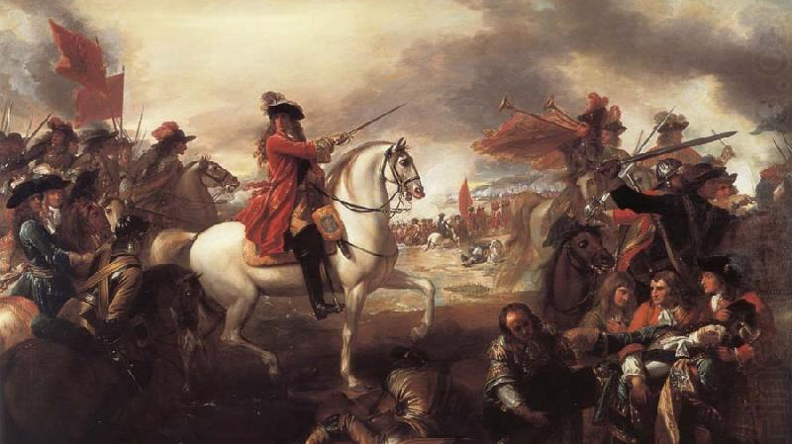
Continuity and Change
The Revolution edition

Slide 2
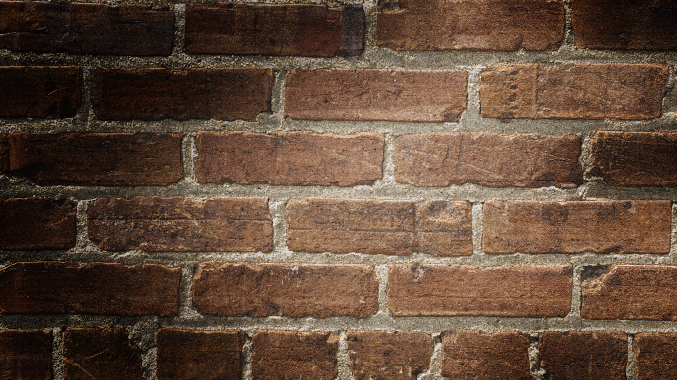

Slide 4
Continuity and Change
historical events often result in change, some big and some little, but there are ALWAYS things that stay the same
continuity – what stayed the same?
change – what is different?

Slide 5
Parts of Continuity & Change
Interwoven
Continuity & Change can exist in the same space
Change
Change is a process with “Turning points”
Progress & Decline
Progress & Decline help to evaluate change
Time
Time Periods help us to organize out thinking abouot continuity & Change

Slide 6
Team Time Line
Get out a piece of paper
You have 20 minutes
The timeline starts in 1517
The Timeline ends in 1688

Slide 7
Time to use your learning…
Think about the reformation compared to your assigned topic in English…
what is the same?
What is different?

Slide 8
Continuity & Change Criteria
Criteria for important Change:
Substantial effect
Relatively Permanent
Widespread
Criteria For an important Constant:
No substantial change
Important Aspect
Widespread

Slide 9
Advice When assessing C&C…
Spectrum - often we need to look at continuity and change on a spectrum or continuum to see the big or small the change and to understand the effects of an event
Patterns - it is useful to look for patterns or connections between continuities and changes
Examples - changes were mostly in technology OR the church stayed the same OR daily life changed very little, etc.

Slide 10
Now Make observations, then inferences...
Examples from your research
Continuances…
1.
2.
3.
Changes----
1.
2.
3.

