Slide 1
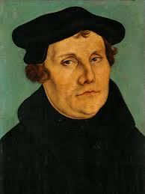
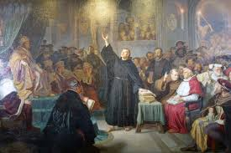
Continuity and Change
The Reformation edition

Slide 2
Continuity and Change
historical events often result in change, some big and some little, but there are ALWAYS things that stay the same
continuity – what stayed the same?
change – what is different?

Slide 3
What has continued / stayed the same for you?
Think about your last year at high school related to last year. Turn and face your partner.
what is the same?
What is different?

Slide 4
Continuity & Change Continued
often we need to look at continuity and change on a spectrum or continuum to see the big or small the change and to understand the effects of an event
it is useful to look for patterns or connections between continuities and changes
ie: changes were mostly in technology OR the church stayed the same OR daily life changed very little, etc.

Slide 5
By the end of the 16th century…
What continued from earlier?
Religion was still very important
Kings and Queens maintained “The divine right of Kings”
Kingdoms still dominated as political systems
People still rely on Monarchies to protect and hold their interests
What was different about life?
Technology improved farming
People had increased access to new ideas
There were many different churches
People questioned rulers with humanistic ideas
The idea of a “nation” developed

Slide 6
Now Make observations, then inferences...
What will happen in the 16th century?
Continuances…
Changes----

