Slide 1
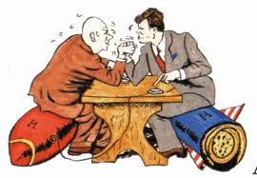
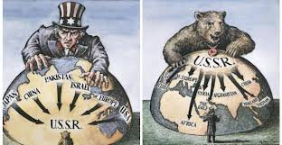
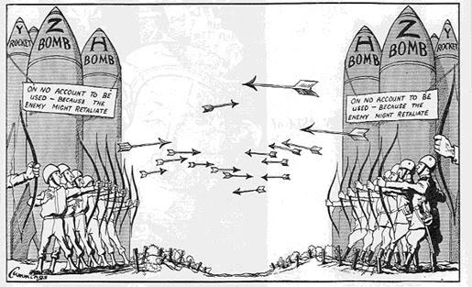
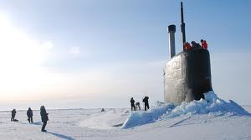
Cold War Study Guide
Test Date

Slide 2
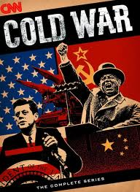
TEST: 1950-2000 (Cold War Unit) Format: Multiple Choice, Matching, Short Answer, Long Answer, Cartoon Analysis
Definitions: NATO, NORAD, UN, UNEF, CRTC
NATO – year, who is involved, what is it
Quiet Revolution – what changes were made (4), who was in charge “Master in our own House”
Korean War – Year, why were men so willing to join
Suez Canal Crisis – year, what was it about, why an international crisis
Peacekeeper – why so suited
Cuba Missile Crisis – year, who was involved
Avro Arrow – who scraped it
FLO – what were they promoting, people killed, kidnapped
Was War Measures Act justified
Trudeamania
1950’s Good life ...
Reason for (2) + against (2) Vietnam
Cold War – who was involved, how did it affect Canada, how did it end
First Nations 20th C issues:
Delgamuluukw Decision - Nisga Treaty
Residential Schools -Oka Confrontation

