Slide 1
The CEF in Battle
Socials 11
WWI Unit

Slide 2
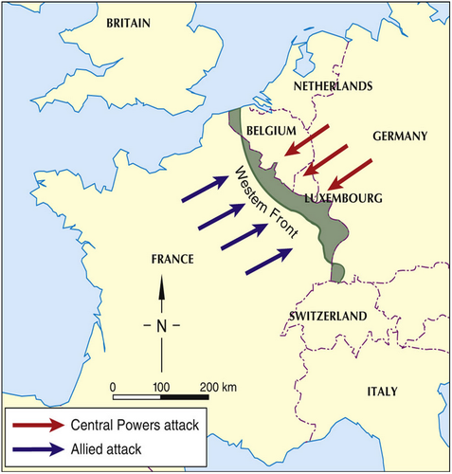

Slide 3
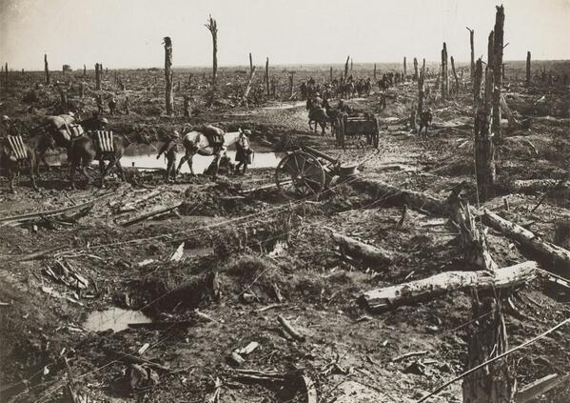
No Man’s Land

Slide 4
The Western Front
After the Battle of the Marne, Germany realized that the Schlieffen Plan had failed.
Germany simply began a holding action in the trenches of the West, in order to concentrate on the Russians in the East.
The Western Front essentially became a stalemate.

Slide 5
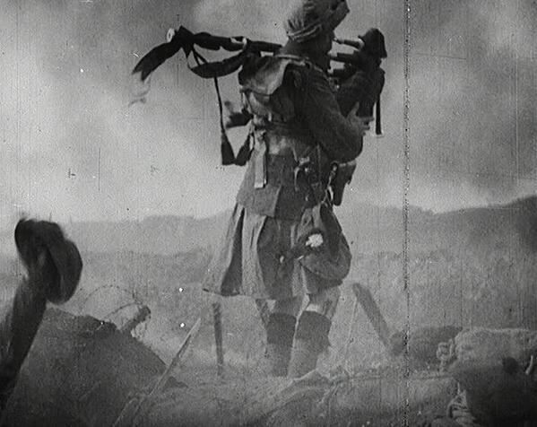

Slide 6
Ypres
April, 1915
Ypres, Belgium
French and Canadian troops were defending Ypres when the Germans used chlorine gas against them.
The French and Canadian troops were forced to retreat, over 6,000 Canadians died.
Significance: Ypres was the first taste of trench warfare for Canadian troops. This was the first battle in which poisonous gas was used. Canadians suffered tremendous losses.

Slide 7
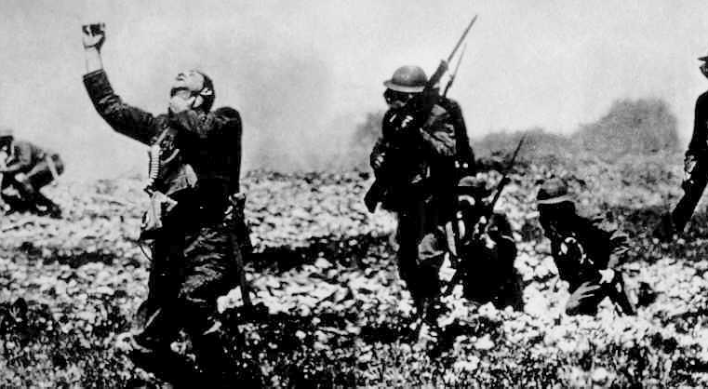

Slide 8
Verdun
February, 1916
Verdun, France
Germany attacked the French in a battle that lasted for six months.
Significance: Over 500,000 French soldiers lost in this deliberately planned battle of attrition. Many claim that the French never recovered psychologically from the Battle of Verdun.

Slide 9
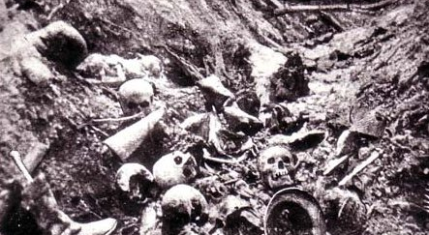

Slide 10
Battle of the Somme
July, 1916
Somme, France
Allied commanders tried to end trench warfare with a large attack on the German trenches as the Somme.
The Germans were not driven back and over 20,000 Canadians were killed.
Significance: Casualties for both sides reached 1.25 million. When the battle ended five months after it began, only a few miles of land had been gained. The Newfoundland Regiment suffered 90% casualties. 23 Canadian men were executed because they would or could not return to the front.

Slide 11
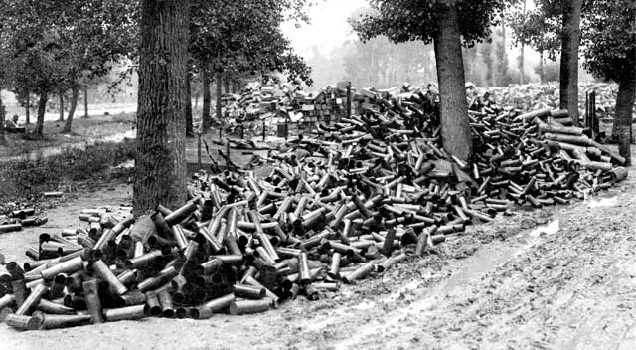

Slide 12

No Man’s Land

Slide 13
Vimy Ridge
April, 1917
Vimy Ridge (between France and Belgium)
The ridge had fallen to German soldiers in 1914. Canadian troops tried to regain the ridge after British and French troops had failed to affect a breakthrough.
The Canadians were successful, although over 3000 were killed and 7,000 were injured.
Significance: Vimy Ridge was the first time that Canadian units fought together as one, and this victory became a symbol of Canada’s independence. As a result of the victory, Canadian troops also became recognized as some of the best troops on the Western Front.

Slide 14
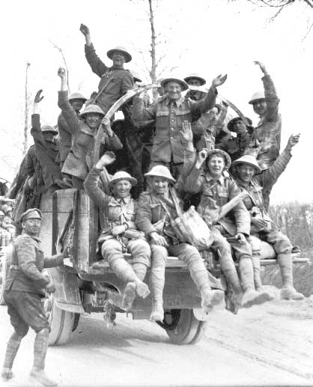

Slide 15
Passchendaele
October, 1917
Passchendaele, Belgium
Canadian troops were asked to attack the Germans
Canadians gained 7km of land and held their position until reinforcements arrived. However, the Germans soon gained back their lost land.
Significance: The objection of the Canadian Commander, General Arthur Currie was overruled and his troops were forced into battle. Many Canadian soldiers lost their lives: only one in five survived. In the end, the battle proved futile as the Germans soon won back their land.

Slide 16
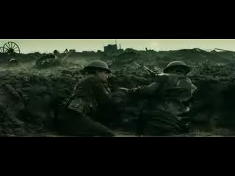

Slide 17
Poetry Analysis
How are the horrors of war expressed in Owen’s poems?
Do you think the speaker creates a realistic picture of his own experiences? Why or why not?
How would you characterize the speaker’s attitude towards war?
Evaluate the validity of poetry as a historical source?

Slide 18
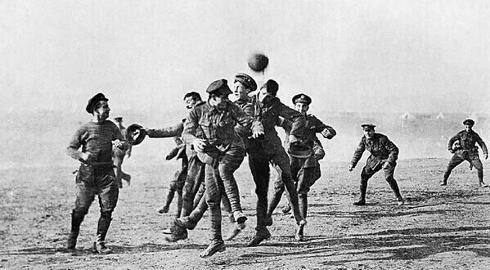
WWI Christmas Truce

Slide 19
Anthem For Doomed Youth
Wilfred Owen
Anthem For Doomed Youth
What passing-bells for these who die as cattle?
Only the monstrous anger of the guns.
Only the stuttering rifles' rapid rattle
Can patter out their hasty orisons.
No mockeries for them; no prayers nor bells,
Nor any voice of mourning save the choirs,--
The shrill, demented choirs of wailing shells;
And bugles calling for them from sad shires.
What candles may be held to speed them all?
Not in the hands of boys, but in their eyes
Shall shine the holy glimmers of goodbyes.
The pallor of girls' brows shall be their pall;
Their flowers the tenderness of patient minds,
And each slow dusk a drawing-down of blinds.

Slide 20
Dulce et Decorum Est
Wilfred Owen
Dulce et Decorum Est
Bent double, like old beggars under sacks,
Knock-kneed, coughing like hags, we cursed through sludge,
Till on the haunting flares we turned out backs,
And towards our distant rest began to trudge.
Men marched asleep. Many had lost their boots,
But limped on, blood-shod. All went lame, all blind;
Drunk with fatigue; deaf even to the hoots
Of gas-shells dropping softly behind.
Gas! GAS! Quick, boys!--An ecstasy of fumbling
Fitting the clumsy helmets just in time,
But someone still was yelling out and stumbling
And flound'ring like a man in fire or lime.--
Dim through the misty panes and thick green light,
As under a green sea, I saw him drowning.
In all my dreams before my helpless sight
He plunges at me, guttering, choking, drowning.
If in some smothering dreams, you too could pace
Behind the wagon that we flung him in,
And watch the white eyes writhing in his face,
His hanging face, like a devil's sick of sin,
If you could hear, at every jolt, the blood
Come gargling from the froth-corrupted lungs
Bitter as the cud
Of vile, incurable sores on innocent tongues,--
My friend, you would not tell with such high zest
To children ardent for some desperate glory,
The old Lie: Dulce et decorum est
Pro patria mori.

