Slide 1
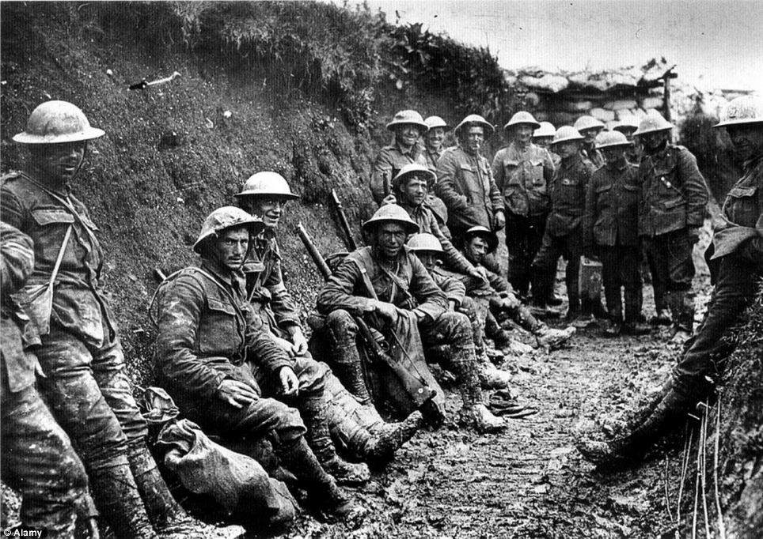
Causes of the First World War
SS 11

Slide 2
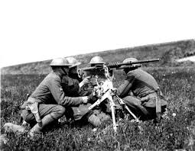
Objectives
I can….identify and explain the main causes of WWI

Slide 3
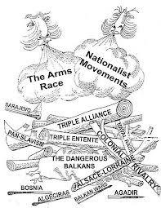
Intro
The following concepts represent the underlying or background causes of the First World War. Although these issues by themselves may not have led to war, in combination, the result was catastrophic.
M.A.N.I.A.

Slide 4
Militarism
The policy of making a country’s armed forces very strong, and allowing military interests to dominate government policy.
Accepts war as a respectable way of advancing a country’s interests and resolving disputes.
Naval and arms races increased tension, and the possibility of war in Europe.

Slide 5
Examples of Militarism
Early 1900s, the British Navy was the largest in the world – a necessity in order to protect its huge empire. Because Germany wanted to expand its colonial holdings, it required a large navy as well. This element brought Germany into direct conflict with Britain.
Arms Race: a competition to see who could build the strongest and largest navy. Focal point – the launching of the Dreadnought class warships in the early 20th century.
German competition with France and Russia to build the largest army.

Slide 6
Dreadnought Class

Slide 7
Alliances
The close association of nations for the achievement of common objectives, or a group of countries united for the purpose of joint military protection. The principal method for nations to ensure their security in the years leading up to WWI.
Colonial rivalries in Europe led each country to seek friends (defensive alliances) for their protection.

Slide 8
In Context of WWI
Triple Alliance (Central Powers): Germany, Austria-Hungary and Italy, all agreed to support each other if attacked.
Triple Entente (Allied Powers): France, Russia and Britain, loosely agreed to support each other. No formal agreement ever signed, only France and Russia truly formed a defensive alliance.

Slide 11
Nationalism
Type 1: A strong feeling or patriotism and pride for one’s country, and/or the desire of a people to preserve its own language, religion, and traditions.
Type 2: exists within an ethnic group that does not have its own country. These groups desire to be liberated from a dominant ethnic group, different than themselves.
Most European countries valued national interests over anything and wanted to assert themselves and their national identities.

Slide 12
The Balkans – “Powder Keg of Europe”
There were 11 Slav groups in A-H that were nationalistic and wanted independence. A number of rebellions took place within the Austrian Empire as various groups tried to break free of Austrian rule.
Black Hand: A terrorist organization formed by Bosnian Serbs determined to free Bosnia from A-H. Their goal was to liberate all the ethnic groups of Slav-descent in A-H and form what they called “Greater Serbia”, later known as Yugoslavia.

Slide 13
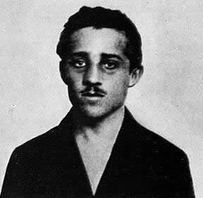
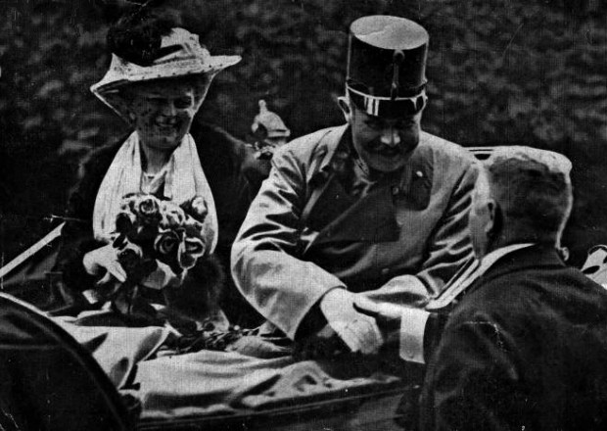

Slide 14
Imperialism
Extending the rule of authority of one country over other countries or territories. Involved the forming and maintenance of an empire through colonies.
Resulted from industrialization because countries needed raw materials to supply factories and markets.
Countries often came into conflict over competition for colonies – particularly Africa and South-East Asia.

Slide 15
In Context of WWI – Part I
Great Britain: “The sun never sets on the British Empire.” Military and naval bases around the globe. Britain made tremendously wealthy by its empire. The envy of other colonial powers.
France: Large holdings in Central Africa. Had a history of problems maintaining its empire. Germany main rival of France in Europe.
Belgium, Holland, Spain, Portugal, and Italy: Minor players on the European scene. All managed to secure some colonies.

Slide 16
“The sun never sets on the British Empire”

Slide 17
In Context of WWI – Part II
Russia: Promoted Pan-Slavism (Unite the Slavic peoples of the Balkans). Wanted control of a warm water port, thus dominance in the Balkans would allow Russia to be the “Big Brother” in the Balkans.
Austria-Hungary: Also sought to dominate the Balkans, not for imperial reasons, more for survival and prevent the disintegration of Austria-Hungary. As such, A-H stood aggressively in the way of Russian advancement in the region.
Germany: Colonial holdings were a drain on Germany. Sought to acquire more colonies, thus more raw materials for industrial expansion. This pursuit changed many relationships between other countries that had reason to fear German expansion, mainly Britain and France.

Slide 19
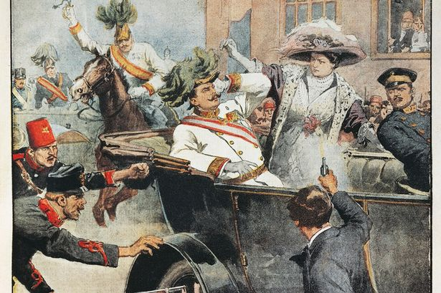
Assassination
June 28, 1914 – Archduke Franz Ferdinand, the heir to the Austrian throne, and his wife Sophie, killed by Gavrilo Princip, a member of the Black Hand, while visiting Bosnia. “The shot heard around the world.”

Slide 20
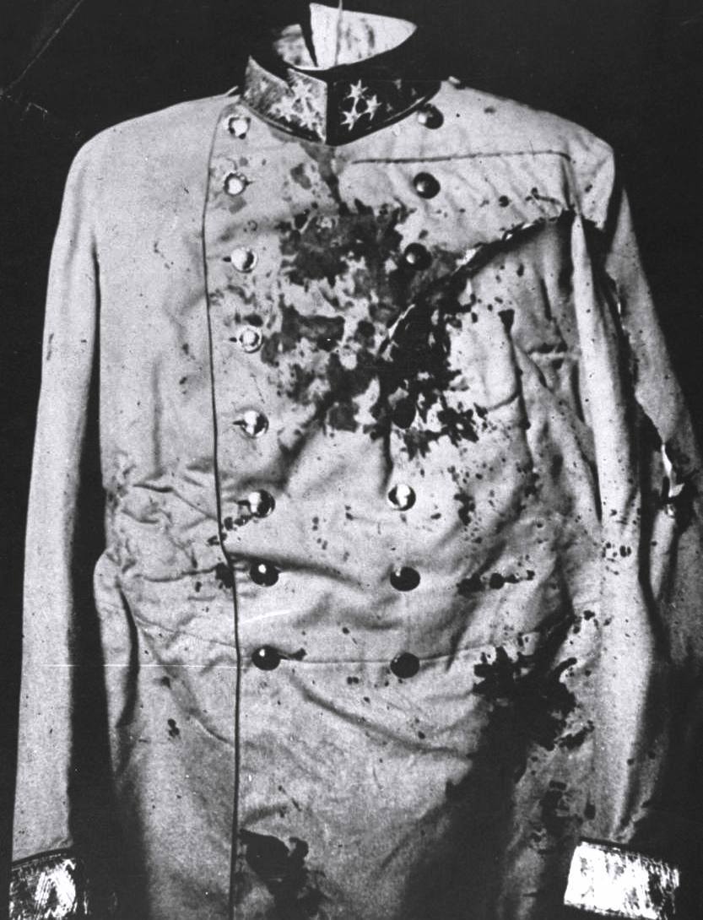
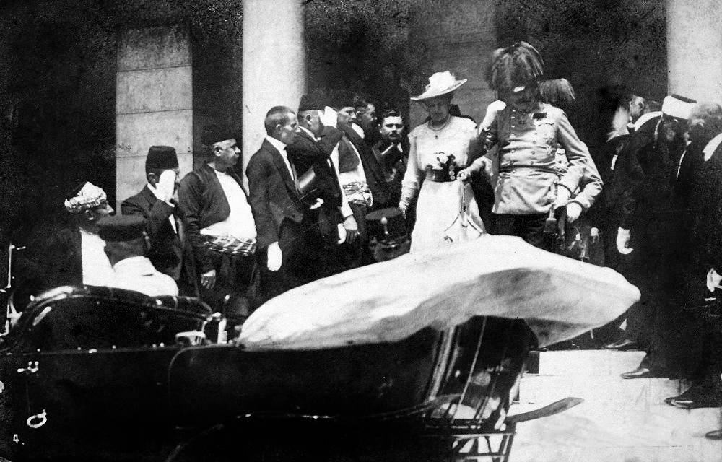
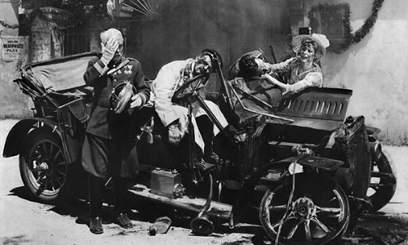

Slide 21
“A Chain of Friendship”

Slide 22
Countdown to War – Part I
Blank Cheque: Germany gives A-H the famous Blank Cheque, which meant that Germany would support A-H, even if it meant going to war. Germany felt certain that Britain would remain neutral if war broke out.
A-H Prepares for War: With the support of Germany, A-H began to prepare for war against Serbia.
The Ultimatum: Because the Black Hand was a Serbian terrorist organization, the Austrians sent Serbia an ultimatum – hand over the terrorist or face war.

Slide 23
Part II
Serbia’s Reply: Although agreeing to most of the points of the ultimatum, Serbia asked for clarification on a few points. A-H interpreted this response to be a rejection, as it was looking for an excuse to go to war.
July 28th, 1914, Austria Hungary declared war on Serbia.

Slide 24
Part III
Russia’s Mobilization: Under Tsar Nicholas II, Russia gives Serbia its own version of a blank cheque and began to mobilize its army against A-H.
Germany Declares War on Russia: Under Kaiser Wilhelm II, Germany demands that Russia stand down. When this didn’t happen, Germany supports A-H by mobilizing its army and declaring war on Russia.

Slide 25
Part IV
France Supports Russia: Due to their alliance, France promises Russia its support.
Germany Declares War on France: Germany felt threatened by Russia and France and ordered them to stop mobilizing. Upon refusal, Germany declares war on France.

Slide 26
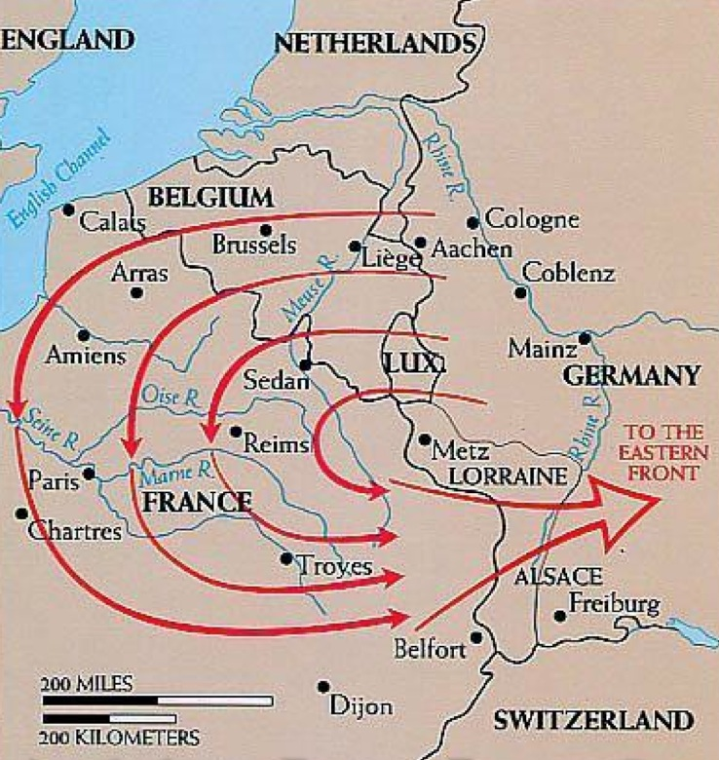
Schlieffen Plan
Germany planned to attack France through the neutral country of Belgium in order to avoid a two-front war.
Belgian neutrality was guaranteed by Britain.

Slide 27
Part V
August 4, 1914 - Britain Declares War on Germany: Because Britain had agreed to protect the neutrality of Belgium, it declared war on Germany when Germany invaded Belgium.
The First World War had begun.
Canada automatically at War upon British Declaration

Slide 28
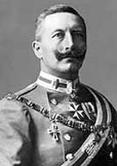
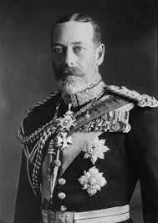
Family Feud

Slide 29
