Slide 1
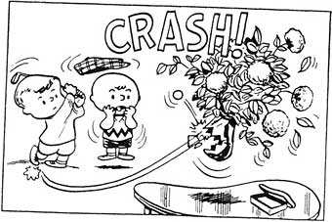

Slide 2
I burned my hand when I touched the hot stove.
I slept in and missed my bus.
A mouse ran across the floor and the girl screamed.
The door was locked, so I didn’t go to class.

Slide 3
Cause – something that occurs and has a consequence
Effect – the consequence(s) of the action/event NOTE: “consequences” can be positive

Slide 4
Cause + Effect
Events have immediate (short term) and underlying (long term) causes
Consequences can be intended or unintended, and immediate or delayed
All prior events are not causes. All following events are not effects. There must be reason to believe that one event influenced another (connections).
Events have different types of causes (ie: social, political, economic, cultural, etc.)
Effects may be direct or indirect.

Slide 5
CAUSE | EFFECT(S)
E-books are becoming more and more popular | The sales of paper books are declining Bookstores are closing There are fewer jobs in publishing It is easier to take books to read “on the go” (ie: on holiday, transit, school, etc.)

Slide 6
CAUSE | EFFECT(S)
Netflix has increasingly been creating its own content (TV series, movies, documentaries, etc.) for people to stream on their subscription service

Slide 7
CAUSE | EFFECT(S)
In recent years, people are more aware of how human activity has a negative effect on the environment

Slide 8
Reformation Causes?
CAUSE | EFFECT(S)
Elizabeth I crowned Spanish Armada attacks Charles I dies

Slide 9
Reformation Causes?
CAUSE | EFFECT(S)
1. 2. 3.

