Slide 1
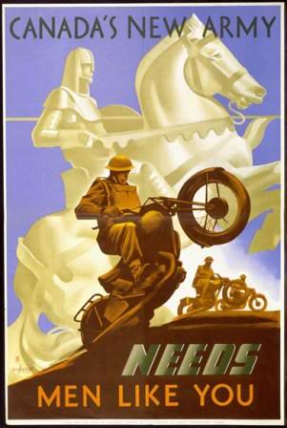
Canada Goes to War
SS 11

Slide 2
Objective
I can...explain Canada’s entrance into WWI.
I can…outline and explain the War Measures Act.

Slide 3
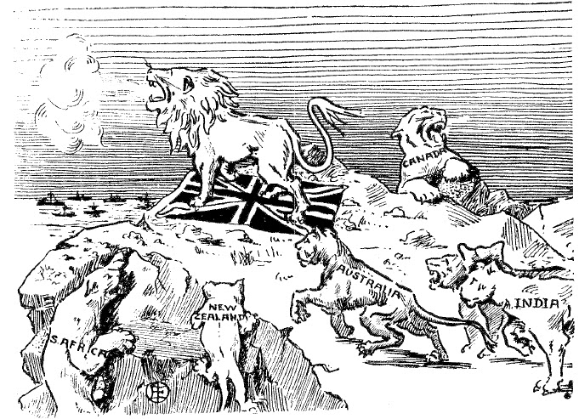
ANSWERING THE CALL. "The whelps of the lion are joining their sire"

Slide 4
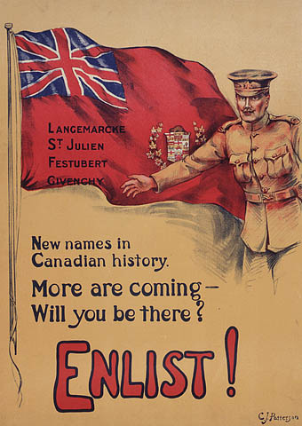
Jumping In
Canada automatically entered the war as part of the British Empire.
When Britain declared war, Canada was at war.

Slide 5
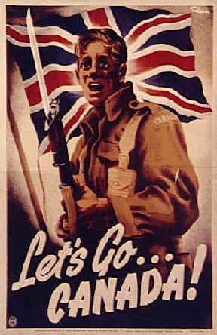
Support
Canadian support was widespread. PM Robert Borden and his cabinet decided to support Britain wholeheartedly.
Canada offered Britain a force of 25,000 (Canadian Expeditionary Force) men, trained, equipped, and paid for by the Canadian government.

Slide 6
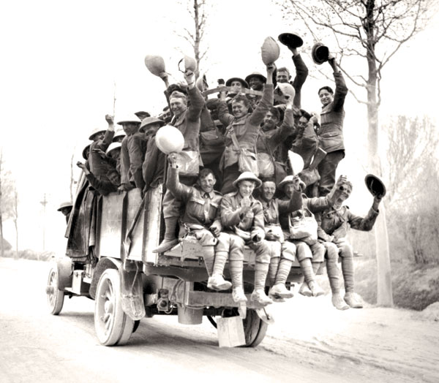
Two different takes on the situation…
How do the following two statements differ on Canada’s support for WWI?

Slide 7
PM Robert Borden
“We are part of the British Empire, so of course we are at war. That is the law. We must now decide on the kind of aid that we should send to Britain. I believe that we should send soldiers to fight alongside the British army in France. Canadians, I am sure, will be proud to fight of their King and country.”

Slide 8
Wilfred Laurier – Leader of the Opposition
“We are at war. That is the law. It is now our job to decide just what to do about this sad fact. M hope is that the war will soon be over and our help will not be needed. We should offer both money and food to France and Britain.”

Slide 9
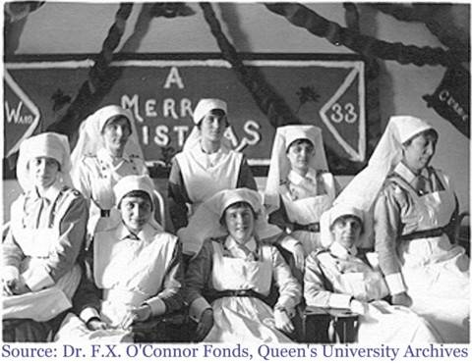
Padding the Numbers
However, while Canada had only 3000 regular army soldiers and two navy cruisers, it had over 60,000 militia (citizen soldiers). Moreover, Newfoundland (not yet a Cdn. Province) offered up its own reg.
To supplement the forces, Colonel Hughes sent out a call for volunteers. Over 10,000 volunteered, including hundreds of women who joined as nurses and ambulance drivers.

Slide 10
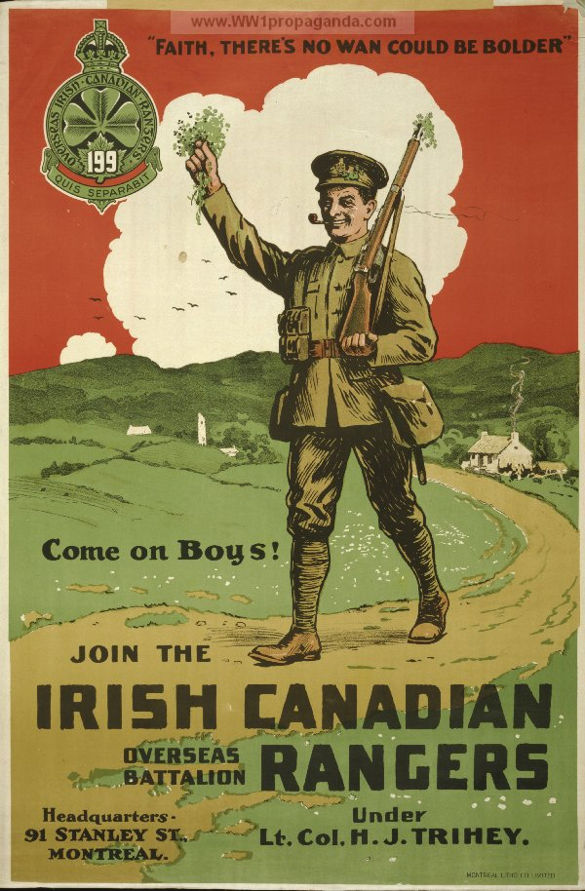
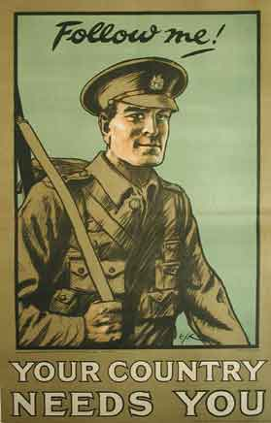
Why?
List at least three reasons why Canadians would volunteer for service?

Slide 11
Answering the Call
Sense of Patriotism: Canadians felt proud to serve their country. Strong sentimental ties to Great Britain from English-speaking Canada.
Feelings of Excitement & Adventure: Many young men viewed war as an adventure and enlisted for the sense of excitement they thought the war would bring. They would be heroes when they returned. No one knew how long the war would really last. Home by Christmas.
Aboriginal, African, and Asian-Canadians were not allowed to serve at first. Although allowed eventually, they were not often promoted.

Slide 12
A Canadian Perspective
“When the war started I wanted to go, but I was too young, only fifteen. By the time I was seventeen, I couldn’t wait any longer. I guess I was afraid the war would end before I got a chance to get involved.” – Source Unknown
“A lot of us were farm boys. Fighting was bound to be more exciting than farming and none of us thought we’d ever get another chance to see overseas places like England and France.” – Source Unknown

Slide 13
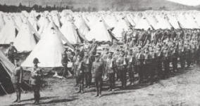
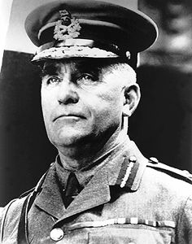
Training the Troops
Sir Sam Hughes was Canada’s Minister of Militia and Defence at the beginning of the war.
Hughes set up a training camp for over 30,000 men at Valcartier, Quebec.

Slide 14
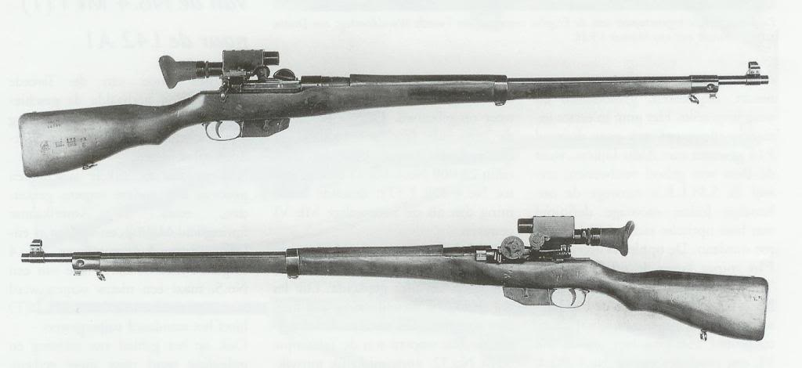
Getting Ready
Troops were issued the Ross Rifle (manufactured in Canada), which was good for sharp shooting, but poor in trench warfare.
By October 1914, Canadian troops were on their way across the Atlantic, and by February, Canadian troops were on their way to the front lines of Europe.

Slide 15
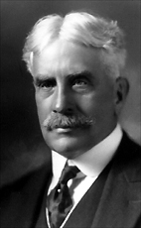
War Measures Act
PM Borden wanted greater control over the country’s affairs to meet the demands of the war.
Introduced the War Measures Act
Granted the Canadian Government the authority to do everything necessary “for the security, defence, peace, order and welfare of Canada.”

Slide 16
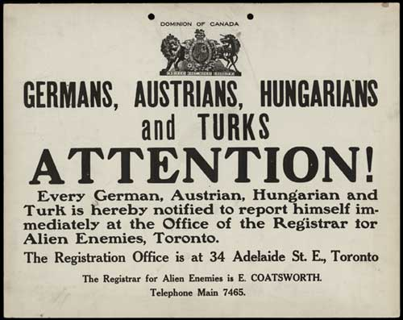
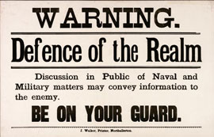
Enemy Aliens
Striped Canadians of their civil rights
Anyone suspected of being an enemy alien or threat to the government could be imprisoned or deported or both.
Recent immigrants from Germany or Austria-Hungary were treated particularly harshly under the act.
Over a half million were required to carry ID cards
8578 were held in isolation in internment camps

Slide 17
Were these actions necessary?
Complete a T-Chart with arguments for and against the War Measures Act in 1914
Arguments Supporting War Measures Act | Arguments Opposed

Slide 18
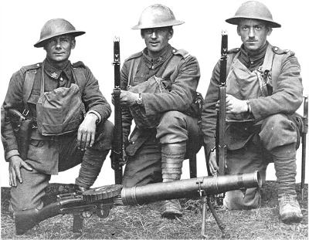
Group Discussion Questions
Why were Canadians so naïve about the war?
What had been the Canadian experience of war prior to this?
Why did Canadians have so little idea about what they were getting into?

