Slide 1
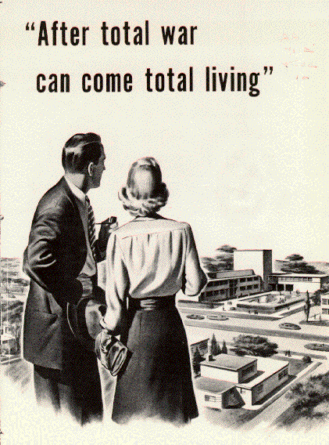
Canada After WWII

Slide 2
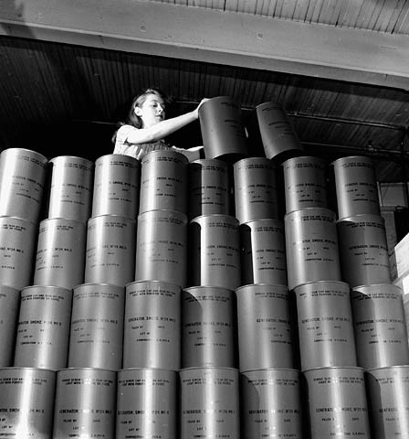
Economy - Industrial Sector
The “total war” effort caused the Canadian economy to grow (boom)
However by war’s end - in debt over $10 billion
Industrial and manufacturing production replaced agriculture as Canada’s most important economic sector
Highly skilled workforce created during war

Slide 3
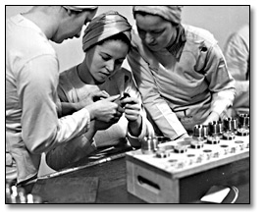
Economy – Government Control &
Emergence of Crown Corporations
The war created an unprecedented demand for military & civilian goods
Canada was Britain’s principal supplier of war materials until the US entered the war
  in 1940 created the Department of Munitions and Supply - headed by C.D. Howe.

Slide 4
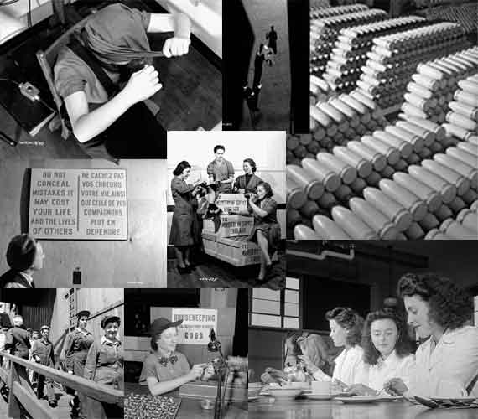
Economy – Government Control &
Emergence of Crown Corporations
Under Howe’s direction, the government created 28 Crown corporations (companies owned and operated by the government) for large-scale production of manufactured goods

Slide 5
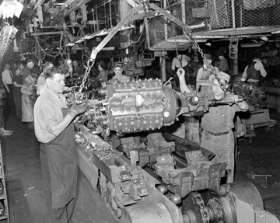
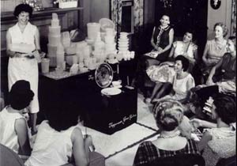
Economy –
Impact on Women & Families
When men returned home, many women left their jobs and returned to their traditional role as homemaker
created immediate employment opportunities for men

Slide 6
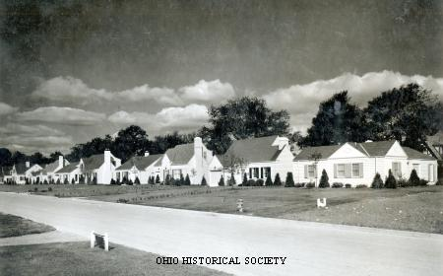
Economy –
Growth of Infrastructure & Exports
From 1946 to 1957, the country saw rising prosperity, fuelled partly by the needs of a rapidly growing population (suburbs) for:
  homes,
  schools,
  hospitals,
  roads, and
  factories.
Canada’s exports also continued to grow with its participation in the US-led reconstruction of a war-ravaged Europe

Slide 7

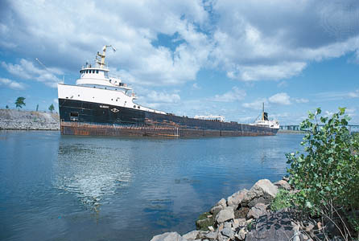
Economy –
Increased Ties to USA
By the end of the war, the United States emerged as the most powerful economy in the world
helped the Canadian economy in terms of its exports and growth
The two countries undertook major building projects such as the St. Lawrence Seaway

Slide 8
The St Lawrence
Seaway
This project was undertaken in cooperation with the United States.
Its purpose was to allow ocean going ships to enter Lake Superior.
It would also allow the development of hydro-electric power on the St. Lawrence River.
It was opened in 1959 and is a symbol of the economic ties between Canada and the USA.

Slide 9
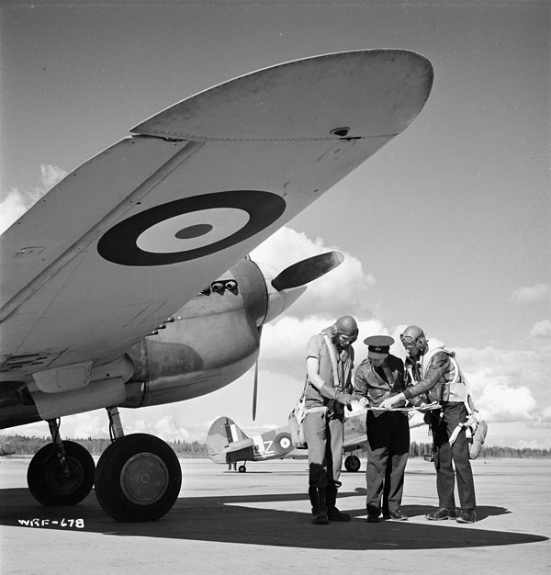
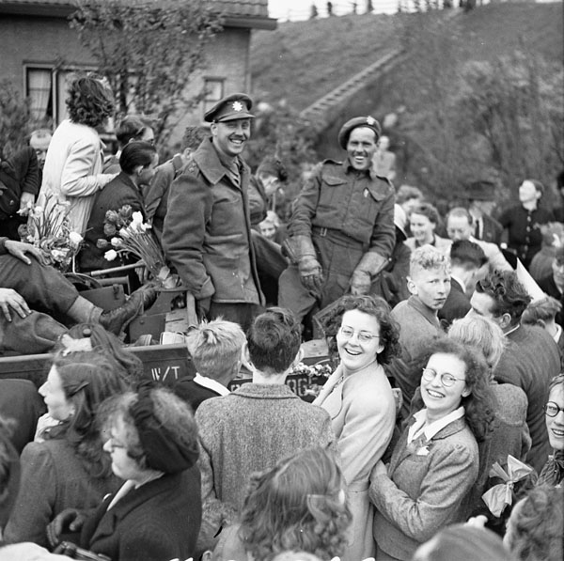
Politics – Recognition
Canadian WWII contributions were recognized internationally (Dieppe, Hong Kong, Normandy, Liberation of Holland)

Slide 10
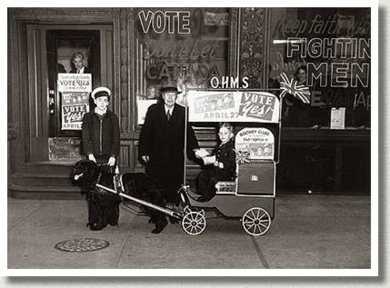

Politics – Conscription Crisis
Prime Minister King managed to avert (avoid) a conscription crisis, and therefore French-English relations were strained, not broken

Slide 11
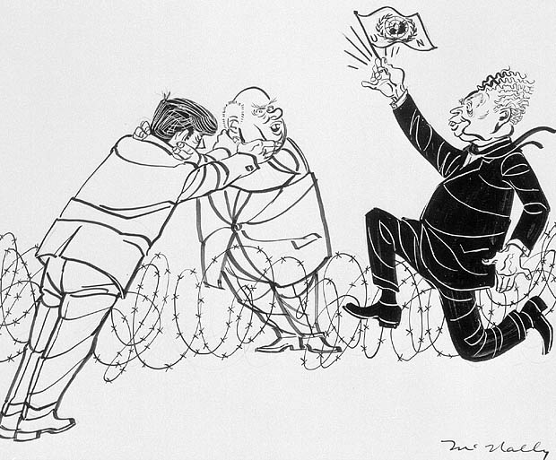
Politics – Middle Power
Canada was established as a middle power (smaller than a great power, but wealthier than smaller or poorer nations) in the international community (Between USA and USSR)

Slide 12
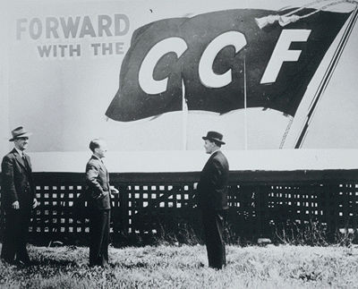
Politics – Socialism
Canadian government played a larger role in the lives of Canadians (social safety net)
  Rise of Socialist parties such as the CCF in Saskatchewan (led by Tommy Douglas)
  Led to the Liberals (led by PM King) cutting off the “threat from the left” by adopting socialist policies

Slide 13
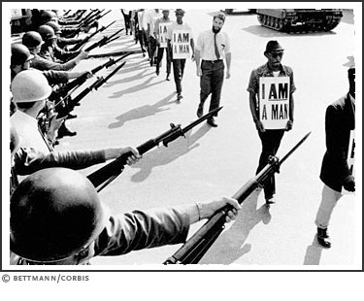
Politics – Civil Rights
Civil rights in Canada advanced after WWII as a result of the contributions of African-Canadian and Aboriginal people

Slide 14
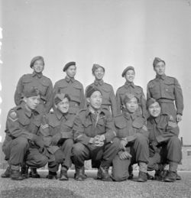
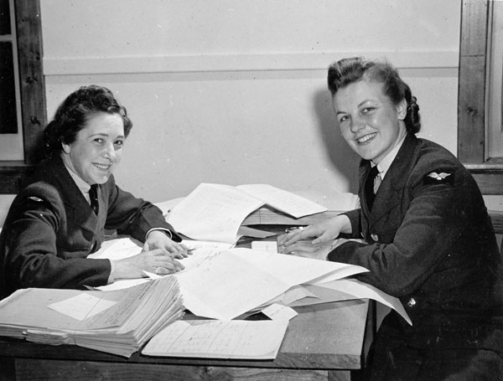
Social Changes - Overall
Women were recognized for their contributions to the war effort (1 million employed during war)
Canada became a more tolerant nation
Population increased caused by the “baby boom” and a wave of immigration

Slide 15
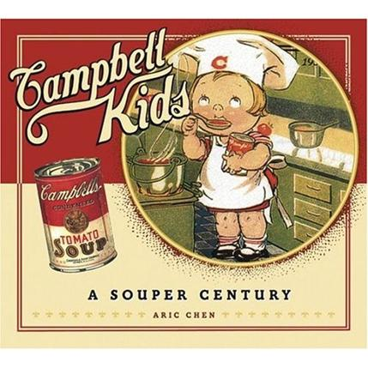
Social Changes
Impact on Women & Families
Marriages that had been postponed because of the war now took place and the “baby boom” followed— the birth rate was relatively high for more than a decade

Slide 16
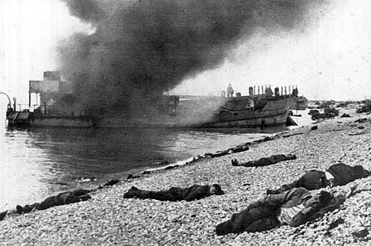
Social Changes – Loss of Life
Canada lost over 42,000 people to the war

Slide 17
A New Social Order
Canadians feared economic problems following the end of the war.
Social Programs such as unemployment insurance which had begun during the war marked a new trend.
Even the Conservative Party felt it necessary to add the term Progressive to their party name.
The Beveridge Report in Britain had set out a program of social reform which strongly influenced Canadian politicians

Slide 18
Mackenzie King Responds to Social Change
King was not easily convinced that social reform was good for Canadians.
He was shocked by the idea of family allowances but he was also a political realist.
He promised Canadians that once the war was over the government would extend a helping hand - not only to veterans but to all of its war weary citizens.

Slide 19
The Election of June 11, 1945
The Liberal slogan was “A New Social Order” offering family allowances and a health insurance plan.
It was Mackenzie King’s plan to capture as much ground on the political left as he possibly could.
It was clear that Canadians wanted social programs but not political socialism.
This was the beginning of a trend toward the development of a “welfare state.”

Slide 20
The 1945 Election
King won a small majority but the CCF had demonstrated remarkable strength.

Slide 21
Immigration to Post War Canada
Life in Europe after the war did not return rapidly to normal.
Refugees filled relocation camps as they waited for an opportunity to make new lives for themselves.
These refugees were called “displaced persons” or derisively “DPs.”
In 1948 Canada allowed nearly 500,000 immigrants to enter the country.
"DPs"

Slide 22
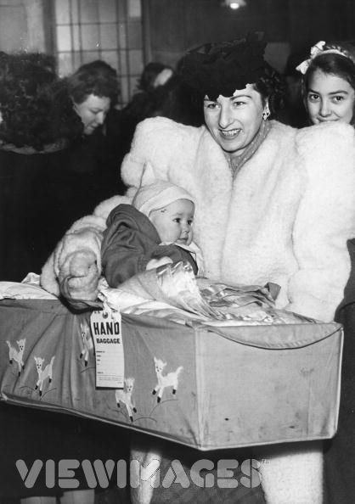
Immigration to Canada 1931 to 1956
In 1947, Pier 21 in Halifax reopened for immigration
processed many war brides (48,000)
children (22,000)
displaced people (DPs)
refugees (500,000)

Slide 23
The Settlement of Post War Immigrants
The largest group of immigrants came from Great Britain followed by Italy, the USA, Germany, Greece, Portugal, Poland and the Netherlands.
Most settled in Ontario and Quebec.

Slide 24
Population Growth
1945 - 1970
Population increased 75% in these years - from 12 million to 21 million.
Part of the reason for this was a very high post- war birth rate.
Immigration also played an important role with 2,500,000 immigrants entering Canada from 1945 to 1965.
Much of Canada’s population growth was in the urban centres of the country.

Slide 25
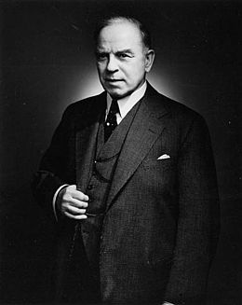
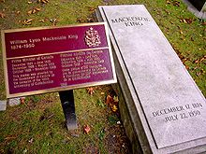
King’s retirement from Politics
On January 20, 1948, King called on the Liberal Party to hold its first national convention since 1919 to choose a leader.
The August convention chose Louis St. Laurent as the new leader of the Liberal Party.
Three months later, King retired after 22 years as prime minister. King also had the most terms (six) as Prime Minister.
Sir John A. Macdonald was second-in-line, with 19 years, as the longest-serving Prime Minister in Canadian history
King died on July 22, 1950, aged 75, from pneumonia, with his retirement plans to write his memoirs unfulfilled.
He is buried in Mount Pleasant Cemetery, Toronto.

Slide 26
Louis St. Laurent 1948 - 1957
“Uncle Louis”, as he was called, became the second French-Canadian Prime Minister in 1948.
St. Laurent had been Mackenzie King’s Minister of External Affairs in 1946.
He is identified with Canada’s post-war economic prosperity.

Slide 27
Post-War Prosperity
The discovery of oil near Leduc, Alberta in 1947 began a period of economic growth for Canada.
Development included mining iron ore in the Ungava Peninsula, uranium at Elliot Lake and potash from Saskatchewan, as well as aluminum smelting in Kitimat.
Canada constructed refineries and pipelines and expanded her already strong industrial base.
Wheat sales until the late 1960s were very profitable but pulp and paper continued to be Canada’s most important industry.

Slide 28

Newfoundland Joins Canada 1949
Newfoundland and Labrador became the tenth province of Canada on April 1, 1949.
Newfoundland’s entry into confederation was led by Joey Smallwood - in the face of considerable resistance from the anti-confederationists.
The “baby bonus” was very attractive to large Newfoundland families and this allowed Smallwood to convince Newfoundlanders of the economic benefits of joining Canada.
NEWFOUNDLAND
Notes:
I need to look in NAC for a picture of Joey Smallwood

Slide 29
The Commonwealth
Canada remained an influential member of the Commonwealth where we provided economic assistance to emerging nations.
We were also strong supporters of the multi-racial nature of this organization.
Our Commonwealth contacts enhanced our respect and effectiveness in world affairs.

