Slide 1
https://www.worldometers.info/world-population/

Slide 2
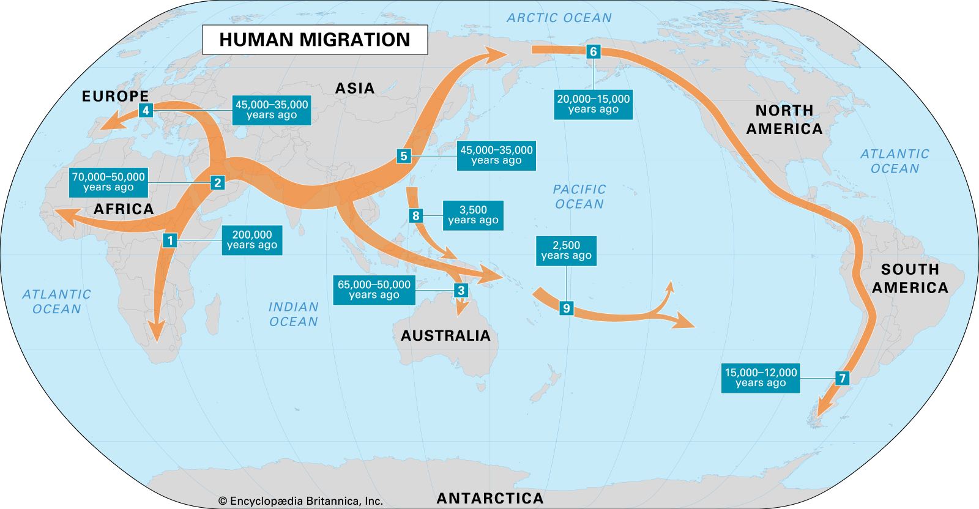

Slide 3
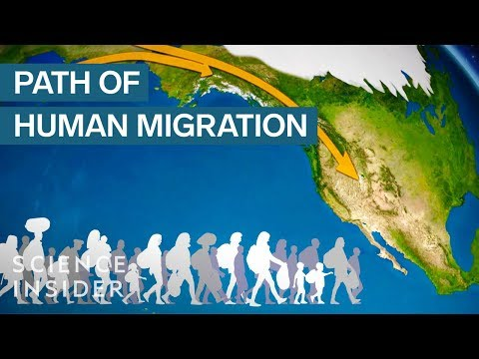
Notes:
(2:23)

Slide 4
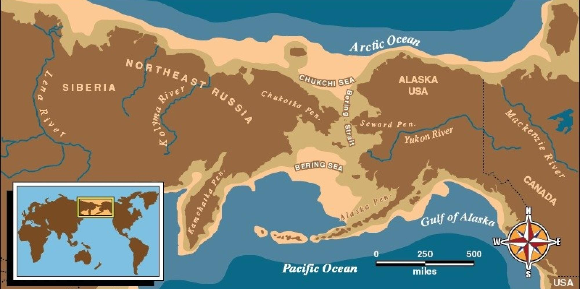
BERINGIA MIGRATION THEORY

Slide 6
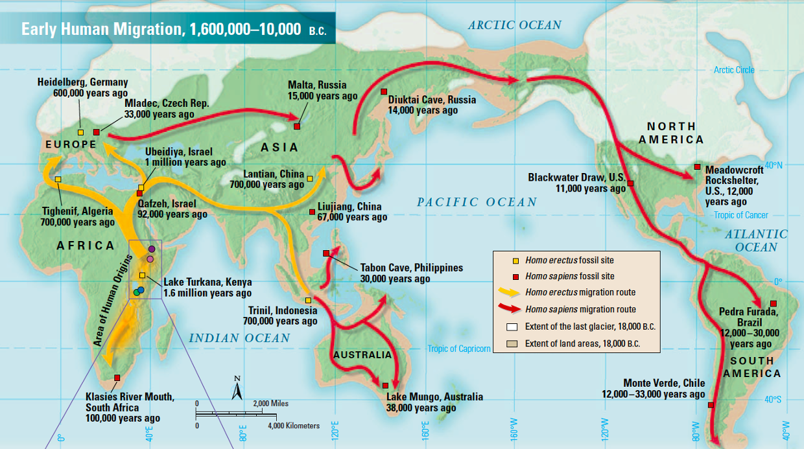

Slide 7
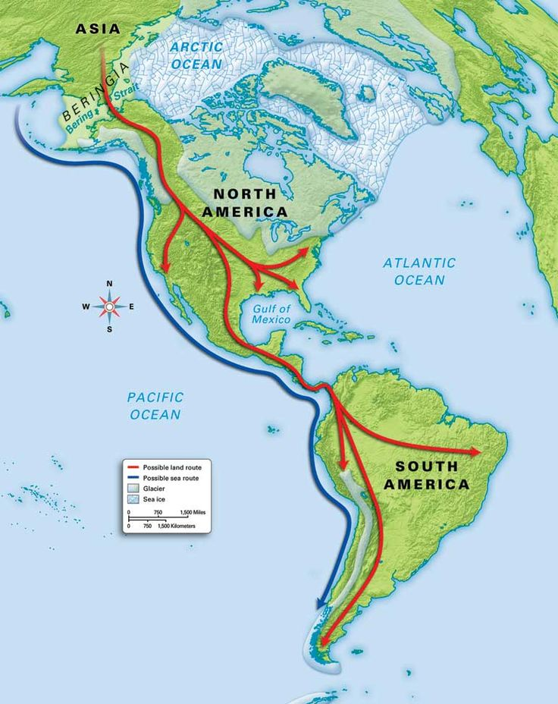

Slide 8
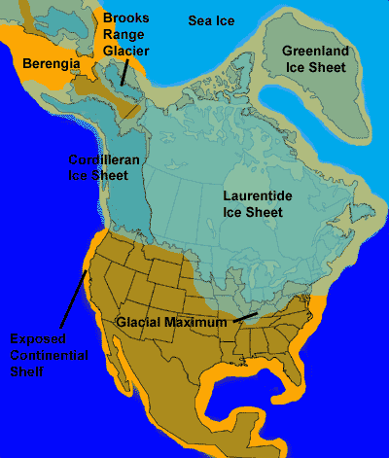

Slide 9
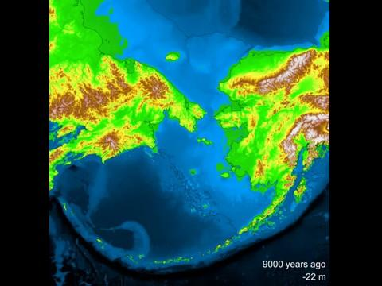
Notes:
(46 seconds)

Slide 10
The Bering Land Bridge

Slide 15
Scimitar Cat

Slide 16
Mammoth

Slide 17
Fossilized Mammoth

Slide 18
Arctus Simodus (Giant Short Faced Bear)

Slide 19
Rinoceros

Slide 20
BISON

Slide 21
Water Buffalo

Slide 22
Giant Sloth

Slide 23
Giant Beaver?

