Slide 2
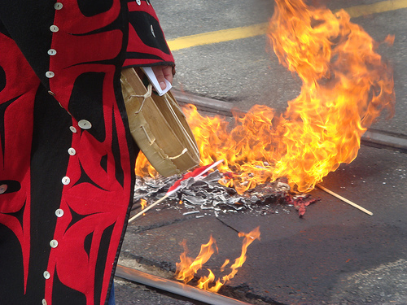
Canadian Aboriginal Issues

Slide 3
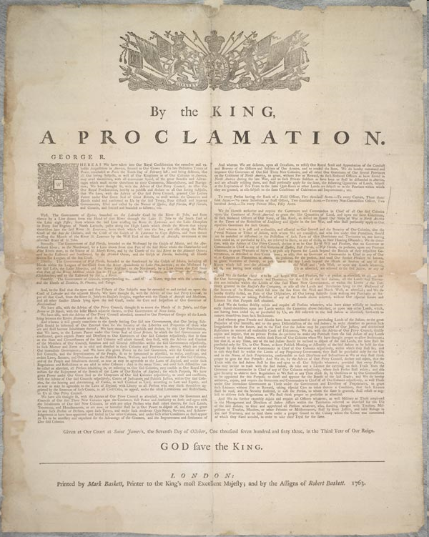
ABORIGINAL RIGHTS IN CANADA
1763 Royal Proclamation is signed.
This document explicitly recognizes aboriginal title; aboriginal land ownership and authority are recognized by the Crown as continuing under British sovereignty.
It states that only the Crown could acquire lands from First Nations and only by treaty.
By the 1850s major treaties are signed with First Nations east of the Rocky Mountains.

Slide 4
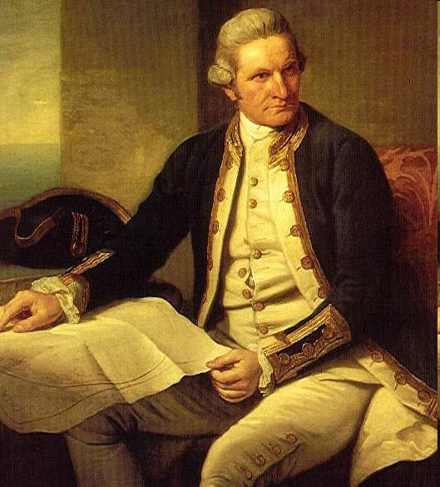
ABORIGINAL RIGHTS IN CANADA
1778 Captain Cook explores the BC Coast and claims British sovereignty
He says that BC is owned by the British.

Slide 5
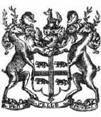
ABORIGINAL RIGHTS IN CANADA
1849 British colony is set up on Vancouver Island.
Trade rights given to the HBC.
First Nations allowed to acquire land like others, British officials refuse to acknowledge that First Nations title had been acknowledged.

Slide 6
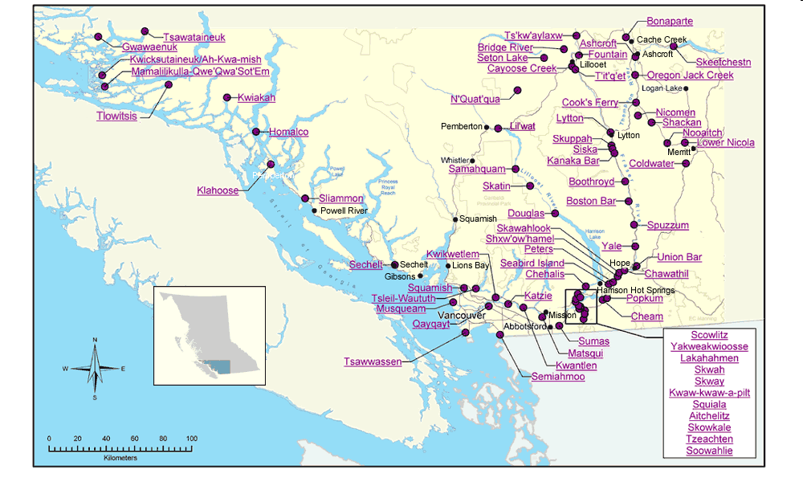
ABORIGINAL RIGHTS IN CANADA
1858 Fraser River Gold Rush.
A colony is established on the mainland of BC. New immigrants believe that the land is free and empty for the taking.

Slide 7
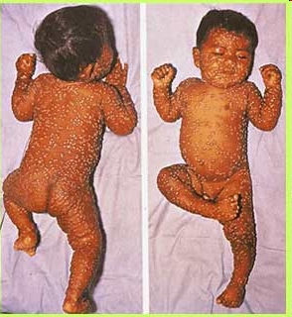
ABORIGINAL RIGHTS IN CANADA
1862 Smallpox kills 33% of the First Nations in BC.

Slide 8
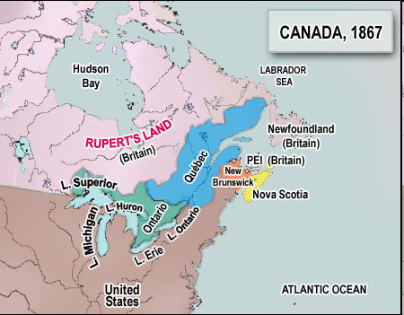
ABORIGINAL RIGHTS IN CANADA
1867 Canada is created.

Slide 9
ABORIGINAL RIGHTS IN CANADA
Canada is created.
Treaties are now negotiated by the Canadian government.
Louis Riel will soon rebel, because aboriginal land covered in the Selkirk treaty was sold back to the feds.

Slide 10
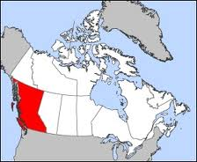
ABORIGINAL RIGHTS IN CANADA
1871 BC joins Confederation.
Aboriginals have no say in the matter, despite the population differences:
“WHITE” POPULATION OF BC: 10,586
TOTAL POPUTION OF BC: 36,274

Slide 11
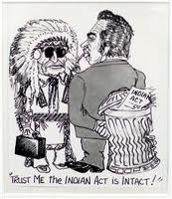
ABORIGINAL RIGHTS IN CANADA
1876 Indian Act established
Influences all aspects of First Nation’s life from birth to death.
Created “Status” Indians, a status you could lose by:
Voting… if you voted you gave up Indian status
Marrying a non-status Indian
Created Indian Bands and Indian Agents.
Created to “protect” aboriginals.

Slide 12
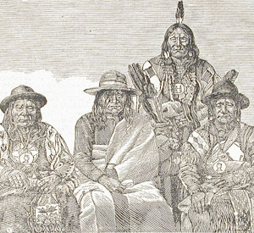
Indian Act – positives?
Gave special “status” to Aboriginal peoples
provided health care, treaty payments, and hunting and fishing rights
But – often limited by the government
Lost special status if chose to vote or live off reserve

Slide 13
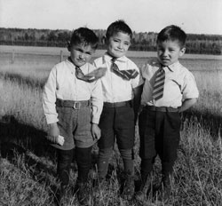
Indian Act 1876
turned the Aboriginals into legal wards of the state (like children)
goal of the government through the Indian Act was to force the assimilation of the Aboriginal peoples
All "half-breed" Indians, like the Métis, were not entitled to Indian status.
Assimilation – when a cultural group is encouraged or forced to give up its culture in favour of the dominant culture

Slide 14
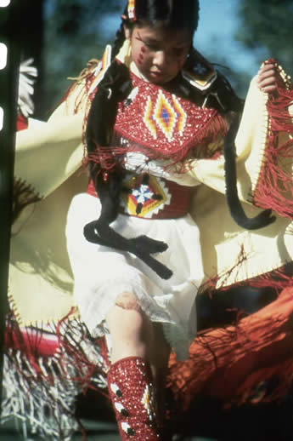
Indian Act – Negatives
It was used to ban the potlatch and Sundance
Aboriginals were treated harshly when in possession of alcohol
Aboriginal children were removed from their homes by provincial governments and sent to residential schools
Status Indians were denied the right to vote
they did not sit on juries and
they were exempt from conscription in times of war
The definition of “person” which was in the Indian Act until 1951 included “an individual other than an Indian.”
Alberta girl performing Sundance

Slide 15
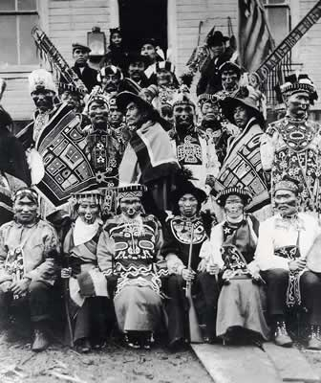
Potlatch
A potlatch is a highly complex event or ceremony among nations on the coast of British Columbia that has been practiced for thousands of years.
A potlatch, includes celebration of births, rites of passages, weddings, funerals, puberty, and honoring of the deceased.
involves feasts, with music, dance, theatricality and spiritual ceremonies
Within it, hierarchical relations within and between clans, villages, and nations, are observed and reinforced through the distribution of wealth, dance performances, and other ceremonies.
Status of any given family is raised not by who has the most resources, but by who distributes the most resources.
The host demonstrates their wealth and prominence through giving away the resources gathered for the event, which in turn prominent participants reciprocate when they hold their own potlatches
Tlingit chiefs at potlatch, 1904

Slide 16
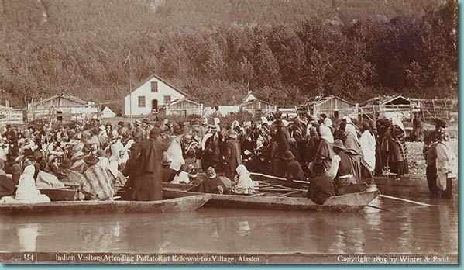
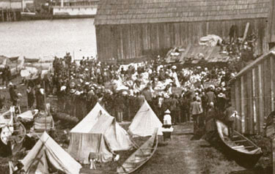
Anti-Potlatch Legislation 1884
Parliament outlawed the potlatch which was the primary social, economic and political expression of some Aboriginal cultures.
Can be seen as some Aboriginal peoples as being devastating to the community: Going into debt to prove wealth.
It is the government’s job to stop harmful practices.
1951 Parliament repeals laws prohibiting potlatch and land claims activity.

Slide 17
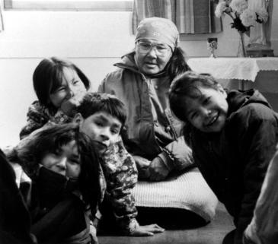
The Pass System
The Pass System was instituted during the Northwest Resistance years.
It was to be a temporary measure during the events of 1885 to control and monitor Indian people and keep them from joining the Resistance
Indian people were restricted to their Reserves
If they wanted to leave, they had to get permission from the Indian Agent
An Indian person who was absent from the Reserve without a Pass was classified as a criminal
Neither the Indian Act nor any other Federal legislation empowered the Department to institute such a system
The Pass system was still in use in the Treaty 4, 5 and 7 areas as late as the mid 1930's
It was removed from the Indian Act in 1951

Slide 18
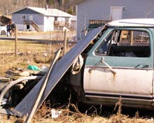
Reserves
The more pressure there was for settlement of Western Canada, the more the government pressured Indian people to settle on Reserves
Land controlled by the government
Reserve clusters were kept far enough apart to discourage Bands from forming alliances against the government
Also kept far from the rest of Canadian population, making assimilation difficult

Slide 19
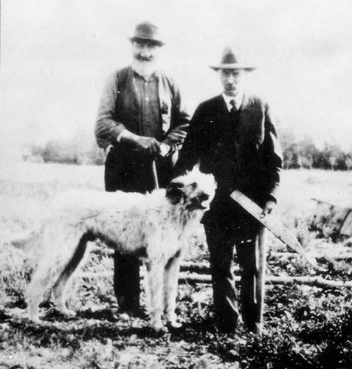
Indian Agents
Indian Agents and Farm Instructors were sent to Reserves
Life on the Reserves centred around them -- they lived on Reserves and made all decisions:
they provided family and marriage counseling
they married and buried people
they kept law and order
they did the work of the public health nurse
sometimes they filled in as the teacher

Slide 20
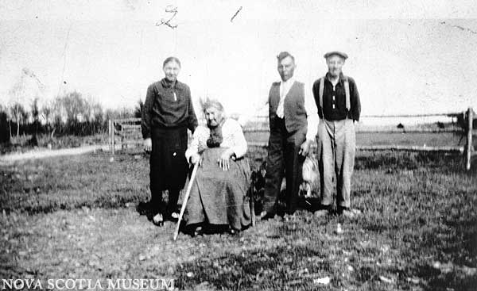
Permit System
The Department of Indian Affairs had control over the financial transactions of Indian people
Sales and purchase transactions were strictly monitored under the Permit system
Indian people needed a permit to:
sell cattle and grain;
sell a load of hay, firewood, lime, charcoal;
sell produce grown on the Reserve; and
buy groceries or clothes.
As Bands began to adopt elected forms of governments in the 1950's and 60's they began to acquire more authority and eventually superseded the Indian Agent
The Permit system gradually disappeared.
However, it remained in the Indian Act until 1995

Slide 21
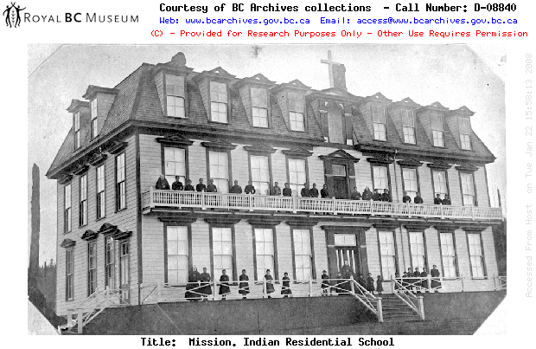
Residential Schools
Before contact with Europeans, First Nations had their own educational processes. The goal was to become responsible members of society.
Education was considered a life-long process. Elders were the transmitters of knowledge and wisdom.
Traditional Indian cultures exhibited a close relationship with the environment and learning the relationship with nature was an essential component of a child's upbringing.

Slide 22
ABORIGINAL RIGHTS IN CANADA
1884 Indian Act amended to assimilate First Nations.
Education in Residential schools.
Anti-Potlatch laws.
By 1895, amended to outlaw all dances, ceremonies and festivals that involve wounding animals, giving away money or goods.
By 1911, amended to allow municipalities to take portions of reserves away from bands.

Slide 23
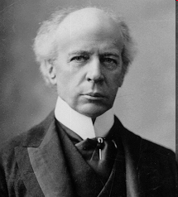
ABORIGINAL RIGHTS IN CANADA
1910 Wilfrid Laurier visits BC.
Laurier supports the recognition of aboriginal title.
BC government does not support recognition of title.

Slide 24
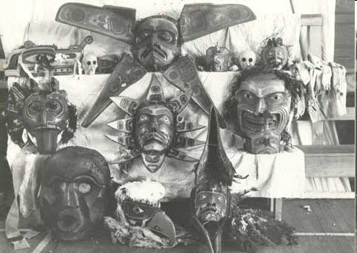
ABORIGINAL RIGHTS IN CANADA
1922 Alert Bay Potlatch
45 people, including an aboriginal chief, are arrested for attending a potlatch. 17 are put in jail and their ceremonial regalia is illegally seized.

Slide 25
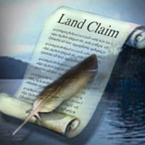
ABORIGINAL RIGHTS IN CANADA
1927 Aboriginals cannot hire lawyers for land claims
Indian Act amended to block effective court action.
1931 Native Brotherhood formed.
Aboriginals begin to organize.
1949 First Nations can vote in BC (but not Canada)
After fighting for Canada in WWI and WWII, First Nations can finally vote. Japanese also get the vote.
WOMEN: 1920 (federal)
Some groups, such as Doukhabours (1953), still cannot vote.

Slide 26
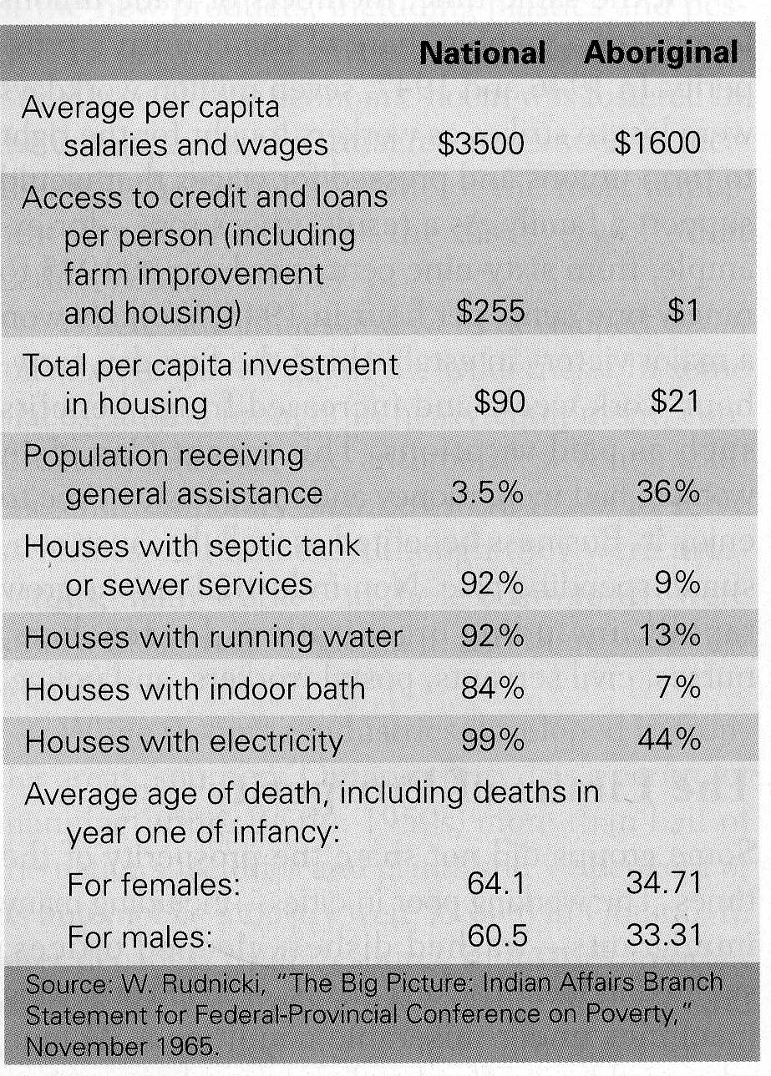
ABORIGINAL RIGHTS IN CANADA
1951 Parliament repeals anti-potlatch laws & anti-land claims laws

Slide 27
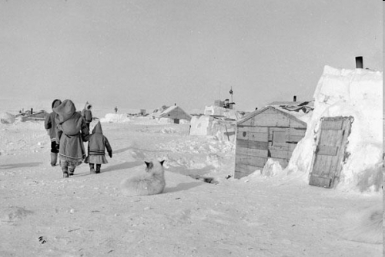
ABORIGINAL RIGHTS IN CANADA
1950s Inuit population relocated
In a bid to “protect” Canada’s sovereignty over the high north, federal government relocates Inuit families from northern Quebec to the Arctic. Many die.

Slide 28
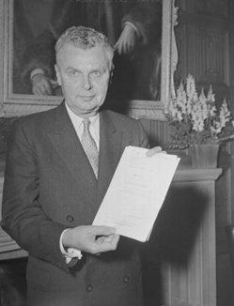
Bill of Rights 1960
After the passing of the Bill of Rights, Status Indians on reserves gained equality in the right to vote without losing their status
Prior to this time, those who applied to become enfranchised lost their status
Gradually, provinces gave Aboriginals the right to vote provincially in 1969
Though a noble attempt, the Bill of Rights legislation had not given the aboriginals the right to govern themselves

Slide 29
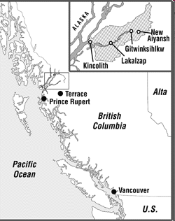
ABORIGINAL RIGHTS IN CANADA
1969 Nisga’a win in court.
Court rules that Nisga’a did hold aboriginal title to their land in BC.

Slide 30
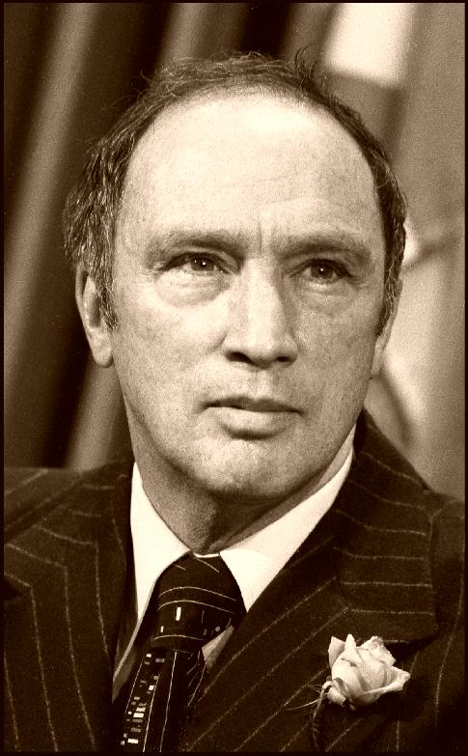
Federal White Paper 1969
The 1969 White Paper rejected the concept of special status for Aboriginal peoples within confederation.
The government argued that Aboriginal and treaty rights were problematic regarding the economy, education and social issues and that all Canadians should be equal in law to all other Canadians.
Could be argued that Trudeau didn’t want special status for everyone/ anyone, so this IS equality (just not equity).
Aboriginal peoples fought against it (response called the “Red Paper” – 1970) because it meant losing historical rights and ties to land and heritage: their efforts eventually resulted in the inclusion of some Aboriginal rights in the Charter.
Pierre Trudeau and Jean Chretien advocate the assimilation of First Nations.
No land claims.
Abolish the Indian Act.
Treat First Nations like any other minority rather than distinct.
First Nations protest with the RED PAPER.

Slide 31
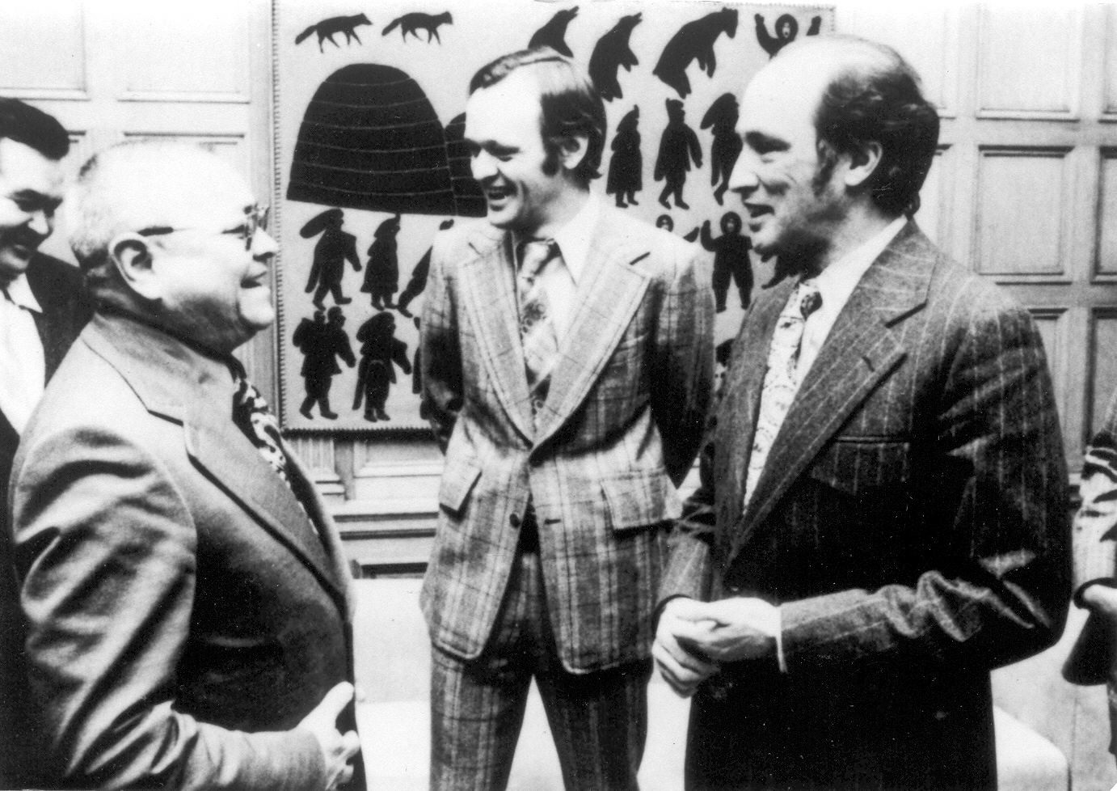
The Calder Case - 1973
Supreme Court of Canada recognized the existence of aboriginal title in principle
The Court ruled that aboriginal title is rooted in the 'long time occupation, possession and use' of traditional territories.
Result: Canada initiates a Comprehensive Claims process for treaty negotiations across Canada

Slide 32
1973 – Aboriginal Education
In 1972, the Assembly of First Nations (formerly the National Indian Brotherhood) published a document entitled "Indian Control of Indian Education" which asserted the rights of Indian parents to determine the kind of education they wanted for their children.
Two principles of education were proposed in this document:
parental responsibility, and
local control of education.
The Federal Government accepted the document as policy in 1973.
After more than a century, cultural assimilation was finally abandoned as the official goal of the federal government.
Ovide Mercredi, former National Chief of the Assembly of First Nations stated:
If you heal a person, you will heal a family, A family will help heal a community, A whole healthy community Can be a proud nation.

Slide 33
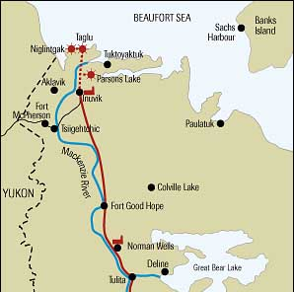
Mackenzie Valley pipeline- Berger Commission 1974-1977
During the 1960s, new natural gas reserves were found in the Beaufort Sea in the Arctic
oil companies began to express interest in building a pipeline straight through the fragile ecosystem of the northern Yukon and Mackenzie River Valley to Alberta
In the mid-1970s, the Berger Commission, led by Thomas Berger, examined the effects of this proposed pipeline

Slide 34
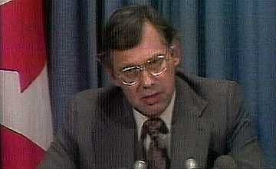
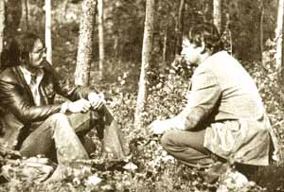
Berger Commission 1974 - 1977
Aboriginals in the region were particularly opposed to the pipeline, for several reasons:
Environmental concerns
Skepticism about the motives and interests of big business
Perceptions that it infringed upon their land rights and special status.
believed the project that could jeopardize regional land claims
Berger Commission - ruled that a moratorium should be placed on construction until 1987 to give time towards land claim settlements.
However, the pipeline was never built due to the controversy and an unstable economy.
CBC archives: Victors and victims of the Berger report
http://archives.cbc.ca/society/native_issues/topics/295/

Slide 35
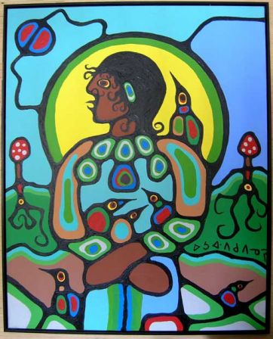
ABORIGINAL RIGHTS IN CANADA
1982 Constitution recognizes First Nations land claims.
Acknowledges treaty rights.
Section 25 - The guarantee of Aboriginal and Treaty Rights
Section 35 - The recognition and affirmation of Aboriginal and Treaty Rights; Aboriginal people are defined as Indian, Métis, and Inuit
Section 37 - Outlines a process for successive constitutional talks on Aboriginal Rights.

Slide 36
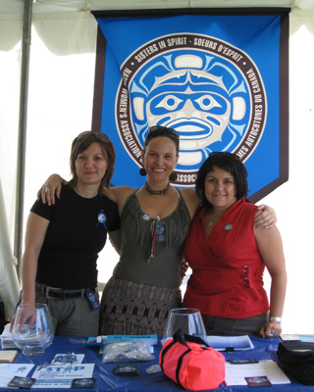
Bill C-31 - 1985
Prior to 1985, women lost Indian status if they married a man who did not have Indian status. Their children did not receive Indian status.
The Charter of Rights in 1982 guaranteed protection of rights equally for women and men.
Bill C-31, An Act to Amend the Indian Act, was passed in 1985. This Bill amended the Indian Act in the areas of Status and Membership.
By 1992, over 81,000 people had regained status.

Slide 37
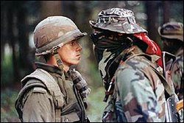
Oka Standoff- 1990
The Oka Crisis was a land dispute and blockade between the Mohawk nation and the town of Oka, Quebec which began on July 11, 1990, and lasted until September 26, 1990.
crisis developed from a dispute between the town of Oka and the Mohawk community of Kanesatake.
The Mohawk nation had been pursuing a land claim which included a burial ground and a sacred grove of pine trees near Kanesatake.
This brought them into conflict with the town of Oka, which was developing plans to expand a golf course onto the land.
The mayor of Oka, Jean Ouellette, announced in 1989 that the remainder of the pines would be cleared to expand the members-only golf club's course to eighteen holes. Sixty luxury condominiums were also planned to be built in a section of the pines. However, none of these plans were made in consultation with the Mohawks.
The golf-course expansion, which had originally triggered the situation, was cancelled. The Oka Crisis eventually precipitated the development of Canada's First Nations Policing Policy.
Quebec's Minister for Native Affairs John Ciaccia wrote a letter of support for the natives, stating that "these people have seen their lands disappear without having been consulted or compensated, and that, in my opinion, is unfair and unjust, especially over a golf course."
CBC archives: The Standoff Begins
http://archives.cbc.ca/politics/civil_unrest/topics/99/

Slide 38
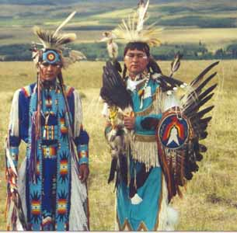
ABORIGINAL RIGHTS IN CANADA
1990 Sparrow Decision (Supreme Court)
Musqueam people argue that they have the right to fish and have ceremonial food. Supreme court agrees.
1995 Gustafson Lake standoff
Shuswap nation want their sacred land and recognition of their sovereign rights. RCMP launch large military operation, firing 77,000 rounds of ammo, killing a dog and injuring a woman.
15 people sent to jail.

Slide 39
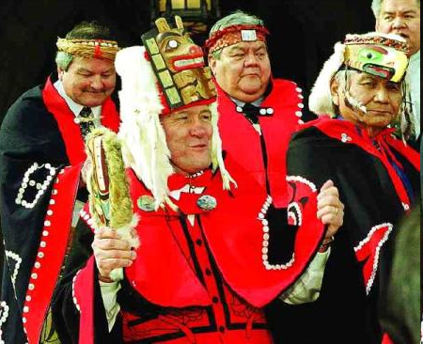
ABORIGINAL RIGHTS IN CANADA
1996 Nisga’a Treaty
BC and Nisga'a people sign an agreement for disputed lands.

Slide 40
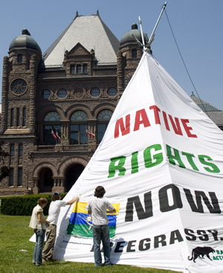
Delgamuukw – 1997-98
Gitksan +Wet’suwet’es people’s claims
Defined aboriginal title –ruled Aboriginal groups could claim ownership of land if they can prove that they occupied the land before the Canadian government claimed sovereignty and occupied continuously and exclusively.
If government building is next to native reserve –must consult. i.e - effects on reserve- aboriginals claim to have never been consulted.

Slide 41
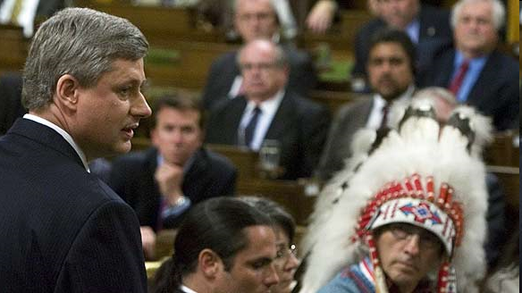
ABORIGINAL RIGHTS IN CANADA
2008 Stephen Harper apologizes
PM says residential schools were a “sad chapter” in our history.
“Today, we recognize that this policy of assimilation was wrong, has caused great harm, and has no place in our country “

Slide 42
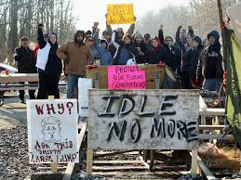
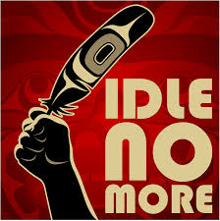
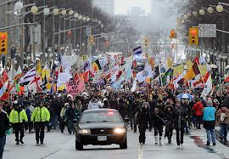
2013 Idle No More

