Slide 1
Essay Recipe
Using your Rhetorical device kit and your informal/formal essay notes, create a recipe card for the structure of a good speech/essay.
Your recipe must include:
Speech/Essay structure – intro, body paragraphs, conclusion
Rhetorical structure – where to put types of sentences/ how to use them
Explanation of method – short paragraph explaining how to put these components together
Five of the following ‘cooking’ terms:
- cup, pint, teaspoon, pinch, chop, mince, blend, fold, stir, bake, saute, chill, grill, broil, serve on, spoon in, garnish with

Slide 2
Essay Recipe Continued:
Put your name on the card.
On the Back of your index card, IN PENCIL, please write your Research Question and a possible answer to your research question:
Then partner up:
Exchange with a partner for a three minutes and record constructive criticism on the card you have received from your partner
Exchange your partners card with a different process and repeat the process for another three minutes
Repeat a third time
Return the recipe cards to their owners

Slide 3
Supporting your Essay’s Ideas:
How to find appropriate sources and support your essay with specific details

Slide 4
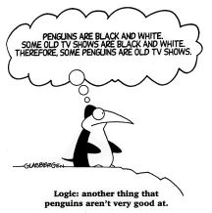
Don’t use false logic:

Slide 5
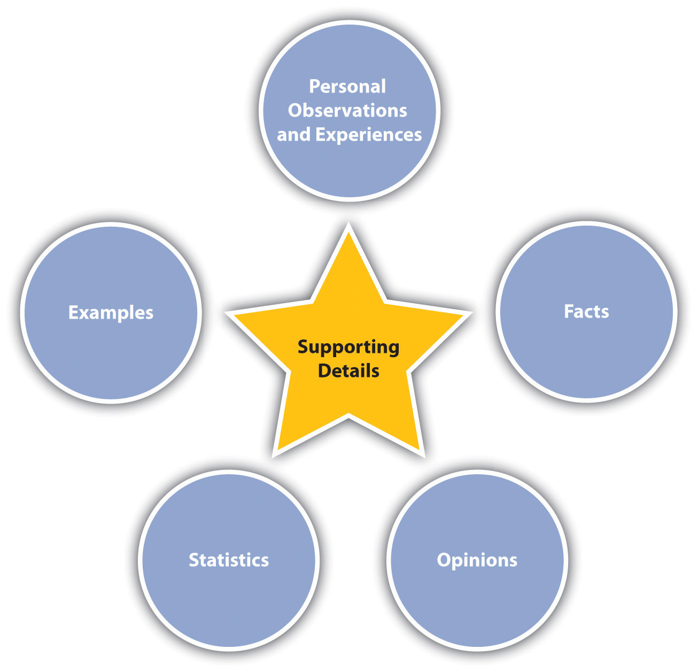
Use these as your ‘Q’ in a PQE:

Slide 6
Putting the ‘Q’ to use as evidence
To evaluate the supporting details as evidence you must:
a. Question the source of the document
b. Compare and Contrast the source with other sources that you have found
c. Examine the document’s bias & determine if the information present is relevant or irrelevant

Slide 7
Example:
When a big-city symphony wants to hire musicians, they do not judge the applicants on their appearance; they judge them only on their musical ability. That seems fair, doesn't it? But that hasn't always been the case. At one time, more men than women were hired to play in symphonies. For some reason, the judges preferred male musicians. Today, however, most symphonies listen to the musician applicants from behind a screen so they can't see what they look like. Sometimes the musicians even have to take off their shoes so the judges can't get hints from their footsteps about whether they are listening to a man or woman. Although that may seem unnecessary, it has been proven to be the fairest way to hire. Now, because of the practice of "blind auditions," the balance of men and women is more equal. This is how the symphony overcame a bias. It wasn't enough just to be aware they had a bias; they had to guarantee it with a "blind audition" so they wouldn't let their bias toward male musicians influence their decisions.

Slide 8
Activity: Bias & Fact
In pairs you will be working with your sources to determine the difference between bias and fact. This activity with Using the sheet provided you will:
Sitting side by side, read one of the articles you/your partner has chosen to work with
a. Talk about the main point of the article. Then summarize the main point of the source in your own words
b. Talk about the facts/biases that this source presents, record your thoughts
c. Talk about how you might incorporate this source into an essay, explain how it may [or may not be] useful toward proving a point. Record your thoughts.

Slide 9
Most important point
What is the most important point of your essay?
Write it down silently
Pair up with a partner
Share the most important point of your essay
Exchange essays to see if the most important point of your essay shines through.

Slide 10
Essay Writing – Introduction & Conclusion
The intro in a 5 paragraph essay should be approximately 4-7 sentences long. It should include:
A “Hook” – a declarative sentence that addresses a problem
Background information that gives the reader an idea of how you are going to focus your topic
Thesis statement – a declarative sentence that hypothesizes a solution to the problem that has been outlined.

Slide 11
Example – Label 1/2/3
In recent months, British Columbia’s television stations have been flooded by commercials that claim to have the solution for Canada’s ailing economy. These advertisements support the creation of British Columbia’s northern gateway pipeline; a oil pipeline that will travel from northern Alberta to Kitimat British Columbia. The ads claim to support Canada’s economic future. They suggest that “prosperity, jobs, world-class safety, thriving communities, increased trade and low environmental impact” will pave a “path to our future” and intimate that families, the environment and Canadian communities will benefit from the development of such a pipeline. However, as a company, Enbridge has been responsible for several major oil catastrophes in recent years and as it has “paved a path to [the] future in several other communities, it has also refused environmental responsibilities, destroyed local community gardening initiatives and contributed to the downfall of the tourist economy in several locations. Though it may seem like a “path to our future,” Enbridge’s Kitimat pipeline encourages a path of environmental and economic destruction that is unacceptable for British Columbia.

Slide 12
Activity – Take out your Essay
On your essay label – 1/2/3 in your introduction
When you have finished – crumple it up into a ball [make sure your name is on it]
Throw the ball at the front of the room
Go and pick up a ball
Provide feedback on the person’s introduction – have they labeled it correctly?
Count the rhetorical devices – underline them.
Repeat.

Slide 13
Warm-up : Collaborative Intros
In your row, choose one of the following positions:
- Democracy is to blame for the worlds problems
Marijuana is the most terrible gateway drug
High-school is pointless and it should not imprison young people any longer
You will each write one sentence in the introduction. Do you remember the format of the introduction? TEST TIME

Slide 14
Conclusion
Purpose: To tie together the points that you have explained in your body paragraphs. Usually only takes 5-7 sentences
How to:
Restate - Have a look at your thesis and restate it in a way that declares and concludes your thoughts - this will take practice
Acknowledge - the other position in the debate, but identify one or more reasons why it cannot work.
Conclude - Finish with final thoughts – these are logical conclusions that you have drawn from the evidence that you have presented.

Slide 15
Conclusion Example
The Enbridge pipeline in Kitimat British Columbia is an risky endeavor. The potential negative environmental and economic consequences that would result from an oil spill in the North would damage the residents of the Province considerably. Though the northern cities of the Province would benefit from the inflow of capital into the district, the short term gains in the Province would not outweigh the effect of the long term losses. British Columbians have chosen to live in a Province that is beautiful; it even says so on their license plates. The residents of this Province have come here because the Province continues to succeed both economically and environmentally. The Enbridge pipeline would damage this reputation of success and would force residents of this province to compromise beauty for economic profit. Keep British Columbia’s license plate true, keep the Beauty in B.C, keep Enbridge out of the Province.

Slide 16
Activity: Thesis to Conclusion
Take out your thesis statement:
Rephrase your own thesis statement in three different ways. Decide on the one that you will use for your conclusion.
Mix the thesis statement and conclusion together on one piece of paper – do not identify which is which.

Slide 17
Activity continued
Find a partner:
Thesis & Conclusion showdown
- Take turns trying to guess which of the statements the persons thesis and conclusion
One guess per turn – you may only guess either the thesis or the conclusion [not both]
Winners to me

Slide 18
Citation & Notation
You will be using MLA in-text citation. Just so you know it is important for three reasons:
Identification - In-text citation is different than your bibliography it allow you reader to see what research you have done.
Ideas- It allows your reader to identify where you got your ideas from in the cited articles
Information - It shows that you are using external information to support the claims that you are making in your argument.

Slide 19
In-Text How To:
First there are three types of information that you must quote:
Direct quotations – just like from Shakespeare
Paraphrased sections/ideas – if you have taken a section and put it into your own words, you must cite where you got it from
Examples or ideas – Anything that you have researched and/or found in another document and that is not 100% original. If you are sure, cite it.
I have posted two documents on my website about how to do this. I will expect that it is done correctly on your final draft.

Slide 20
In-Text Citation How to:
You must make sure that you have the following information:
The name of the author
The name of the article
The date the article was published
The page number or title of the section that you got the information from.

