Slide 1
100 Days & Treaty of Versailles
THE END OF WW1

Slide 2
100 Days Offensive

Slide 3
Background
Spring Offensive 1918 – Germany launches Operation Michael (or the Ludendorff Offensive).
For the second time in the war, Germany was able to advance to the Marne River.
Coincidently, the German forces would suffer the same fate they did 4 years prior
Would outstretch their supply lines again
Again, unable to move past the Marne
*Now turning to an Allied offensive

Slide 4
Allied Offensive – 100 Days
August 8th – November 11th ,1918.
Technically just 96 days…
Called the “hundred days” due to Canada & Britain’s substantial role in causing the defeat and/or retreat of the German Army in a series of major battles from Amiens to Mons which along with other Allied offensives ultimately led to Germany's final defeat and surrender.

Slide 5
The collapse in German morale led Erich Ludendorff to dub it "the Black Day of the German Army”
On 10 August, the Germans began to pull out of the salient that they had managed to occupy during Operation Michael, back towards the Hindenburg Line

Slide 6
Battles of the Hindenburg Line
With the front line broken by September 2nd, the Germans had been forced back close to the Hindenburg Line, from which they had launched their offensive in the spring.
Hindenburg Line broken on On Oct 5th.
On October 8th, led by the Canadian Corps, the 1st and 3rd British armies broke through the Hindenburg Line for a 2nd time
This collapse forced the German High Command to accept that the war had to be ended.
Extremely low troop morale

Slide 7
The Germans armies were now retreating through the territory they gained in 1914.
As the Germans were forced to retreat, they had to abandon increasingly large amounts of heavy equipment and supplies
Further reducing their morale and capacity to resist

Slide 8
Casualties remained heavy in all of the Allied fighting forces, as well as in the retreating German Army.
Fighting continuing until the last minutes before the Armistice took effect On Nov 11th, 1918 at 11:00am.
One of the last soldiers to die was Canadian Private George Lawrence Price, killed by a sniper two minutes before the armistice took effect

Slide 9
As the war neared its end, the Canadian Corps pressed on towards Germany and the final phase of the war for the Canadians was known as the 'Pursuit to Mons’ (in Belgium).
Some criticism was leveled at Canadian Corps commander Arthur Currie by Sam Hughes and others for needlessly wasting lives to capture Mons once it was known that the armistice was imminent.
Though successfully, the final offensive by the Allies proved to be very costly in lives:

Slide 10
Top 10 Deadliest Battles of WWI
1. Hundred Days Offensive (1,855,369 total casualties)
2. Spring Offensive (1,539,715 total casualties)
3. Battle of the Somme (1,219,201 total casualties)
4. Battle of Verdun (976,000 total casualties)
5. Battle of Passchendaele (848,614 total casualties estimated)
6. Serbian Campaign (633,500+ total casualties)
7. First Battle of the Marnes (483,000 total casualties)
8. Battle of Gallipoli (473,000 total casualties)
9. Battle of Arras (278,000 total casualties)
10. Battle of Tannenberg (182,000 total casualties)

Slide 11
Canada’s Conclusion
Roughly 100 000 Canadian troops, engaged and defeated or made to retreat elements of 47 German divisions
representing 1/4th of the German forces fighting on the Western Front
Successes came at a heavy cost, the Canadians suffered 20% (or 1/5th) of their total war battlefield casualties during these offensives.

Slide 12
Canada’s Legacy
Along with their participation in the battles at the Somme, Vimy Ridge and Passchendaele, Canada's Hundred Days cemented the reputation of the Canadian Corps as a tough and professional fighting force amongst its allies and foes.
British PM David Lloyd George:
“Whenever the Germans found the Canadian Corps coming into the line they prepared for the worst.”

Slide 13
Treaty of Versailles

Slide 14
Armistice – an agreement to stop fighting
Aka. A “cease-fire”
An attempt to negotiate a peace treaty.
Capitulate – an unconditional surrender
usually of troops and/or territory

Slide 15
I. Important Dates
Armistice
11/11/1918 @ 11 a.m.
Paris Peace Conference
January 1919

Slide 16
Wilson’s 14 Points
Plan for Post WW1 Europe
Goal: To prevent future wars
Listed in a speech delivered by President Wilson January 8, 1918.
Only 4 points ultimately adopted in Treaty

Slide 17
Negotiations
Negotiated by the “big three”
Woodrow Wilson (USA)
David Lloyd George (Britain)
Gorges Clemenceau (France)
***Canada placed her own signature on the Treaty of Versailles and took a separate seat on the League of Nations

Slide 18
Germany agreed to the Armistice in November 1918
assumed that they would be consulted by the Allies on the contents of the treaty.
This did not happen and Germany was in no position to continue the war
army was no longer in the field and had all but disintegrated.
Signed on June 28th 1919, in the Hall of Mirrors at the Palace of Versailles
German representatives only saw the terms of the Treaty a few weeks before they were to sign it.

Slide 19
Terms
Territorial – Germany had to give back:
Alsace-Lorraine (to France)
Eupen and Malmedy (to Belgium)
Northern Schleswig (to Denmark)
Hultschin (to Czechoslovakia)
West Prussia, Posen and Upper Silesia (to Poland)
The Saar, Danzig and Memel were put under the control of the League of Nations and the people of these regions would be allowed to vote to stay in Germany or not in a future referendum.

Slide 20
The League of Nations also took control of Germany's overseas colonies.
Germany had to return to Russia land taken with the Treaty of Brest-Litovsk.
Some of this land was made into new states: Estonia, Lithuania and Latvia.

Slide 21
Terms
Military – Germany had to:
Reduce Army to 100,000 troops
Were not allowed tanks or an air force
Were allowed only 6 naval ships and NO submarines
The creation of a demilitarized zone (DMZ). Basically everything west of the Rhine River.
No German soldier or weapon was allowed into this zone.
The Allies were to keep an army of occupation on the west bank of the Rhine for 15 years.

Slide 23
Terms
Financial – Germany was to pay lots of $$!
Almost 7 TRILLION!!
But…The loss of industrial territory would be a severe blow to any attempts by Germany to rebuild their economy.
Coal from the Saar and Upper Silesia in particular was a vital economic loss.
Allies wanted nothing else but to bankrupt Germany!

Slide 24
Terms
The Three main clauses in the Treaty were:
Germany had to admit full responsibility for starting the war.
- This was Clause 231 - the infamous "War Guilt Clause".

Slide 25
2. By agreeing to term #1, Germany was therefore taking responsibility for all the damages caused by the First World War.
*Therefore, they had to pay reparations, the bulk of which would go to France and Belgium - a huge sum of money well beyond Germany’s ability to pay.

Slide 26
3. A League of Nations was created to keep world peace. - However, unable to prevent WWII
*seen as a failure.
- United Nations (UN) eventually formed and replaced the League.

Slide 27
Other Axis countries
Austria-Hungary – This one state officially divided into two.
Bulgaria – lost land and had to pay reparations as well.
Turkey (Ottoman Empire) – Lost a considerable amount of land, most of its empire.

Slide 28
German Reaction (population)
Many Germans were angered Treaty and did not want it signed, but the representatives there knew that they had no choice as German was incapable of restarting the war again.
Germany was given two choices:
1) sign the Treaty or 2) be invaded by the Allies.

Slide 29
Conclusion
The "Big Three" were satisfied because the Treaty would:
keep Germany weak militarily
keep the Belgian/French border with Germany safe from another attack
created an organization that would attempt to end warfare throughout the world.
*However, it left a mood of anger throughout Germany as it was felt that Germany had been unfairly treated.
Above all else, Germany hated the clause blaming it for the cause of the war and the resulting financial penalties.

Slide 30
Were all parts of the treaty carried out?
For the most part, yes. Throughout the 1920’s, however, after 1933 (WWII) Hitler and Germany renounced the Treaty
Exceptions:
The heavy payments were seldom paid in full, if at all.
The military was reduced to 100,000, but there was still a considerable number of reserves

Slide 31
Was the Versailles Treaty a just peace????

Slide 32
Postwar Territorial Changes
Germany

Slide 33
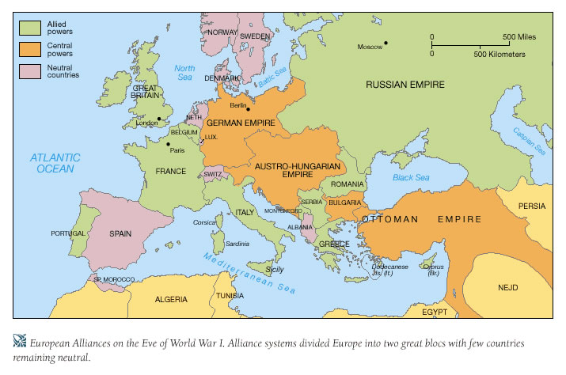
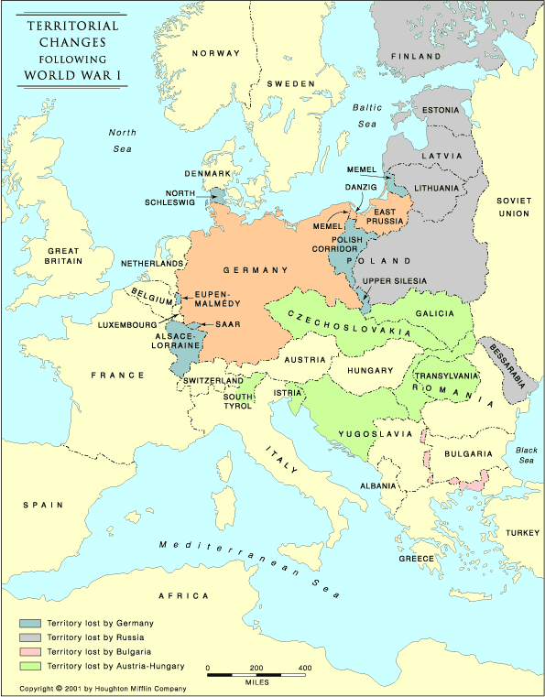
Which countries in Europe were born out of WWI?
Poland, Czechoslovakia, Yugoslavia
Finland, Estonia, Latvia, Lithuania, Finland, Bessarabia (Moldova)

Slide 34
Which countries in the ME were born out of WWI?
Lebanon, Syria (France)
Palestine, Transjordan, Iraq (GB)
Turkey (ind.)

Slide 35
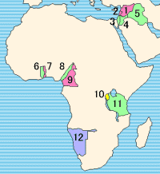
League of Nations Mandates
(Middle East & Africa)
French Mandate of Syria
French Mandate of Lebanon
British Mandate of Palestine
British Mandate of Transjordan
British Mandate of Iraq
British Togoland
French Togoland
British Cameroon
French Cameroon
Ruanda-Urundi
Tanganyika
South-West Africa

Slide 36
Effects of WW1
How WW1 set History for the 20th century

Slide 37
1. Political Chaos
A) Collapse of Monarchies
Russia, Germany, Austria-Hungary, Ottoman Empire
Instability will ultimately lead to rise of Dictators
B) Creation of New Countries
Czechoslovakia, Poland, Latvia, Lithuania, Estonia, Finland, Yugoslavia, Syria, Iraq
Leads to Ethnic Conflicts

Slide 38
2. Crushed Economies
Parts of Europe completely demolished by the fighting → farm lands, industry
German reparations were so high, unable to keep up
Economic stagnation – unemployment, sagging currencies
Leads to DEPRESSION, especially in Germany

Slide 39
Country | Dead | Wounded | Missing | Total
Africa/ S. Africa | 17,000 | - | - | 29,000
Australia | 58,150 | 152,170 | - | 210,320
Austria-Hungary | 922,000 | 3,600,000 | 855,283 | 5,377,283
Belgium | 44,000 | 450,000 | - | 494,000
Britain | 658,700 | 2,032,150 | 359,150 | 3,050,000
Bulgaria | 87,500 | 152,390 | 27,029 | 266,919
Canada | 56,500 | 149,700 | - | 206,200
France | 1,359,000 | 4,200,000 | 361,650 | 5,920,650
Germany | 1,600,000 | 4,065,000 | 103,000 | 5,768,000
India | 43,200 | 65,175 | 5,875 | 114,250
Italy | 689,000 | 959,100 | - | 1,424,660
Japan | 300 | 907 | 3 | 1,210
Montenegro | 3,000 | 10,000 | 7,000 | 20,000
Portugal | 7,222 | 13,751 | 12,318 | 33,291
Romania | 335,706 | 120,000 | 80,000 | 535,706
Russia | 1,700,000 | 5,000,000 | - | 6,700,000
Serbia | 45,000 | 133,148 | 152,958 | 331,106
Turkey | 250,000 | 400,000 | - | 650,000
USA | 58,480 | 189,955 | 14,290 | 262,725

Slide 40
Social Chaos
displaced refugees
Social damage from:
millions dead
millions wounded and/or disabled
Millions of widows
9 million orphans
Unstable birth rate
Psychological damage due to shell shock, loss of limbs, death of friends/families
Lead to: alcoholism, morphine addiction
Many disabled soldiers struggling to find a new role in society, no equipment produced in their aid

Slide 41
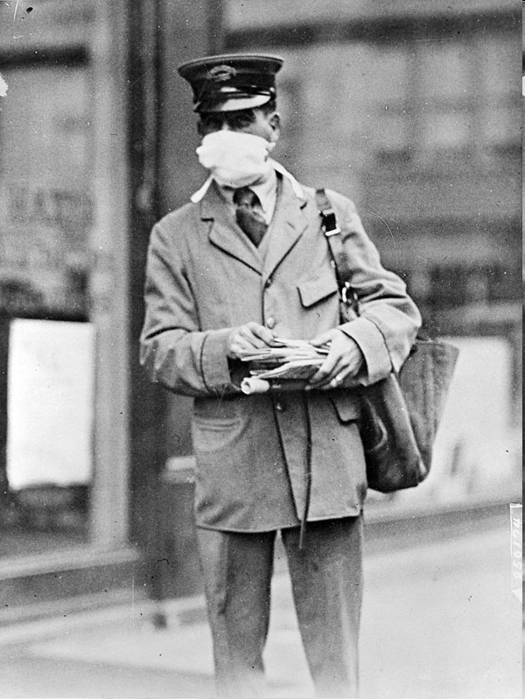
As if War Wasn’t Enough
The influenza pandemic took hold around the world in 1918-1919 and resulted in more death than in WWI.
Some estimate that between 40-50 million people died from the Flu.
More people died of influenza in a single year than in four-years of the Black Death Bubonic Plague.

